Slide 1
Mineta Transportation Institute Parking Reform for Housing Production
November 7, 2018
Richard Willson, Ph.D., FAICP
Department of Urban and Regional Planning
Cal Poly Pomona

Slide 2
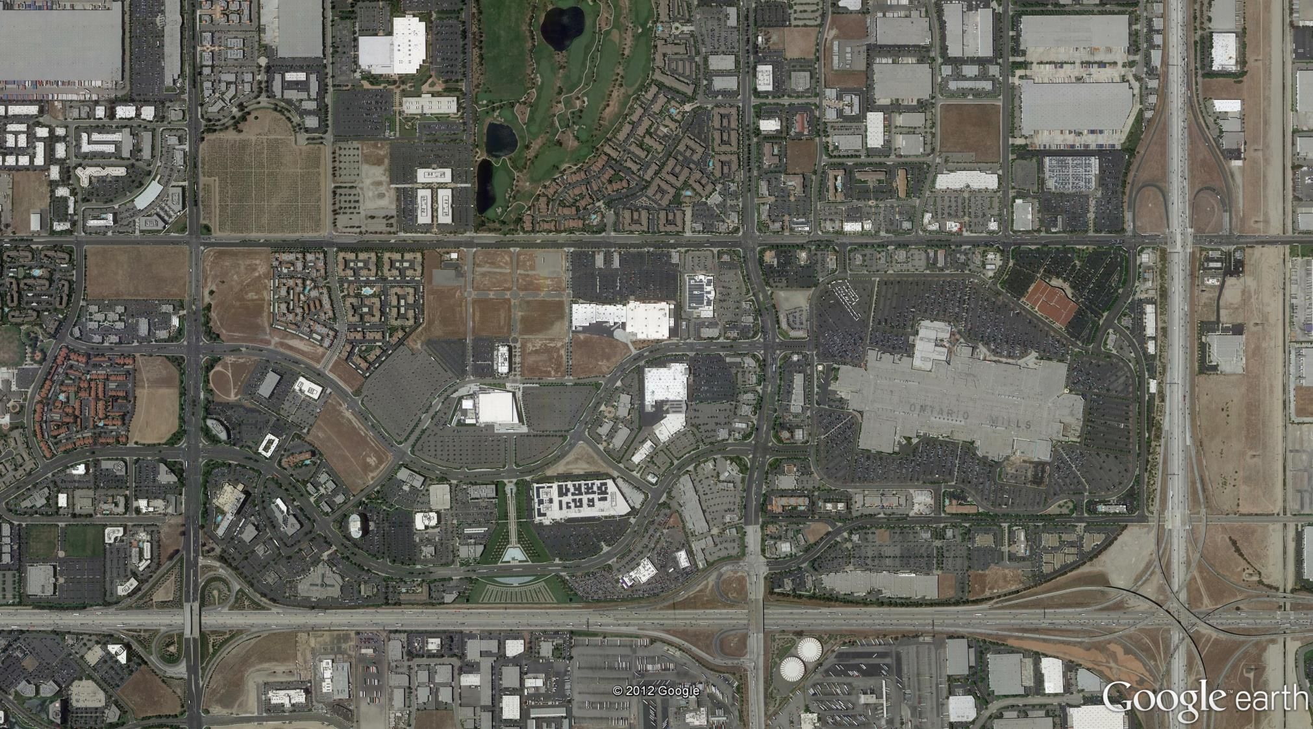
Single site, peak use parking…
Walkability and land use challenges…

Slide 3
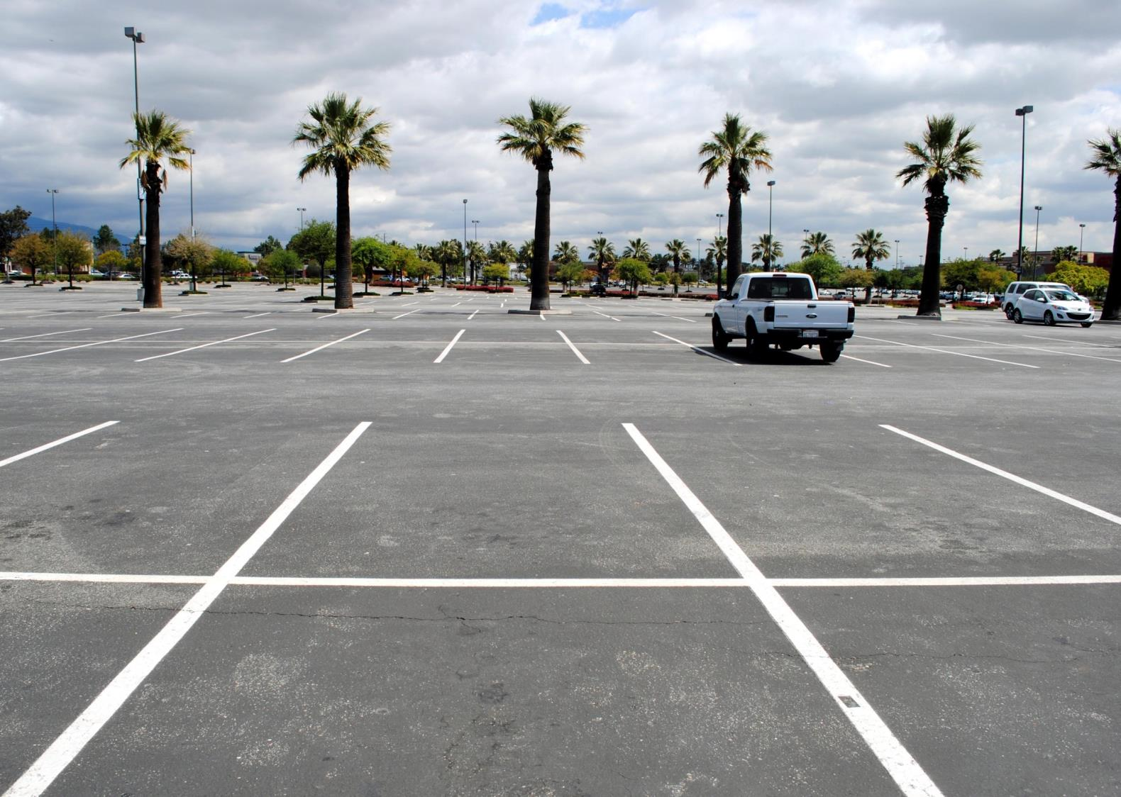

Slide 4
Fine grained livability…
Roadblocks to revitalization…

Slide 5
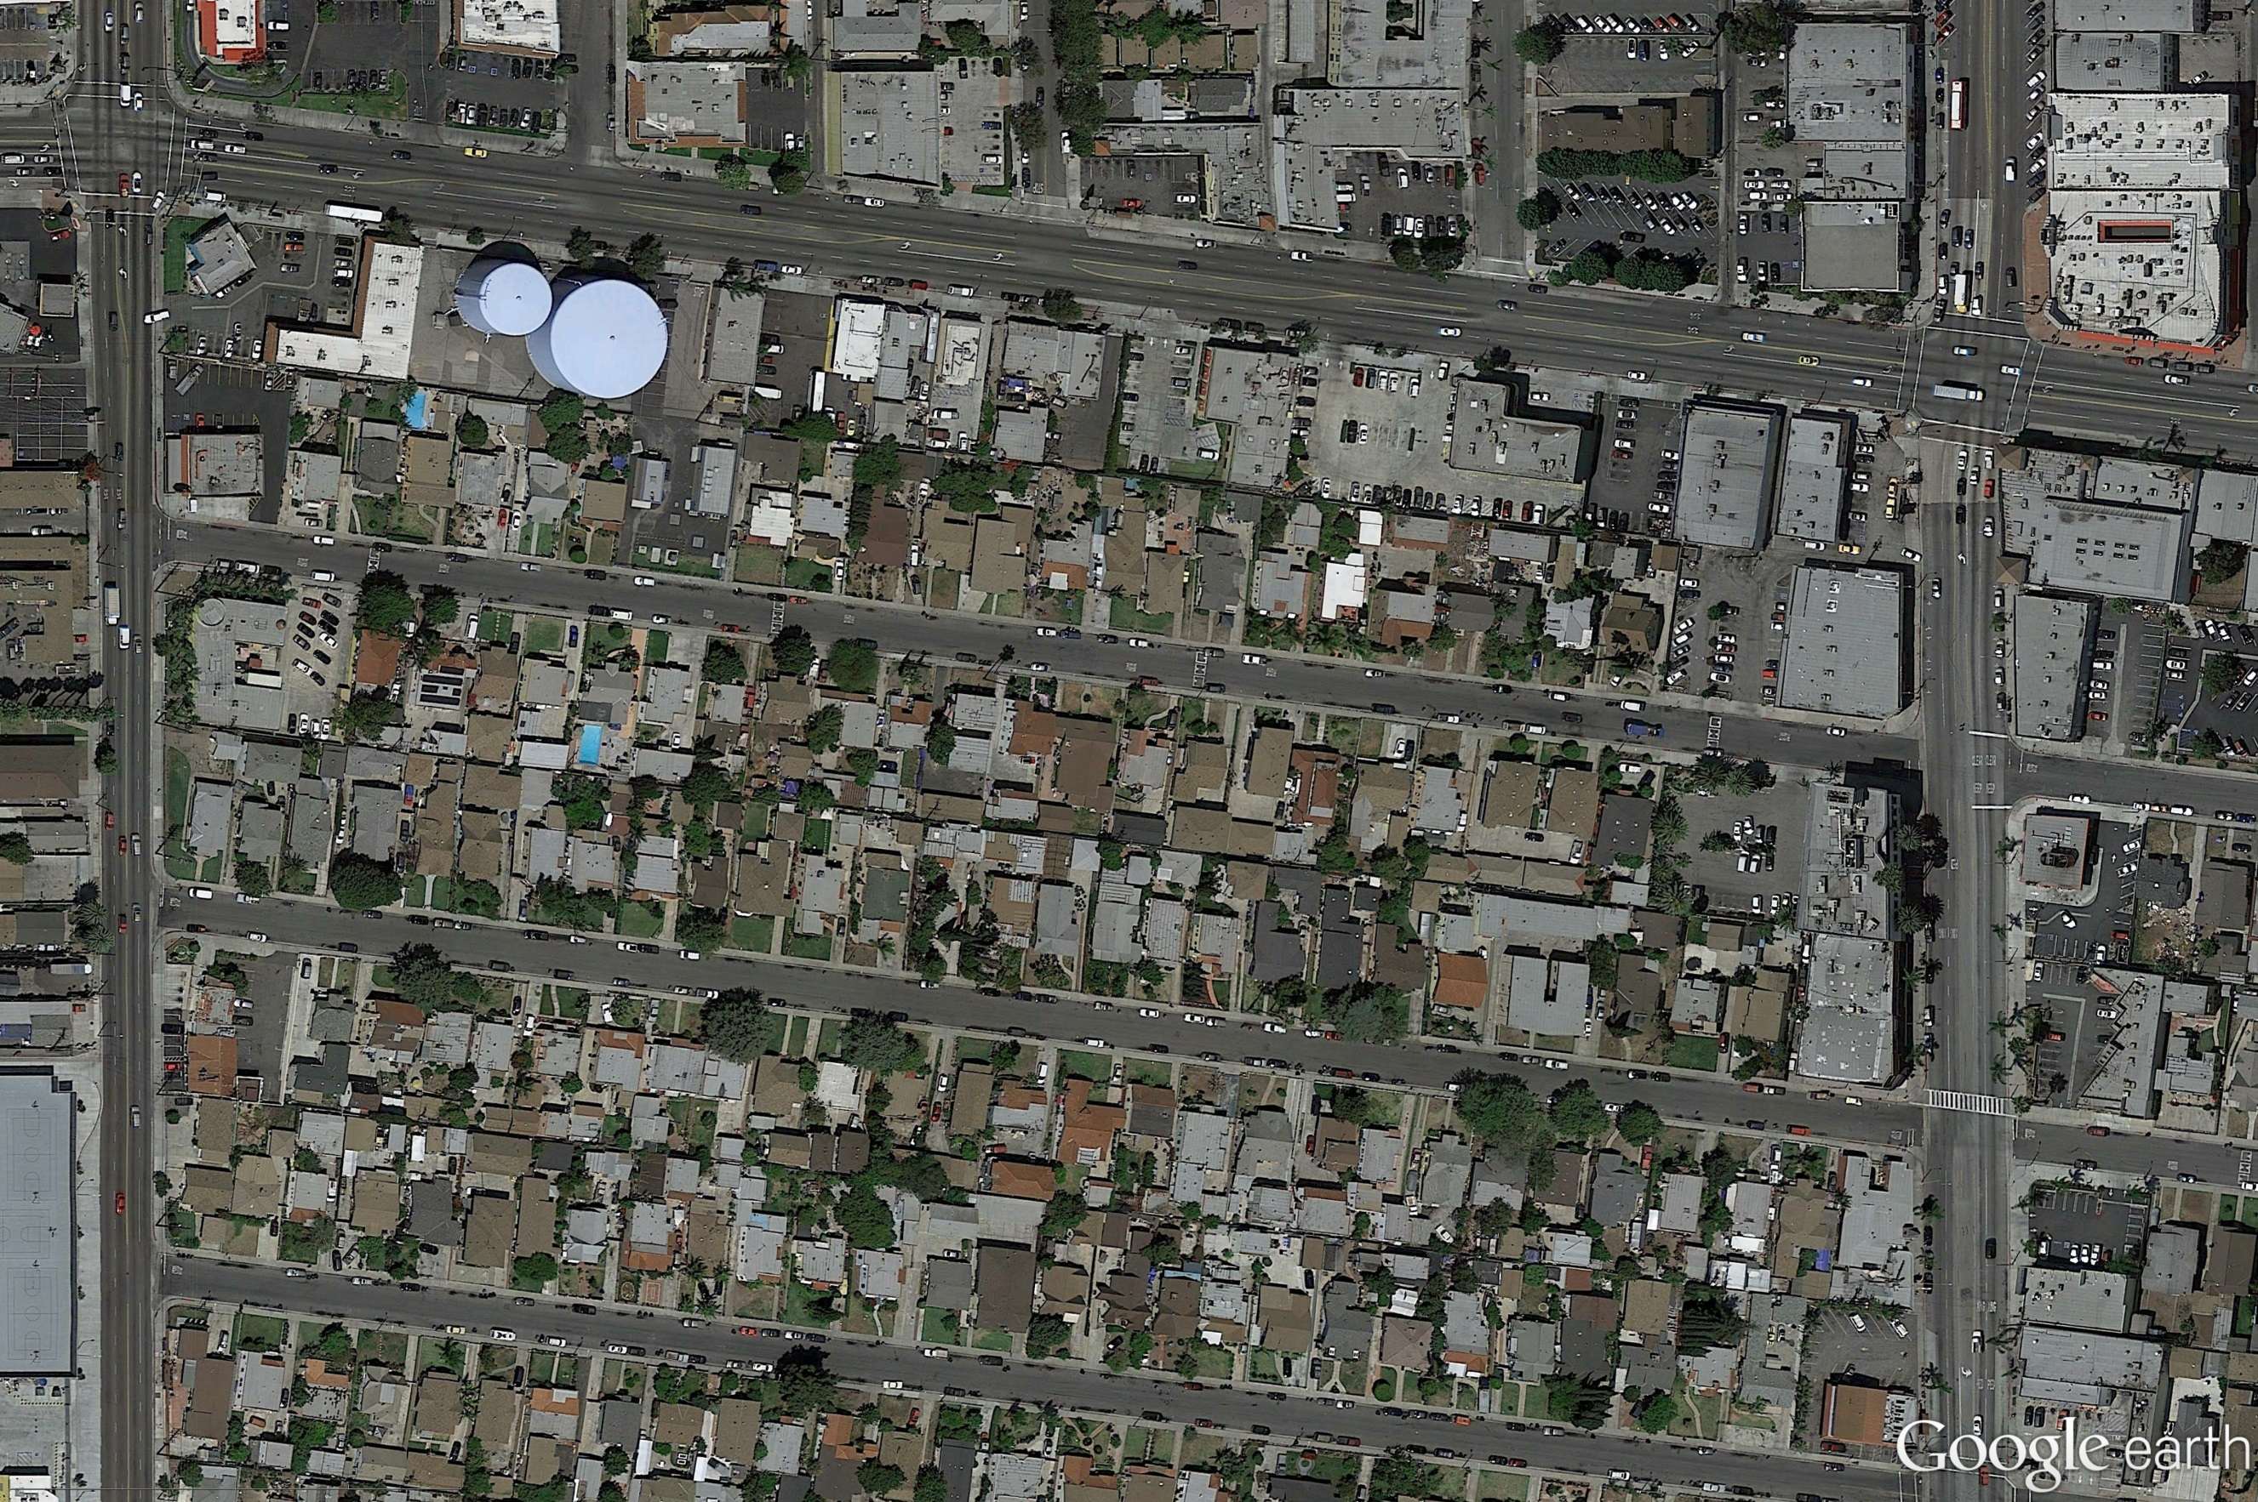
Built out, small parcels…
..people density = parking anxiety

Slide 6
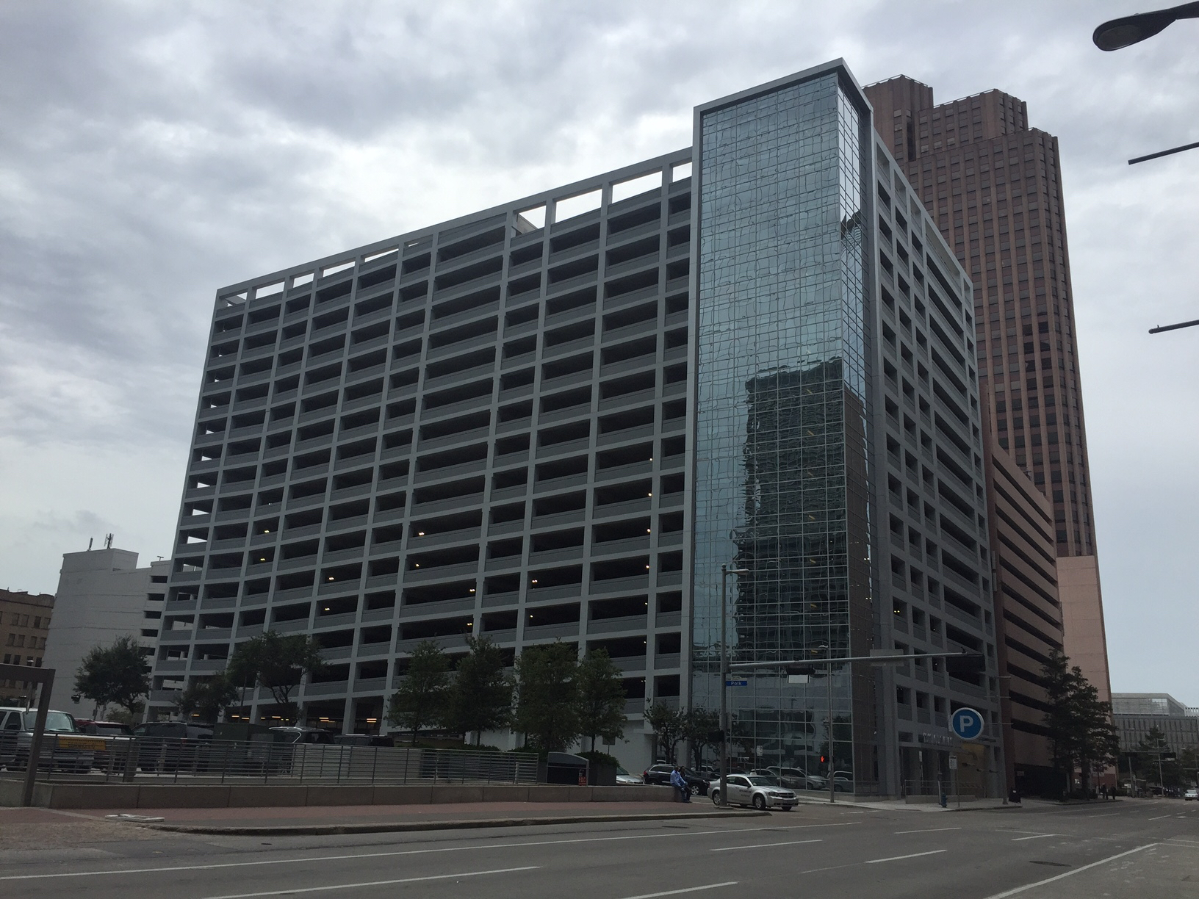
The circle of vice

Slide 8
Parking is policy

Slide 10
Putting parking requirements “in their place”

Slide 12
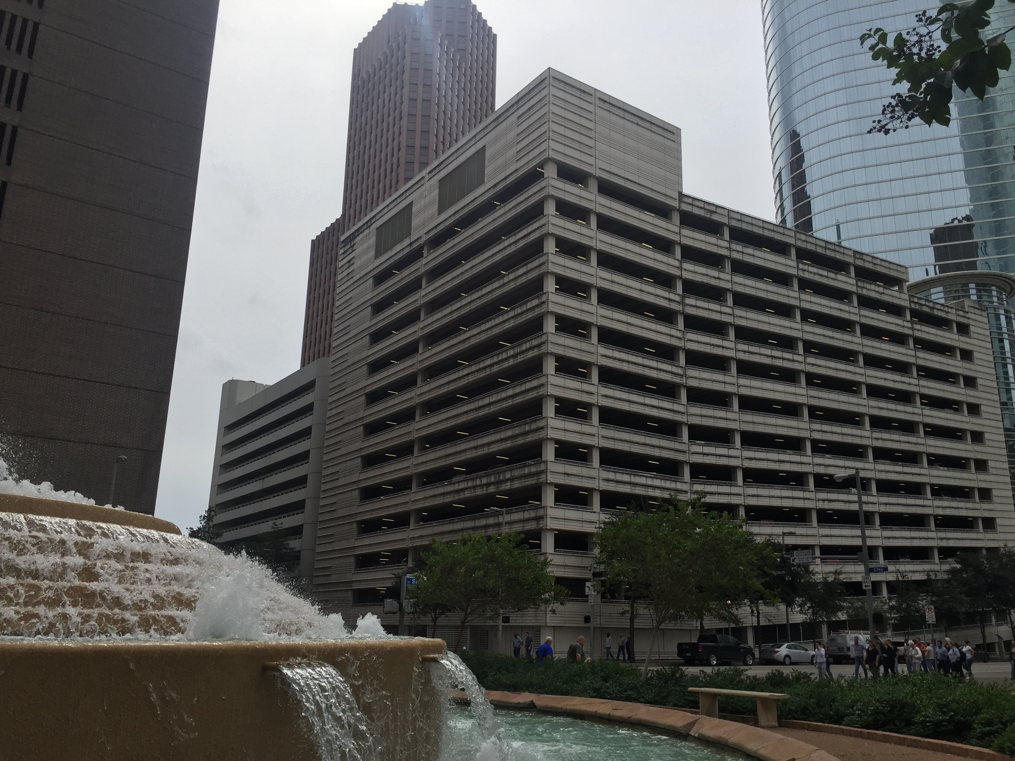
Habit, leverage, addiction, or what?

Slide 13
Stakeholder | Reason for the Status Quo
Individuals who park | Maintain free parking Territoriality
Notes:
WH parking credit very cheap compared to parking space; if rates were lowered, parking credit fee would need to be raised.

Slide 14
Stakeholder | Reason for the Status Quo
Individuals who park | Maintain free parking Territoriality
Local planners | Leverage public benefits, e.g., affordable housing. Nexus questions for other types of fees
Notes:
WH parking credit very cheap compared to parking space; if rates were lowered, parking credit fee would need to be raised.

Slide 15
Stakeholder | Reason for the Status Quo
Individuals who park | Maintain free parking Territoriality
Local planners | Leverage public benefits, e.g., affordable housing. Nexus questions for other types of fees
Public works/police | Less on-street parking management and enforcement
Notes:
WH parking credit very cheap compared to parking space; if rates were lowered, parking credit fee would need to be raised.

Slide 16
Stakeholder | Reason for the Status Quo
Individuals who park | Maintain free parking Territoriality
Local planners | Leverage public benefits, e.g., affordable housing. Nexus questions for other types of fees
Public works/police | Less on-street parking management and enforcement
Development community | Reduce risk Level playing field with competitors Other parking standards: tenants, lenders, appraisers, etc.
Notes:
WH parking credit very cheap compared to parking space; if rates were lowered, parking credit fee would need to be raised.

Slide 17
Stakeholder | Reason for the Status Quo
Individuals who park | Maintain free parking Territoriality
Local planners | Leverage public benefits, e.g., affordable housing. Nexus questions for other types of fees
Public works/police | Less on-street parking management and enforcement
Development community | Reduce risk Level playing field with competitors Other parking standards: tenants, lenders, appraisers, etc.
NIMBY groups | Limit density, challenge projects
Notes:
WH parking credit very cheap compared to parking space; if rates were lowered, parking credit fee would need to be raised.

Slide 18
A twelve-step reform method…

Slide 20
Step 1 | Method | Comments
Existing utilization | Measure local utilization using counts, air photo interpretation, census data (vehicle availability) for housing | Existing rates may reflect past practice of free parking, separated land uses
Notes:
1) Challenges of measuring occupancy in mixed use districts – overall counts and duration; intercept survey; data collection conditioned for new developments
Variation among uses, e.g., traditional retail versus mom and pop retail – how many categories can you have? Greater precision can lead to excess complexity, gaming the system…
Technology supported revoluation reducing vehicle ownership and use – zip car, use your neighbor’s car, real time ridematching, lyft, etc., telecommunication substitution of trips (building on less frequent car use, greater acceptability of off-site car storage) Greenprint story that many cars in the neighborhood are not use during the week.

Slide 21
Step 2 | Method | Comments
Future baseline | Identify 20 year trends in demographics, economics, culture | Most trends suggest declining parking utilization rates
Factor | Likely Effect Per Unit of Development
Local and regional land use and transportation plans | -
Demographic changes, aging population | -
Dense, mixed-use development | -
Changes in intensity of occupancy | +
Transit development and non-motorized transportation | -
Energy prices | -
Congestion as a travel disincentive | -
TNC’s and autonomous vehicles lower fleet size | -
Telecommunication substitution of travel | ~
Cultural preferences | -
Parking management, shared parking, and pricing | -

Slide 22
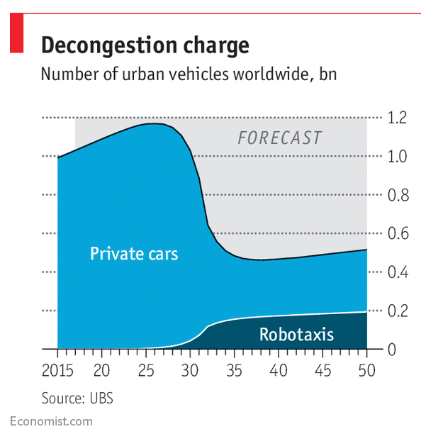
https://www.economist.com/news/special-report/21737422-carmakers-tech-companies-and-ride-hailing-firms-are-all-fighting-piece

Slide 23
Step 3 | Method | Comments
Basis for the rate | Should requirements be based on average or percentile rates? | Higher percentiles (e.g., 85th) are wasteful Shared parking reduces risk of using average rate
 | Minimum | 33rd % | Average | 85th % | Maximum
Adjustment | 0.3 | .9 | 1.0 | 1.21 | 1.96
Rate | 0.9 | 2.7 | 3.0 | 3.63 | 5.88

Slide 24
Step 4 | Method | Comments
Project and context | Adjust for special characteristics of the land use and the subarea | May lead to differentiated rates in land use categories; affordable housing a prime example

Slide 25
Step 5 | Method | Comments
Pricing/un-bundling/ cashout | Adjust for impact of pricing policies – renting/buy parking separate from residential unit | Studies of price elasticity show that parking demand is responsive to price
-0.3 +/-

Slide 26
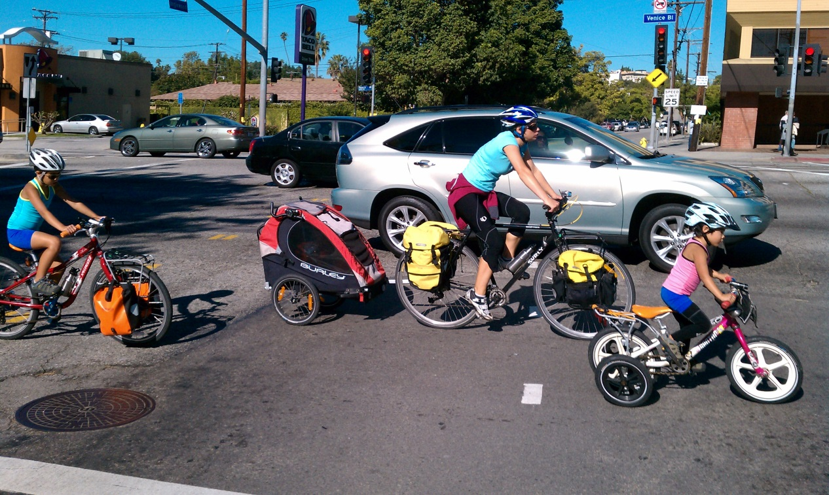
Step 6 | Method | Comments
Transit/ pedestrian/ bicycle | Adjust for local and subregional plans for alternative access | Affects travel mode choice for all land uses; affects household vehicle ownership for housing

Slide 27
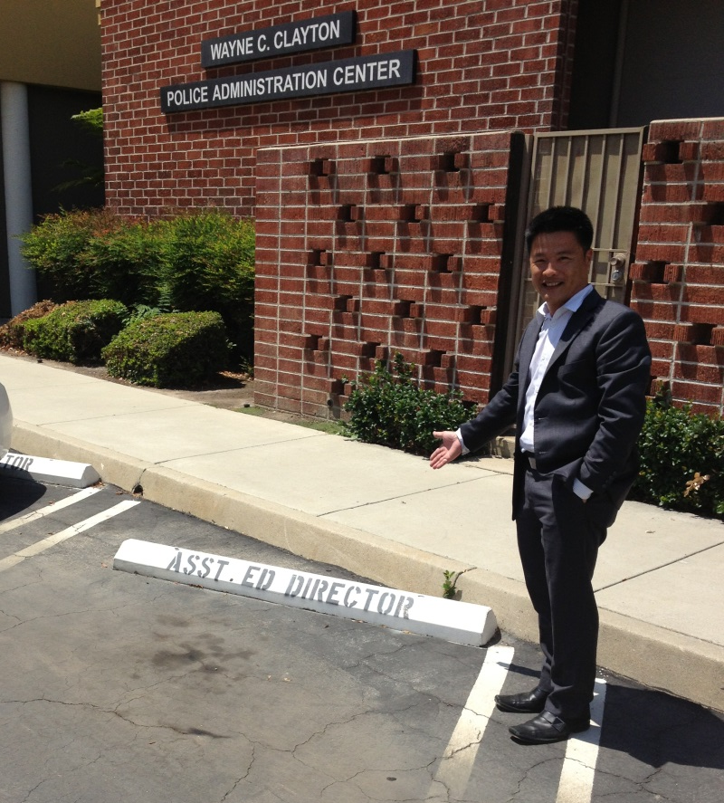
Step 7 | Method | Comments
Space use efficiency | Adjust for assigned versus pooled spaces, circulation factor | Real-time parking information and guidance systems reduce need for circulation factor

Slide 28
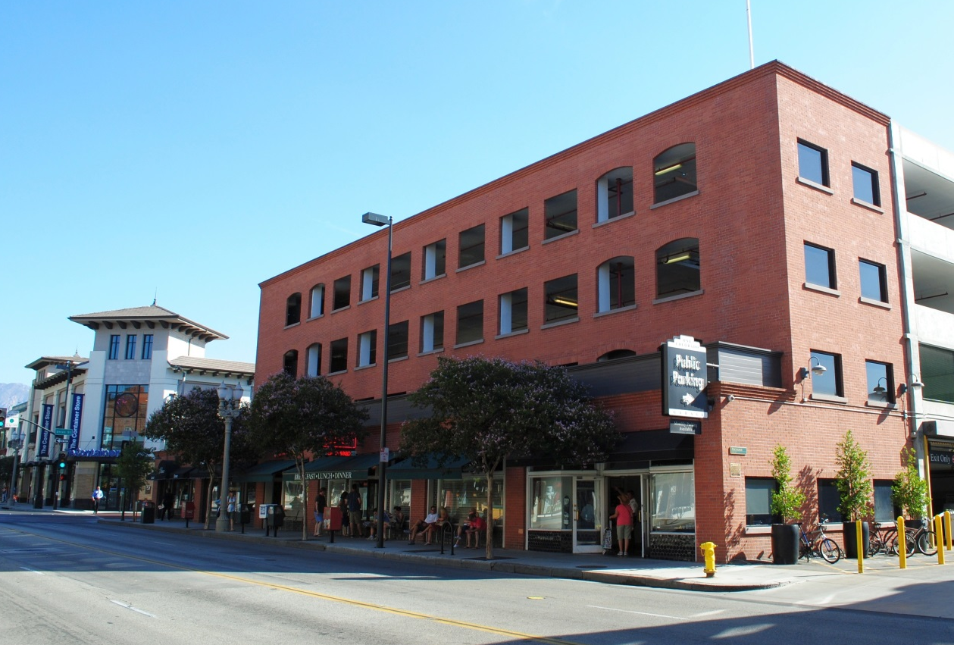
Step 8 | Method | Comments
Off-site parking | Reduce on-site requirement to account for portion of off-site parking | Districts may be oversupplied with parking. Overnight parking for residential uses could occupy empty spaces in office buildlings

Slide 29
Step 9 | Method | Comments
Internal shared parking | For multi-use sites, reduce overall rate to account for different peak use periods | Land uses can be strategically selected to maximize shared parking potential. A challenge for residential uses, but growing in use in urban areas
Use Urban Land Institute Shared Parking or free models (MTC)

Slide 30
Step 10 | Method | Comments
Evaluate and iterate | Does the prospective rate support community goals? | Consider transportation, urban form, housing affordability, economic development, sustainability, and regulatory practicality
Administrative feasibility +

Slide 31
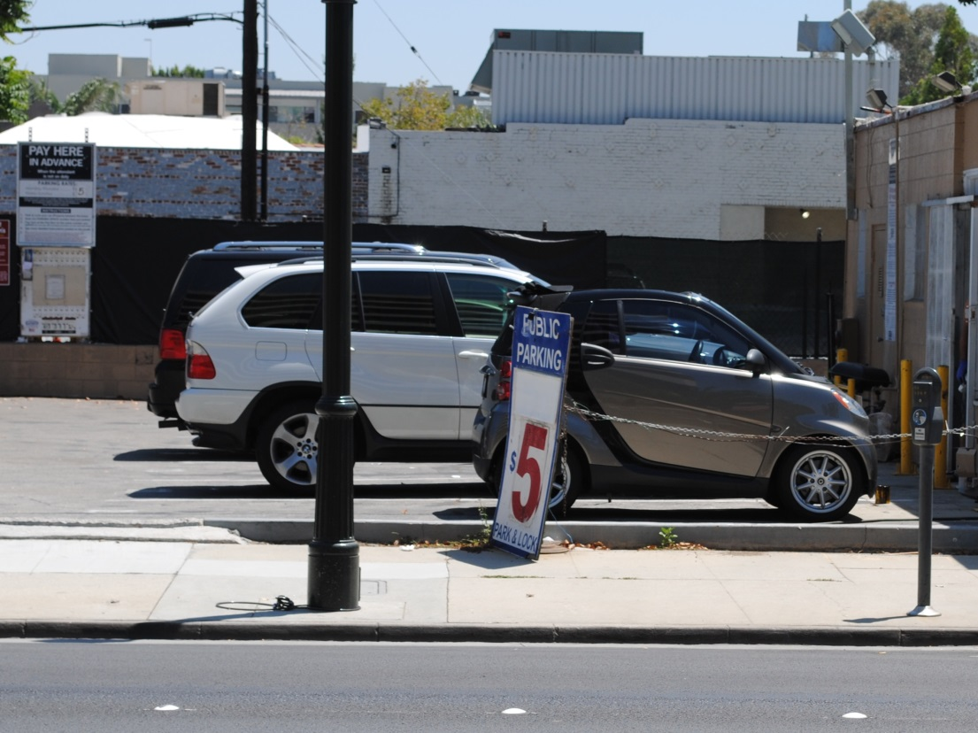
Step 11 | Method | Comments
Space size | Decide on minimum size, compact spaces | Average vehicle size is declining. If spaces are assigned, can allocate by vehicle size

Slide 32
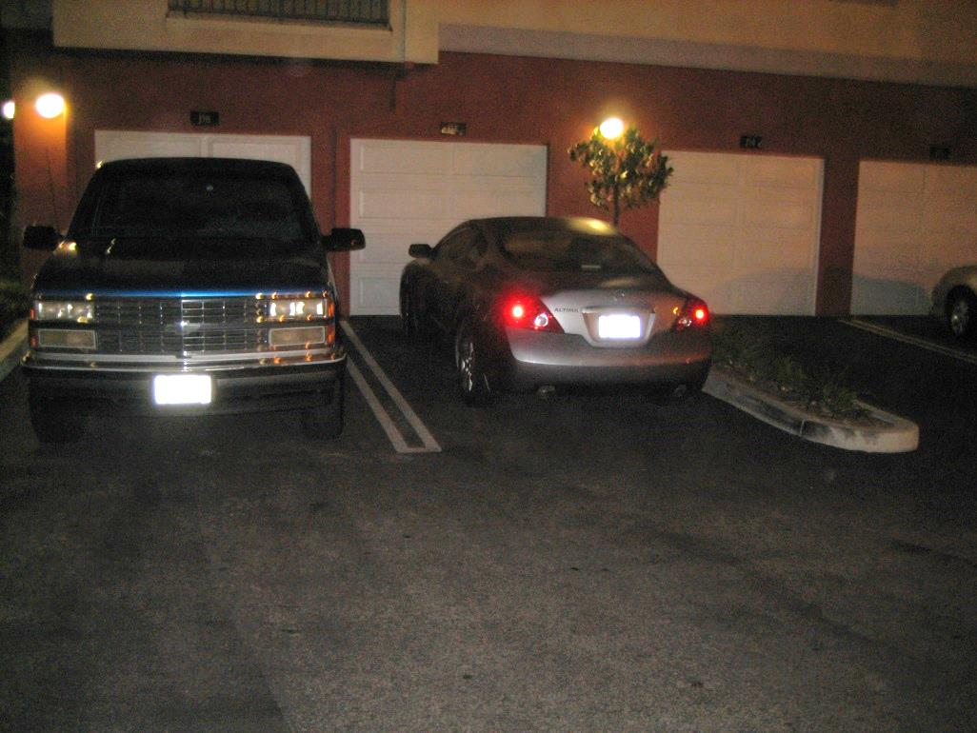
Step 12 | Method | Comments
Tandem, valet, mechanical | Increase the yield of cars parked per square foot of land or building area | Potential varies by land use, district context, and market. Tenant prefer side-by-side, but large density gains possible, lowering housing cost

Slide 33
Example for suburban multifamily housing

Slide 34
Requirement options…and developer responses

Slide 35
Approach | Requirement | Developer response
Traditional | Minimum > utilization No maximum | Rarely build more than requirement
Moderate reform | Minimum = utilization No maximum | Assess market for project, may exceed minimum

Slide 36
Approach | Requirement | Developer response
Traditional | Minimum > utilization No maximum | Rarely build more than requirement
Moderate reform | Minimum = utilization No maximum | Assess market for project, may exceed minimum
Big city approach | Minimum = % of utilization Maximum = ratio or % of minimum | Market decision whether to supply minimum or build to maximum

Slide 37
Approach | Requirement | Developer response
Traditional | Minimum > utilization No maximum | Rarely build more than requirement
Moderate reform | Minimum = utilization No maximum | Assess market for project, may exceed minimum
Big city approach | Minimum = % of utilization Maximum = ratio or % of minimum | Market decision whether to supply minimum or build to maximum
Partial deregulation | No minimum Maximum = ratio or % of minimum | Market decision whether to supply parking or build to maximum
Deregulation | No minimum or maximum; Performance measures, e.g., traffic impacts | Market decision on whether/how much

Slide 38
Priorities | Reform | How to sell it
1 | Allow on-street parking to be counted for visitor parking | On-street parking is traditionally devoted to short-term visitor uses
2 | Eliminate visitor parking requirement | On-street parking pricing manages use

Slide 39
Priorities | Reform | How to sell it
1 | Allow on-street parking to be counted for visitor parking | On-street parking is traditionally devoted to short-term visitor uses
2 | Eliminate visitor parking requirement | On-street parking pricing manages use
3 | Unbundle parking cost from rent or purchase price | Non-auto households deserve lower housing costs
4 | Lower minimums to expected vehicle availability | Lower housing costs, allow greater density

Slide 40
Priorities | Reform | How to sell it
1 | Allow on-street parking to be counted for visitor parking | On-street parking is traditionally devoted to short-term visitor uses
2 | Eliminate visitor parking requirement | On-street parking pricing manages use
3 | Unbundle parking cost from rent or purchase price | Non-auto households deserve lower housing costs
4 | Lower minimums to expected vehicle availability | Lower housing costs, allow greater density
5 | Lower minimums to below expected vehicle availability | Allow for market choice
6 | No minimum requirement | Market decision on whether/how much

Slide 41
Priorities | Alternatives to parking | How to sell it
1 | Free transit passes to residents for defined period | Lowers vehicle ownership rates
2 | Provide spaces for temporary car rental, shared mobility pickup | As above

Slide 42
Priorities | Alternatives to parking | How to sell it
1 | Free transit passes to residents for defined period | Lowers vehicle ownership rates
2 | Provide spaces for temporary car rental, shared mobility pickup | As above
3 | Bicycle parking | Accommodates a more efficient mode
4 | Agree to add mechanical parking if needed, based on monitoring | Reduces risk perceived by city in lowering minimums

Slide 43
Priorities | Alternatives to parking | How to sell it
1 | Free transit passes to residents for defined period | Lowers vehicle ownership rates
2 | Provide spaces for temporary car rental, shared mobility pickup | As above
3 | Bicycle parking | Accommodates a more efficient mode
4 | Agree to add mechanical parking if needed, based on monitoring | Reduces risk perceived by city in lowering minimums
5 | Preference for rentals to those employed locally | Argues for lower vehicle ownership
6 | Pedestrian improvements, bike facilities | Enhances alternative modes, for residents and neighborhoods

Slide 44
Bells and whistles…

Slide 45
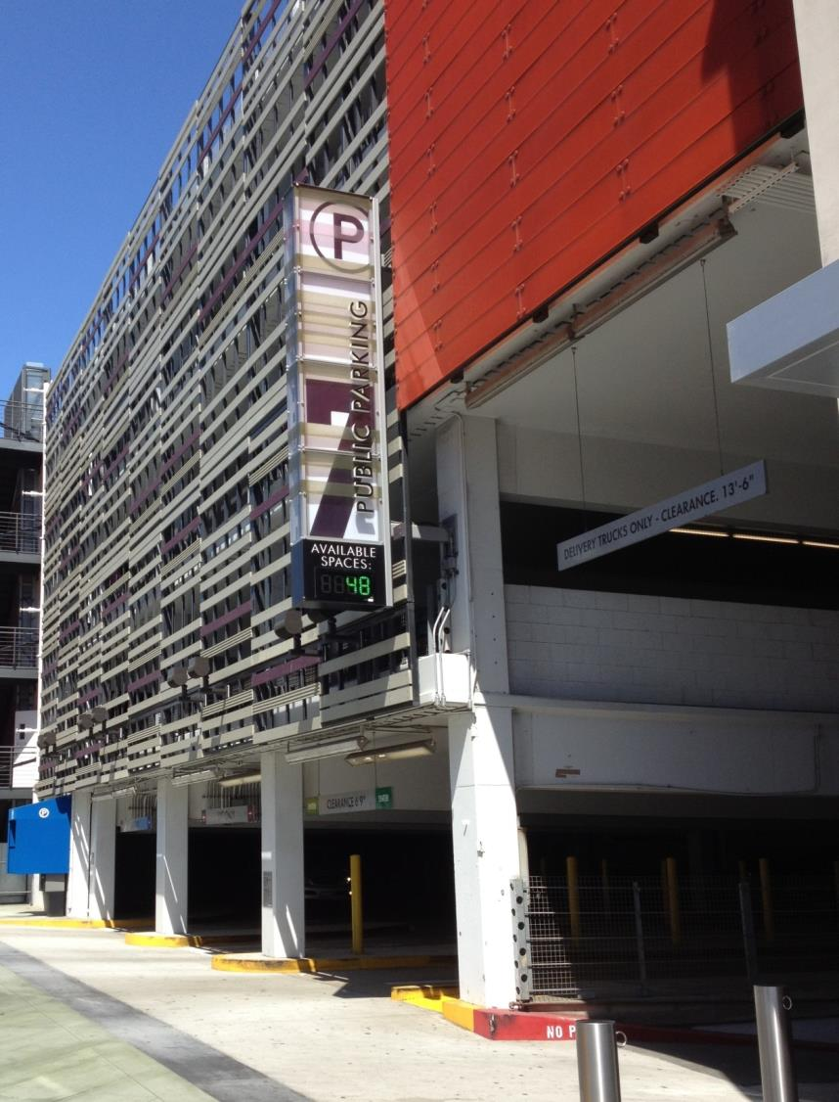
“Taming”
Parking
Driveway regulations
Prohibit surface
Ground floor retail
Height restrictions
% of block facades for garage doors
Discretionary design review
Shading
Permeable pavement
Solar
Real-time information
Guidance systems

Slide 46
“Taming”
Parking
Driveway regulations
Prohibit surface
Ground floor retail
Height restrictions
% of block facades for garage doors
Discretionary design review
Shading
Permeable pavement
Solar
Real-time information
Guidance systems
Supply Regulations
Eliminate minimums
Maximums
Discretionary determination
Tandem
Re-use projects
Overlays zones
On-street credit
Performance-based
In lieu/access fees
Carsharing
Off-site parking
Pricing, unbundling, cash-out
TDM
Bike parking
Electric vehicle parking

Slide 47
Parking management

Slide 48
Approach | Strategy
On-street parking in commercial districts | Time limits, space designations Pricing Dynamic pricing Parking benefit districts
On-street parking in residential neighborhoods | Residential permits Priced residential permits Parking benefit districts

Slide 49
Approach | Strategy
On-street parking in commercial districts | Time limits, space designations Pricing Dynamic pricing Parking benefit districts
On-street parking in residential neighborhoods | Residential permits Priced residential permits Parking benefit districts
Off-street parking, private | Access control Pricing Shared parking arrangements
Off-street parking, public | Time limits, space designations Cost recovery pricing Prioritize use through pricing

Slide 50
Politics and participation

Slide 51
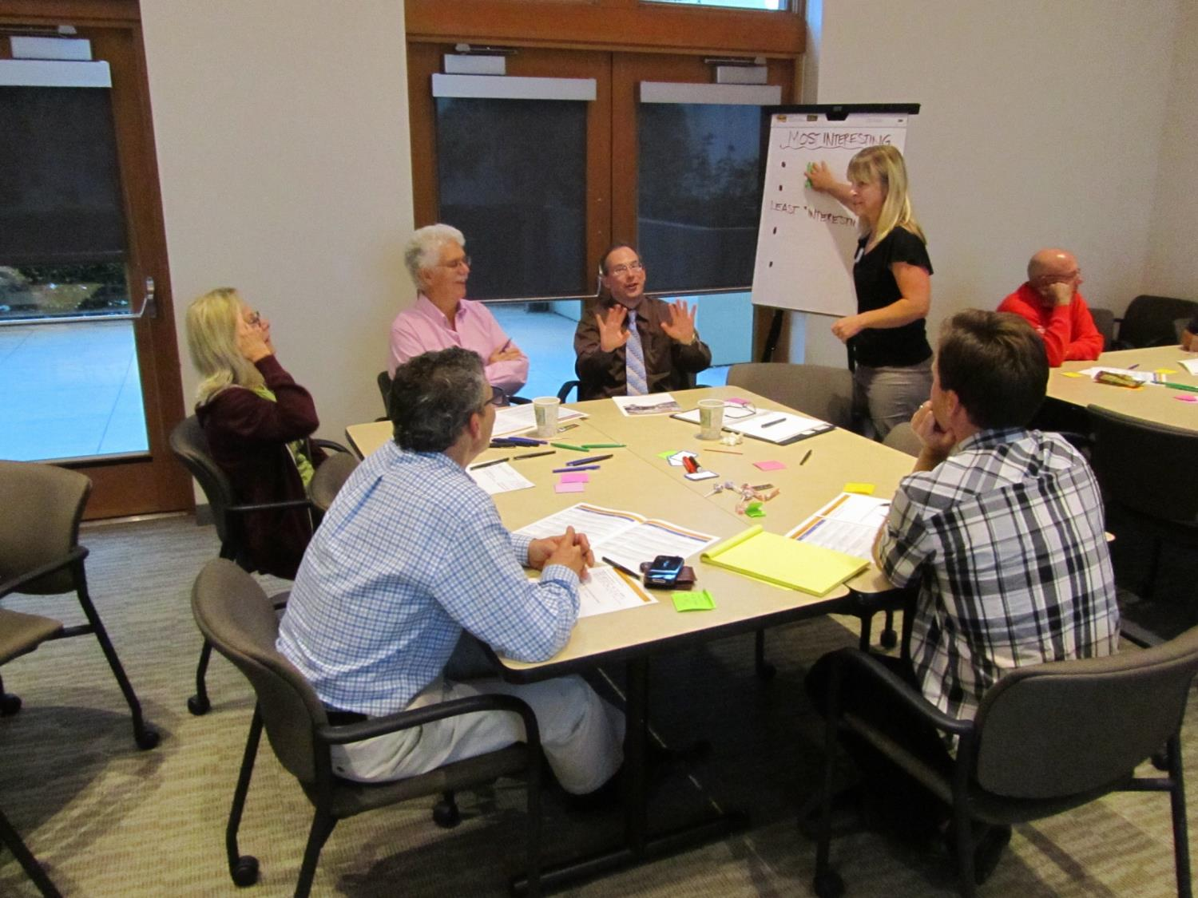

Slide 52
Approach | Strategy
Link reform to community goals and plans | A way of achieving urban design, housing, economic development, transportation, or environmental goals
Educate | Costs of status quo – wasted land, livability Fairness to non-drivers Practice in successful, admired places

Slide 53
Approach | Strategy
Link reform to community goals and plans | A way of achieving urban design, housing, economic development, transportation, or environmental goals
Educate | Costs of status quo – wasted land, livability Fairness to non-drivers Practice in successful, admired places
Appeal to self interest | City managers: lost tax revenues Owners of existing parking and parking operators Revenue return to district or neighborhood Developers/property owners Compensate those disadvantaged by change
Attract allies | Transit operators, cyclists Infill developers, affordable housing developers Small business Historic preservation

Slide 54
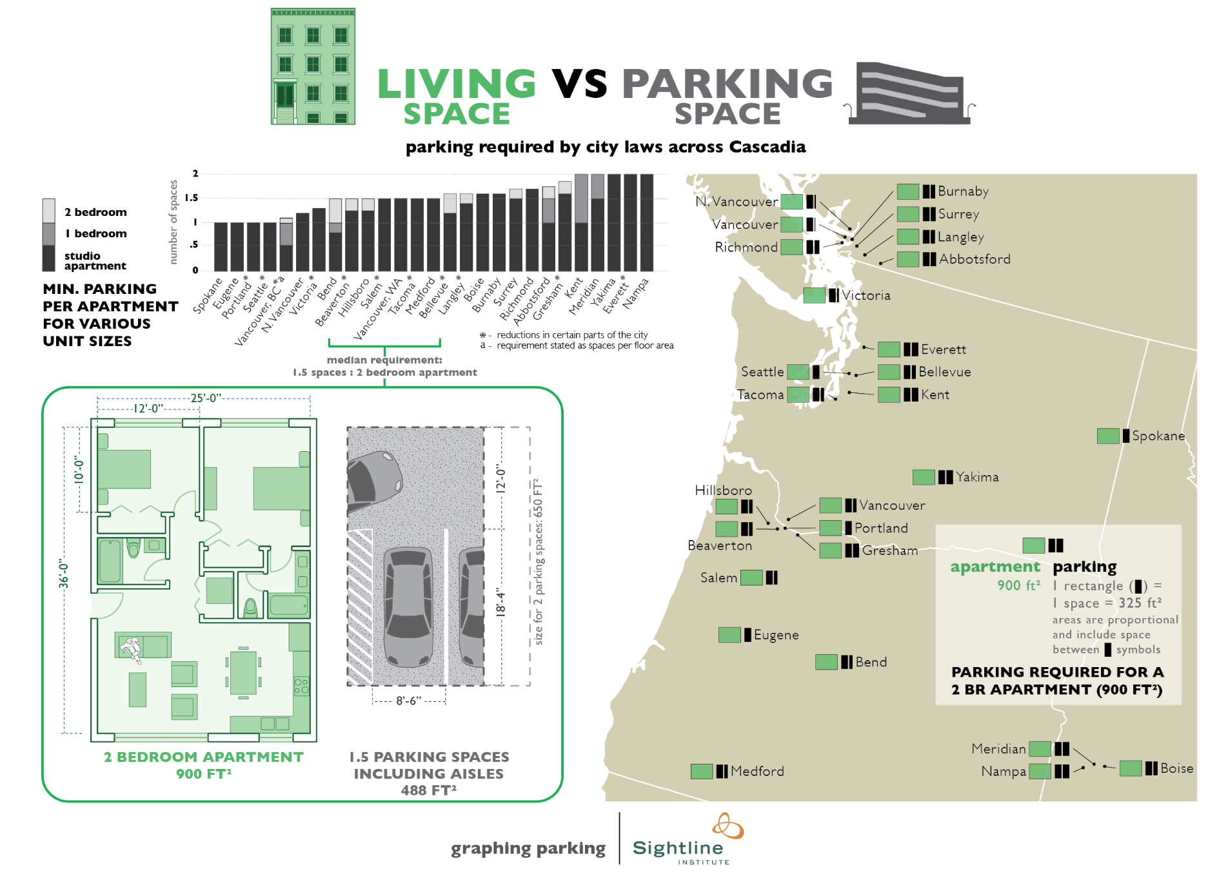
http://www.sightline.org/2013/07/23/infographic-living-space-v-parking-space/

Slide 55
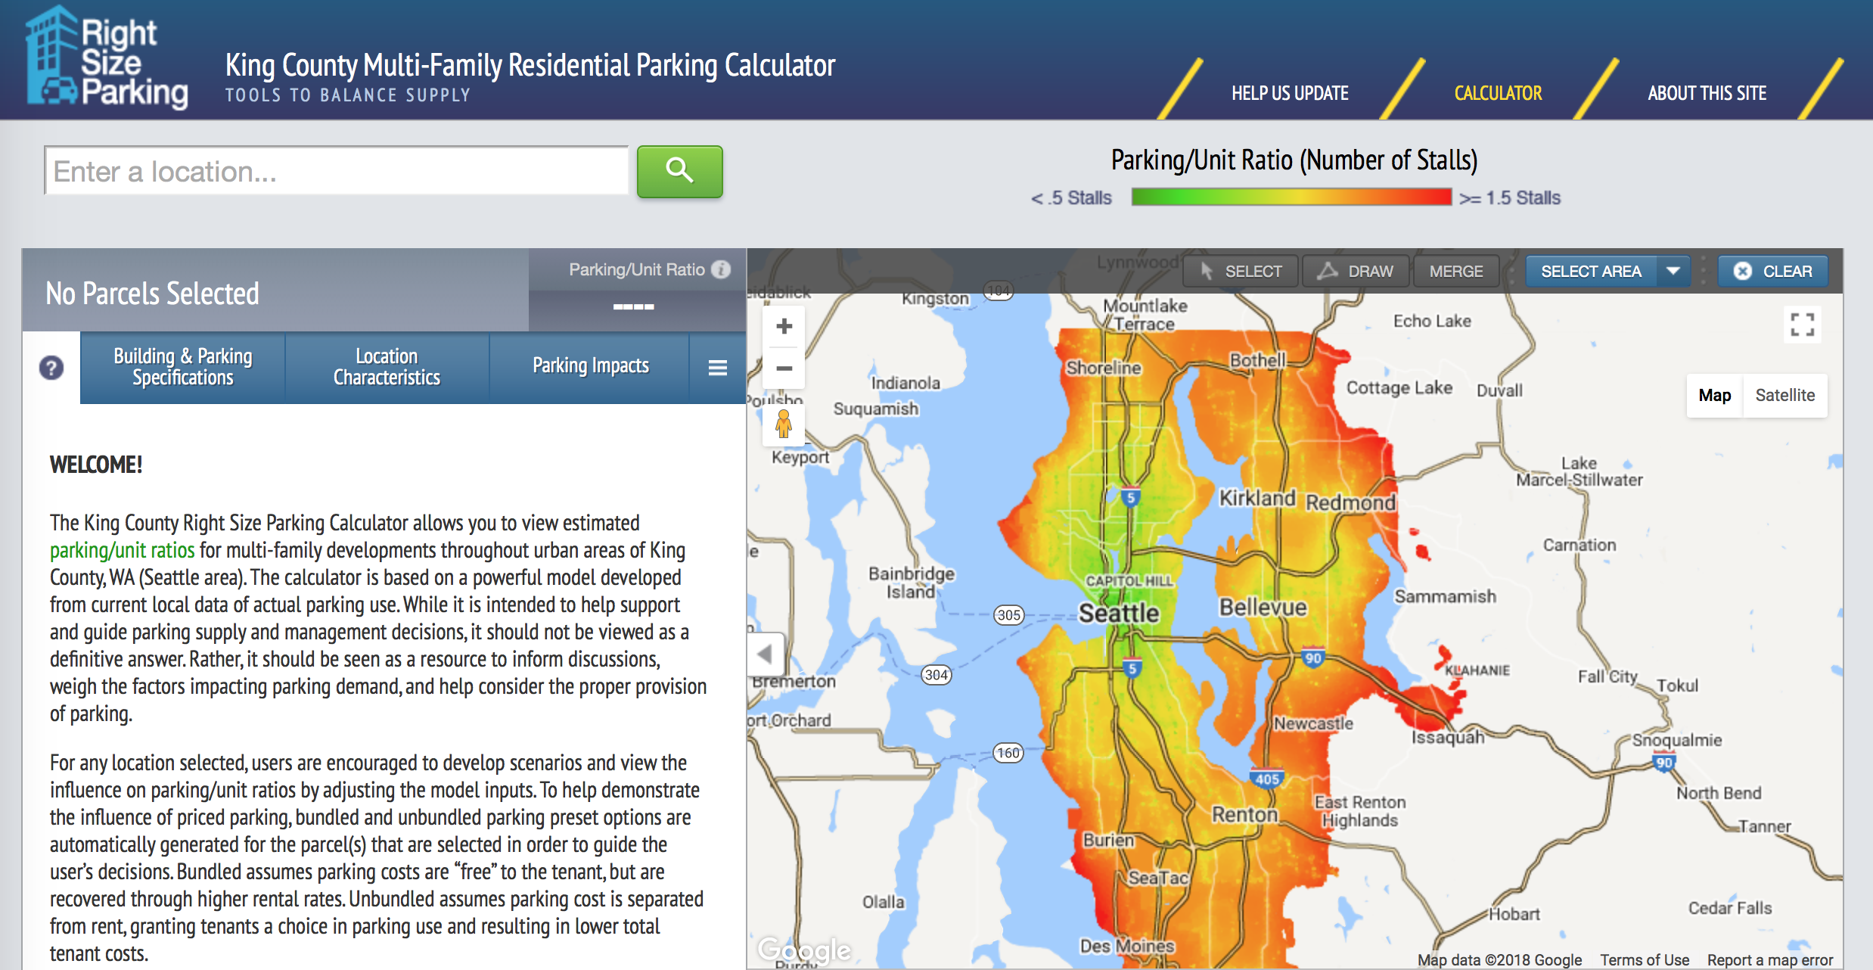
http://www.rightsizeparking.org

Slide 56
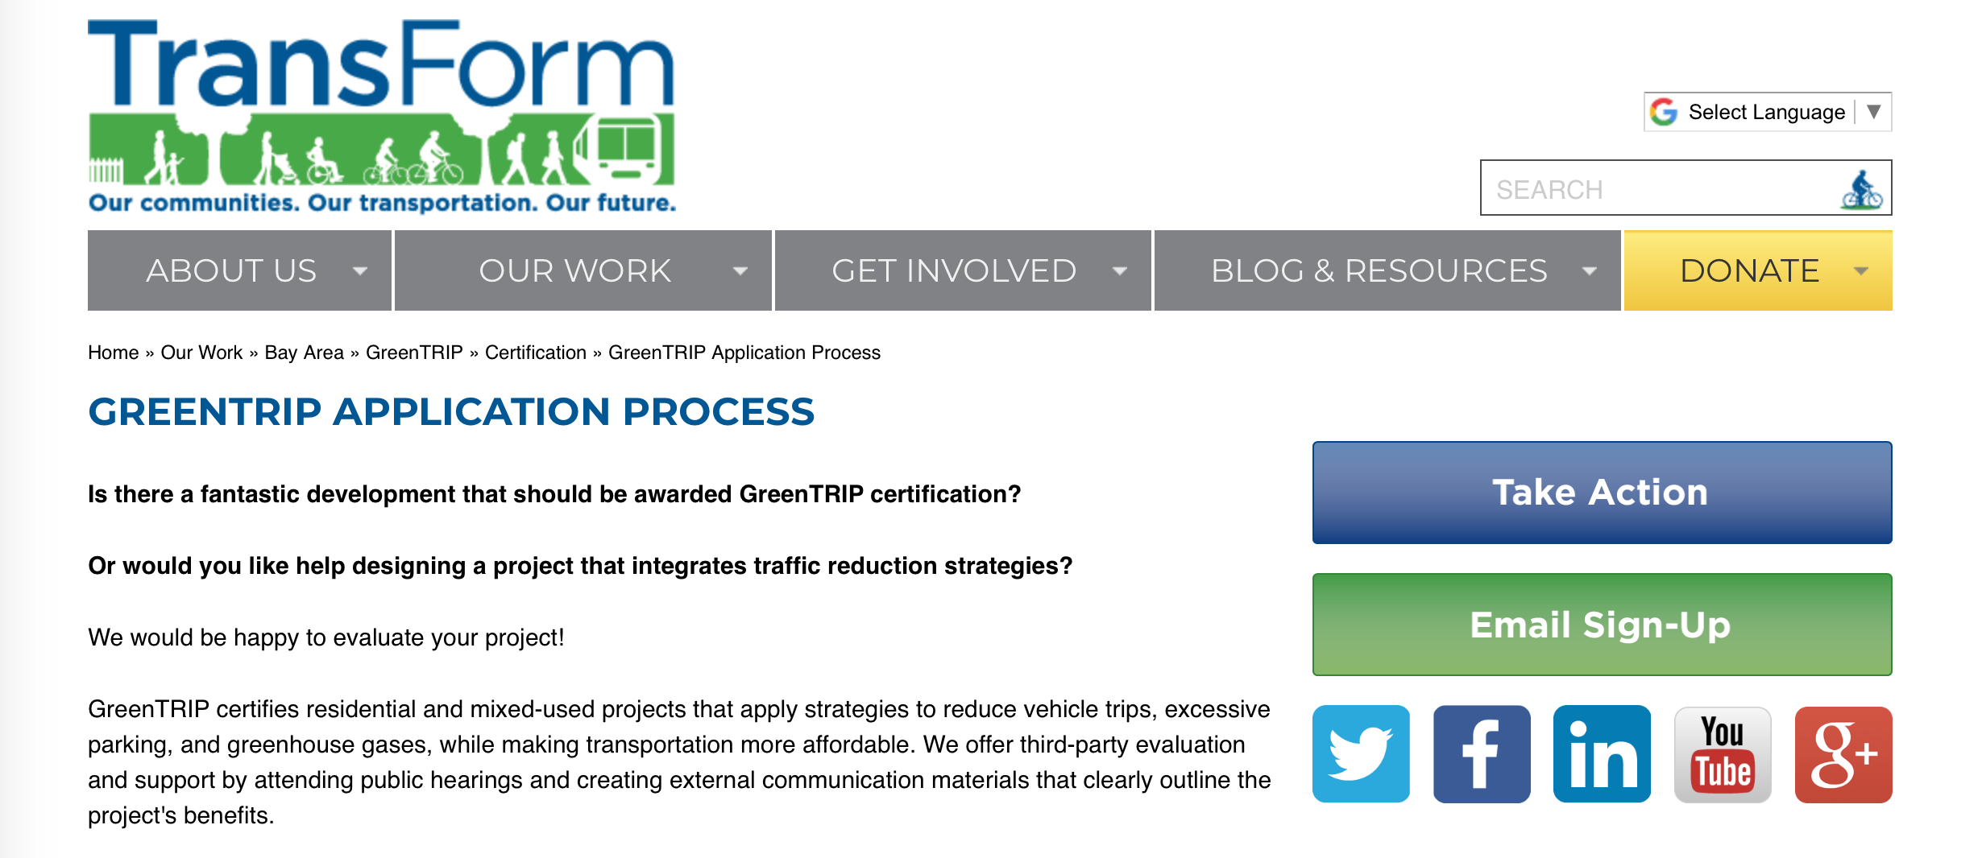
http://www.transformca.org/greentrip/apply-for-certification

Slide 57
If Joni Mitchell and Bob Dylan wrote a song together…

Slide 58
…it would be entitled…

Slide 59
Paved Paradise Revisited
It’s time to reform parking requirements!

Slide 60
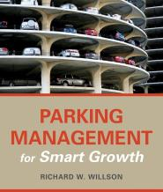
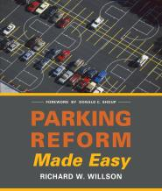
Resources…
Parking Management for Smart Growth (2015) Island Press
How to implement comprehensive and coordinated parking management
Parking Reform Made Easy (2013) Island Press
How to revise (or eliminate) minimum parking requirements

Slide 61
Questions and comments

