Slide 1

Launching and Navigating Your Transportation Career
Mineta Transportation Institute, San Jose State University
November 7, 2018
Richard Willson Ph.D., FAICP
Department of Urban and Regional Planning, Cal Poly Pomona

Slide 2
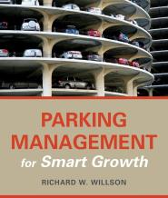
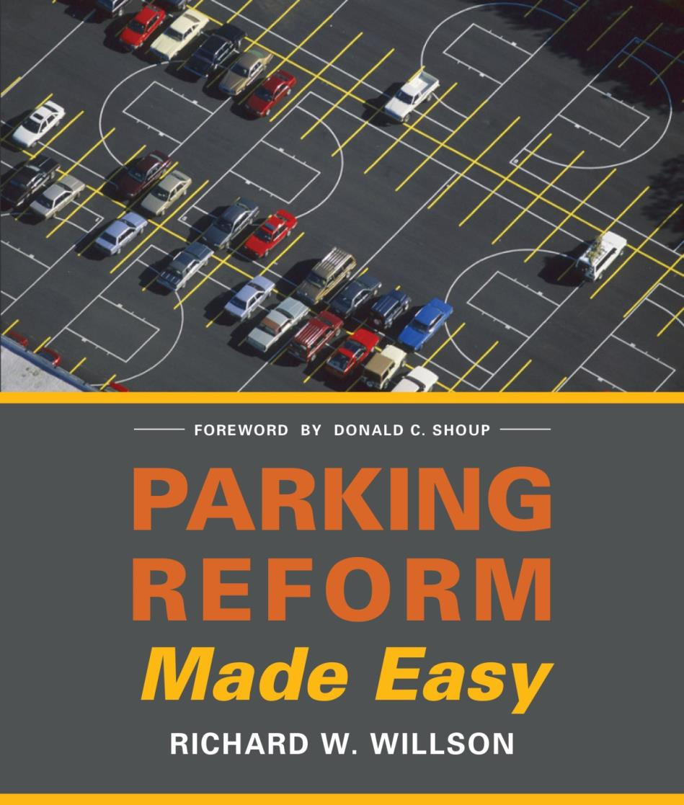

My background…
30+ years of teaching and research at Cal Poly Pomona
Planning practice in Canada and California, primarily transportation planning
Research on parking reform and transit-oriented development
APA blog: Launching Your Planning Career: A Guide for Idealists
A Guide for the Idealist: Launching and Navigating Your Career (Routledge 2018)

Slide 3
Part I. Launching and re-launching

Slide 4

Navigating in a moving stream
Navigation versus blueprint
Decisions under uncertainty
  Your goals
  Changing practices
  Changing nature of work

Slide 5
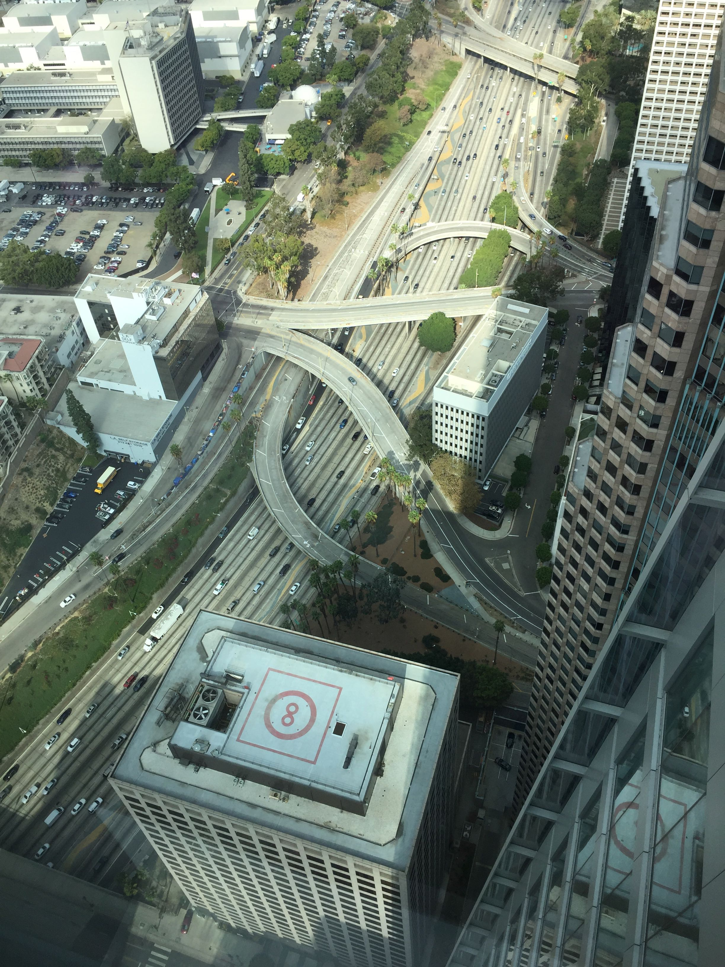
What is my work?
  What is your passion?
  Translate it to planning
  Match your passion with what the world needs
Organizing framework for intent
  People and equity
  Place and environment
  Systems and efficiency

Slide 6
Types of transportation work
 | Highway | Regional transit | Local transit | Active transportation | TNC/ technology | Goods movement | Other
Visioning
Community engagement
Planning
Modeling/analysis
Finance
Facility design
Programming
Operations
Maintenance
Marketing
Other

Slide 7

Personality Assessment Tools
Meyers Briggs Type Indicator
  16 Personalities (variation of Myers Briggs)
  https://www.16personalities.com/free-personality-test
A fallible tool for self-awareness, not a label

Slide 8
About 16 Personalities (variation of Myers Briggs)
Assists in:
  Understanding style/preferences – and articulating them
  Sorting work types and settings for a fit
  Correctly boasting of strengths
  Awareness of weaknesses to prioritize professional development
  Understanding other planners
  Understanding other professionals
  Creating balanced teams
  Managing effectively

Slide 9
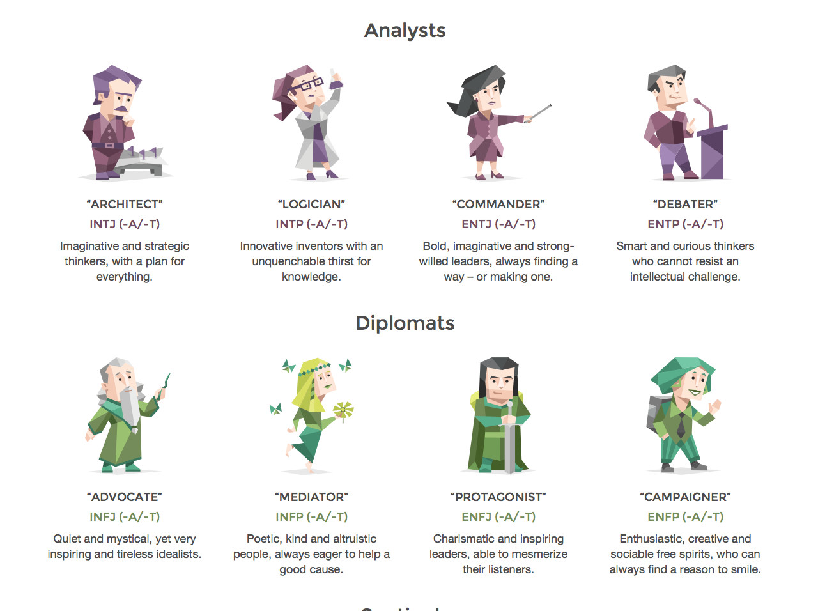
Analysts and Diplomats
Source: https://www.16personalities.com/personality-types

Slide 10
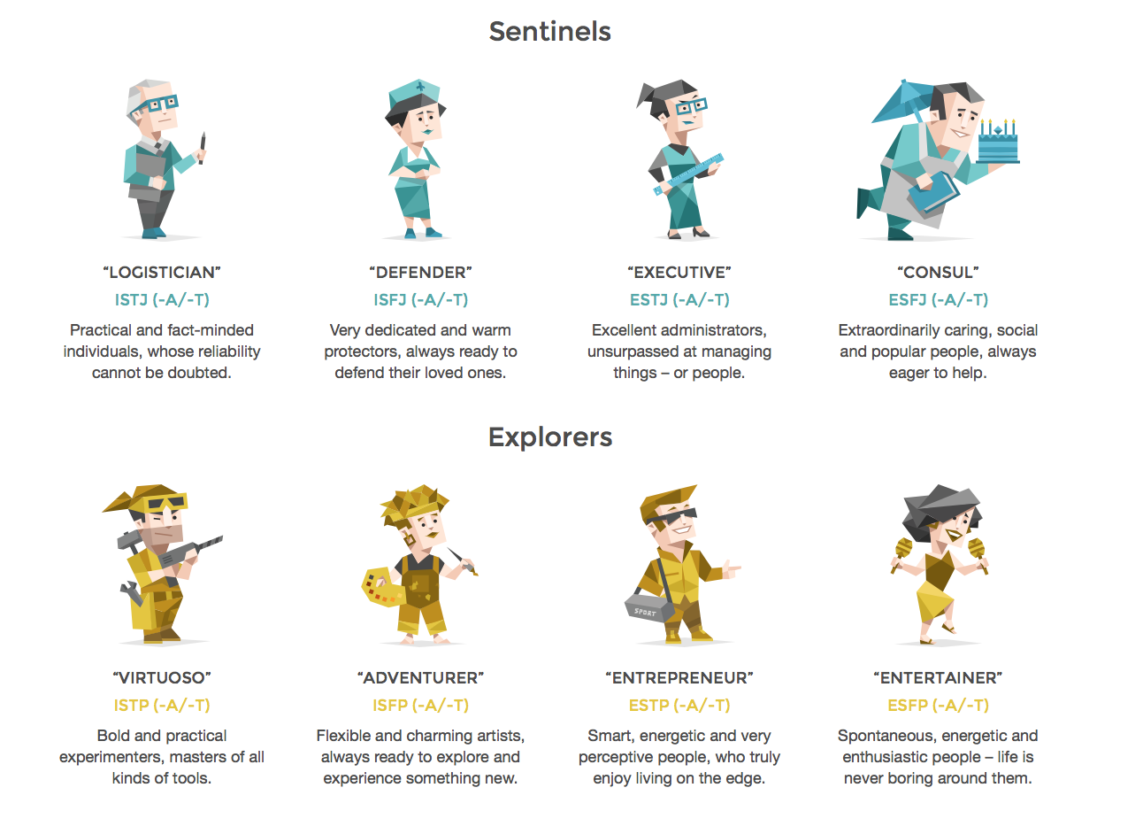
Sentinels and Explorers
Source: https://www.16personalities.com/personality-types

Slide 11
Personality type affects work preferences
Work alone or in groups (coding, modelling versus team projects)
Deskwork, public counter work, presentations, facilitation, field studies
Amount of travel
Creativity/innovation versus regular processes
Level of engagement with politics, stakeholders, and community groups

Slide 12
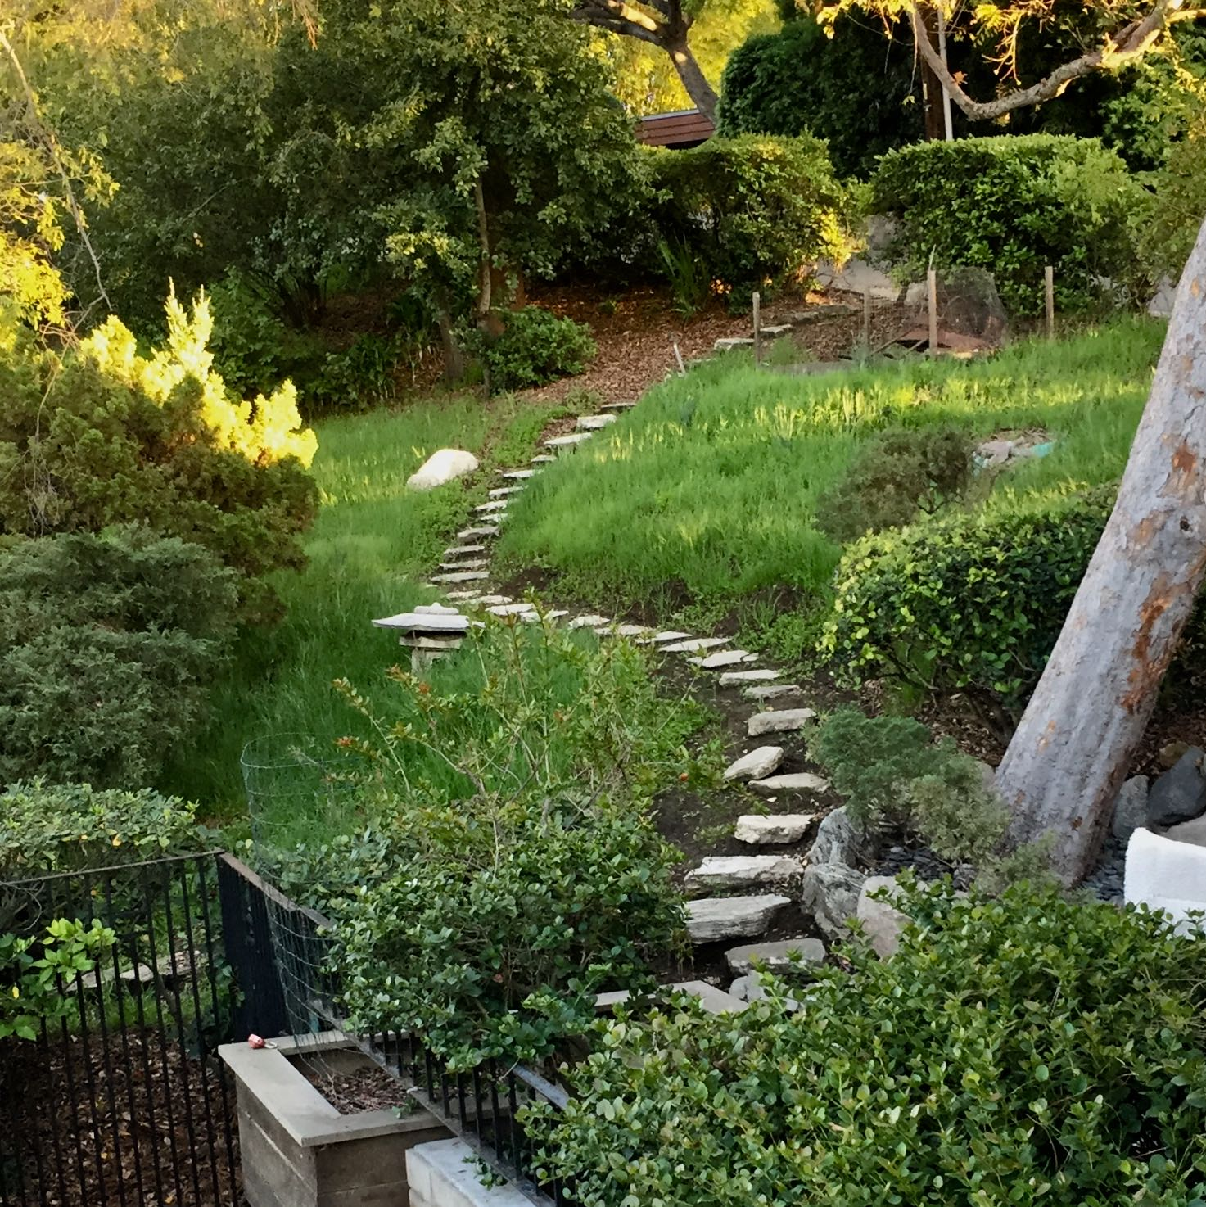
The real you: owning values
Self-assessment tools help you recognize the “real you”
  Organize and target job searches; navigate career moves
Personality tools don’t indicate core values
  Different core values lead to different career paths

Slide 13
Motivating values
Value | Type of planning work | Example jobs
Care | People work: organizing groups and communities normally excluded in transportation planning | Transportation community organizer/advocate, service provider

Slide 14
Motivating values
Value | Type of planning work | Example jobs
Care | People work: organizing groups and communities normally excluded in transportation planning | Transportation community organizer/advocate; service provider
Justice | Equity work: transit programming and route planning, regulation of TNC’s, Vision Zero programs, transportation finance reform | Regulatory reformer, program designer, program evaluator

Slide 15
Motivating values
Value | Type of planning work | Example jobs
Care | People work: organizing groups and communities normally excluded in transportation planning | Transportation community organizer/advocate, service provider
Justice | Equity work: transit programming and route planning, regulation of TNC’s, Vision Zero programs, transportation finance reform | Regulatory reformer, program designer, program evaluator
Truth | Efficiency work: travel modeling, economic analysis, operations planning | Design engineer, transportation modeler, transportation finance, analyst, transit agency service planner

Slide 16
Motivating values
Value | Type of planning work | Example jobs
Care | People work: organizing groups and communities normally excluded in transportation planning | Transportation community organizer/advocate, service provider
Justice | Equity work: transit programming and route planning, regulation of TNC’s, Vision Zero programs, transportation finance reform | Regulatory reformer, program designer, program evaluator
Truth | Efficiency work: travel modeling, economic analysis, operations planning | Design engineer, transportation modeler, transportation finance, analyst, transit agency service planner
Beauty | Placemaking and aesthetics: facility design, integrated transportation/land use planning, public art | Transportation facility designer

Slide 17
What work setting?
Sector (private, public, non-profit)
  Job satisfaction, effectiveness, and public good orientation
  Autonomy in work and working conditions, and level of effort

Slide 18
Satisfaction, effectiveness, and public good across sectors
Characteristic | Public
Primary job satisfaction | Serve the public good; long-term Understand context and witness implementation
Effectiveness | Systemic (you set the rules) Long-term, process-heavy, and slow pace of implementation
Orientation to the public good | Assumed, subject to political determination More comprehensive approach (What?)

Slide 19
Satisfaction, effectiveness, and public good across sectors
Characteristic | Public | Non-profit
Primary job satisfaction | Serve the public good; long-term Understand context and witness implementation | Mission-based; passion; “speak your truth” Flexible strategies
Effectiveness | Systemic (you set the rules) Long-term, process-heavy, and slow pace of implementation | Depends on stability, funding, and leverage Short-term focus
Orientation to the public good | Assumed, subject to political determination More comprehensive approach (What?) | Yes, but often focused on undeserved constituency/ underrepresented issue Founder/board/funder determined

Slide 20
Satisfaction, effectiveness, and public good across sectors
Characteristic | Public | Non-profit | Private (consulting)
Primary job satisfaction | Serve the public good; long-term Understand context and witness implementation | Mission-based; passion; “speak your truth” Flexible strategies | Mission-and profit- driven Teamwork, project completion, quality, winning in the marketplace
Effectiveness | Systemic (you set the rules) Long-term, process-heavy, and slow pace of implementation | Depends on stability, funding, and leverage Short-term focus | Tangible products, clear milestones Quick wins, projects “in the ground” Short-term focus
Orientation to the public good | Assumed, subject to political determination More comprehensive approach (What?) | Yes, but often focused on undeserved constituency/ underrepresented issue Founder/board/funder determined | Yes/No –Yes at the staff level (perhaps), but market orientation competes with the public good at the management level (customers, lenders, investors, etc.)

Slide 21
Satisfaction, effectiveness, and public good across sectors
Characteristic | Public | Non-profit | Private (consulting) | Private (services, tech)
Primary job satisfaction | Serve the public good; long-term Understand context and witness implementation | Mission-based; passion; “speak your truth” Flexible strategies | Mission- and profit-driven Teamwork, project completion, quality, winning in the marketplace | Innovation, discovery Prospects of financial reward
Effectiveness | Systemic (you set the rules) Long-term, process-heavy, and slow pace of implementation | Depends on stability, funding, and leverage Short-term focus | Tangible products, clear milestones Quick wins, projects “in the ground” Short-term focus | Tangible results, clear milestones Potential for transformative change Risk of missing window
Orientation to the public good | Assumed, subject to political determination More comprehensive approach (What?) | Often focused on undeserved constituency/ underrepresented issue Founder/board/funder determined | Yes at the staff level (perhaps), but market at the management level (customers, lenders, investors, etc.) | In a market framework: innovation produces efficiency = public good

Slide 22
Other considerations
Organization size (small to large)
  Autonomy in work, social interaction, security and stability
Organizational type (flat versus hierarchical)
  Autonomy, work process, frustrations, and satisfactions
Other dimensions:
    In-office versus fieldwork
    Amount of travel
Notes:
s

Slide 23
Ways of effectuating change
 | Direct Strategies | Indirect Strategies
Monetary ($’s do the work) | 1. Provide, purchase, program, aka “The Engineer” Design roadways, transit systems, terminals, etc. Implement road diets Install new technology | 2. Tax, price, subsidize, aka “The Economist” Price peak hour road use Distance-based transit fares Gas tax to VMT fee Electric vehicle rebates

Slide 24
Ways of effectuating change
 | Direct Strategies | Indirect Strategies
Monetary ($’s do the work) | 1. Provide, purchase, program, aka “The Engineer” Design roadways, transit systems, terminals, etc. Implement road diets Install new technology | 2. Tax, price, subsidize, aka “The Economist” Price peak hour road use Distance-based transit fares Gas tax to VMT fee Electric vehicle rebates
Non-Monetary (rules, convincing, agreements) | 3. Require, prohibit, allow, aka “The Regulator” Odd/even driving days Rules regarding using the curb Speed limits | 4. Inform, implore, facilitate, aka “The Educator/Marketer” Rideshare marketing, apps Transit apps Climate change education

Slide 25
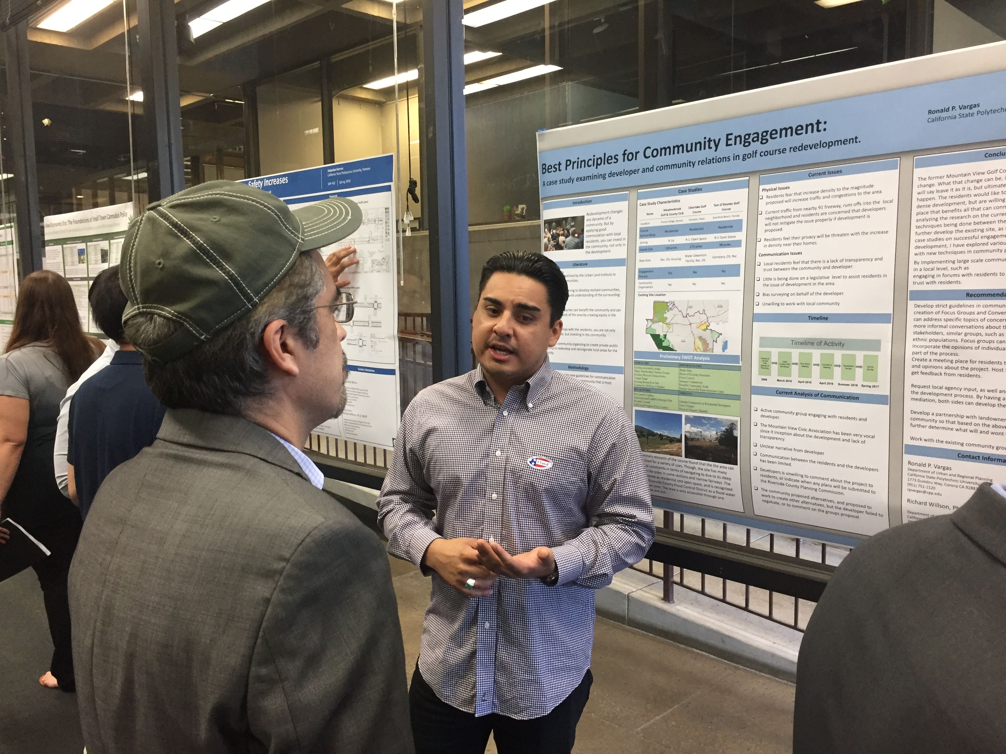
Learning more about work options…
Try different types of work in internships or jobs
Reflect on the appeal of different types
  Read job descriptions
  Find job websites for desired work
  Find respected organizations (awards, media stories, etc.);
  Seek informational meetings and job shadowing
Research types different from your first preference
Develop “elevator pitch” oral presentation on job objective

Slide 26

Making choices
Cultivate a robust and systematic way of making choices
  Not deciding is choosing the status quo
Job choices: apply, accept, and negotiate terms
Practice choices: methods, interactions with stakeholders, compromise or hold firm, comprehensive or incremental progress, etc.

Slide 27
Three steps in choosing
Feelings
Rational thought
Purpose
Philosophers debate this:
  Careful, systematic deliberation, don’t “go with your gut”
  Or, you really know the right course (conscience) immediately and talk yourself out it with deliberation…

Slide 28
Decision tree example
Like job and city
Dislike job, like city
Find new job
Job A – relocation
Quit, start over
Like job, dislike city
Like job
Job B – In your home town
Find new job
Dislike job
Quit, start over

Slide 29
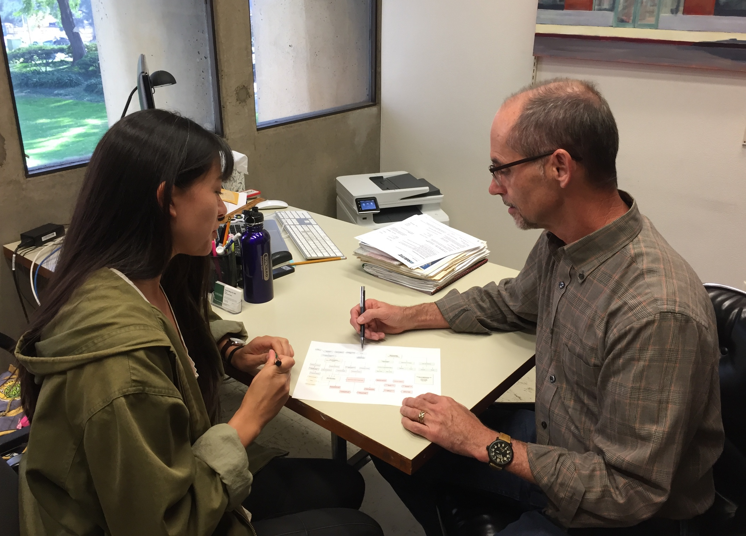
The resume, cover letter, and application game
A game to master
Applicant Tracking Systems (ATS) sort resumes before human review – key words
Apply well to a smaller number of jobs rather than apply superficially to every job
  Research target employer
  Network for word of mouth
  Informational interviews
  Craft a compelling story

Slide 30
The resume
Ten second rule – recruiter needs to “get” your resume in 10 seconds
Pages (1-2), normal fonts, vary font sizes
Use key words from job descriptions, customize to jobs
Job objective not necessary – use skills section (say what you can do)
Limit # bullets describing job duties (3-5)
Put text on a “word diet”
Jobs from most recent to last
  Explain absences from the labor market

Slide 31
The cover letter
Tell a story, provide insights beyond the resume
Don’t repeat the resume – value added
Craft cover letter to each job
Don’t undersell experience outside planning
  Skills in working with people
  Creative solutions, innovation, solving problems
  Multitasking

Slide 32
Interview questions
Why should we hire you?
Why did you choose planning?
Describe a difficult workplace decision and how you made it.
Provide an example of a time you explained a complicated concept.
What is the last book you read for recreation?
What were your favorite and least favorite classes?
Name three strengths in interacting with people and give an example.
What area of planning interests you?
What is a weakness and how do you address it?
How did you prepare for this interview?
What questions do you have for us?

Slide 33
Prepare for interview exams/assignments
Multiple choice tests
Write a short staff report or memo
Interpret a site plan, including measurements
Respond to a scenario
Basic math
Reading and interpretation skills
Employers key concern: writing quality

Slide 34
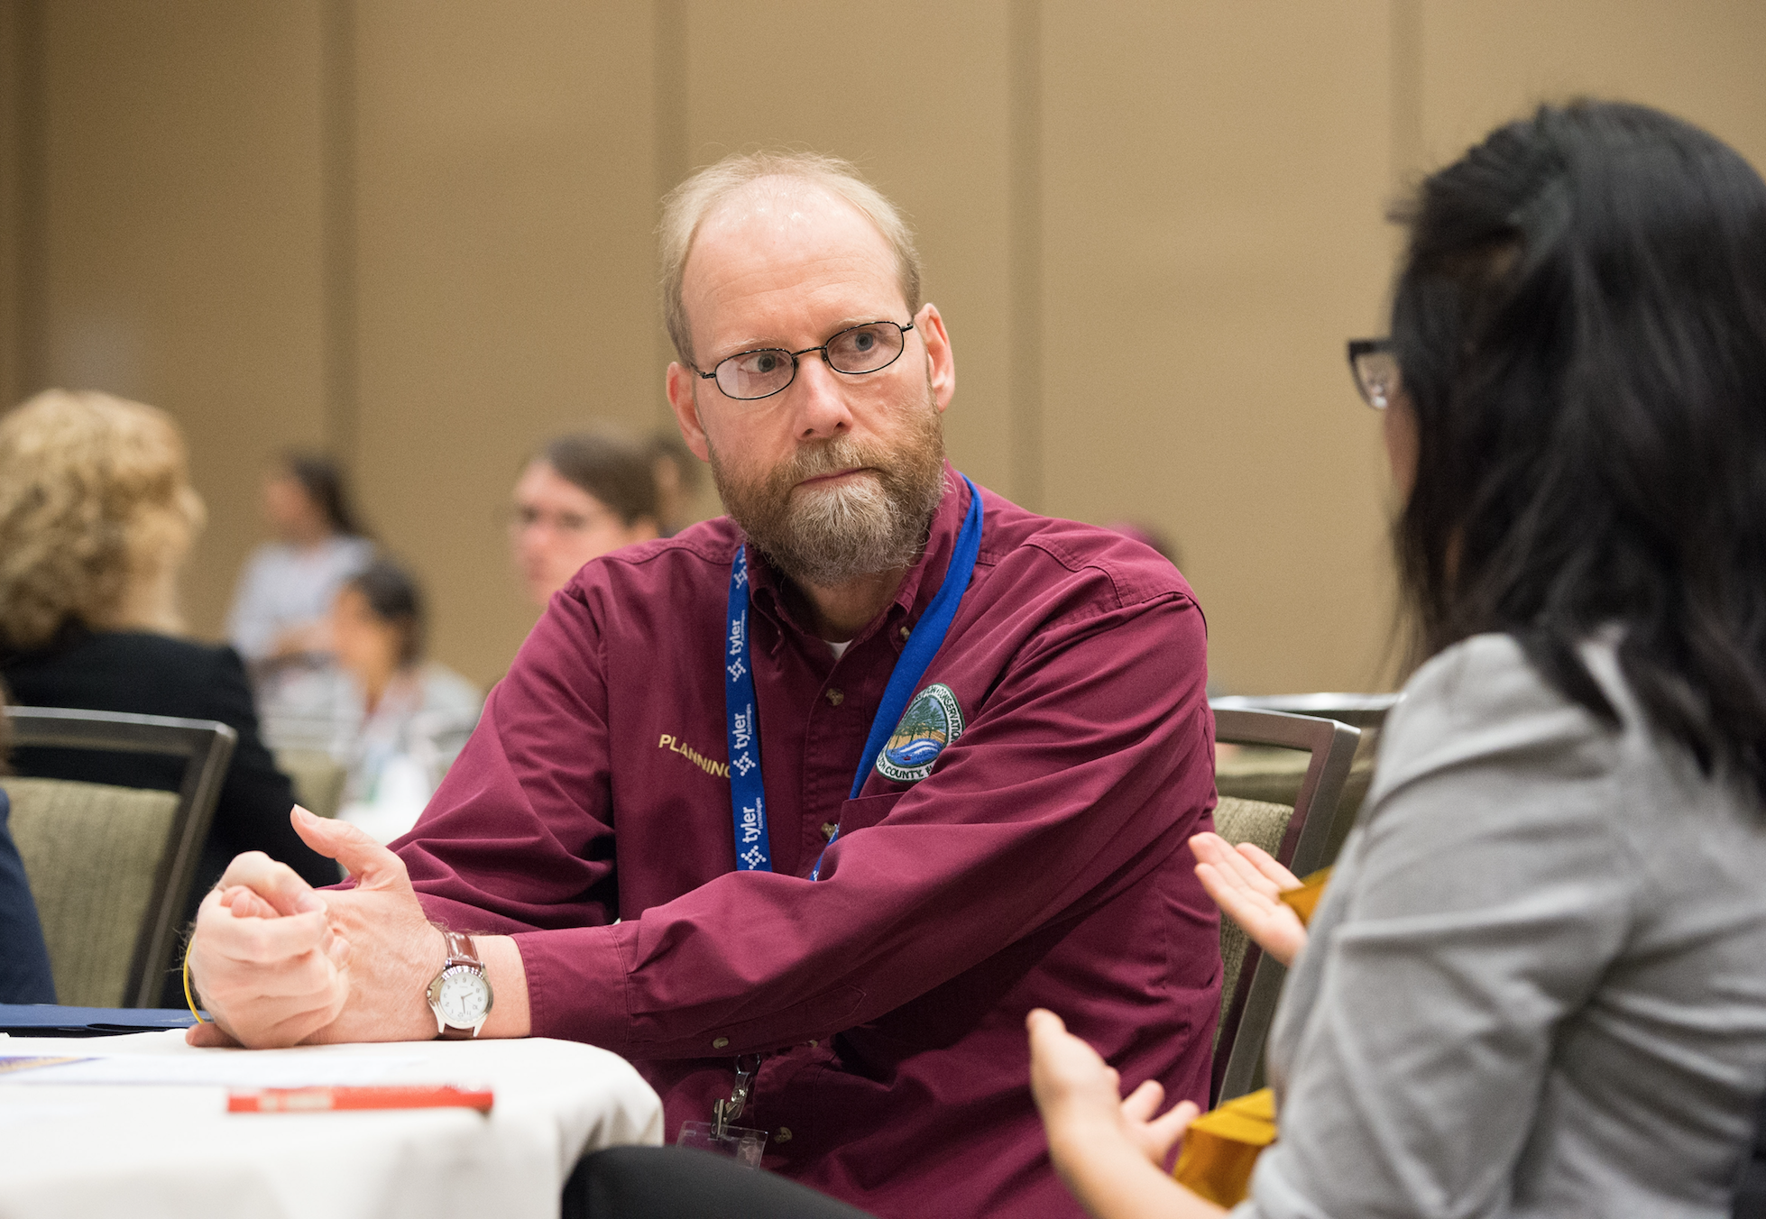
Steps for preparing for an interview, city example
Staff reports
Windshield survey
On-line city newsletter, major development projects
Local media and Nextdoor
Organizational charts
Comprehensive plans, strategic plans, currency of zoning
Look at bios of key staff, alumni connections
Awards won

Slide 35
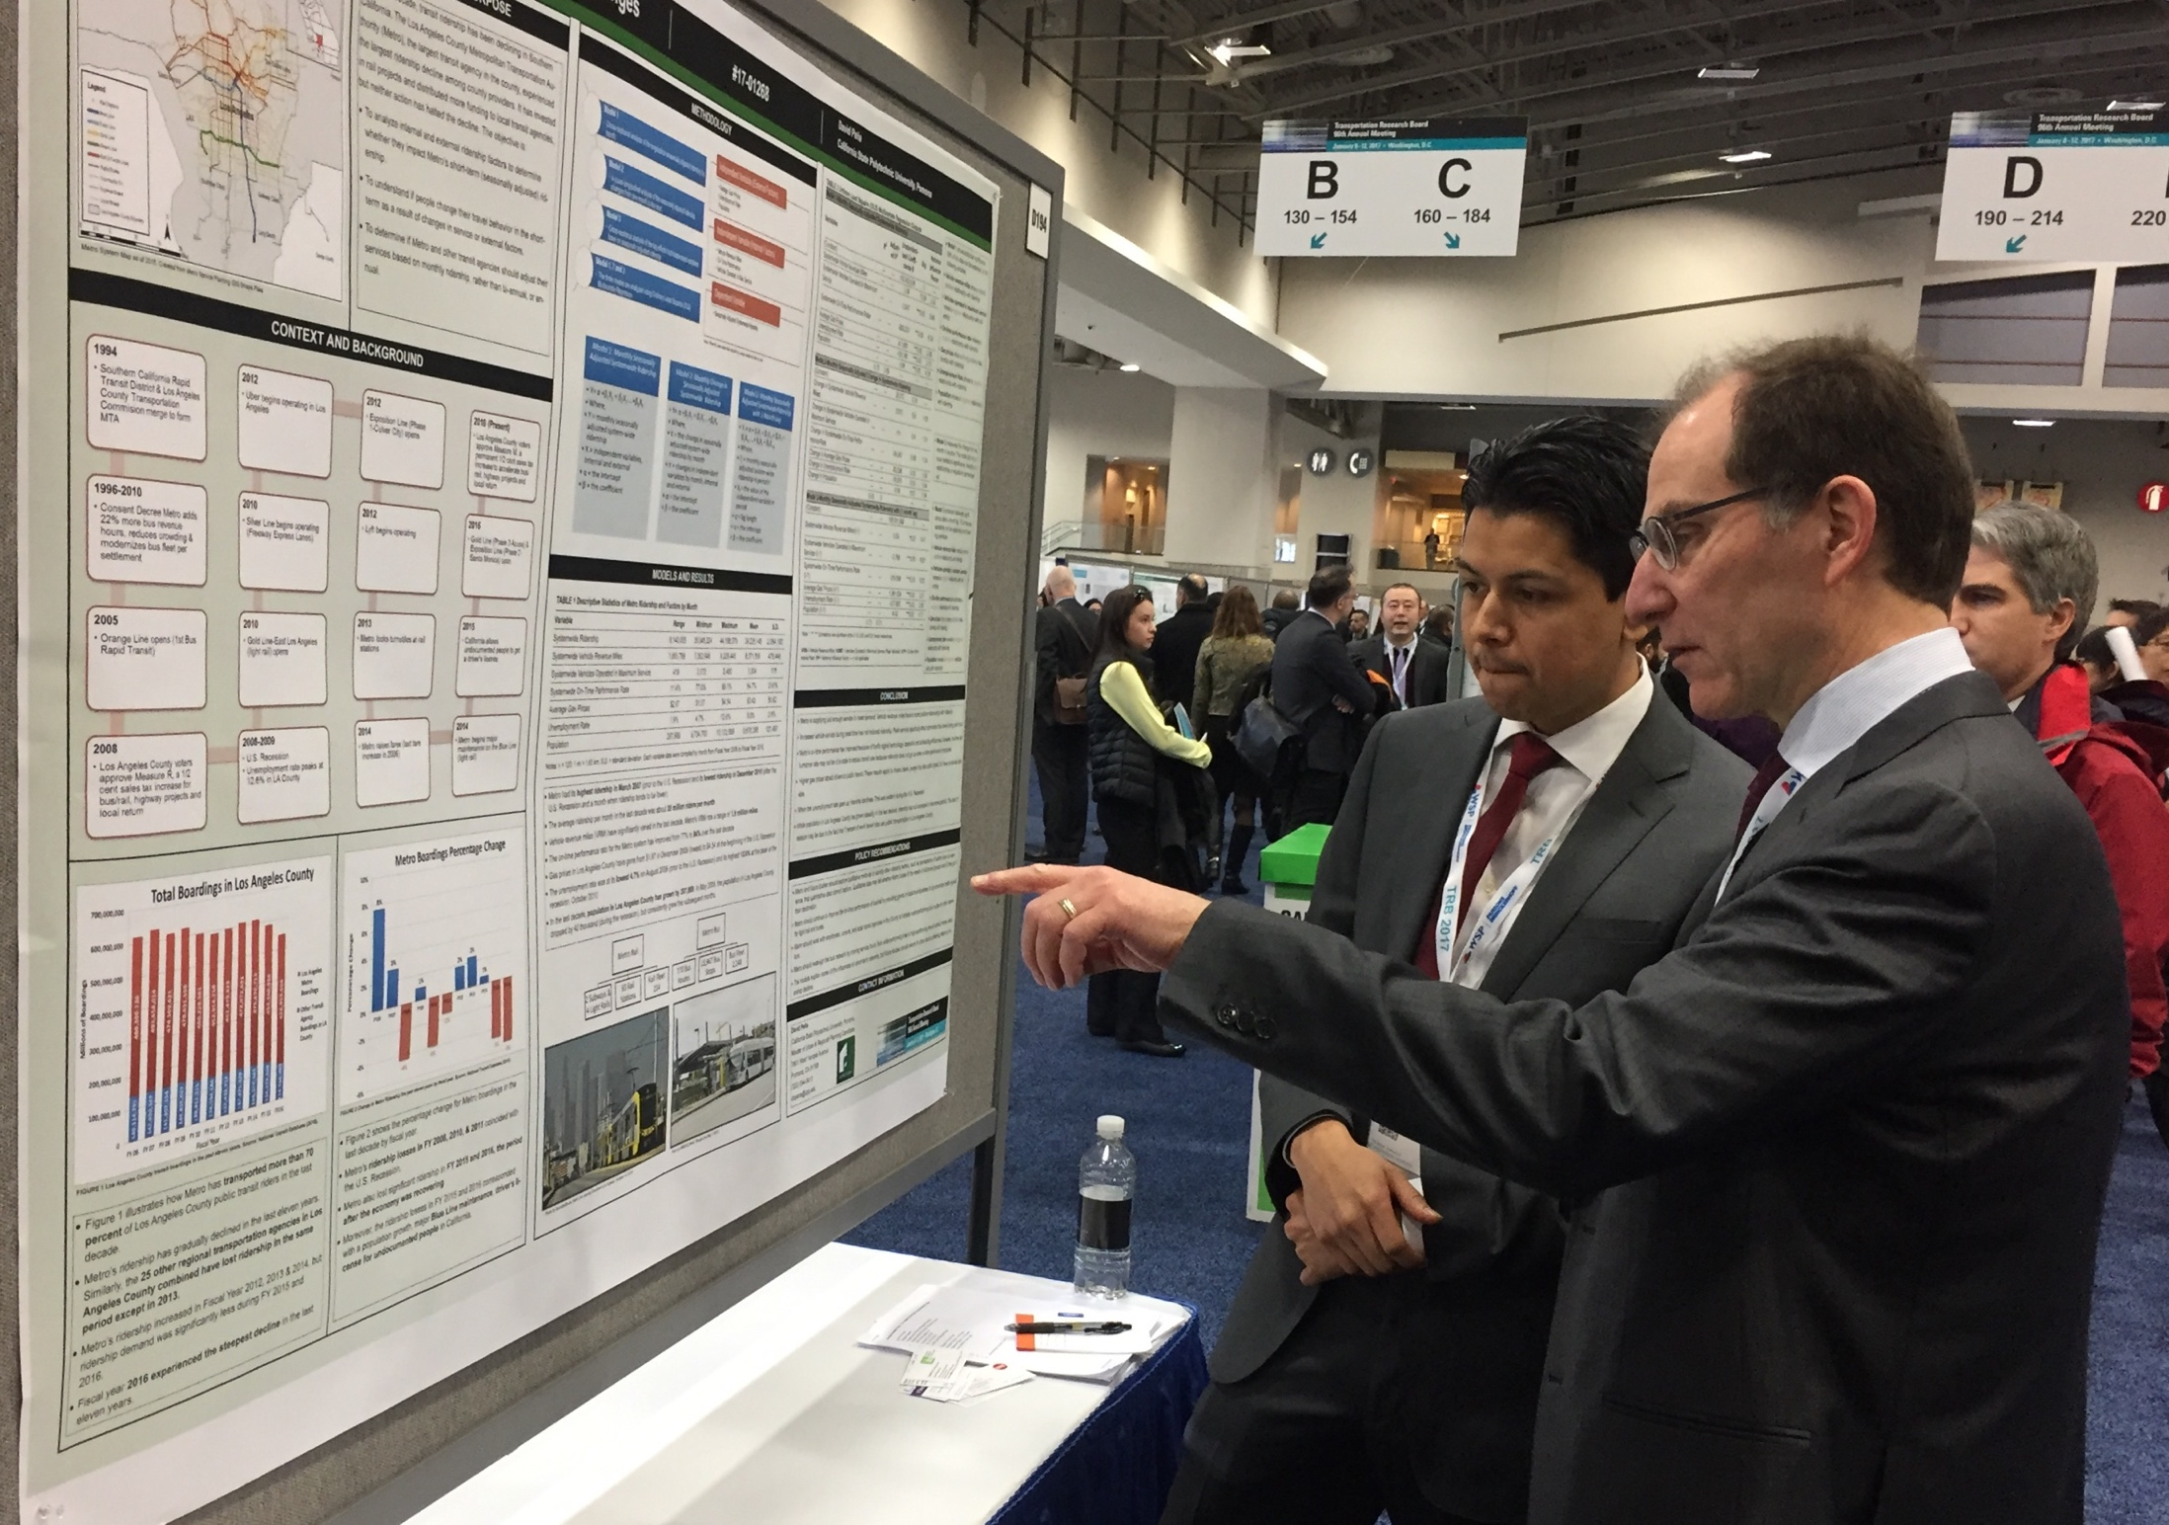
Why is mentoring important?
Transition from school to practice
Professional artistry
Generational change in the profession
Background: Schön’s (1982) “espoused theory” versus “theory in use”

Slide 36
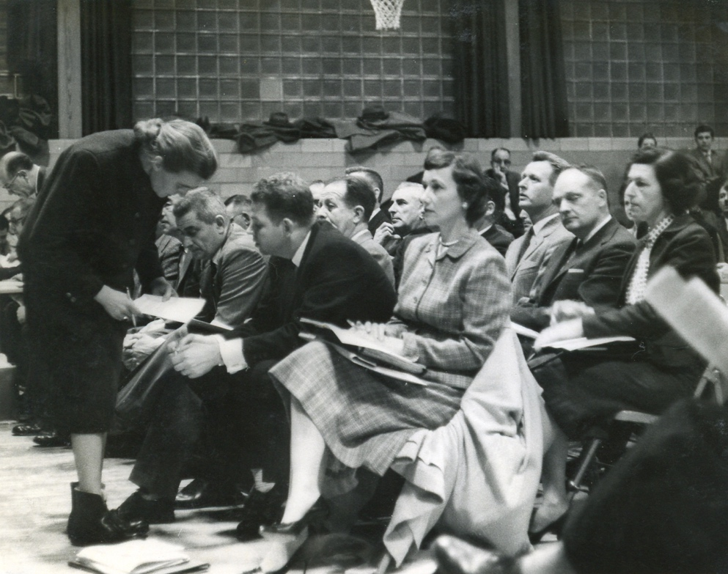
Cultivating and benefiting from mentors
Four type of mentoring
  Launching and re-launching
  Mentor-by-doing
  Professional coach
  Life coach

Slide 37
Where does mentoring occur?
At work, in formal and informal programs
Informally with planning colleagues
Informally in community
Academic programs
Alumni groups of academic programs
APA Career Center, website and conference
Chapter and Section APA programs
Allied professional organizations, e.g., Association of Environmental Professionals, Transportation Research Board, etc.

Slide 38
Tracking your mentors
Mentor name, profession, and position | Start Date/ End Date | What type? (career; mentor-by-doing; life coach) | Involved in evaluation of work performance? | Primary style : supportive, critical, or both? | Formal or informal relationship? | Episodic or long-term? | What are you learning about yourself? | What are you learning about the planning profession?
#1
#2
#3
#4
#5
#6

Slide 39
Job search in six steps
Step 1: Motivating values -> desired type of planning work (people and equity, place and environment, systems and efficiency)
Step 2: Desired type of planning work + preference for form of implementation (build, price, regulate, or educate) -> specific job descriptions
Now filter jobs by…
Step 3. Personal work-style preference (e.g., autonomy, workplace interaction, effort, stability) - > Sector preference (public, private, non-profit),
Step 4. Sector opportunities filtered by organizational size and culture preference.
And then…
Step 5. Acceptable location and commute
Step 6. Track record of organization + advancement opportunities

Slide 40
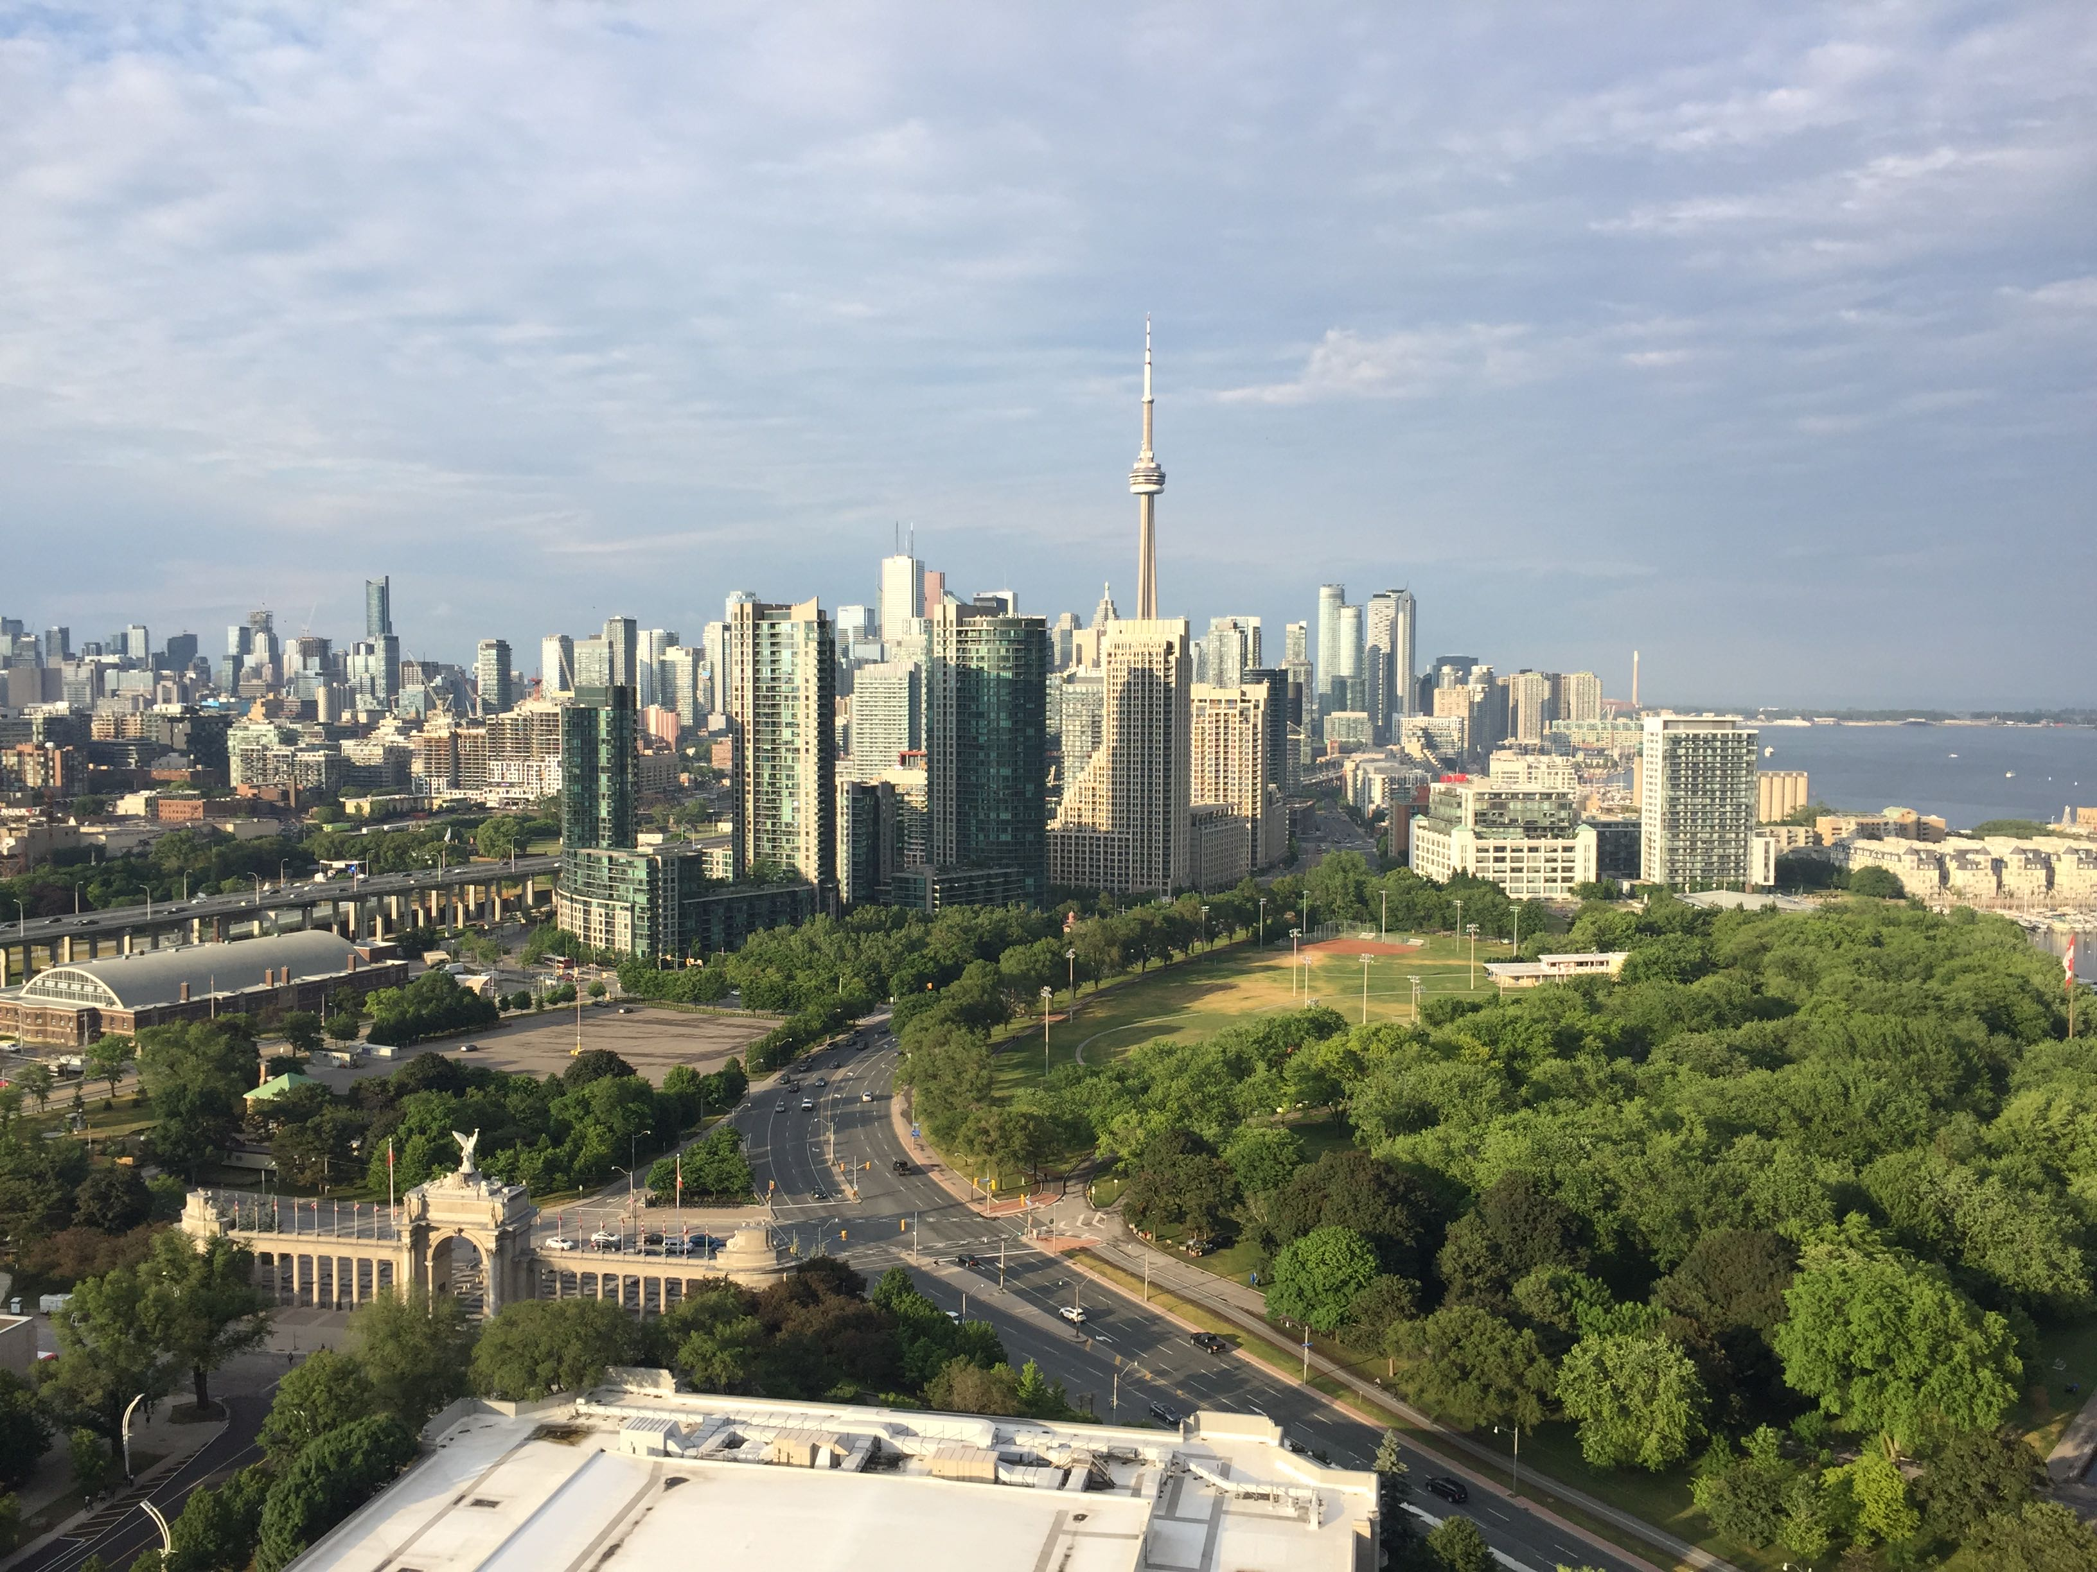
Putting the pieces together
Career plans are useless but career planning is not
  From blueprint to ongoing guidance
Career advancement process
  Pay attention to your experience in current job
  Reflect
  Be attentive to opportunities
Career planning is decision-making under uncertainty

Slide 41
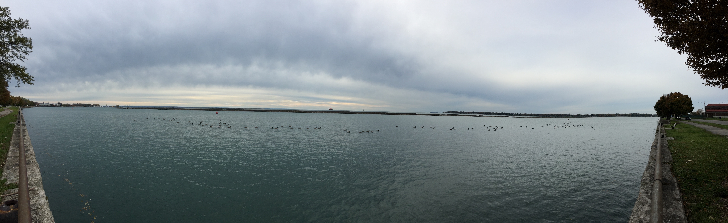
Pause for questions on career launching/relaunching

Slide 42
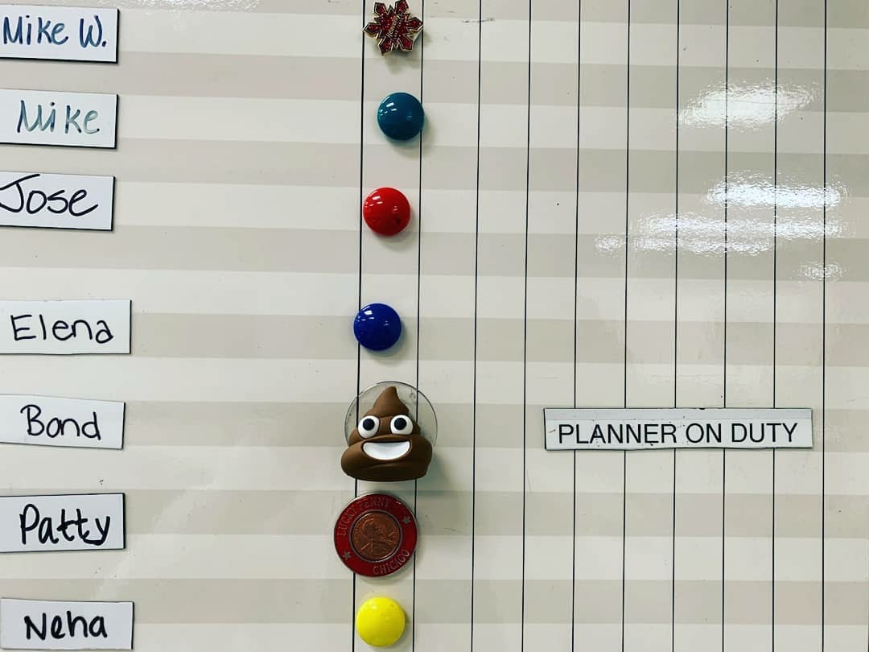
Part II. Early career practice issues

Slide 43

Can theory improve practice?
Yes, but…theories are partial
  Procedural
  Substantive
  Ethical
Most theorists don’t practice

Slide 44
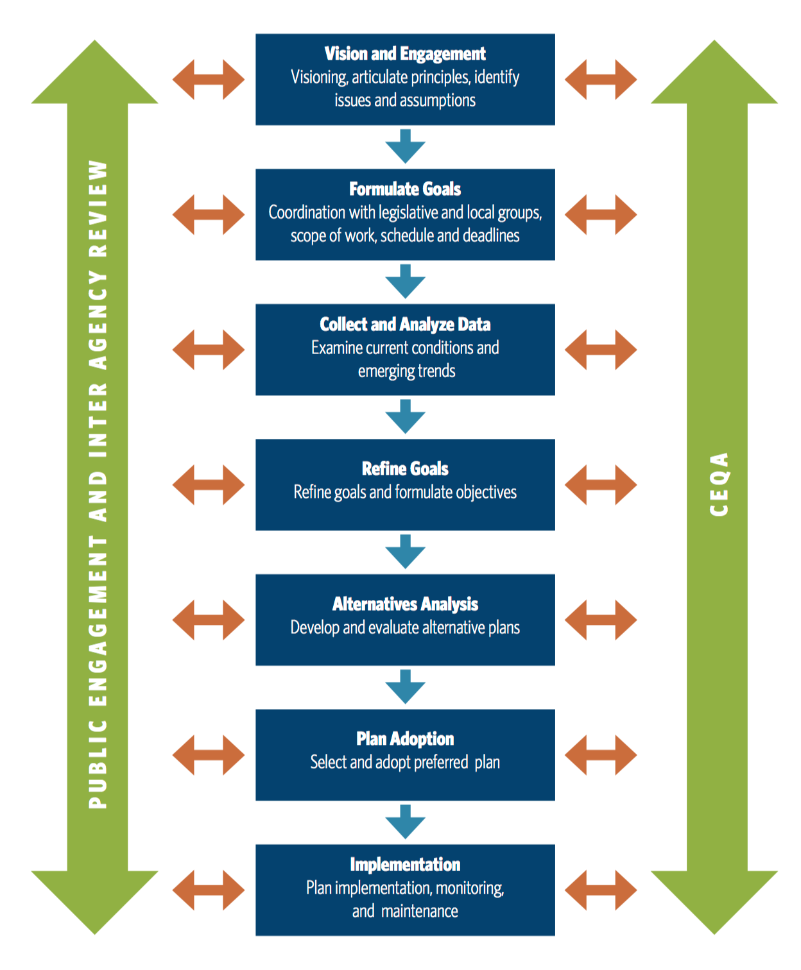
Example procedural rational comprehensive planning
Source: http://opr.ca.gov/docs/OPR_C2_final.pdf

Slide 45
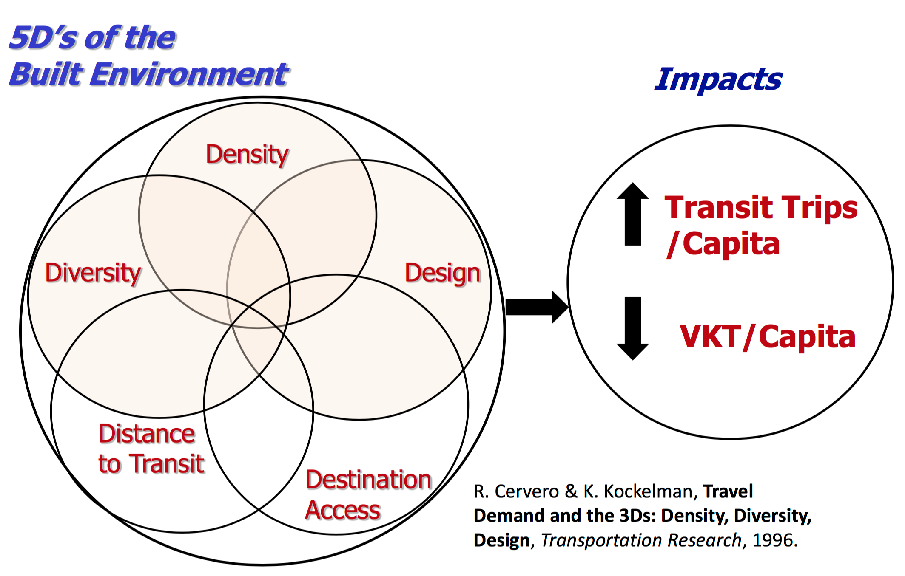
Example substantive theory: 5d’s
Source: http://opr.ca.gov/docs/OPR_C2_final.pdf

Slide 46
Ethical theory example: AICP Code of Ethics
Aspirational principles – ideals to which AICP planners strive. Failure to achieve these principles is not a violation
Rules of conduct – rules to which AICP members are held accountable
Procedural provisions – what to do if there is a violation
Ethical reasoning capability at a personal level
For more information: https://planning.org/ethics/ethicscode/

Slide 47
Ethical theory example: ASCE Code of Ethics
Hold safety paramount
Service with competence
Issue true statements
Act as a faithful agent
Reputation by merit
Uphold profession honor
Continue professional development
Treat all people fairly
For more information: https://www.asce.org/code-of-ethics/

Slide 48
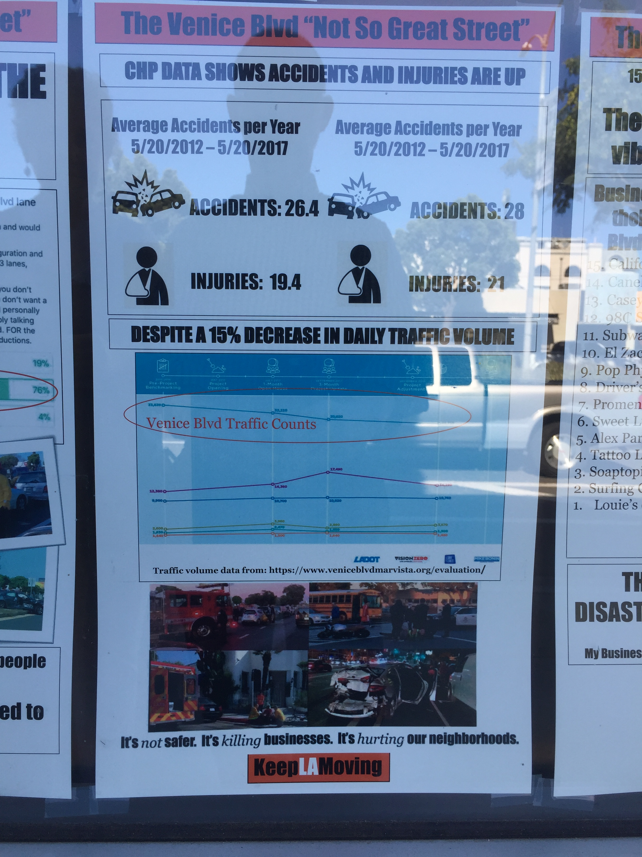
Theory-in-use
Professionals craft a theory-in-use as they go (Schön)
Move from technique to reflection-in-practice
Practitioners embroiled in uncertainty, complexity, instability, uniqueness, and value conflict
No single theory can suffice
Schön, D. (1983). The Reflective Practitioners: How Professionals Think in Action

Slide 49
Less effective
More effective
Less effective
Each planning engagement begins anew…

Slide 50
Less effective
More effective
Less effective
Philosophical approach
Each planning engagement begins anew…
Idealist
Realist

Slide 51
Less effective
More effective
Less effective
Philosophical approach
Each planning engagement begins anew…
Doctrinaire
Nihilist
Idealist
Realist
Dreamer
Hedonist

Slide 52
Less effective
More effective
Less effective
Philosophical approach
Each planning engagement begins anew…
Doctrinaire
Nihilist
Idealist
Realist
Dreamer
Hedonist
Planning style
Agenda-driven
Principled adaptability
Technocratic

Slide 53
Less effective
More effective
Less effective
Philosophical approach
Each planning engagement begins anew…
Doctrinaire
Nihilist
Idealist
Realist
Dreamer
Hedonist
Planning style
No-compromise, zero-sum
Agenda-driven
Principled adaptability
Technocratic
Passive, status quo

Slide 54
Less effective
More effective
Less effective
Philosophical approach
Each planning engagement begins anew…
Doctrinaire
Nihilist
Idealist
Realist
Dreamer
Hedonist
Planning style
No-compromise, zero-sum
Agenda-driven
Principled adaptability
Technocratic
Passive, status quo
Personal outcomes
Motivation and resilience

Slide 55
Less effective
More effective
Less effective
Philosophical approach
Each planning engagement begins anew…
Doctrinaire
Nihilist
Idealist
Realist
Dreamer
Hedonist
Planning style
No-compromise, zero-sum
Agenda-driven
Principled adaptability
Technocratic
Passive, status quo
Personal outcomes
Burnout
Motivation and resilience
Checkout
Ethical
rigidity
Ethical avoidance

Slide 56
Less effective
More effective
Less effective
Philosophical approach
Each planning engagement begins anew…
Doctrinaire
Nihilist
Idealist
Realist
Dreamer
Hedonist
Planning style
No-compromise, zero-sum
Agenda-driven
Principled adaptability
Technocratic
Passive, status quo
Personal outcomes
Burnout
Motivation and resilience
Checkout
Ethical
rigidity
Ethical complexity:
virtue - deontic - utilitarian
Ethical avoidance

Slide 57
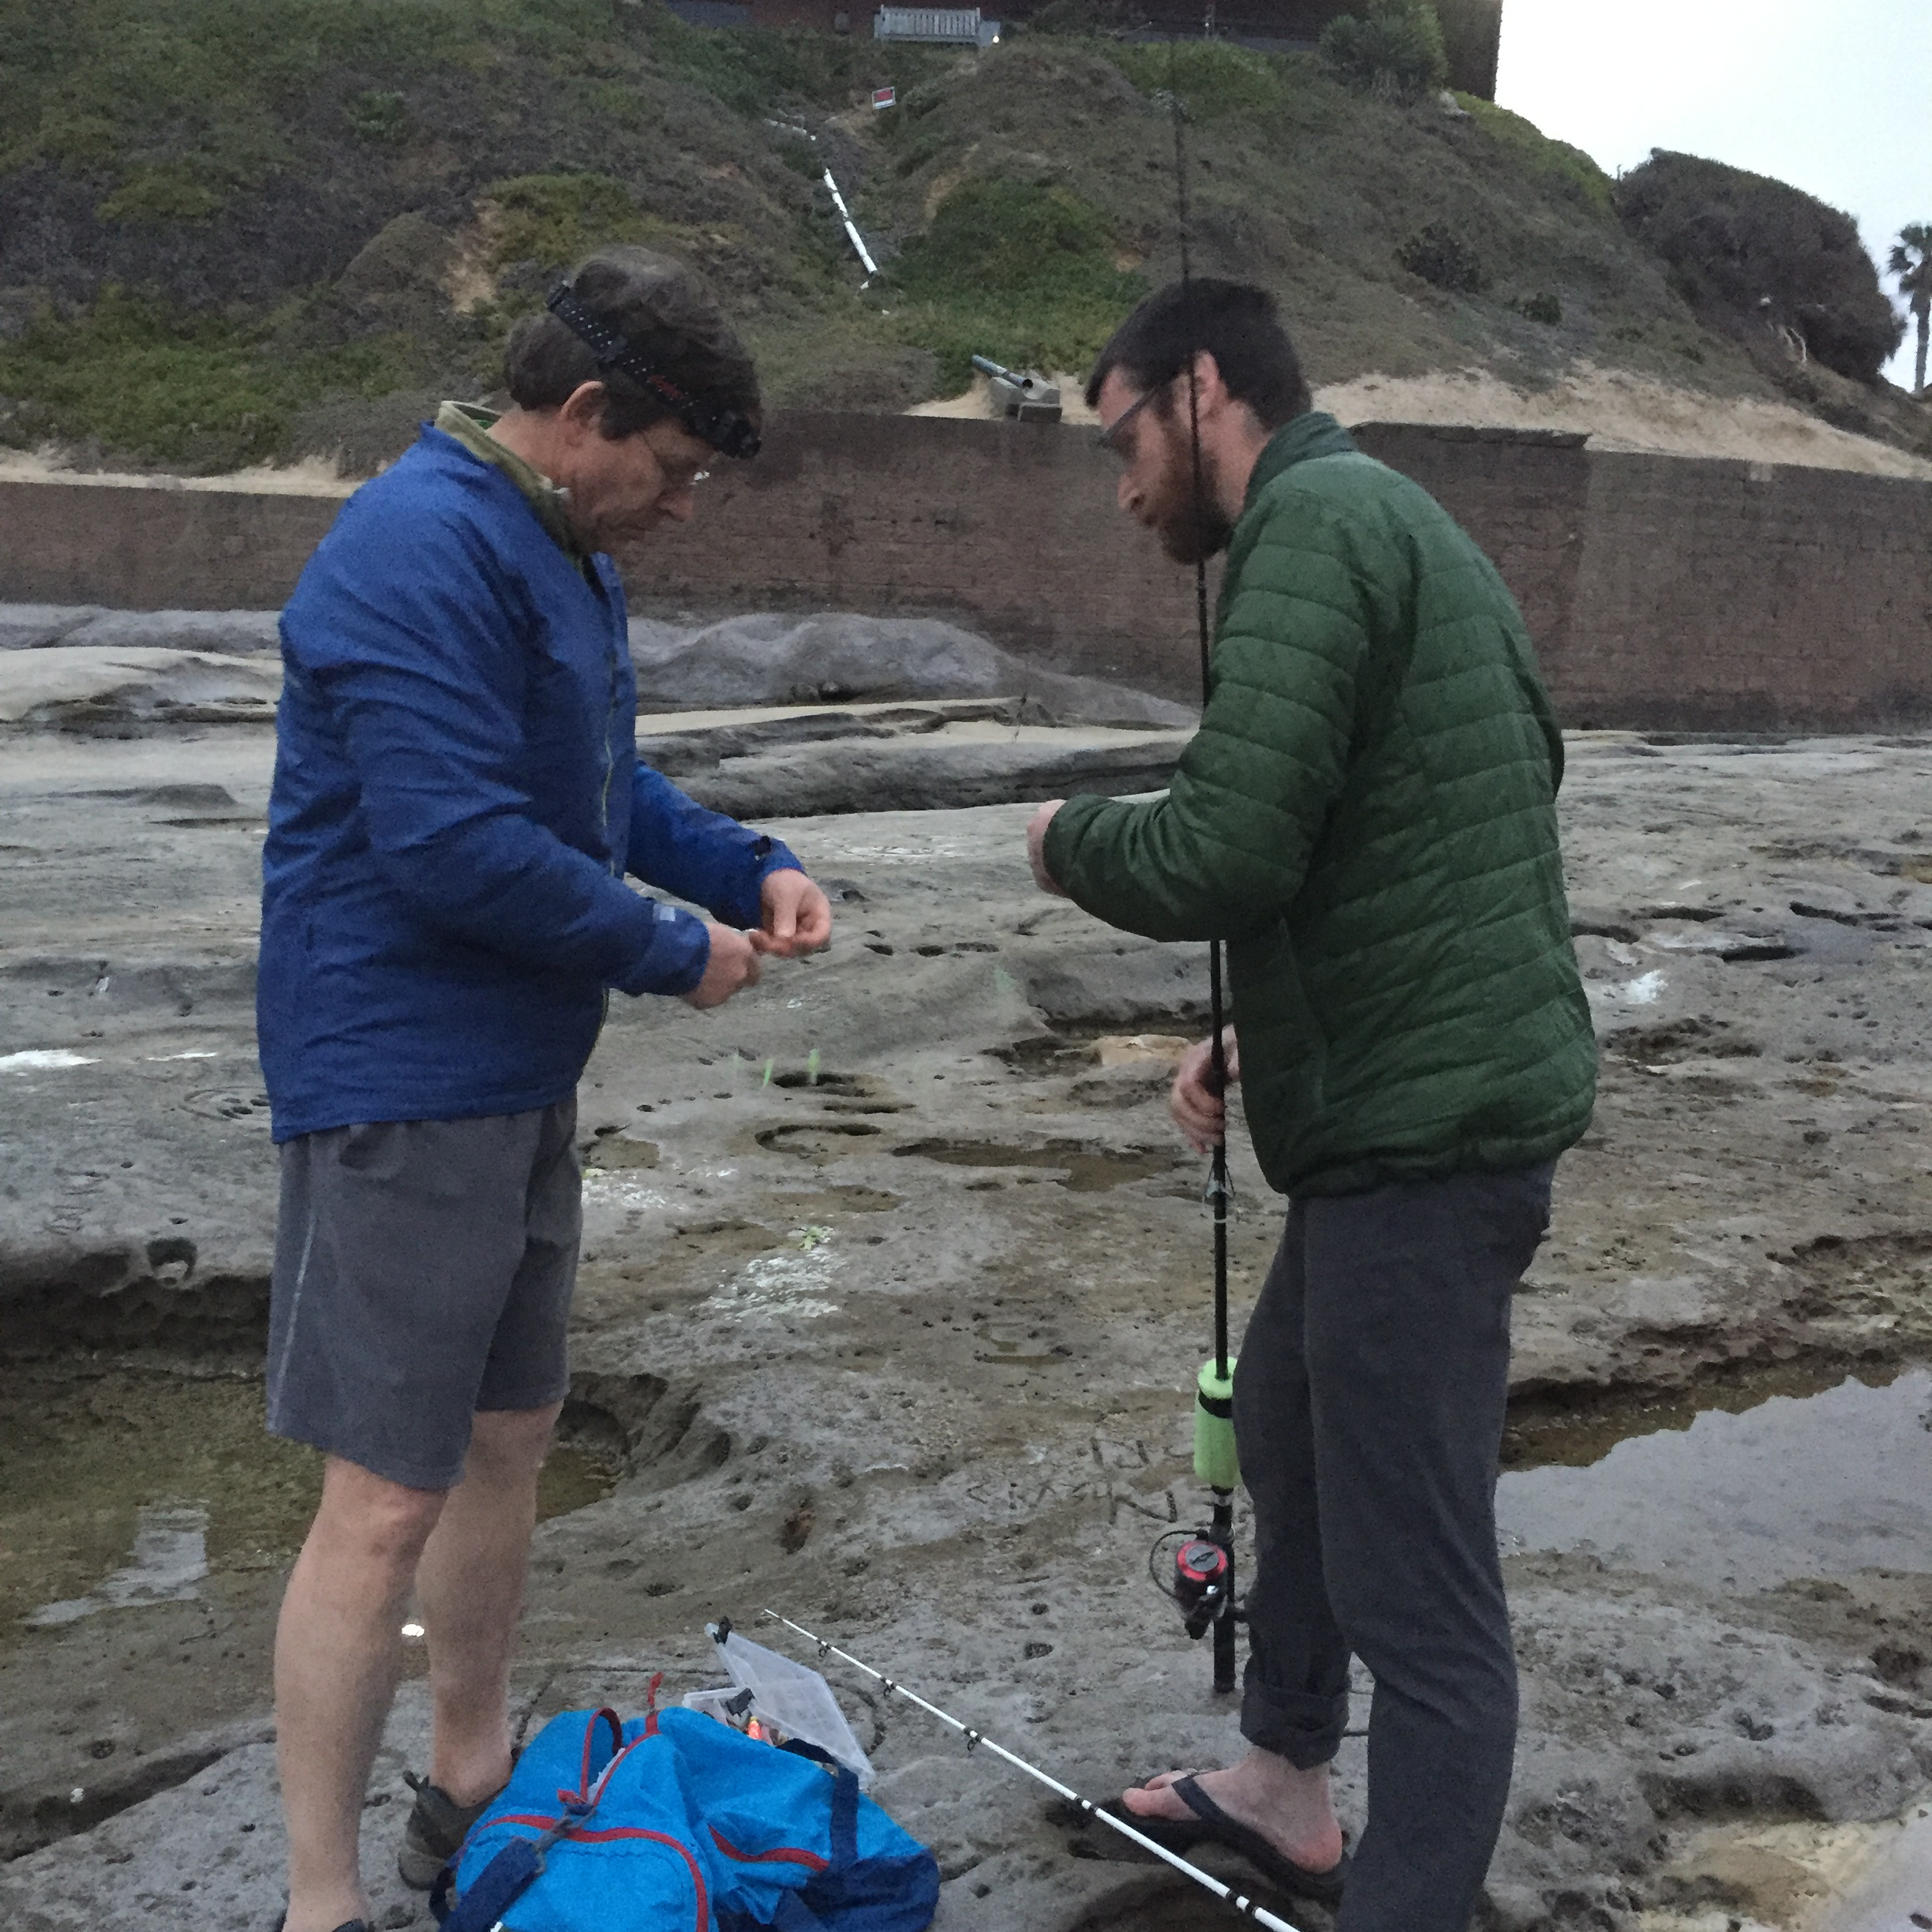
Being right
Right in relation to?
Supervisor
Colleagues
Client/decision-maker
Right about what?
Values
Technical matters
Means
Tactics
Next slides review different “I’m right” situations

Slide 58
Issue | Example | Nature of the disagreement
Social justice | Financial analyst is directed to redeploy budget from “owl” transit service that supports many low income service workers towards an high income neighborhood demanding new services | Value disagreement
Environmental sustainability | Project manager considers a wetland a “useless” swamp and directs design engineer to develop a project that leads to its degradation, while the design engineer wants to preserve it | Value and technical disagreement

Slide 59
Issue | Example | Nature of the disagreement
Social justice | Financial analyst is directed to redeploy budget from “owl” transit service that supports many low income service workers towards an high income neighborhood demanding new services | Value disagreement
Environmental sustainability | Project manager considers a wetland a “useless” swamp and directs design engineer to develop a project that leads to its degradation, while the design engineer wants to preserve it | Value and technical disagreement
Rail transit development | Planner is directed to support a regional transit agency’s sale tax measure that focuses on rail transit rather than bus rapid transit, in opposition to research on cost effectiveness modes and needs of transit users | Problem frame and technical disagreement
Cost effectiveness | A client directs consultants to ‘buy’ support for initiatives by providing community benefits for a wide range of stakeholder groups, even if the extra elements are only tangentially relate to the main proposal | Tactic disagreement

Slide 60
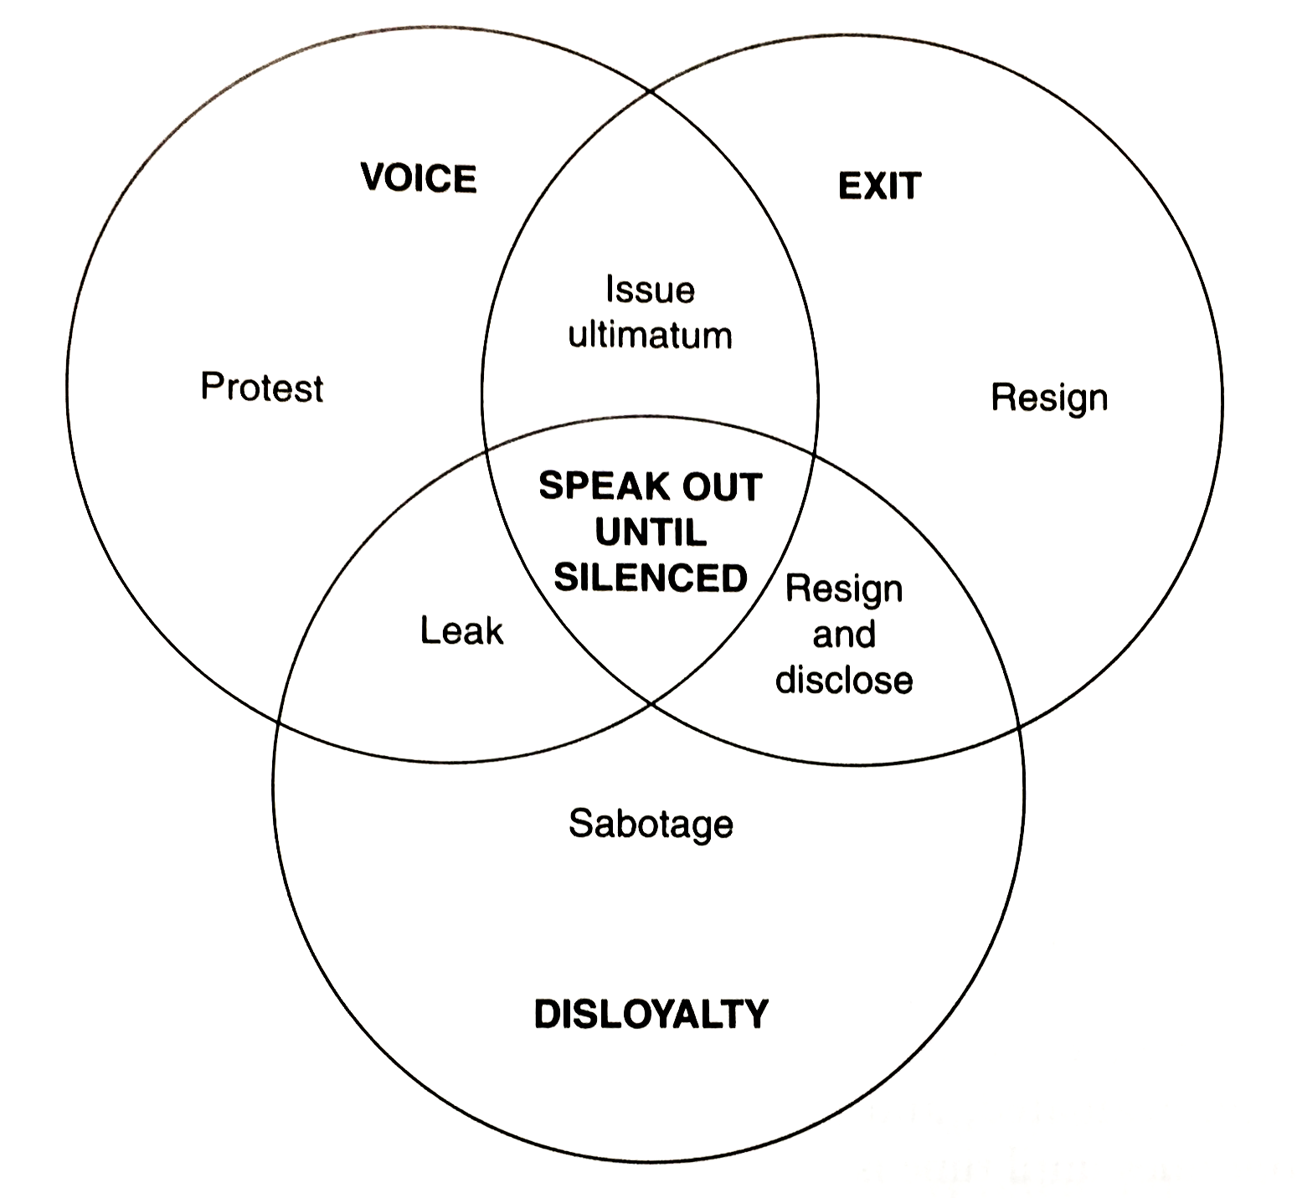
Options if you are sure you’re right
Weimer, D. and A. Vining. 1992. Policy Analysis: Concepts and Practice.

Slide 61
Process for ethical reasoning
Sense a pang of conscience, either before or after an action
Use a moral reasoning process
Avoid the mistake or make amends if it has already occurred.

Slide 62

How to think about the choices
Allow time for emotions to calm
Consider a “police report” – the context, the facts, external factors
Critically analyze competing ethical principles
Analyze alternative actions
Make a judgment, step back and reconsider ethical principles, adjust judgment
Iterate between judgments and principles – that is moral reasoning!

Slide 63

Navigating supervisors, organizations, and teams
Understanding the supervisor’s perspective
Organizational culture and norming
Teams and personality styles

Slide 64
Understanding supervisors
Recognize differences: generational,
Differences in context knowledge
Empathy for the manager’s situation
Pushing back on inappropriate manager behavior

Slide 65
Supervisor communication styles
Too many questions versus not enough
Preferred communication styles
Level of formality and respect for hierarchy
What supervisor challenges mean (attacking/testing/teaching/seeking?)

Slide 66
Putting the pieces together
Real-time career navigation
Your obligation: moral reasoning
At stake: credibility, influence, and power
Success, for what end?
Reflection

Slide 67
Resources
Transportation Research Board
Women’s Transportation Seminar
Transportation Division of the American Planning Association
Institute of Transportation Engineers
Leadership NACTO
APTA Emerging Leaders Program
Employer programs
APA blog: Launching Your Planning Career: A Guide for Idealists
A Guide for the Idealist: Launching and Navigating Your Career (Routledge 2018)

