Slide 1

Emergency Planning / Business Continuity Plans for​ Railroads​
Planning for Extreme Events​

Slide 2

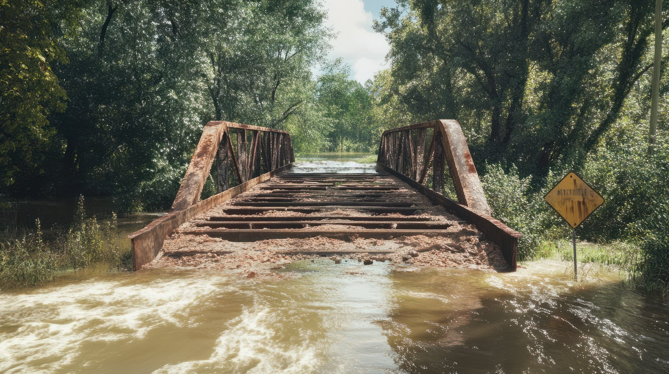
What is business continuity planning for railroads?​
An effort to foresee unwanted events and determine how the organization can prepare for, respond to and recover from them.
Bridge in Fries, Virginia after Hurricane Helene.​
Source: Adobe Stock​

Slide 3

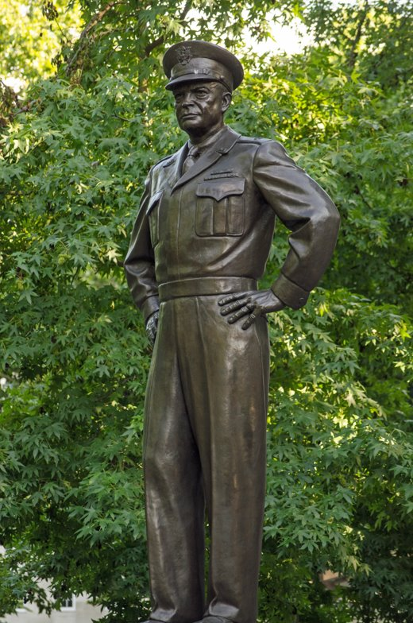
General Dwight Eisenhower said:​
“Plans are worthless, but planning is everything. There is a very great distinction because when you are planning for an emergency you must start with this one thing: the very definition of “emergency” is that it is unexpected, therefore it is not going to happen the way you are planning.”​
Statue of General D.W. Eisenhower.​
Source: Adobe Stock​

Slide 4

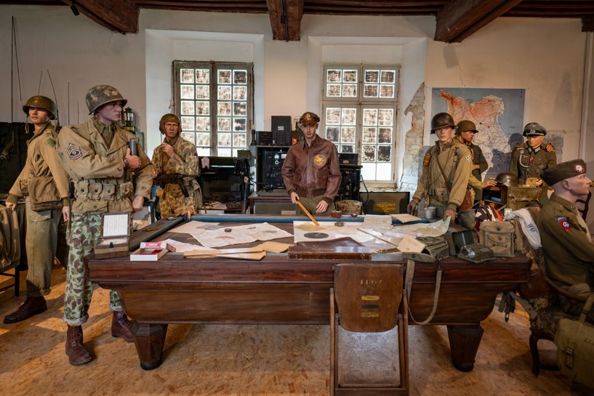
President Dwight Eisenhower​
“The details of a plan which was designed years in advance are often incorrect, but the planning process demands the thorough exploration of options and contingencies. The knowledge gained during this probing is crucial to the selection of appropriate actions as future events unfold.”​
General Eisenhower and Staff Diorama.​
Source: Adobe Stock​

Slide 5

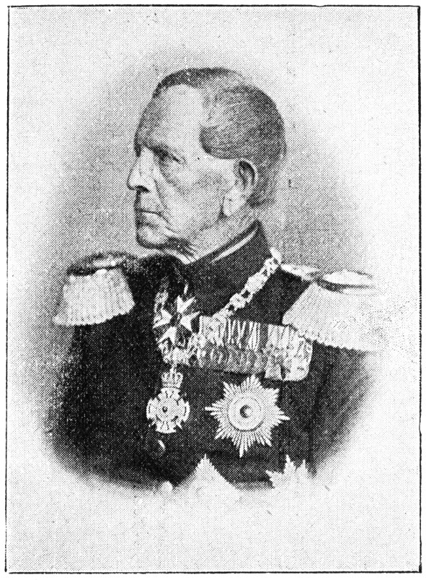
Field Marshal von Moltke​
​1871: “No plan survives first contact with the enemy.”​
Our “enemies” are usually forces of nature or technology that we have had to estimate in advance.​
  Building codes are based on the “design earthquake” – the largest that we can imagine​
Portrait of Field Marshal​ Von Moltke​
Source: Adobe Stock​

Slide 6

Steps in ​Emergency Planning​
Inventory the hazards​
  Natural​
  Technological​
  Human-caused​
Estimate the vulnerabilities​
  Property and infrastructure at risk​
  Old construction, old materials, wrong metallurgy for the heat, wrong location​
Determine the consequences​
  When the hazard occurs, what will the consequences to the railroad be? Loss of track, loss of rolling stock, debris on the track, loss of power for signals?​
Consider the criticality​
  Are there alternate routes?​
  How much will those routes extend travel time?​
  Is there freight on the line that will be damaged or destroyed by the delay?​
Determine the alternatives to the extreme event​
  Can protective measures be taken now to prevent impacts in the future?​

Slide 7
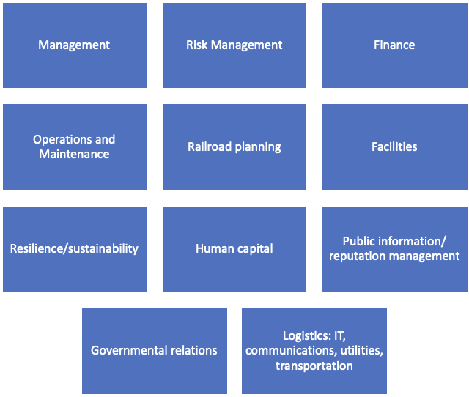
Emergency Operations Plan: Organization-wide​
The Emergency Operations Plan is created to respond to the greatest threats to the organization’s assets.​
The threat analysis, sometimes called THIRA, is the basis for developing the emergency plan.​
Then, products are planned for the enterprise level of response and the field level of response.​
  NWS and USGS might be invited to offer scientific information.​

Slide 8
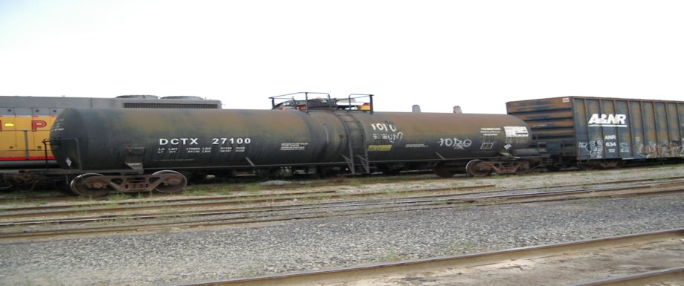
Emergency Planning​
Plan guidance is available​
CPG 101 – federal format​
Business continuity plan guidance is available at Ready.gov, and includes hazard-specific checklists​.
Plan needs updating on regular schedule​
  Up to date? Correct? Appropriate? Thorough?​
Hazardous materials cars on a siding in Mojave, California.​
Source: Edwards​

Slide 9

State-Level Notification Points
Collect notification information for each state warning center and document it in the plan.
Ready access to state warning center numbers will speed contact and get help to the railroad extreme event more quickly, saving lives and protecting property.
Public safety answering point.
Source: Adobe Stock.

Slide 10
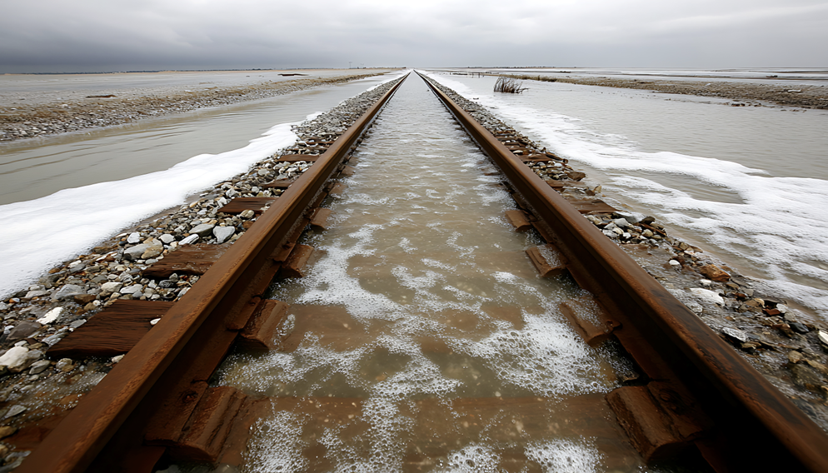
Risk Management: Insurance
Enterprise-wide insurance policies that are in place may cover some of the damage from extreme events.
Flood insurance is usually a separate policy with coverage for buildings.
Railroad Protective Liability Insurance covers some extreme events when the railroad causes damage to others.
Natural disaster coverage is a separate policy. For example, Amtrak got $275 million to cover future damage from events like Hurricane Sandy.
Storm surge over tracks in Hurricane Sandy
Source: Adobe Stock

Slide 11
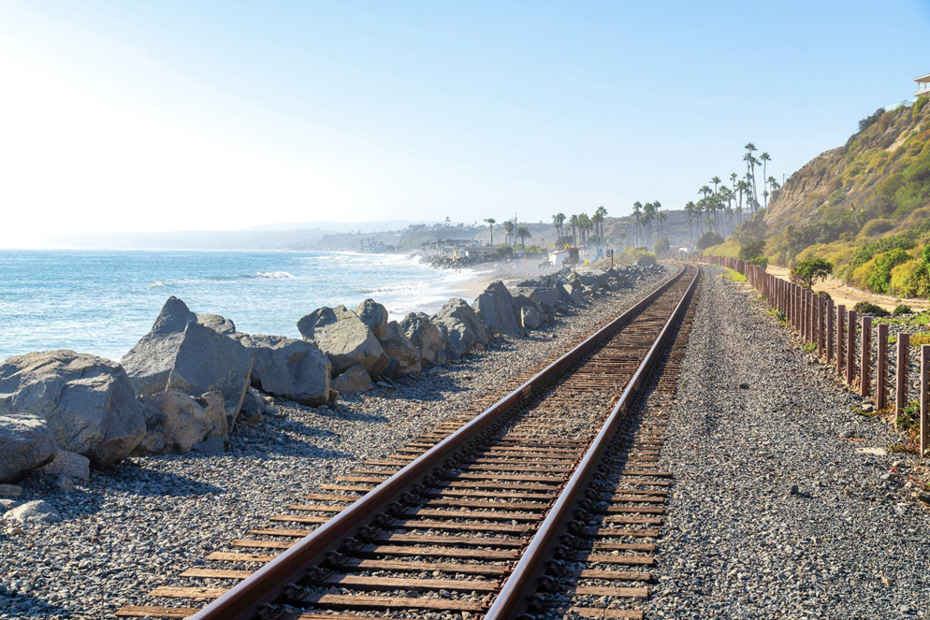
Risk Management:
Adaptation
Adaptation to extreme events means investing in capital projects that protect railroad property and changing the way railroad activities are conducted.
Decisions on which projects to build will depend on economic analyses like cost/benefit and return on investment.
Amtrak’s Future project is relocating some portions of its Northeast Corridor track inland to avoid rising water tidal puddles in the short run and sea level rise in the long run.
Sea wall constructed along the coast to protect the railroad line from storm surge.
Source: Adobe Stock

Slide 12
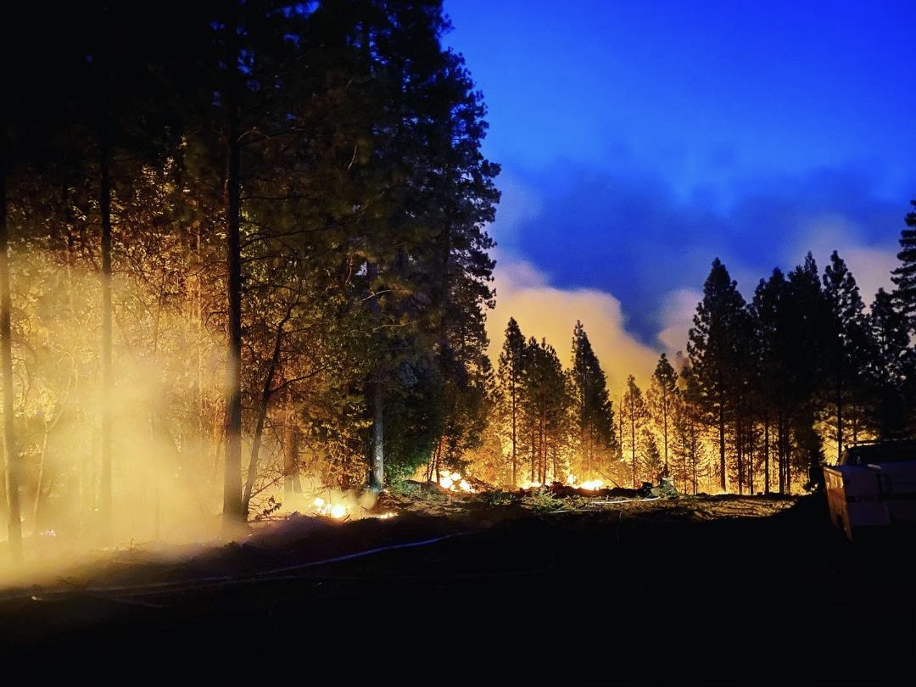
Risk Management:
Adaptation
Sometimes adaptation involves changes to the way assets are managed or used.
Union Pacific and BNSF have created special trains that carry 30,000 gallons of water to fight fires along the track.
Brush clearance along the track can prevent wildfires from starting due to sparks from train wheels.
Wildland firefighting, 2020
Source: Sgt. Galen Yusufzai-Boggs, California National Guard

Slide 13
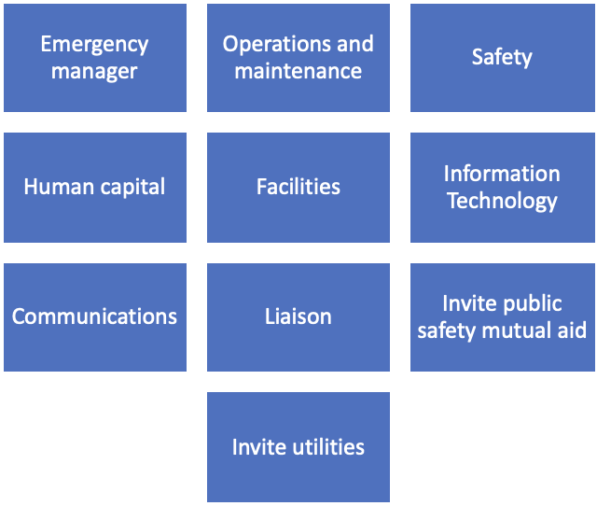
Emergency Operations Plan: Division/Subdivision
The Emergency Operations Plan is created to respond to the greatest threats to the division or subdivision.
The THIRA spreadsheet created at the organizational level indicates the threats of greatest concern to the division.
Products are developed for the field level of response.
Public safety mutual aid leaders for the subdivisions should be invited to provide information to the emergency planning committee. Each county will usually have its own mutual aid coordination system.
Utility companies should be invited to explain their adaptation activities and response capabilities.
Typical Division/Subdivision Level Emergency Planning Committee Membership

Slide 14
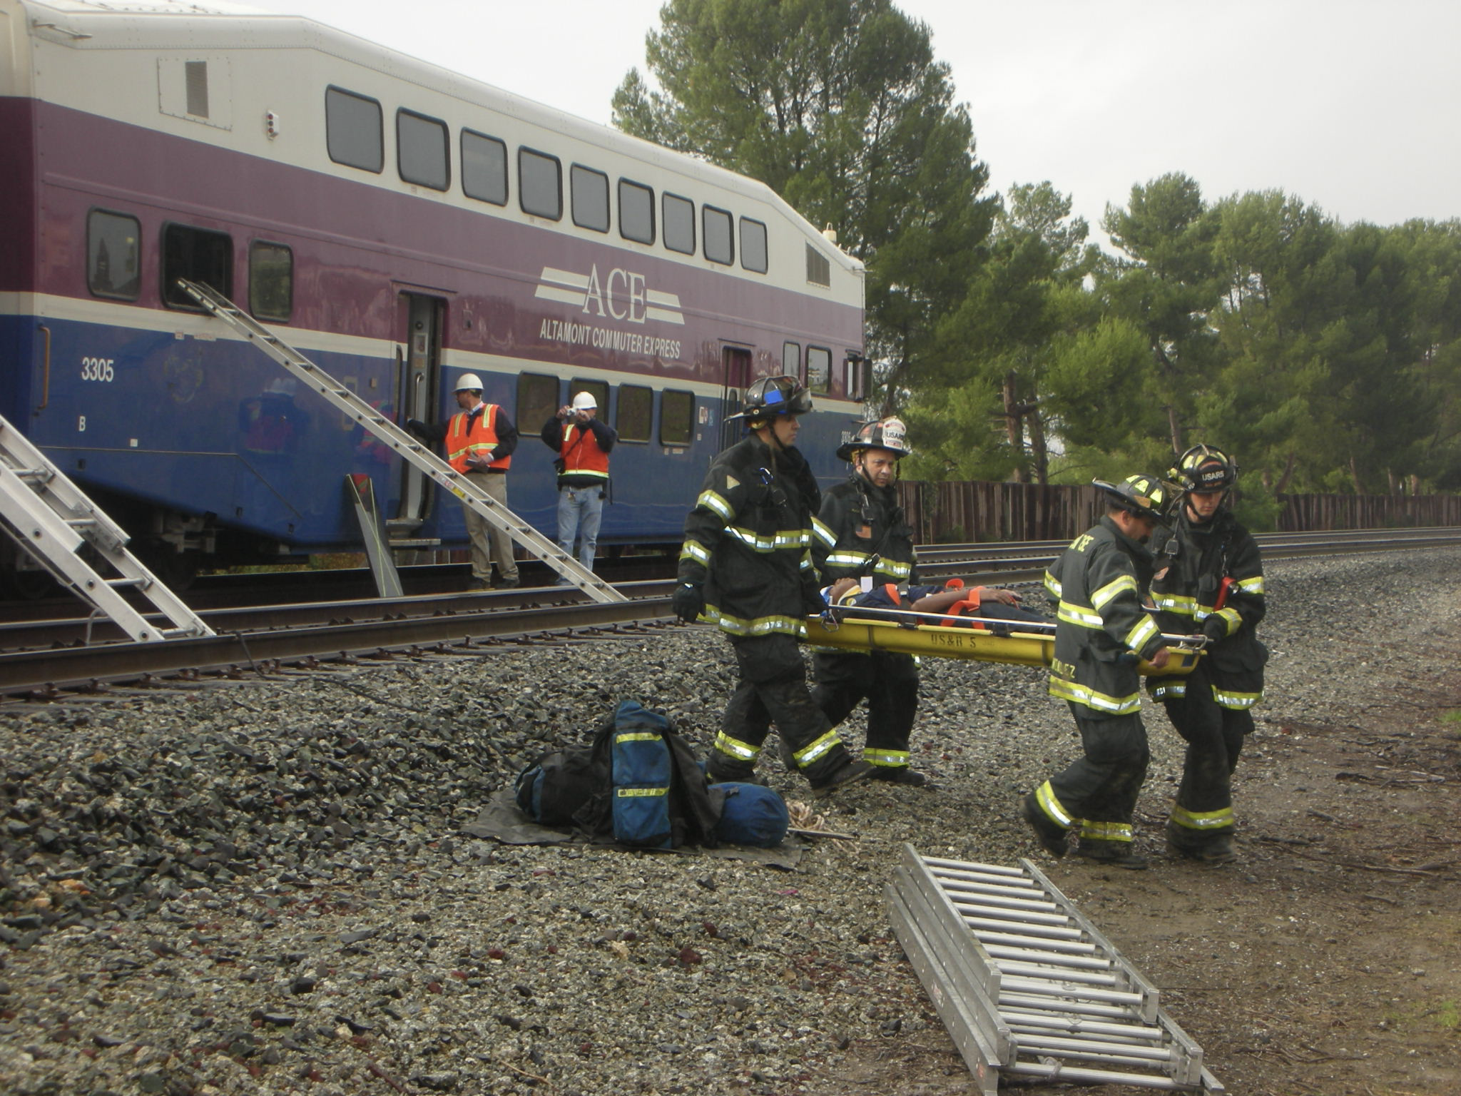
Emergency Operations
Plan: Division/ Subdivision
Even large city fire departments may have little understanding of how railroad equipment and systems work.
Offering railroad familiarization to local law enforcement and fire personnel before an emergency will lead to a more successful outcome when an extreme event occurs. These firefighters were taught how to open emergency access windows and extricate victims as part of an exercise.
Joint exercise with railroad and fire
department personnel.
Source: Edwards

Slide 15
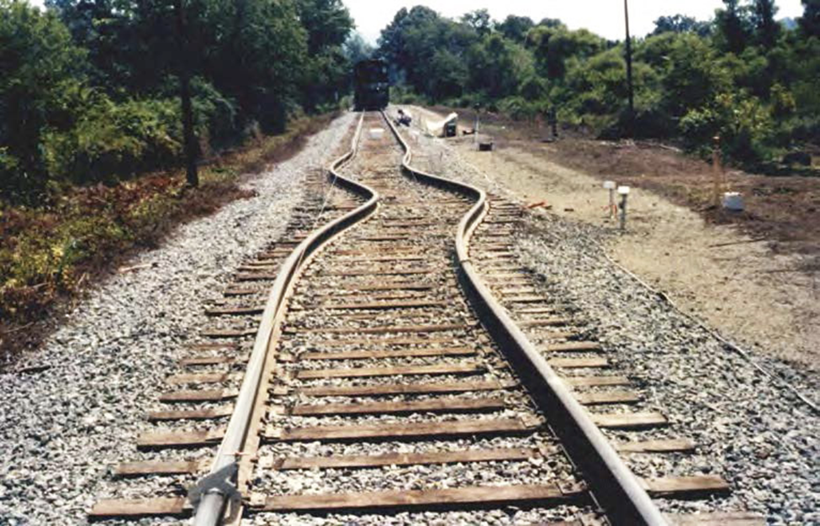
Inventory the Assets
at Risk
Use the THIRA spreadsheet created by the organizational planning committee as a guide to creating new annexes for the division’s existing emergency plan.
Get additional local information from the National Weather Service and US Geological Survey about likely extreme events in that division.
Review and update the existing emergency plan for ordinary events, based on this up-to-date information.
Add new annexes for identified extreme events.
Buckled rail (sun kink) from extreme heat
Source: NOAA, 2017.

Slide 16
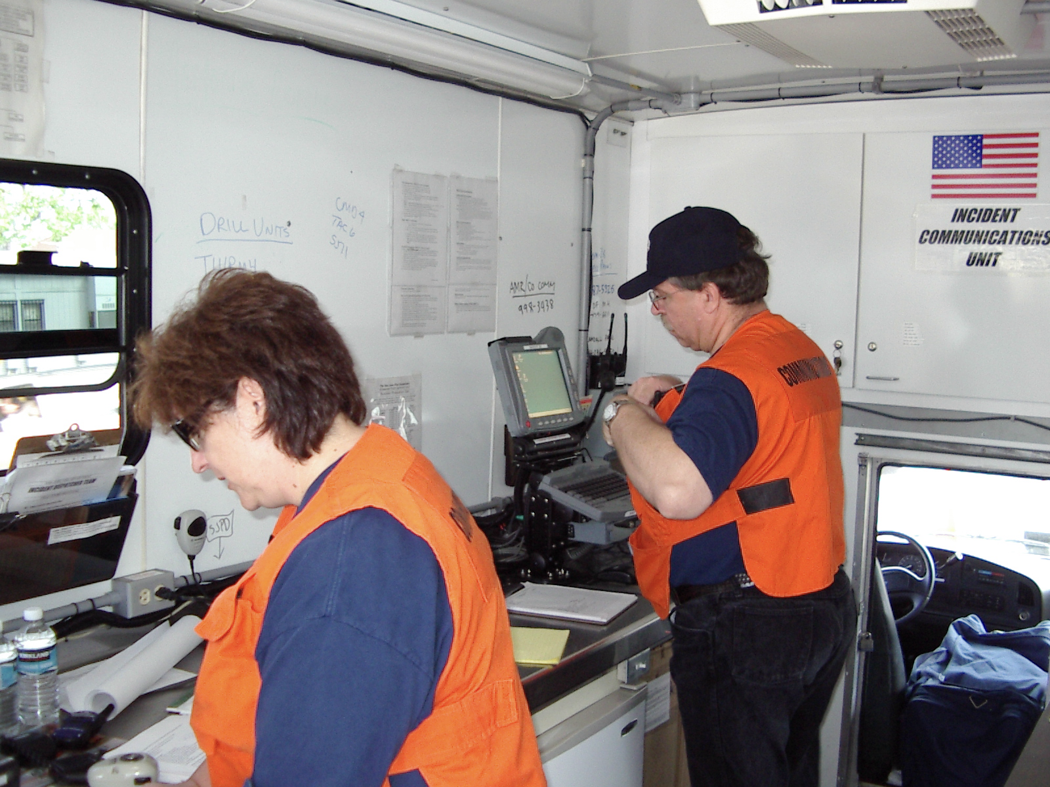
Identify Division Public Safety Answering Points’ Alternative Numbers
9-1-1 system availability and staffing
Alternate phone numbers for fire and law enforcement if 9-1-1 is overwhelmed
Volunteer fire chief contact information
County sheriff contact information
San Jose, California mobile dispatch center
Source: Edwards

Slide 17
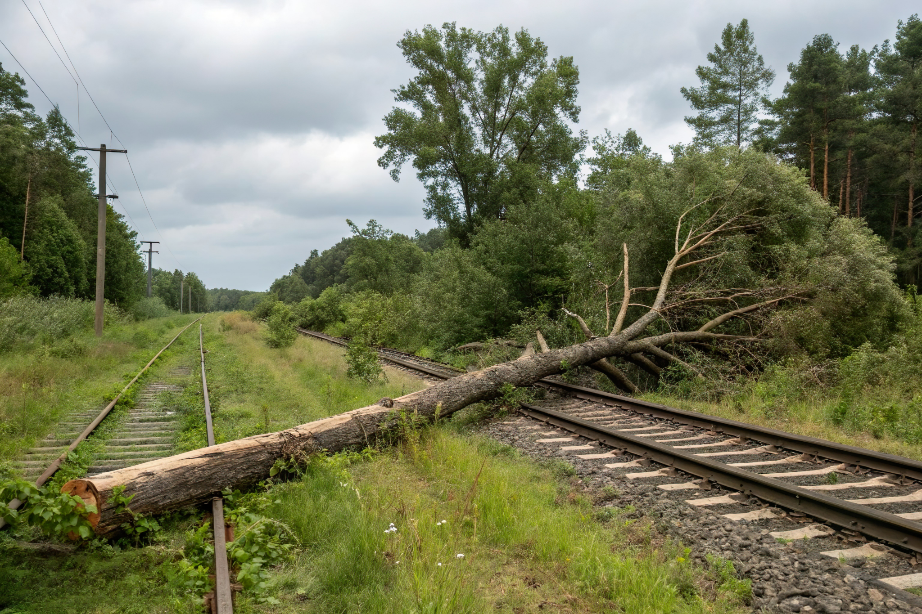
Risk Management: Insurance
Insurance is organized at the enterprise level.
Division needs a spreadsheet of all insurance policies that protect division assets and contact information for the insurer.
Ensure access to contact information for specialized responders like hazardous materials clean-up contractors and debris removal companies.
After a tornado, trees block the
main rail line
Source: Adobe Stock

Slide 18
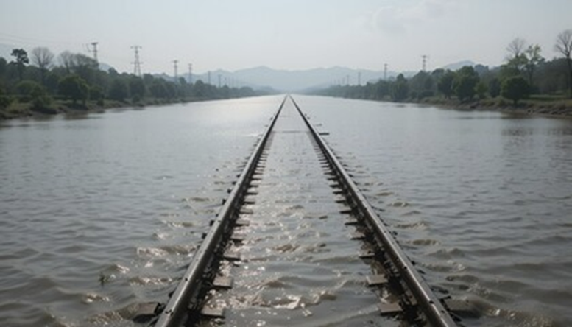
Risk Management:
Adaptation
Division emergency planning committee members have first-hand information about the hazards and risks in the area.
Division committee members have knowledge of operations that can contribute to adaptation projects.
Division committee members will know about the results of previous extreme events, like wildland fires.
Storm surge swamps a single track
section.
Source: Adobe Stock

Slide 19

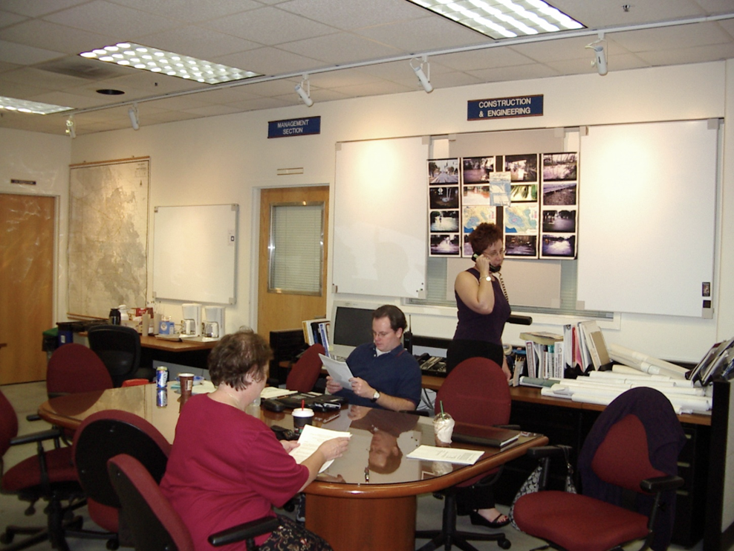
Amending the Existing Emergency Plan: Organizational Emergency Planning Committee
Use scenario-driven approach.
Organizational level collects damage assessment and resource needs from the division’s emergency manager.
Organizational level ensures that rail service is rerouted or rescheduled around the emergency and ensures that other users of the track are notified of the closure of the track.
Coordinate with the local community to ensure that railroad activities do not adversely impact them, and that their responses do not negatively impact the railroad.
Organizational Emergency Planning Committee
Source: Edwards

Slide 20
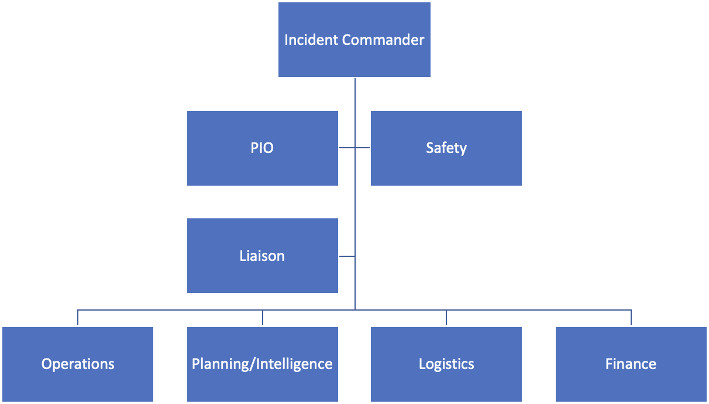
Incident Command System

Slide 21
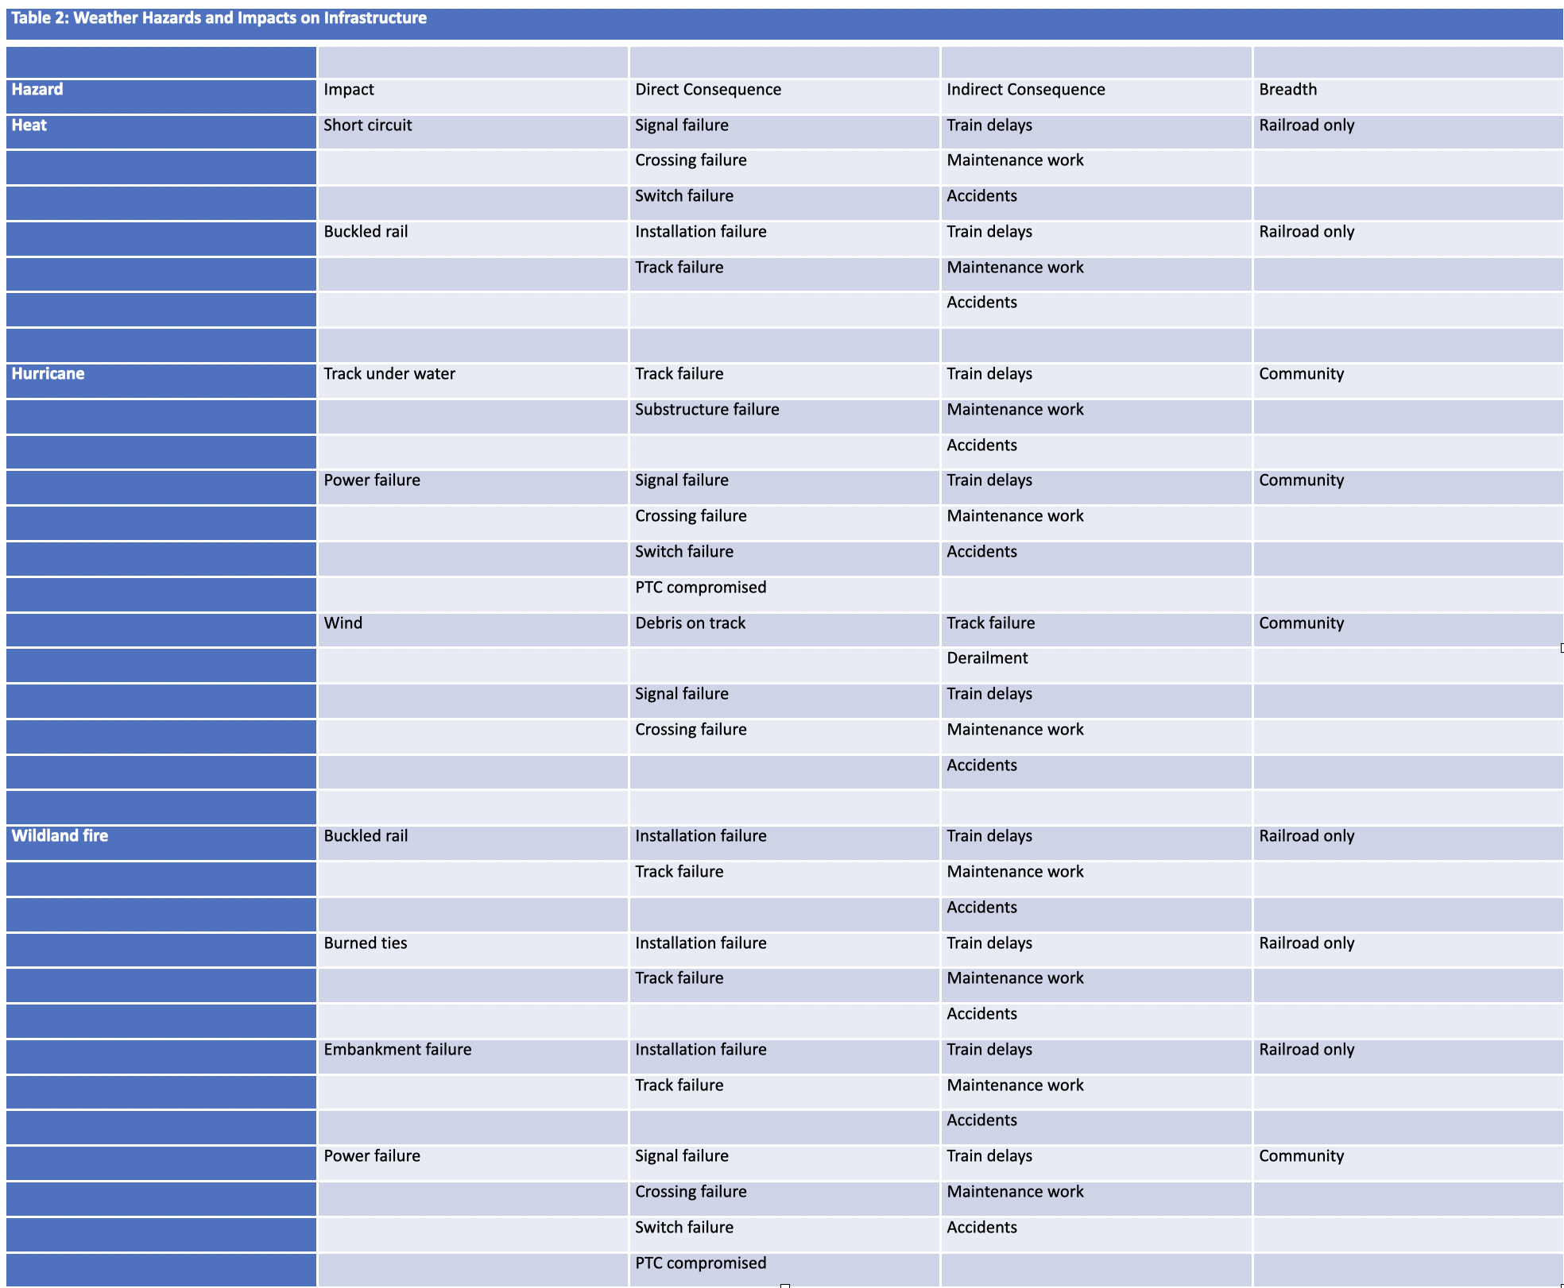

Slide 22
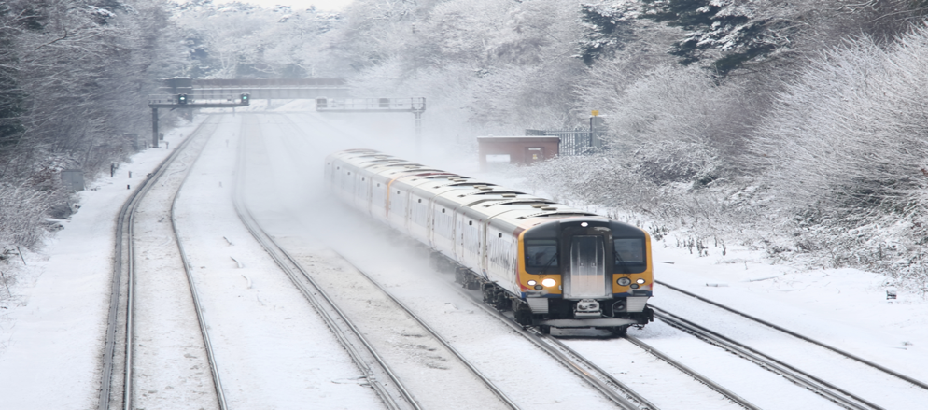
Amending the Existing Emergency Plan: Organizational Emergency Planning Committee
The Organizational Emergency Planning Committee must have a broad view:
  system design, non-operating assets (stations, parking lots) and human capital (operations, maintenance, station, administration);
  strategies like protective measures, relocating assets out of harm’s way before a predicted event, focusing on-going maintenance to ensure that property is preserved, and design of retrofit infrastructure to cope with changing conditions;
  enhancing redundancy when financially feasible provides the possibility of continuing service more quickly after an extreme emergency.
Train in the snow. Source: Adobe Stock

Slide 23
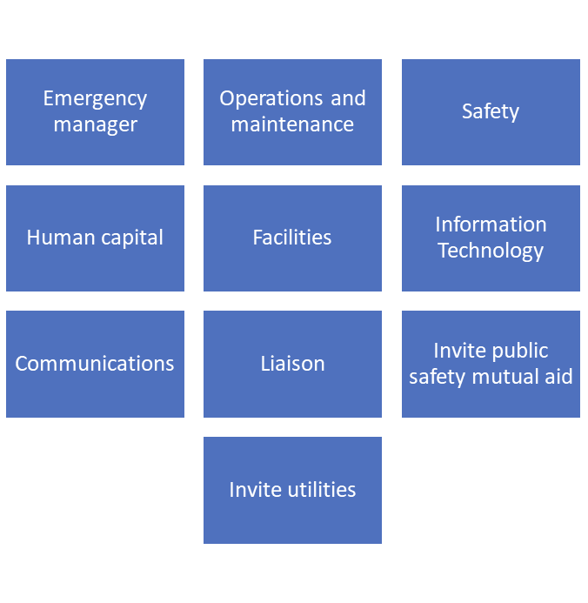
Amending the Existing Emergency Plan: Division/Subdivision Emergency Planning Committee
Planning priorities are:
  Saving lives and preventing injury,
  Protecting the environment,
  Protecting railroad property and adjacent property.
Amend the existing plan based on NWS and USGS information, wildfire intensity map, other local insights.
Add annexes for extreme events.
Typical Division/Subdivision Level Emergency Planning Committee Membership

Slide 24
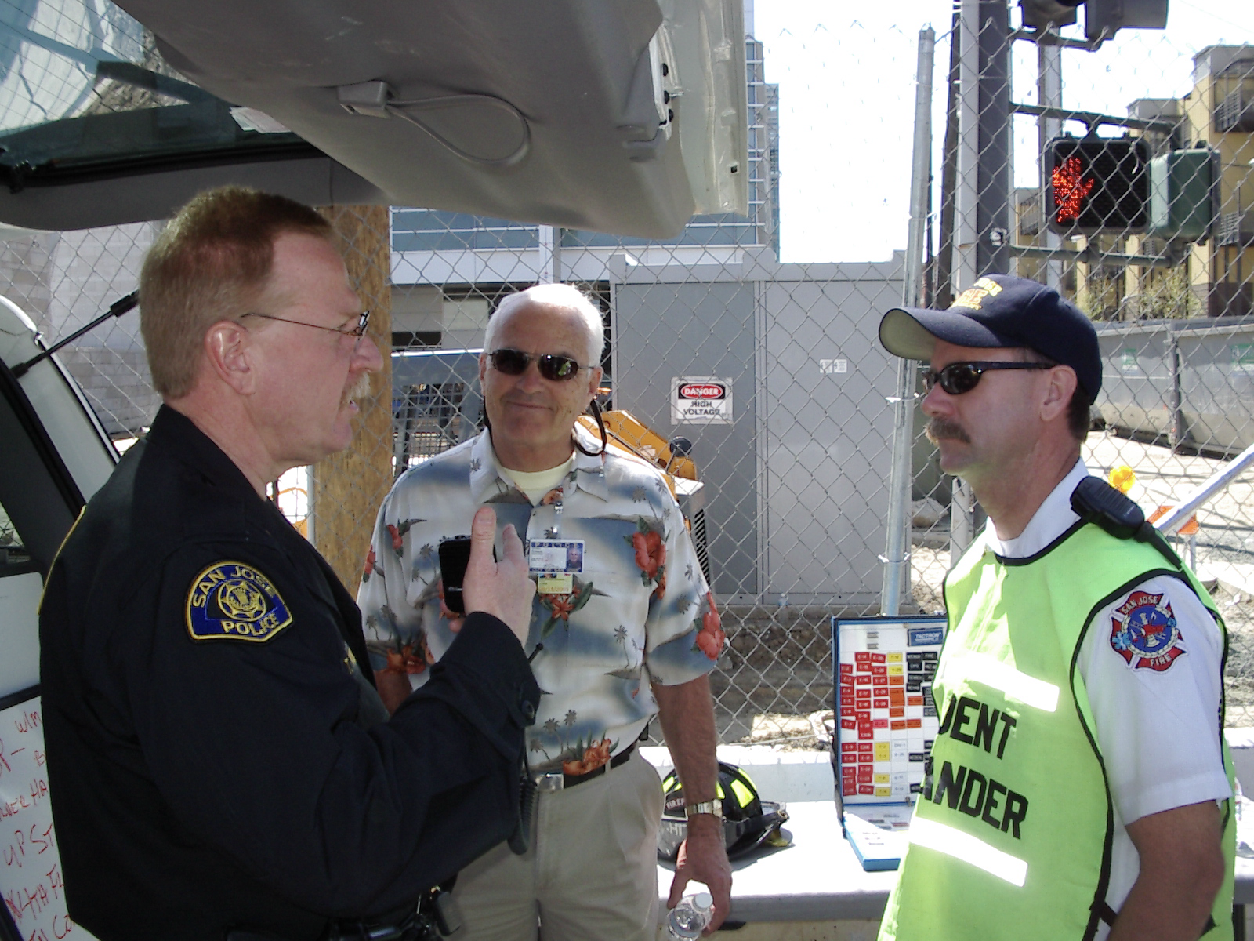
Critical Terminology in
Incident Command
Incident Commander – in overall charge
Command Staff supports the Incident Commander
Safety Officer – responsible for upholding all safety rules at the site of the extreme event
Public Information Officer – communicates with media and community about all aspects of the event, coordinated media releases and conferences
Liaison Officer – coordinates with representatives from outside agencies who contribute to the response. The railroad would send a representative to work with this officer.
Incident commander meets with Law enforcement branch director and liaison officer.
Source: Edwards

Slide 25
Critical Terminology in Incident Command
Operations – responsible to resolve the event
Planning/Intelligence – runs the Incident Command Post, check-in/check-out function and completes all ICS forms
Logistics – provides everything needed to support Operations
Finance – accounts for all costs and coordinates with responsible party and insurance companies; oversees risk management.
Incident Command Post – place where coordination is conducted, check-in/check-out occurs, incident planning meetings are held
Incident Action Plan – actions of all entities working within the ICS
Incident Action Period – 24 hours
After Action Report – documents what occurred and ends with an improvement matrix to improve future responses

Slide 26
Amending the Existing Emergency Plan: Division/Subdivision Emergency Planning Committee
Lessons learned from actual events in the division
Improvement suggestions from after action reports
Changes suggested by National Transportation Safety Board reports

Slide 27
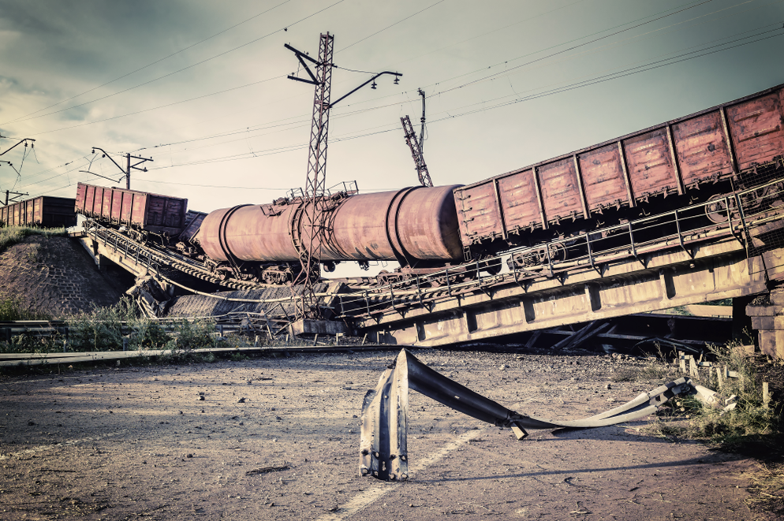
Conclusion
Railroads are subject to extreme events along their routes.
The corporate level planning is focused on risk prevention.
Division level planning is focused on field response.
Railroads have over 150 years of experience with weather events.
The changing environment is creating new extreme events.
Planning in advance will allow for insurance and adaptation to minimize losses and reputational damage.
Destroyed bridge and cargo.
Source: Adobe Stock

