Slide 1
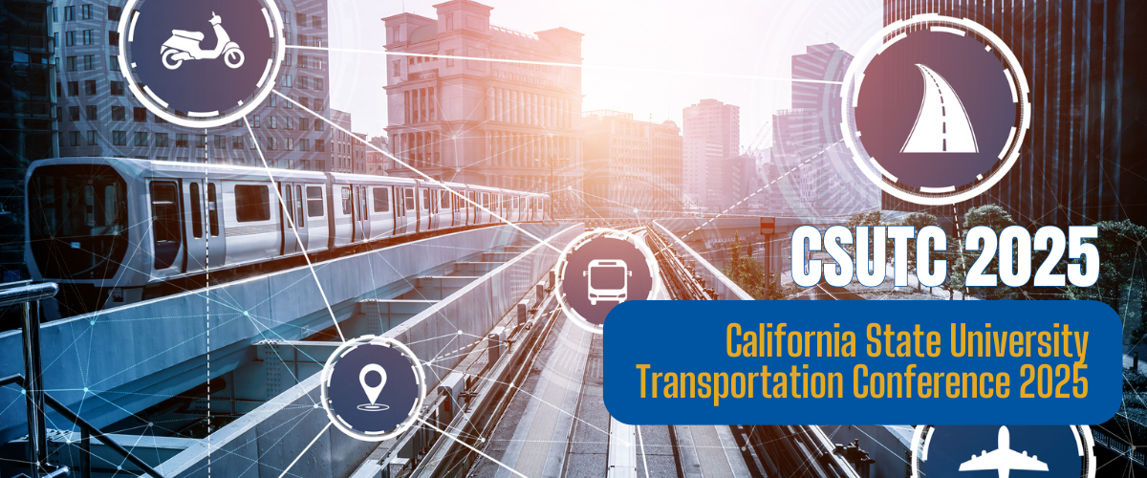
Title
Subtitle
August 15 and 16, 2025 | California State University, Long Beach

Slide 2
Title

Slide 3
Thank you For more information, contact xxx@xxx.edu
This research was generously funded through a grant from State of California Senate Bill 1, the Road Repair and Accountability Act of 2017

