Slide 1
ICS for Rail Rules Instructor’s Guide Part 2
Amtrak derailment, Philadelphia, May 12, 2015.
Source: NTSB.gov.
National Academies of Sciences, Engineering, and Medicine. 2016. Incident Command System (ICS) Training for Field Level Supervisors and Staff: NCHRP Web-Only Document 215. https://doi.org/10.17226/23411. Adapted with permission from the National Academy of Sciences, Courtesy of the National Academies Press, Washington, D.C.
Notes:
This segment focuses on the construction of the Supervisor’s Folder.

Slide 2
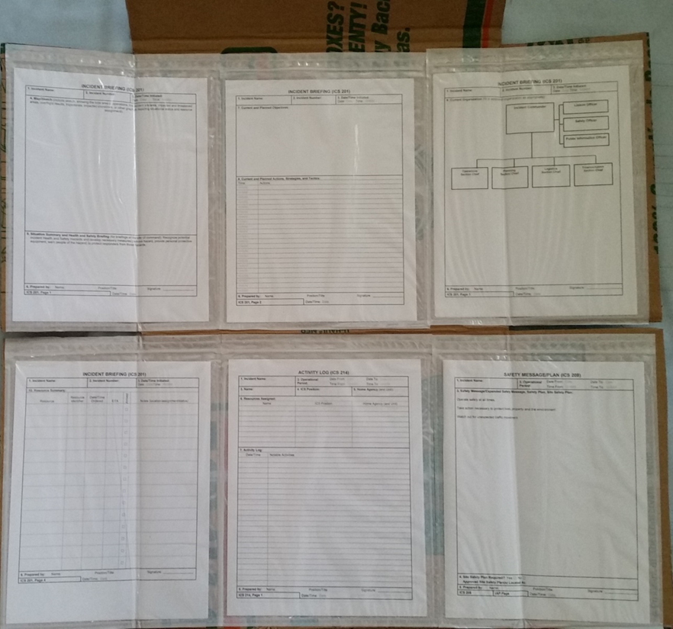
Building the ICS Kit
The ICS kit is a resource for the supervisor or lead worker in the field.
The kit is inexpensive to make.
The kit provides support materials to start an ICS in the field when public safety personnel are not present.
The kit can be stored under the seat of a work vehicle for easy access when needed.
ICS is a seldom-used skill, so the kit provides the resources to support today’s training, even if it is not used for several years.
A 10 minute video Number 4 on building the ICS kit is available at: https://vimeo.com/showcase/11005939
Notes:
ICS is a seldom used skill for everyone outside of the fire service. Other workers only use ICS for occasional serious events, natural hazards, technology-based emergencies or human-caused disasters. Because there is a long time between using ICS it is important to have a way to remember the key points and actions at the time of need.
The supervisor’s folder contains the ICS forms that are used most often, the ICS Field Operations Guide (FOG) for detailed instructions, and the set of Quick Start Cards that provide detailed guidance for the first 15 minutes after arriving at an emergency. After the first 15 minutes, it is likely that a better trained responder may arrive, or that the event will provide the prompts needed to continue with ICS. The FOG can also be used to guide later actions.
Let’s look at the 10 minute video that provides instructions for how to build the kit. After viewing the kit assembly it will be easier to follow the step by step instructions.

Slide 3
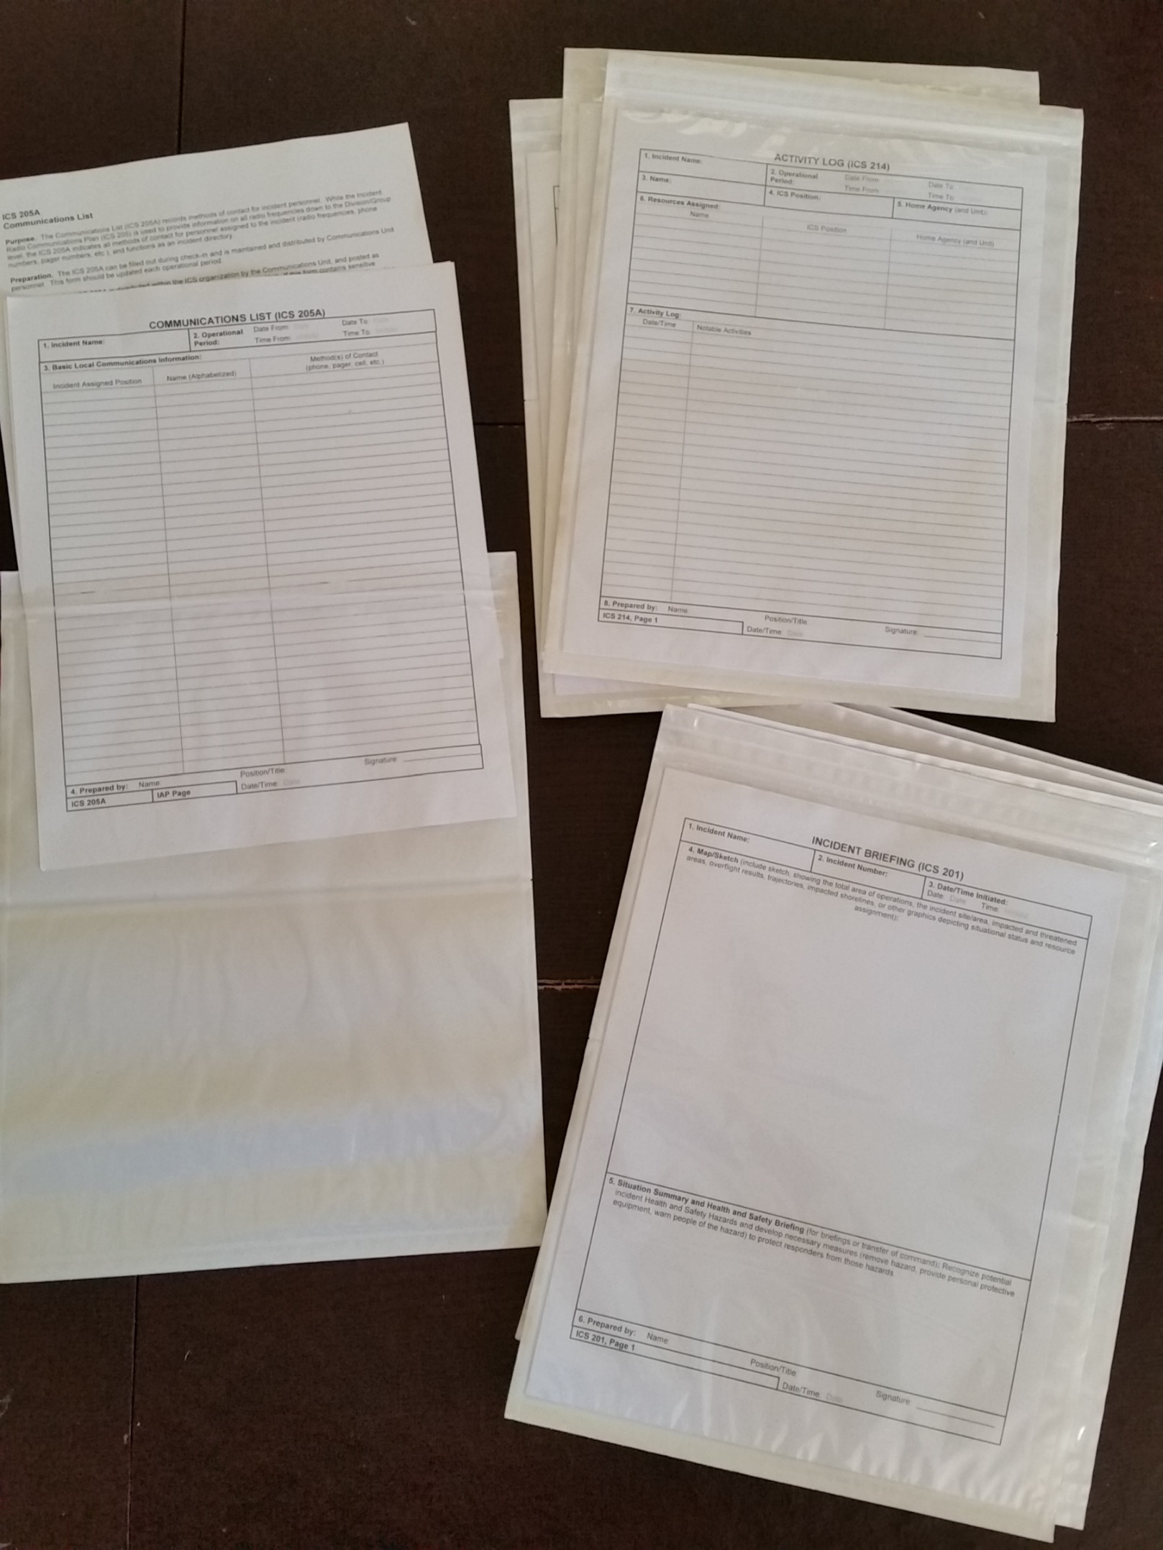
The Forms…are used as needed.
ICS 201 is the starting point of documentation for any field event and often all that is needed.
ICS 214 is used for documentation of activities.
ICS 208 is used when section 5 of ICS 201 page 1 is insufficient.
ICS 205 is used when multiple parties in the Incident Command are present with different communications assets.
ICS 205A is used to list who is involved and how to contact.
Notes:
The ICS forms are found in the ICS Support Materials folder.

Slide 4
ICS Form Inventory
ICS 201 page 1 2 copies
ICS 201 page 2 2 copies
ICS 201 page 3 2 copies
ICS 201 page 4 2 copies
ICS 208 2 copies
ICS 205 2 copies
ICS 205A 2 copies
ICS 214 3 copies
Instruction Sheets
ICS 201
ICS 208
ICS 205
ICS 205A
ICS 214
Notes:
The ICS forms are designed to document the planning and execution process. The materials provided for you include these commonly used ICS forms that will support most emergency events.
If the emergency turns into a multi-day disaster, you may need to document more detail…with more forms.

Slide 5
What about the others?
ICS 202 Incident Objectives – supersedes ICS 201 page 2
ICS 203 Organization Assignment List – supersedes ICS 201 page 3
ICS 204 Assignment List – supersedes ICS 201 page 2, used by Operations Section
ICS 206 Medical Plan – developed by Logistics Section, specifically for IC personnel
ICS 207 Incident Organization Chart – supersedes ICS 201 page 3
ICS 209 Incident Status Summary – Plans Section, Supersedes ICS 201, used to develop ICS 215
ICS 210 Resource Status Change – Used to report status changes from Task Forces, Strike Teams, Supervisors
ICS 211 Incident Check-In List – Supersedes ICS 201 page 4, Logs in personnel and equipment arriving
ICS 213 General Message – used to convey information that cannot be orally transmitted.
ICS 215 Operational Planning Worksheet – supersedes ICS 201
ICS 215A Incident Action Plan Safety Analysis – Safety Officer’s assessment of ICS 215
ICS 218 Support Vehicle/Equipment Inventory – supersedes ICS 201 page 4
ICS 219 Resource Status Card (T-Cards) – Used to track resources within the IC
ICS 220 Air Operations Summary Worksheet
ICS 221 Demobilization Check-Out
ICS 225 Incident Personnel Performance Rating
Notes:
Then there are all the rest for the major disasters, like hurricanes, tornadoes, earthquakes and wildland urban interface fires.

Slide 6
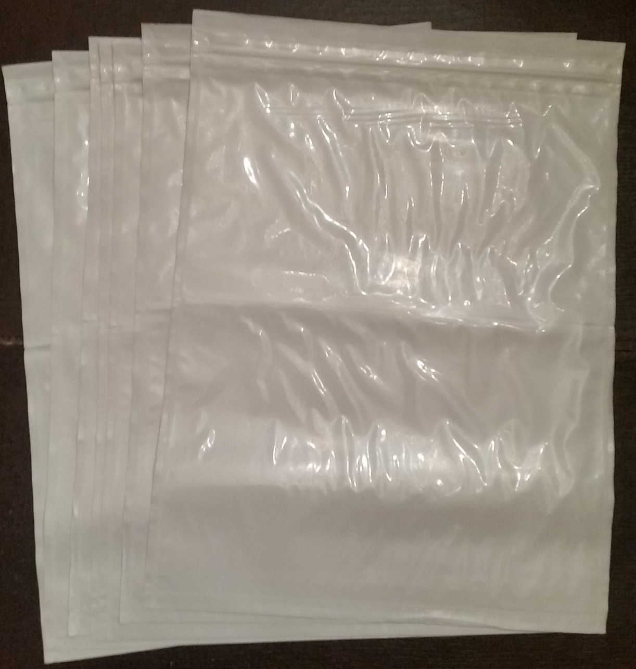
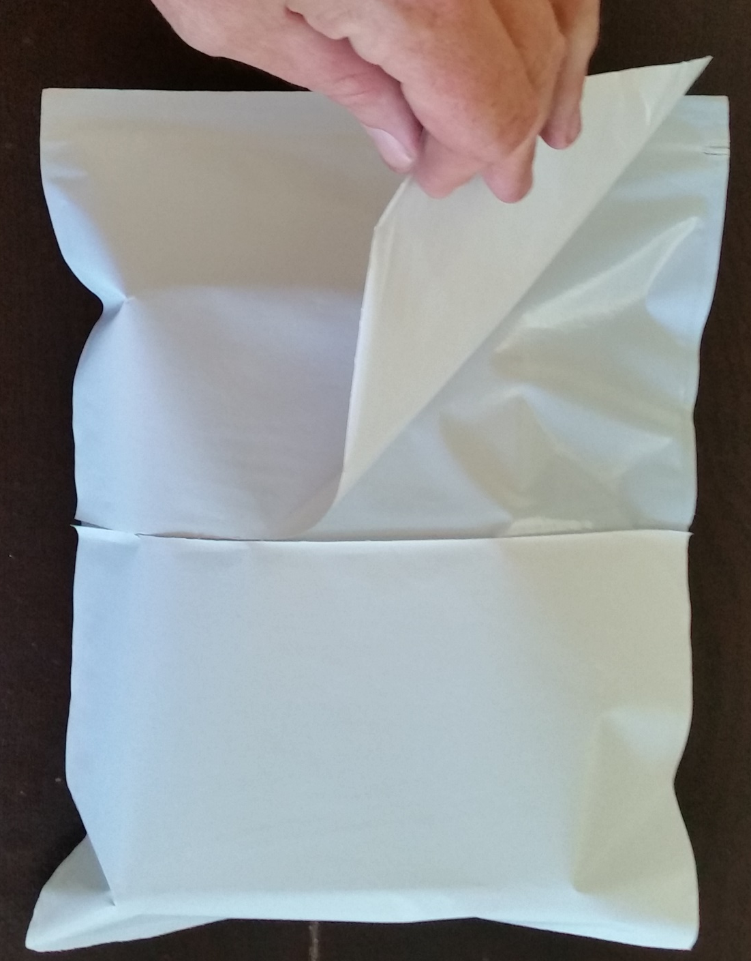
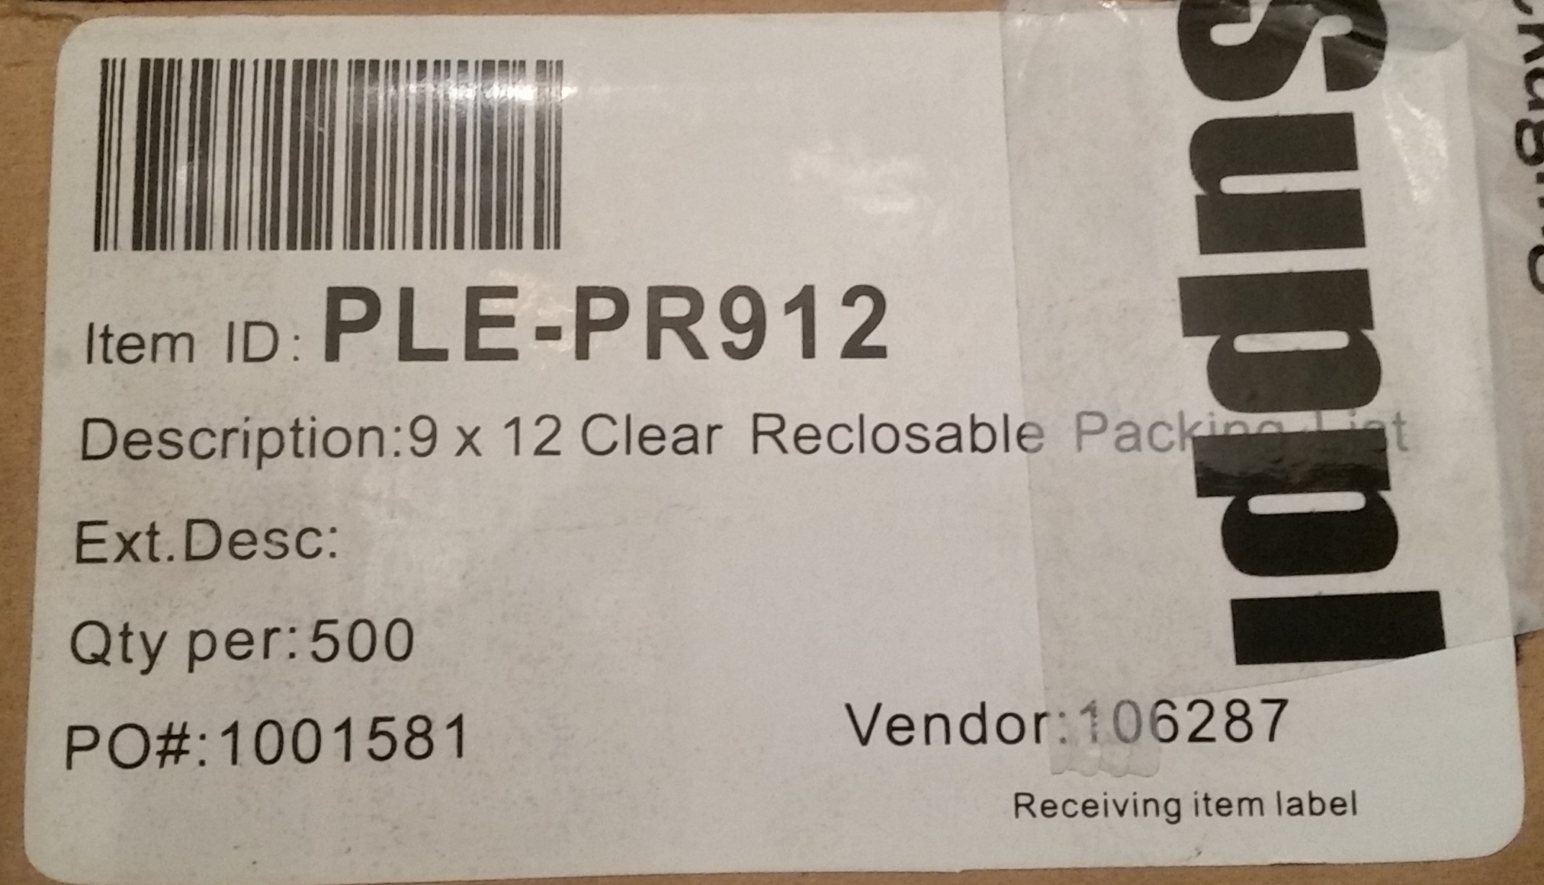
Packing Sleeves
Identified as:
Re-Closeable Packing List Envelopes 9” X 12” or 9 x 12 Clear Reclosable Packing List
Available in increments of 500 per case
Cost per case is $62.95 as of 6/6/2018
Unit price $0.13
Only one reliable source currently identified:
https://www.packagingsuppliesbymail.com/
Items are listed on Amazon but when
ordered (multiple times) wrong item was sent.
Notes:
The forms are put into packing sleeves to protect them from wind and rain while allowing everyone who visits the Incident Command Post to see the information and self-brief on the event status.
Assemble the 2 (or 3) ICS forms of the same number with the instruction sheet of that number at the back in one pile, and insert the pile into the packing sleeve in numerical order, and shift all the forms to the left side of the sleeve, ready to be applied to the packing box folder. Note that there are 4 sheets to ICS-201. They will be placed in order in the top row.

Slide 7
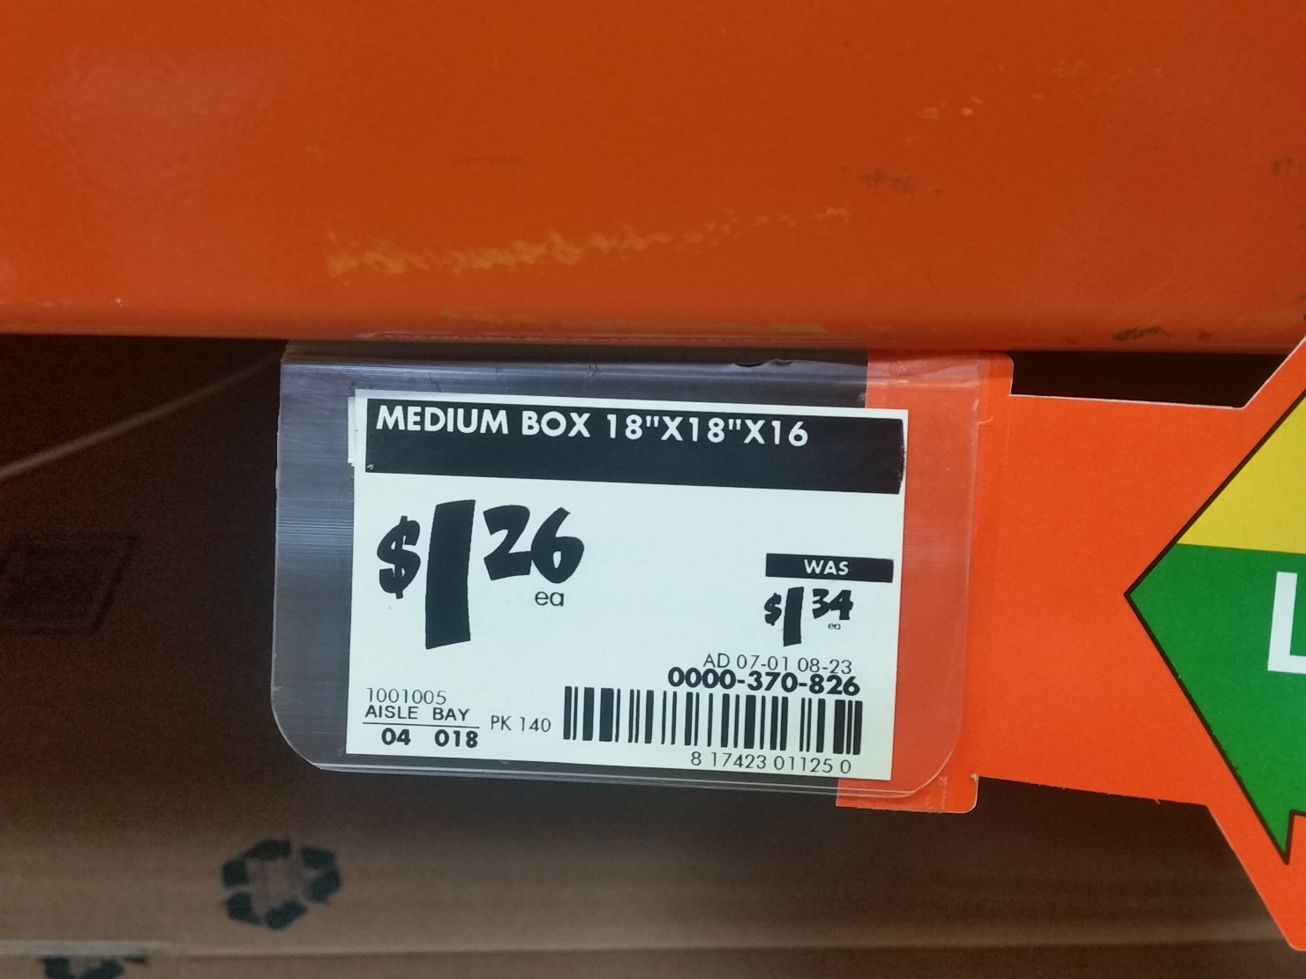
Cardboard
One box yields enough cardboard for two folders that can handle six or eight packing sleeves.
Larger folders are possible, but not advisable due to folded size and cost.
U-Haul, Home Depot, and other retailers may have them available.
Notes:
Get a box and a box cutter or knife for the next phase.

Slide 8
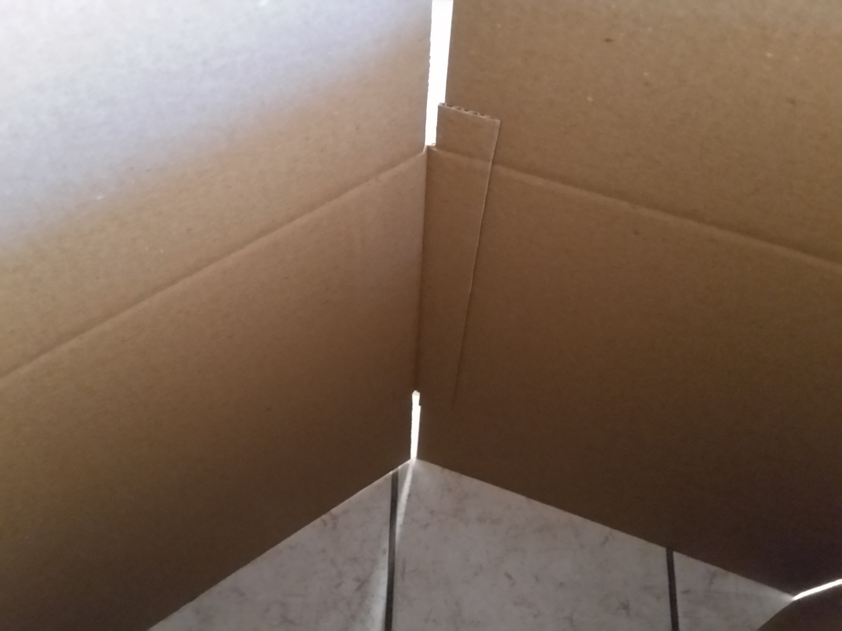
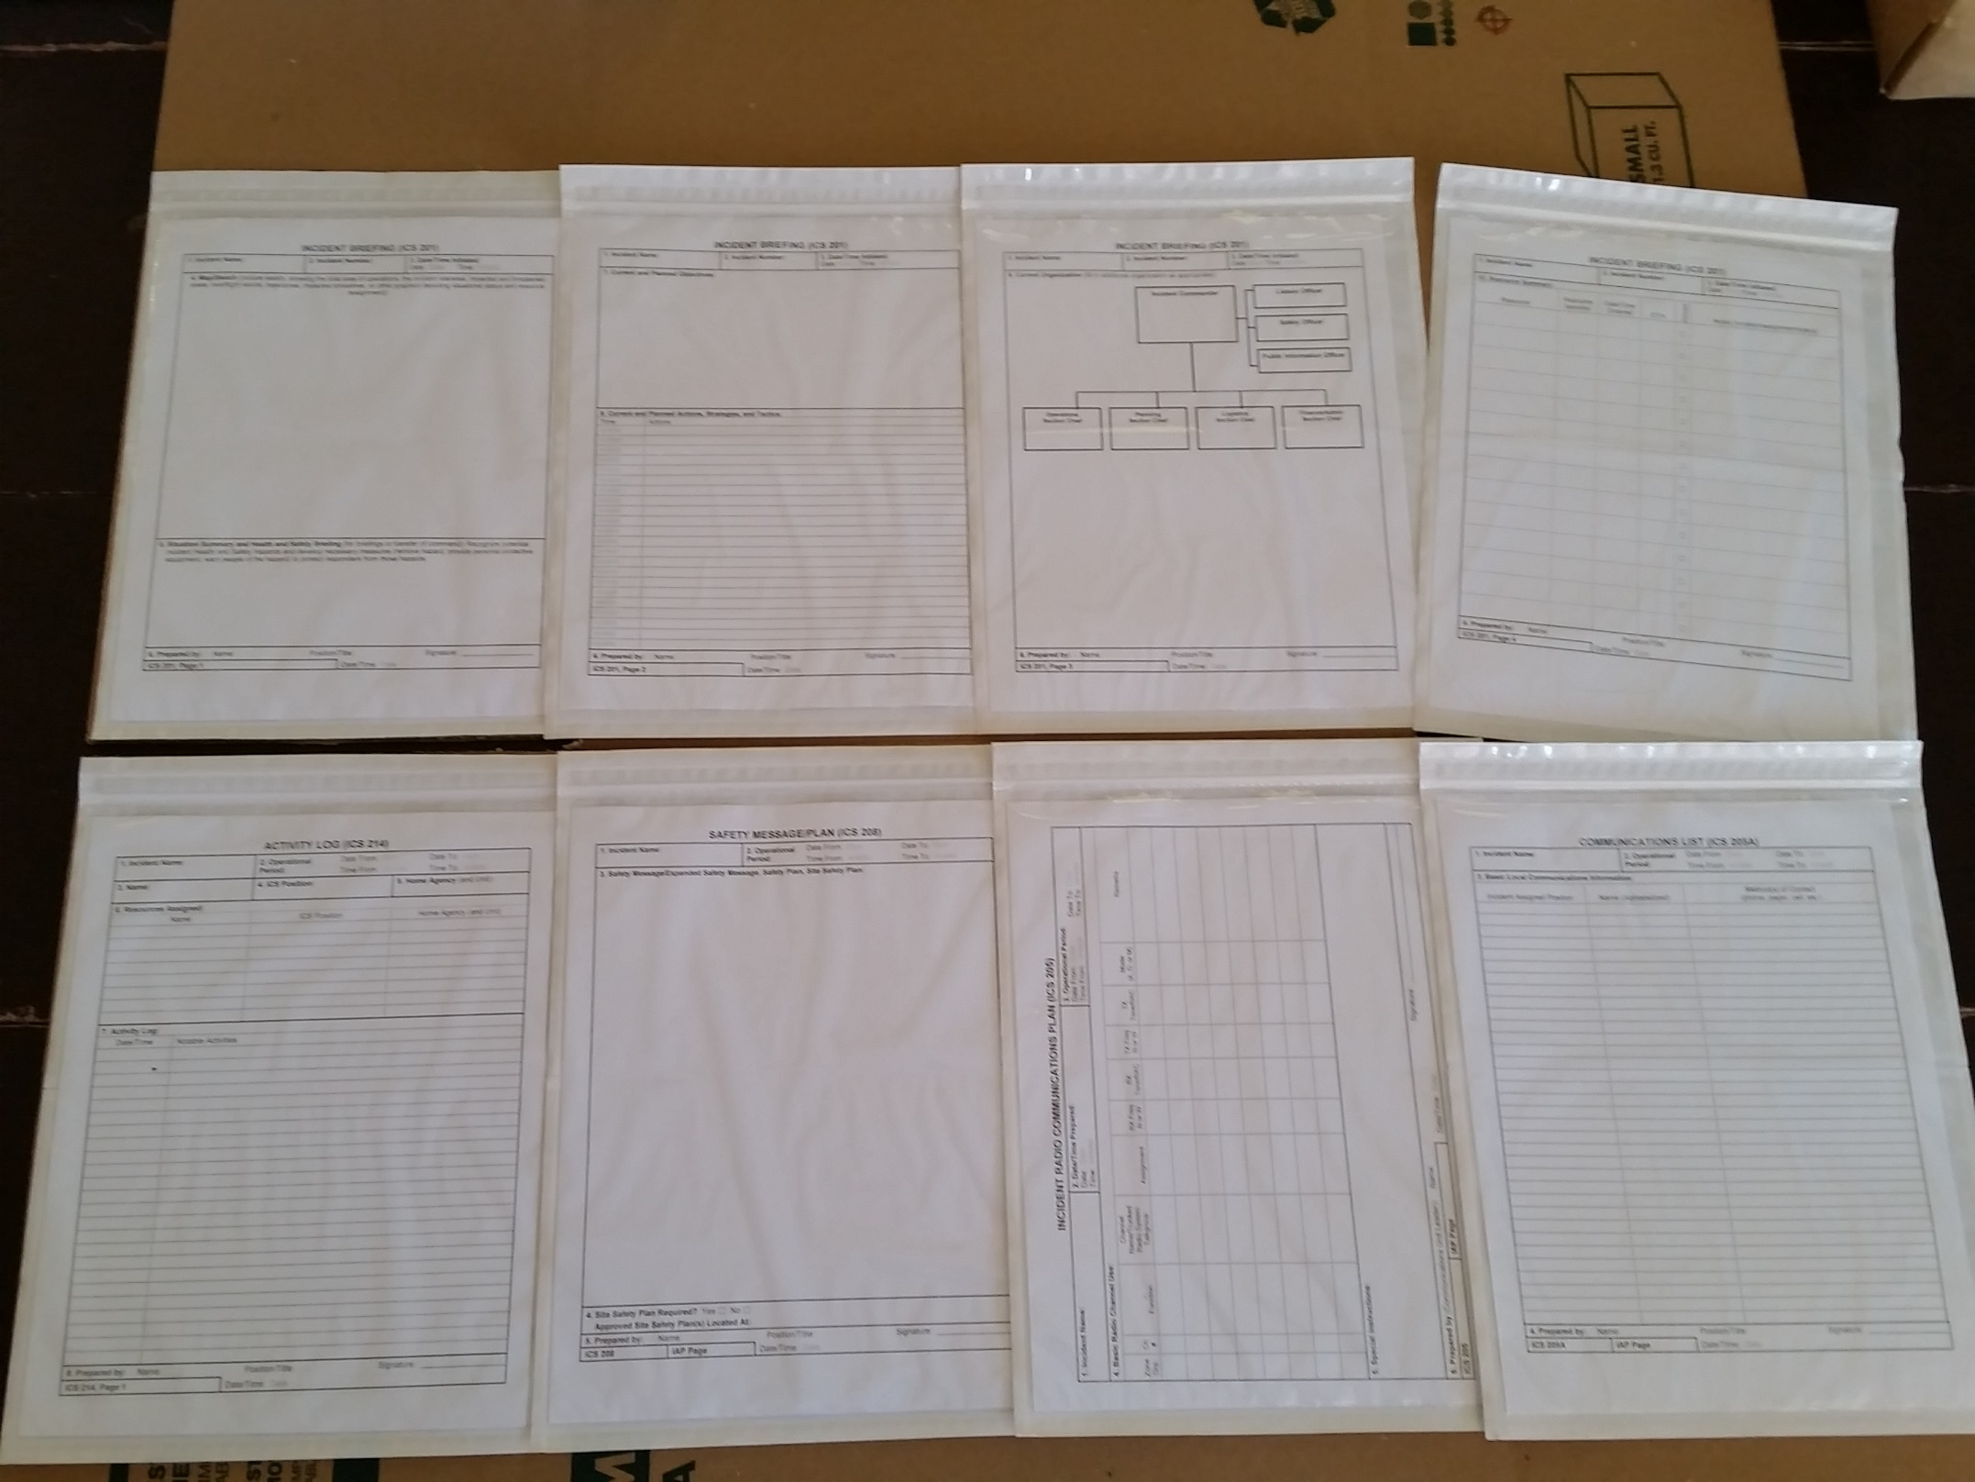
Lay out packing sleeves w/forms. Start on right or left with corner of sleeve aligned to corner of flap. Overlap the next sleeve on the previous one approximately 1”.
Find the overlap, cut the seam and the one counter to it.
Notes:
Starting with the first ICS-201 packing sleeve, place the sleeve on the left side of the box with the bottom of the form at the fold of the box. Remove the bottom cover and place the pack firmly on the cardboard. When it is properly attached remove the top cover and attach the top. Next attach the ICS -201 page 2 with the left side slightly overlapping the empty part of the ICS-201 page 1. Then slightly fold down the top left corner of the packing sleeve for easier access. When all 4 of the ICS-201 pages are secured to the box, start working below the fold.
Place the 205 pack below the fold and below the ICS-201 page 1 pack with the 205 top slightly below the fold. Remove the top cover and secure the 205 pack to the box, then remove the bottom cover. Next, place the 205A with the left side slightly overlapping the empty edge of the 205 form packing sleeve, bending the upper left corner slightly for easier access. Remove the top cover and secure to the box, then the bottom cover. Repeat with 208 and then 214.

Slide 9
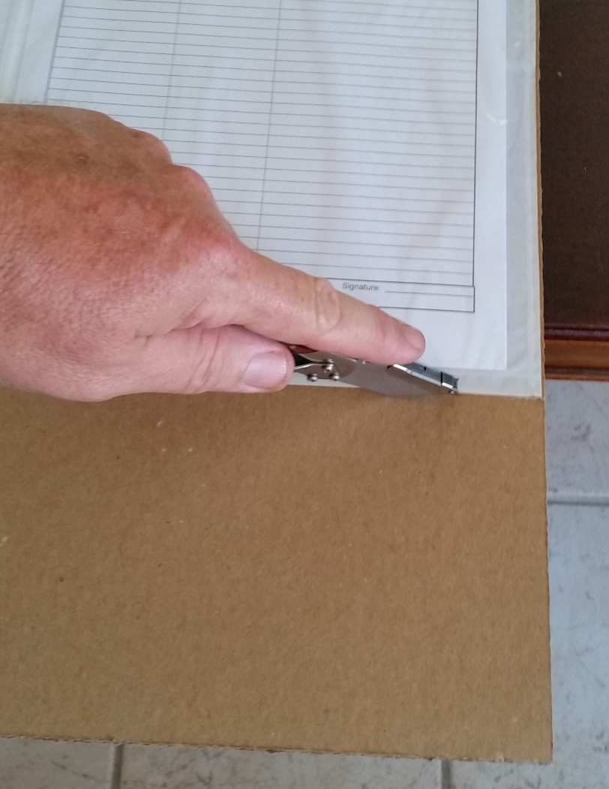
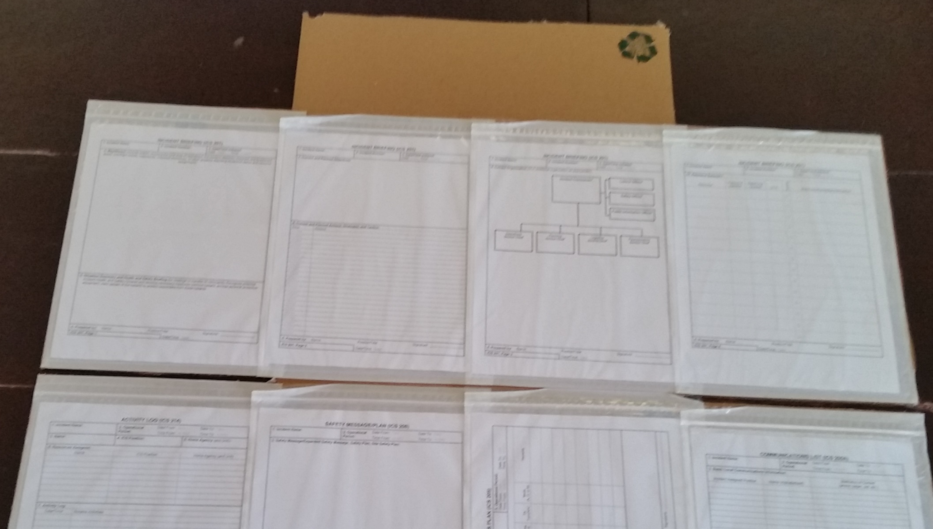
Peel off backing and adhere.
On subsequent sleeves, fold down top ¼” corner of adhesive back to prevent interference of previous sleeve’s zip-lock.
Cut the excess cardboard from bottom.
Using the fold marks at top, cut away the corners as shown.

Slide 10
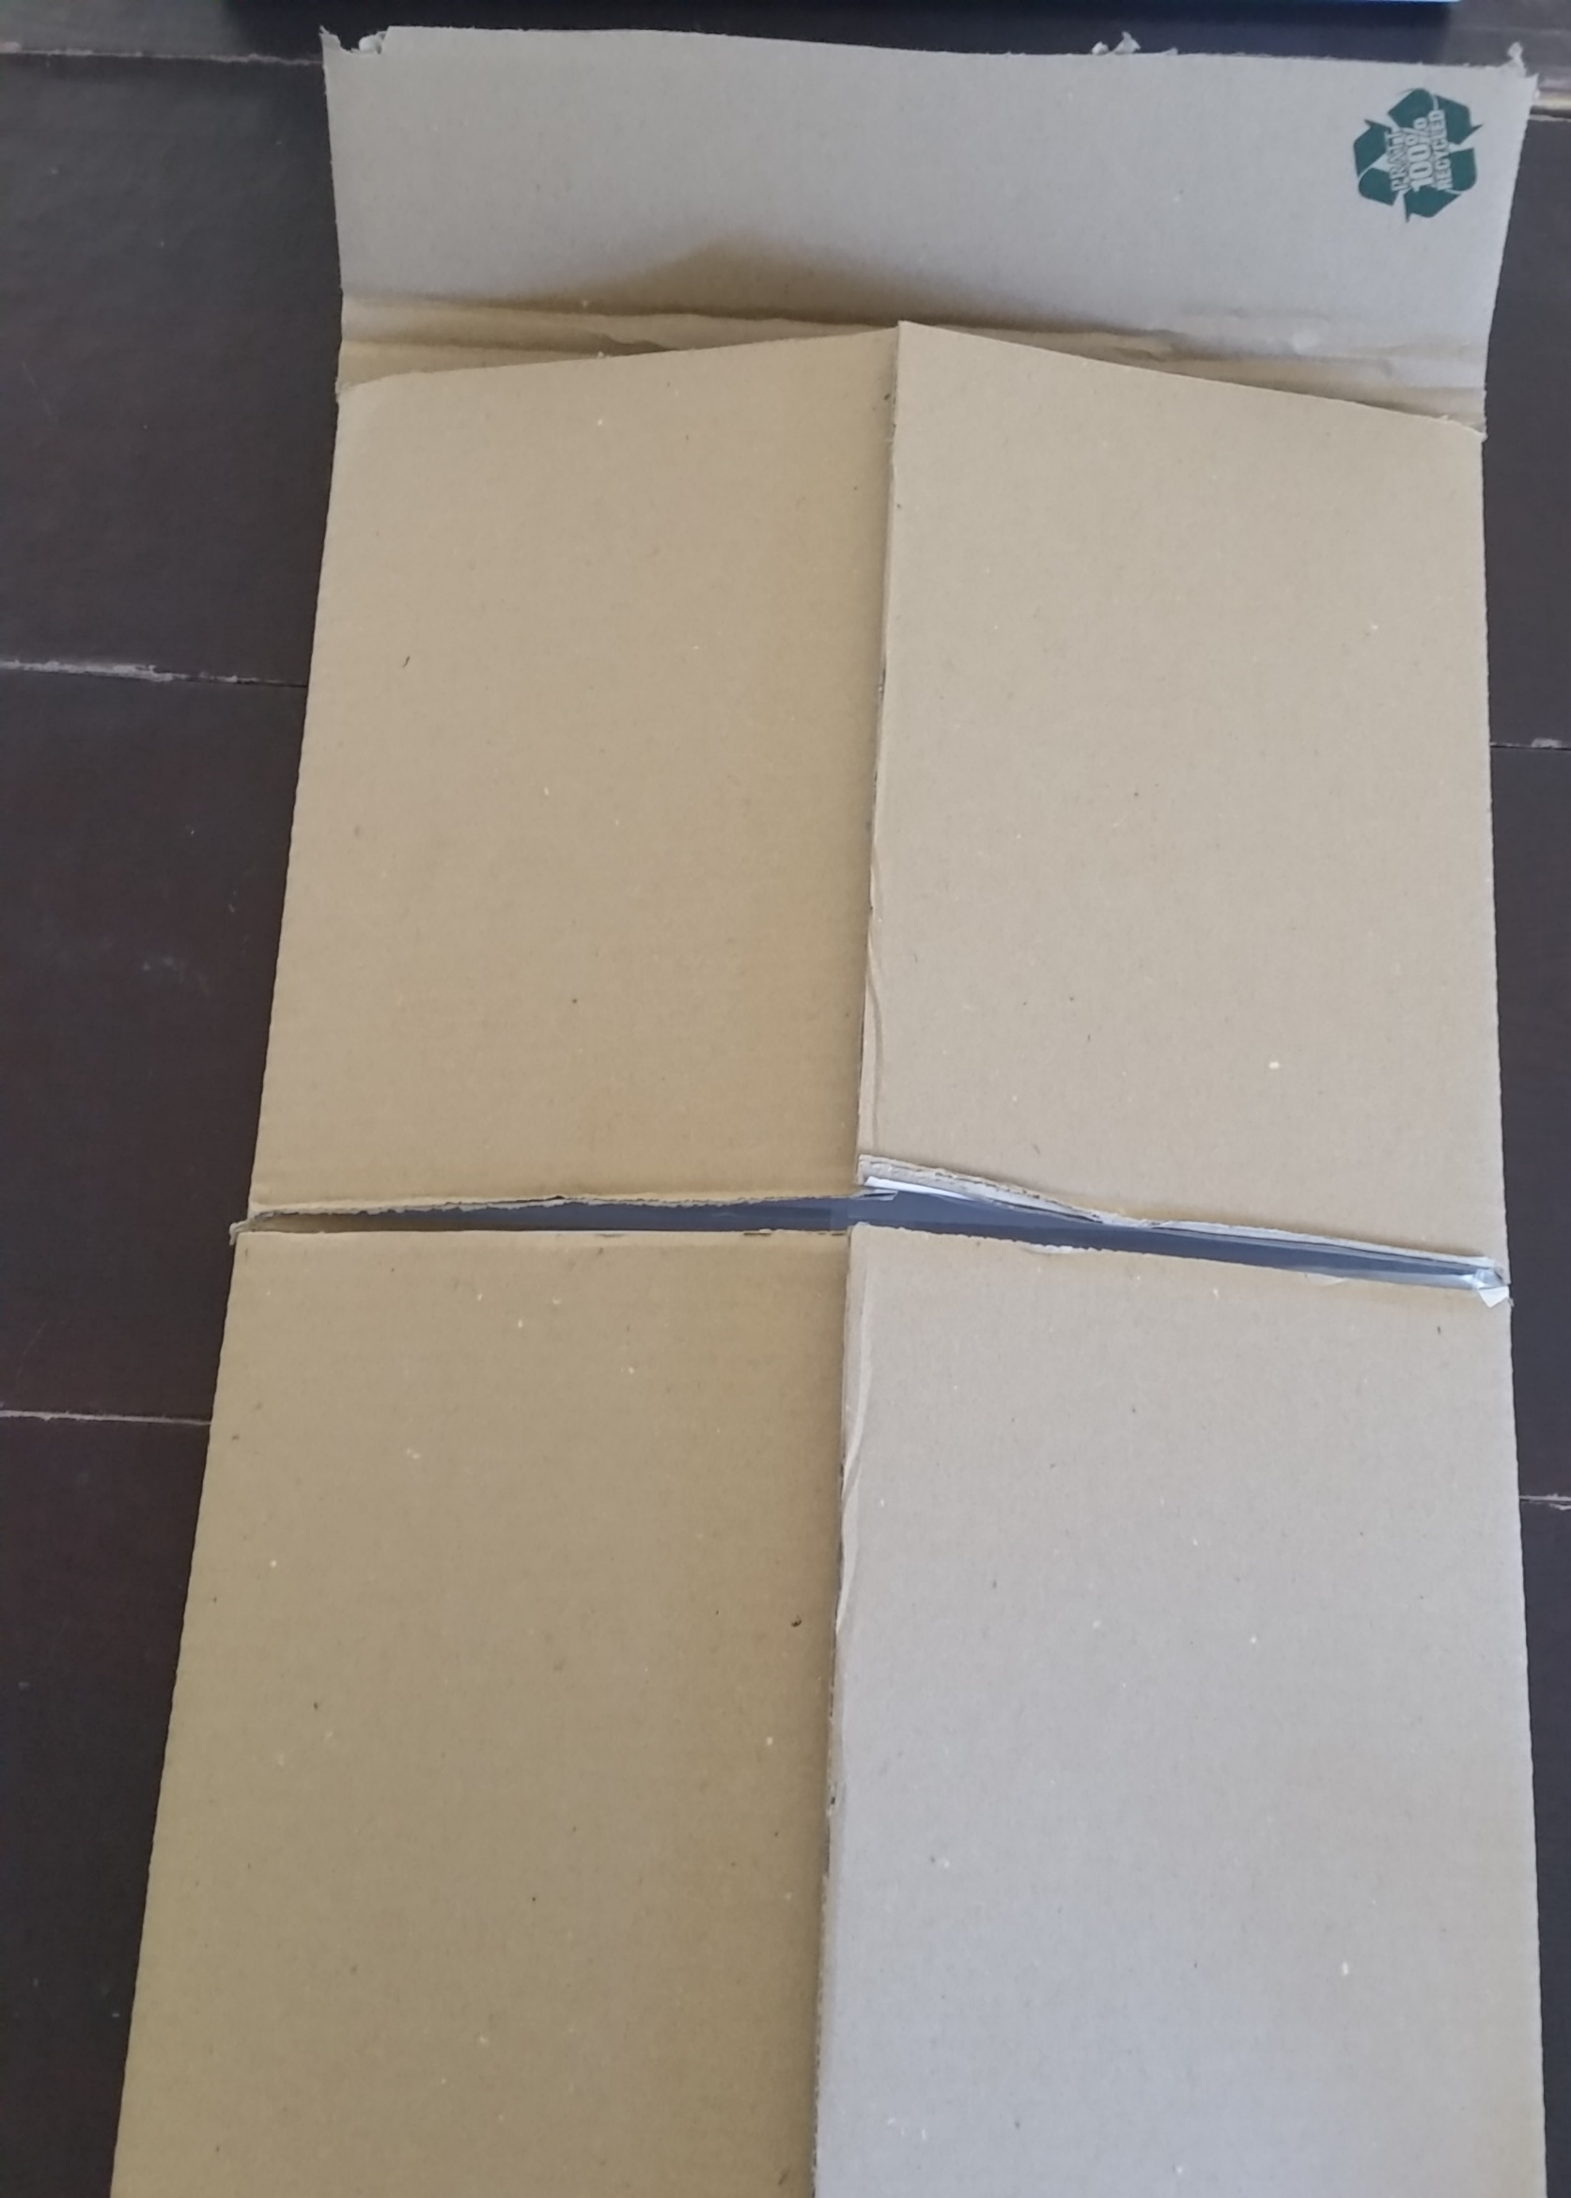
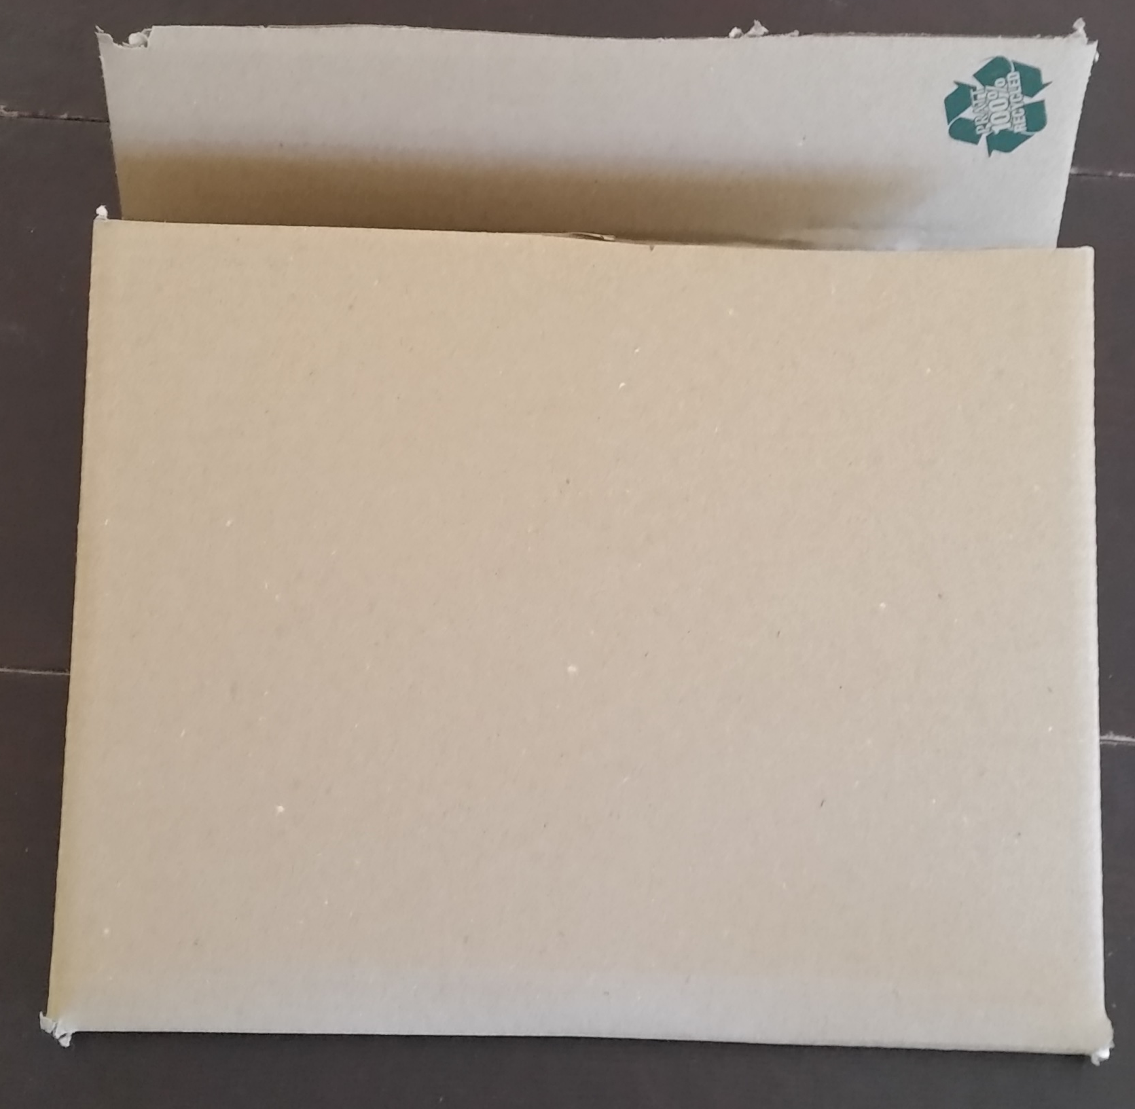
Fold and tape shut.
Notes:
When you open the folder to use it, that flap with the tape becomes the hanging point. You can insert it into a vehicle window and roll up tight, or tape it up, or nail it up… Note the ICS Youtube video #1 to see the Plans Section Chief put it in his truck window.

Slide 11
Quick Reference Cards (aka reference cards, quick start cards, ICS position cards…)
Must be reviewed and tailored for the organization that will use them.
Must be based on reality, not theory.
Must be reviewed aggressively and modified as program develops.
A brief video Number 4A with details on how to make the Quick Reference Cards is available at: https://vimeo.com/showcase/11005939
Notes:
The ICS Quick Start Cards are on a ring, and each has a checklist for the first 15 minutes of activities at an incident.
Here is what to use and how to make them. There is a detailed Youtube video that will also guide you later in making more.

Slide 12
Material and Equipment Used
Laminator https://www.amazon.com/Apache-AL13P2-Professional-13-Inch-Laminator/dp/B01M9GUKNK/ref=sr_1_1?ie=UTF8&qid=1501119461&sr=8-1&keywords=apache+al13p+laminator
Paper Trimmer/Cutter https://www.amazon.com/gp/product/B00006IATG/ref=oh_aui_search_detailpage?ie=UTF8&psc=1
10mm Radius Corner Punch Rounder https://www.amazon.com/10mm-Radius-Corner-Punch-Rounder/dp/B0048W0MQI/ref=sr_1_1?s=industrial&ie=UTF8&qid=1501120011&sr=1-1&keywords=3%2F8%22+radius+corner+rounder
Hole Puncher – 30+ year old Swingline 3-hole punch
https://www.amazon.com/Swingline-A7074133-SmartTouch-Sheets-Capacity/dp/B00AFTQ4X8?source=ps-sl-shoppingads-lpcontext&ref_=fplfs&smid=AY2ANYVC1YIBT&gQT=1&th=1
Colored Paper https://www.amazon.com/gp/product/B00008XPHO/ref=oh_aui_search_detailpage?ie=UTF8&th=1
5mil Thermal Laminate https://www.amazon.com/gp/product/B00FORXKOC/ref=oh_aui_search_detailpage?ie=UTF8&psc=1
OR
3mil Thermal Laminate https://www.amazon.com/dp/B00N54MCFE?psc=1
1” Binder Rings, Box 100 https://www.amazon.com/ACCO-Loose-Binder-Capacity-Silver/dp/B00008XPLC/ref=sr_1_1?s=office-products&ie=UTF8&qid=1501118527&sr=1-1&keywords=acco+loose+leaf+binder+rings+1+inch

Slide 13
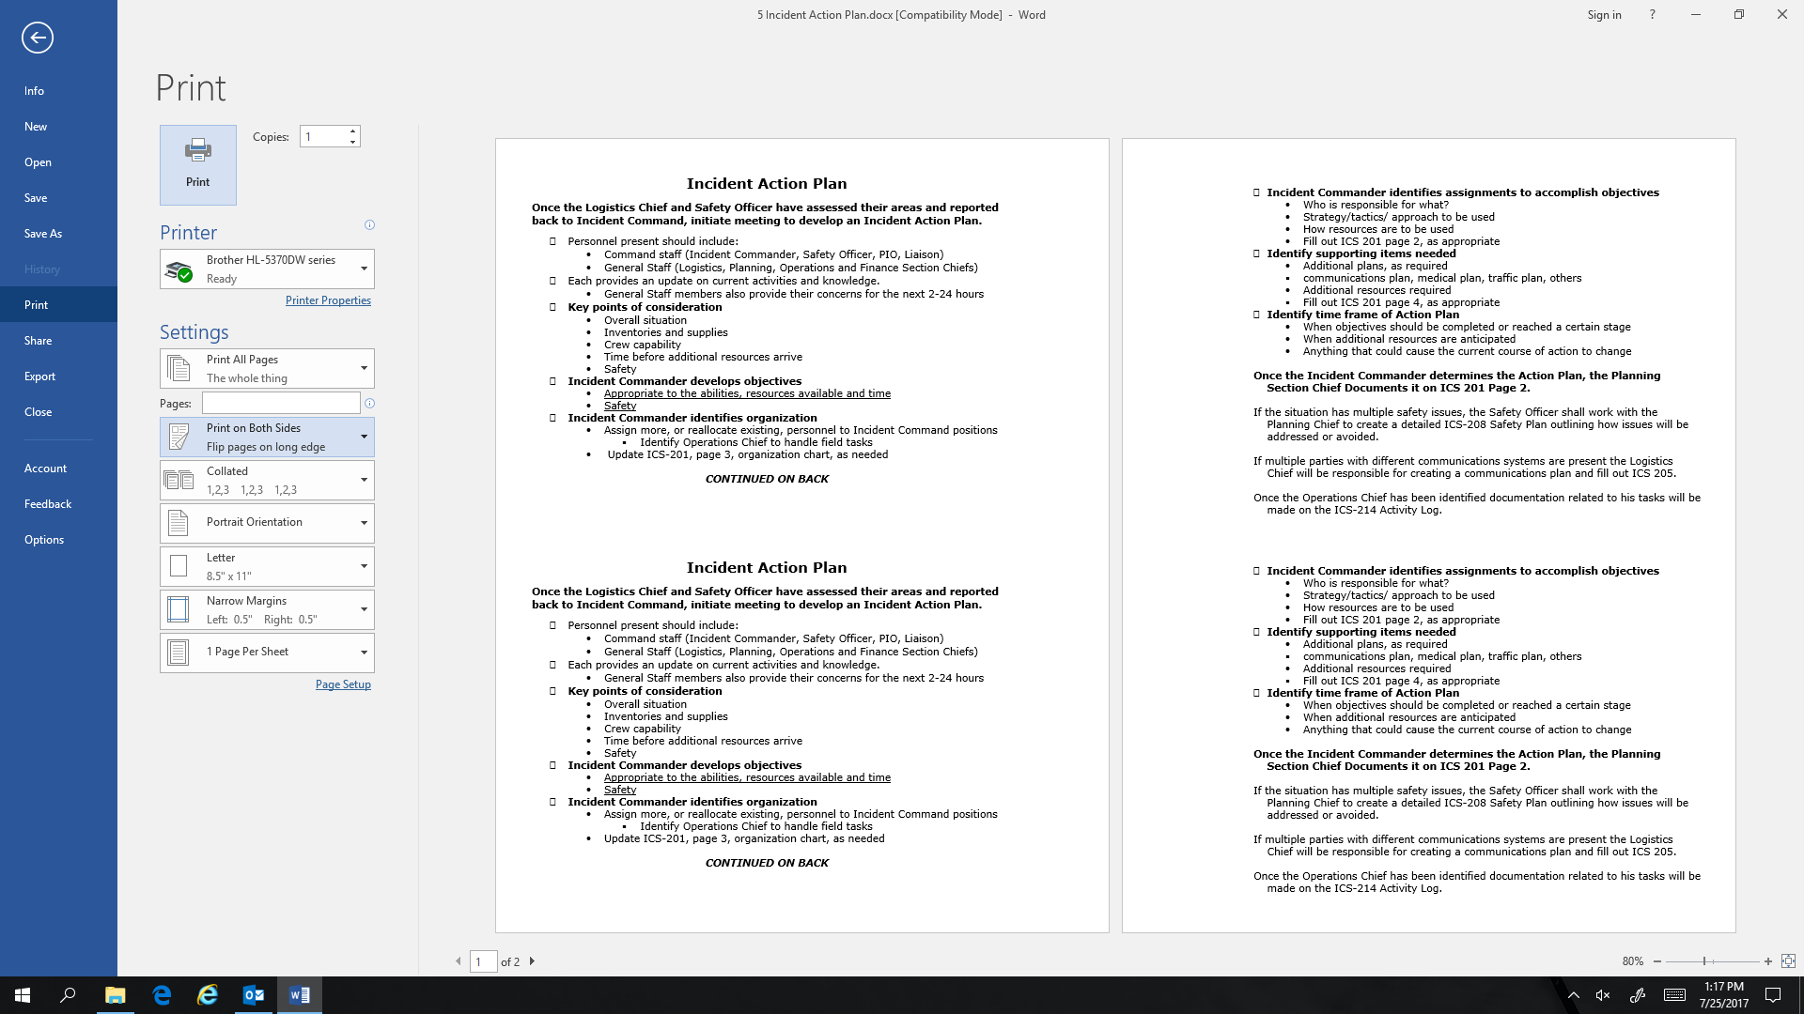
Getting two cards from one sheet of paper
1. Create a master version of the checklist.
2. Half it and then copy the first half again on the first page.
3. Copy the second half of the checklist again on the second page.
4. Adjust margin on second page left side to match first page far right; print.
5. Align the gap between the two pages (red line).
6. Print on both sides of paper

Slide 14
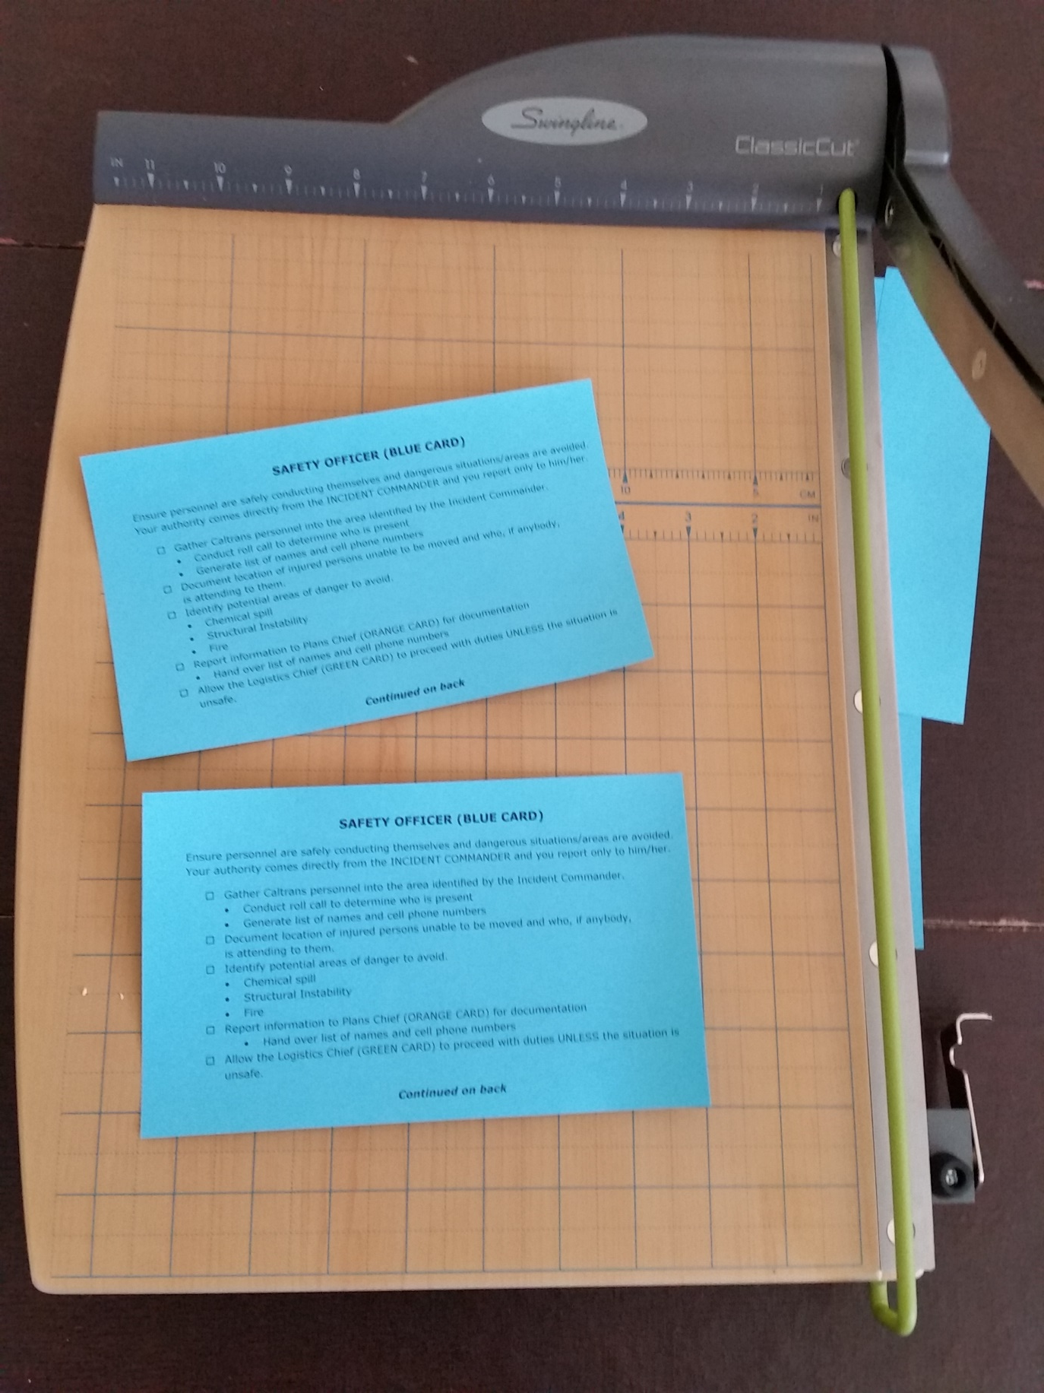
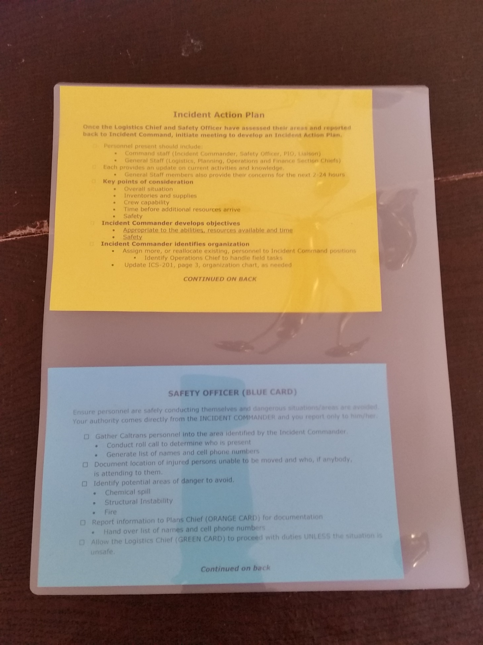
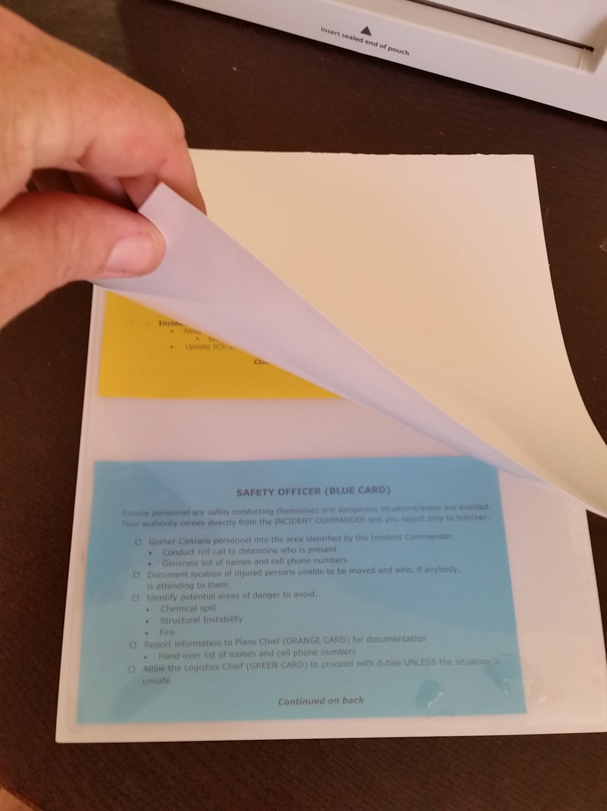
7. Trim right side page one.
8. Cut in half at approximately red line.
9. Mix short and long cards in laminate to maximize coverage.
10. Use a paper sleeve to protect laminator if needed.

Slide 15
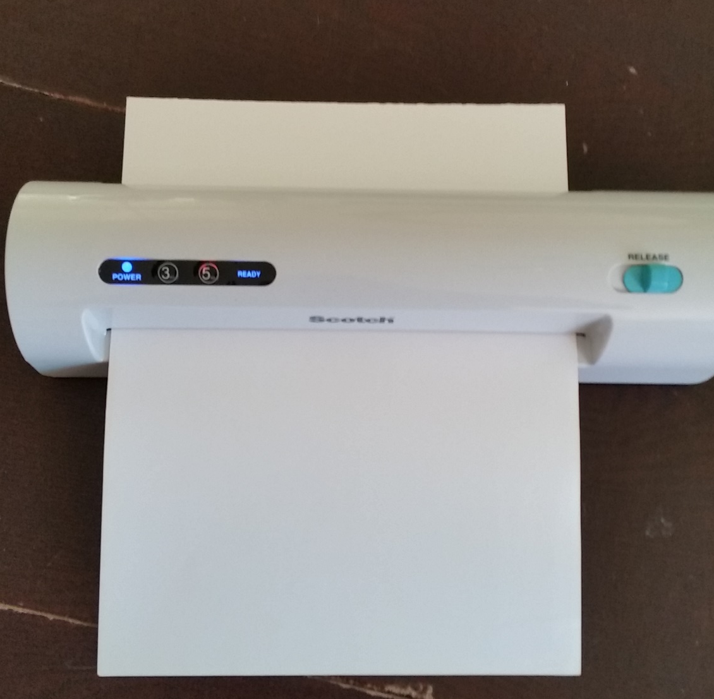
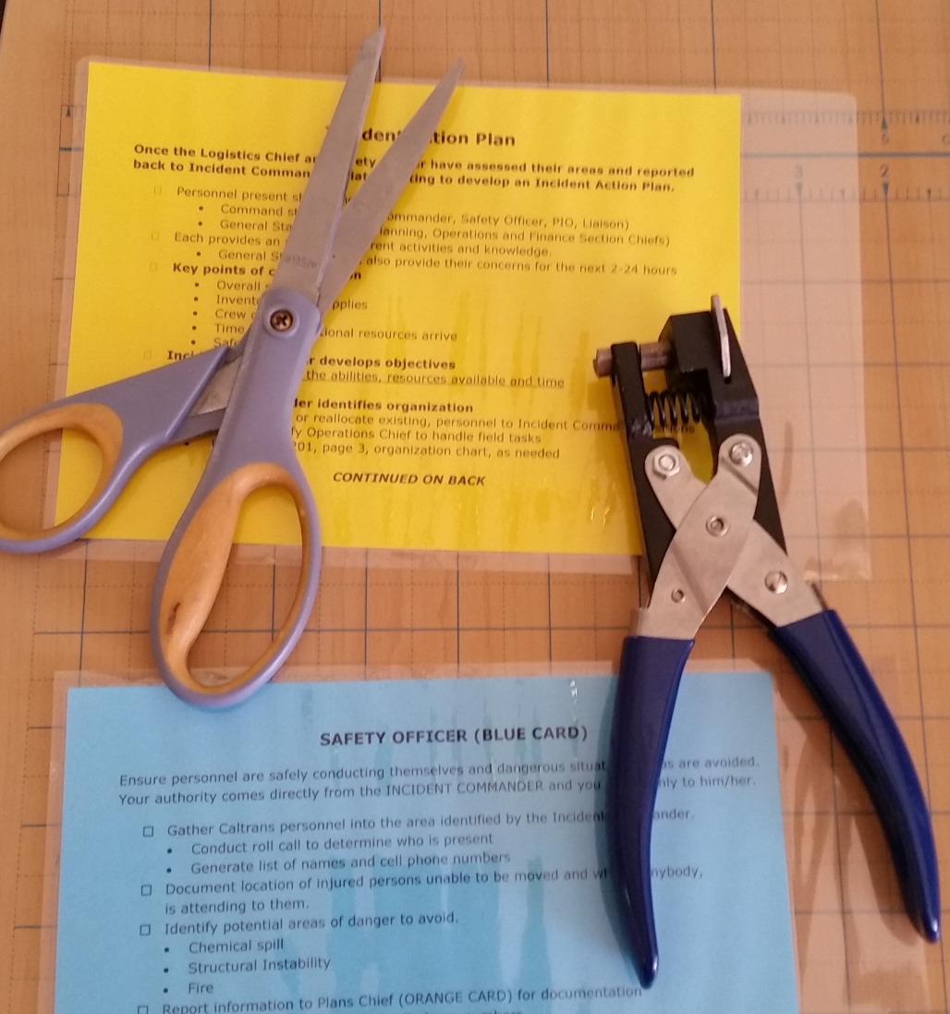
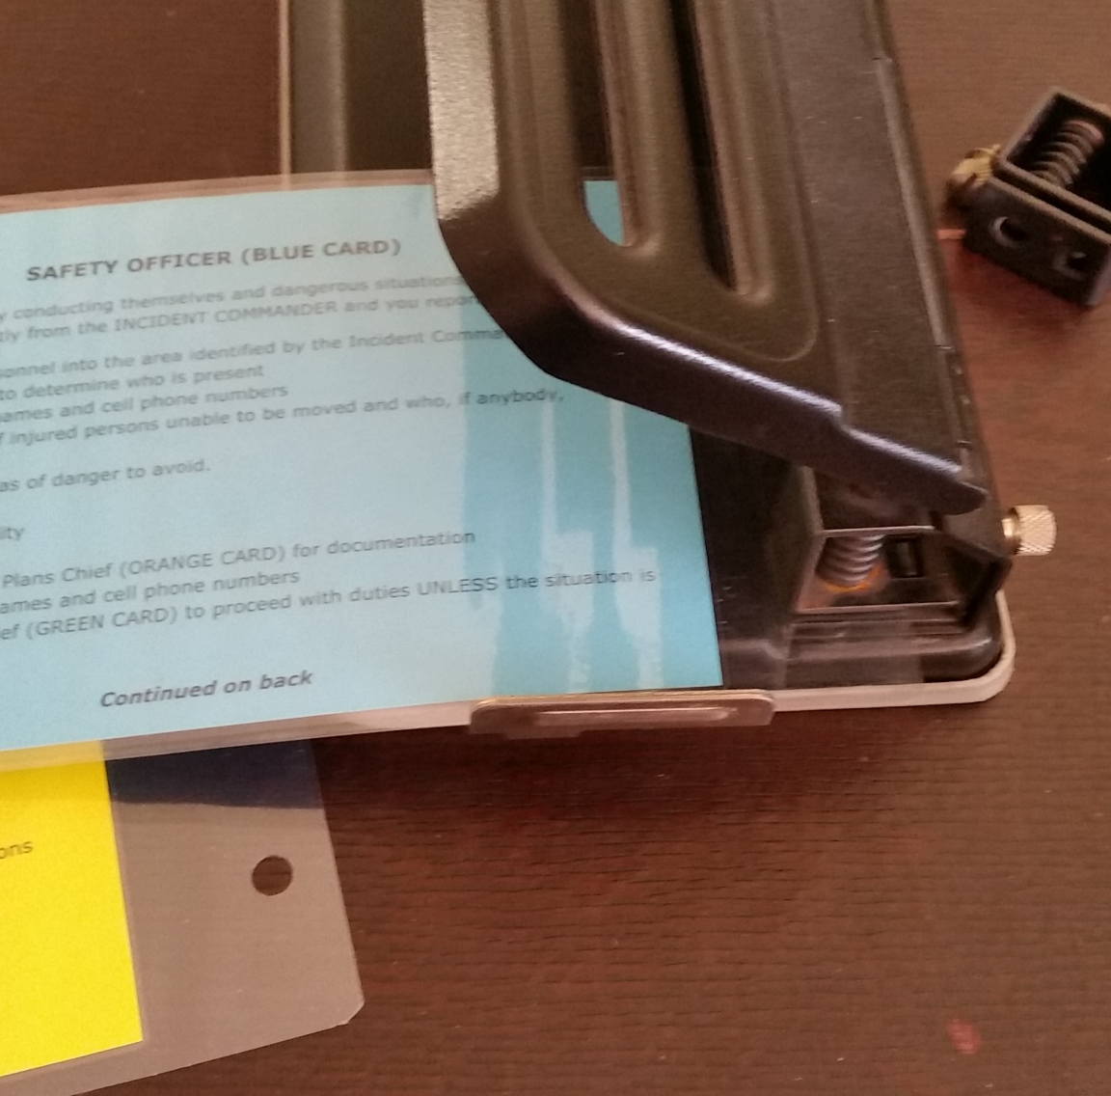
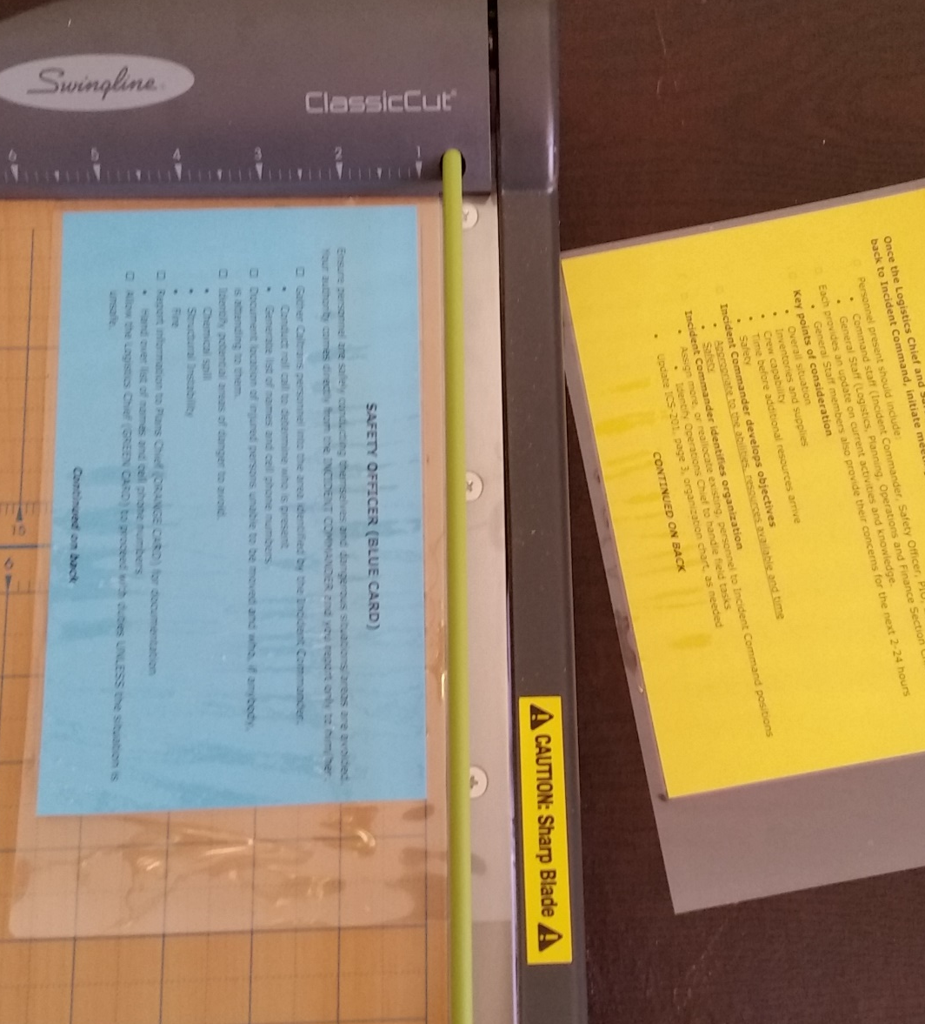
Laminate…
Cut…
Trim corners…
Punch holes.

Slide 16
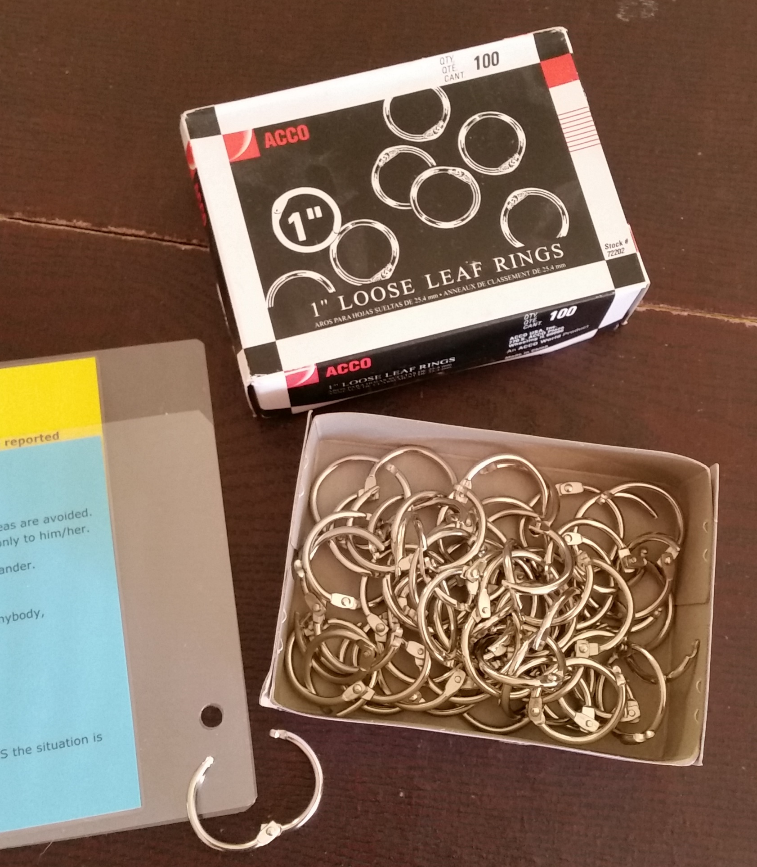
Final Assembly
Stack in order of use
Incident Commander
Safety Officer
Planning Section Chief
Logistics Section Chief
Incident Action Plan
Joining an Existing Command
Transfer of Command

Slide 17
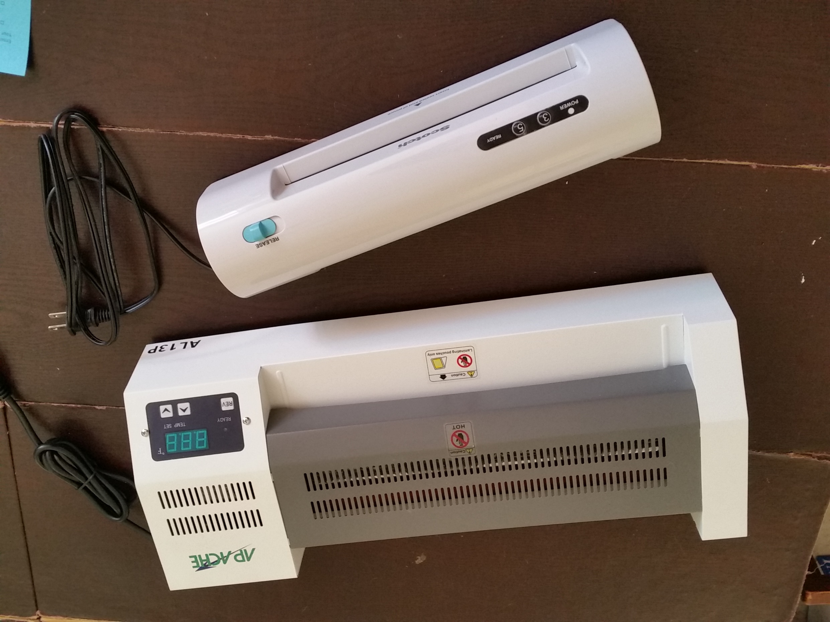
Card Manufacturing Considerations
Number of kits
Existing equipment and supplies
Color of paper
3 or 5 mil laminate
Labor

Slide 18
Alternative Methods
Synthetic Paper https://www.amazon.com/s/ref=nb_sb_noss_1?url=search-alias%3Daps&field-keywords=synthetic+paper
Self adhesive 3 mil laminating sheets https://www.amazon.com/Fellowes-Laminating-Sheets-Adhesive-5221502/dp/B0010K824A/ref=pd_bxgy_229_2?_encoding=UTF8&pd_rd_i=B0010K824A&pd_rd_r=ZK2CH7K8XCWC47PZYP0A&pd_rd_w=2eAw1&pd_rd_wg=PzRAR&psc=1&refRID=ZK2CH7K8XCWC47PZYP0A
“Buy what you need” vs. “Economy of scale” and improvise with what you have available
1” book rings, 12 per pack https://www.amazon.com/BAZIC-Metal-BookRingsSilver/dp/B0019IOEQ8/ref=pd_sim_229_8?_encoding=UTF8&pd_rd_i=B0019IOEQ8&pd_rd_r=3TG1N5MFZ3S2CYQ7B096&pd_rd_w=AfUZA&pd_rd_wg=dNpaA&psc=1&refRID=3TG1N5MFZ3S2CYQ7B096
Heavy stock paper and twist ties…
Notes:
Specific materials can be modified based on your organization’s needs, funding, available materials, and other unique situations.
Here are some alternatives.
You have to decide whether to buy in bulk and store the extra material for future builds, or to pay more per kit by buying just what you need now, but spending less money.
If the budget is tight, use cardstock and twist ties.

Slide 19
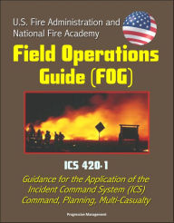
Field Operations Guide
FOG of war… *** Do Not Buy the Soft Copies, They are available for free***
The one you want: only available as digital copy
US Fire Administration/National Fire Academy FOG ICS 420-1
https://www.usfa.fema.gov/downloads/pdf/publications/field_operations_guide.pdf
Others:
Coast Guard Incident Management Handbook
http://www.mdl2179trialdocs.com/releases/release201501260800005/TREX-013516.pdf
EPA Incident Management Handbook
https://emp.epa.gov/empadmin/dynamicContent/centralrepo/EMP/Incident%20Management%20Handbook_IMH.pdf
Why then, pray tell, do I have a copy of the California FIRESCOPE FOG ICS 420-1 sitting in front of me?
Notes:
Firescope website for purchasing hard copies for the folders is
https://firescope.caloes.ca.gov/fog-manual
FIRESCOPE FOG is $15 each in hard copy. It is the same ICS 420 as the US Fire Administration’s digital version. [That is what we recommend that you distribute in the class and put in the supervisor’s folder.]
Printing the digital copy of the manual costs over $30 at FedEx, and it will be 8.5”x11” – harder to carry at an incident. The FIRESCOPE FOG fits in a turnout jacket pocket.
You cannot rely on having internet or cell phone access in a disaster. How long will the battery last on a device where you load the digital copy of the FOG?

Slide 20
firescope.org
Notes:
Ordering from FIRESCOPE online is easy. They ship all over the country.
https://firescope.caloes.ca.gov/fog-manual
The digital copy of the 2022 FOG is avai​lable as a free download on the Apple App Store​ and Google Play App Store.
​
​

Slide 21
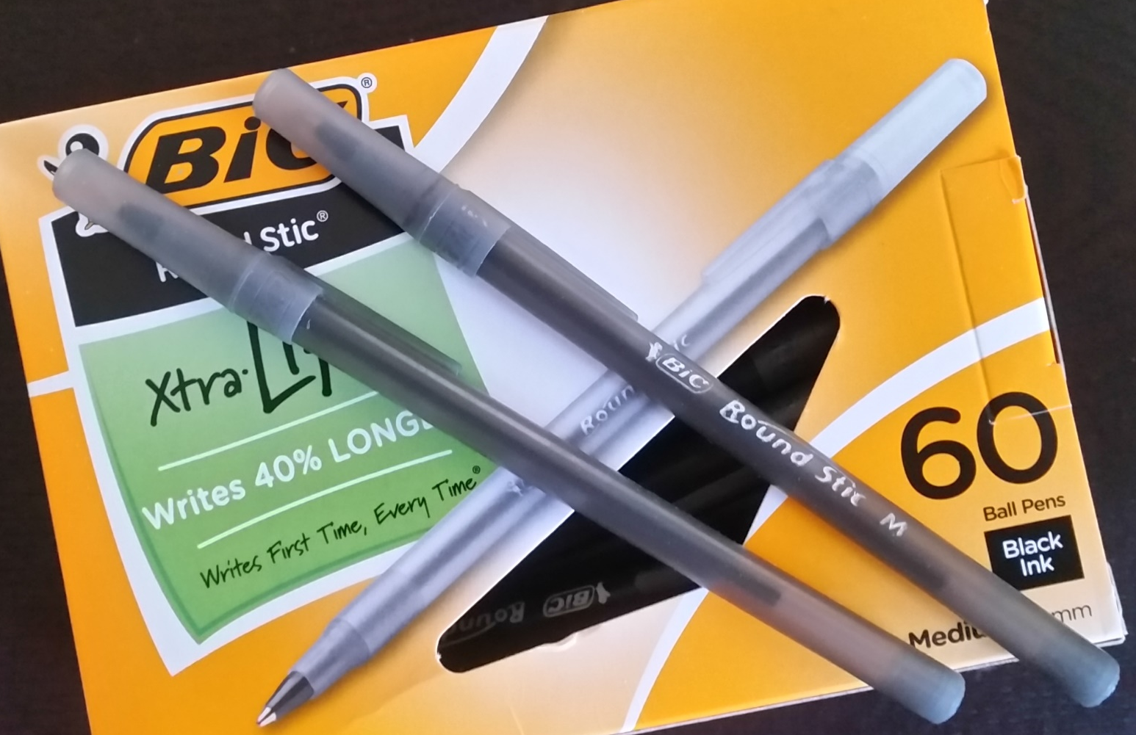
Support Items
Pens
Note Pads
???
Notes:
Buy new, get pens and notepads from the organization’s supply room, or improvise with pens and pads from conferences and hotel stays.

Slide 22
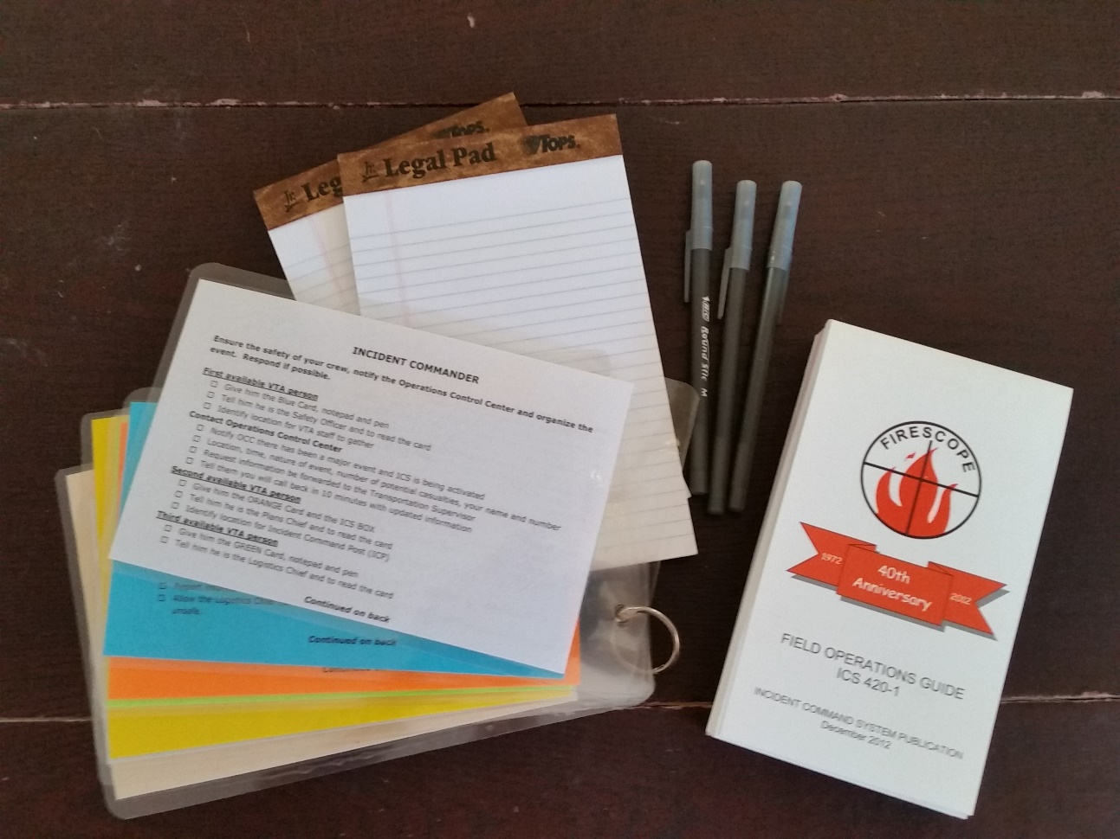
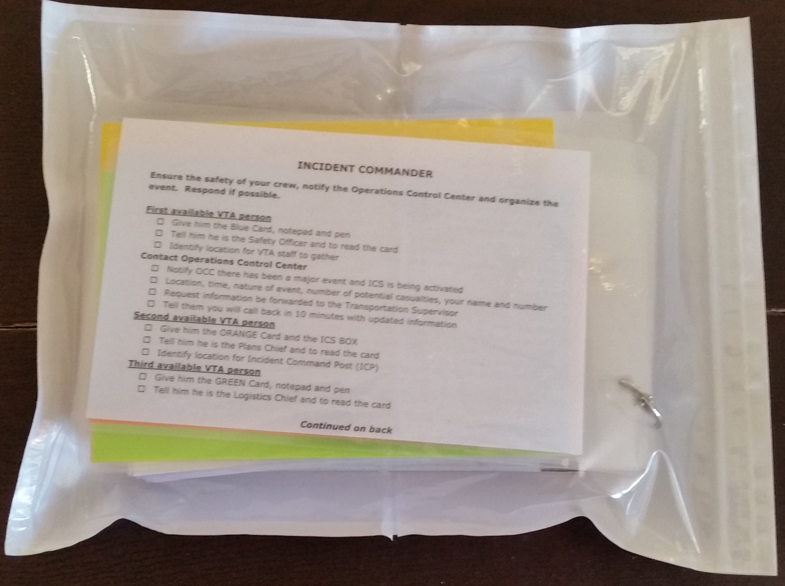
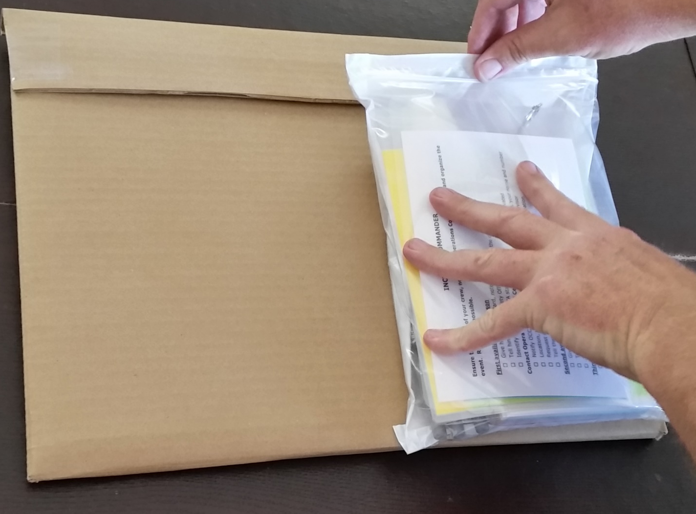
Put it in the ninth packing sleeve and….
Remove paper from adhesive backing and fold sides and bottom in approximately ½”.
Adhere to cardboard component of kit
Notes:
Organize the material with the paper and pens on the bottom, the FOG next, and the Quick Start Cards on the top. Shuffle them around until they fit.

Slide 23
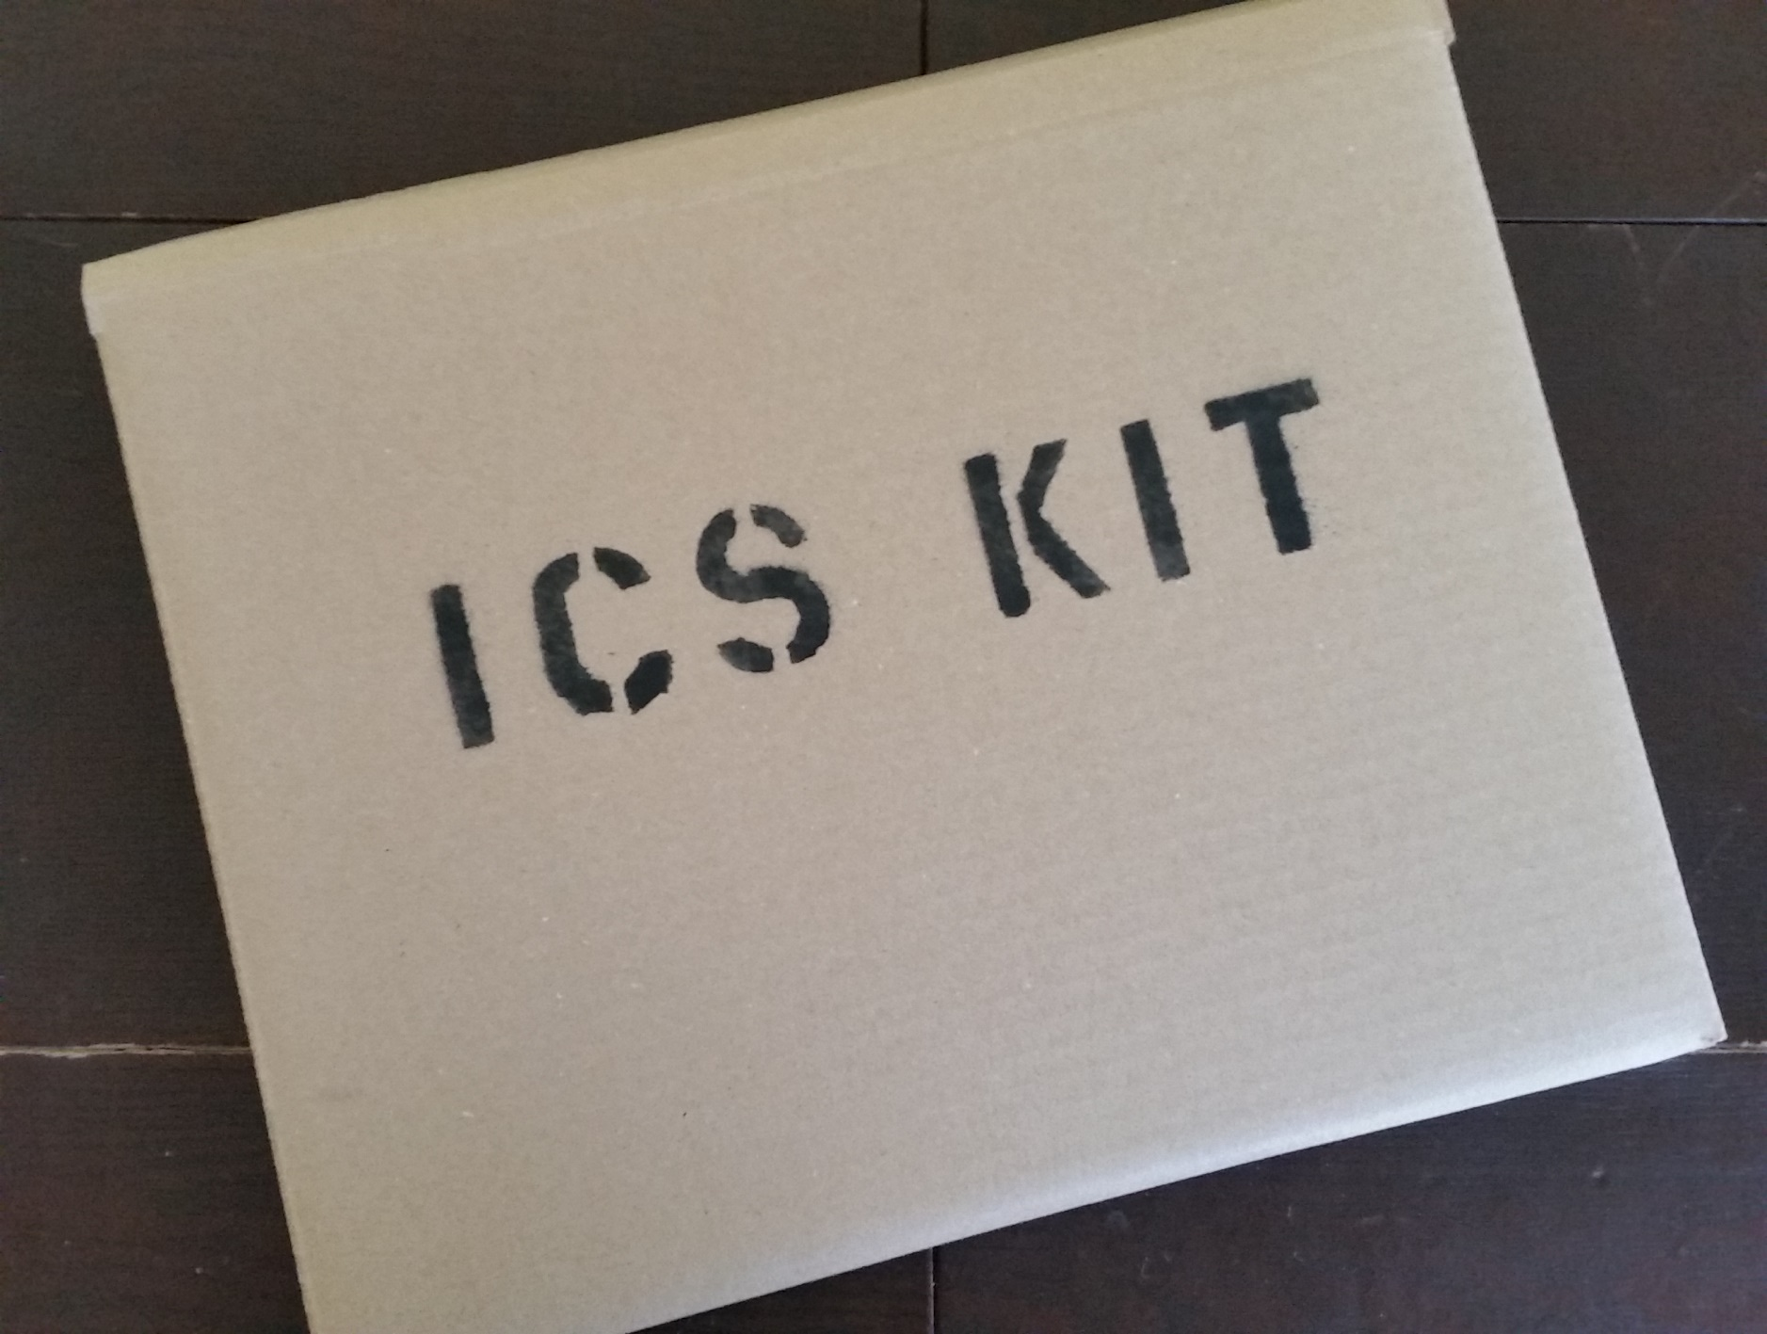
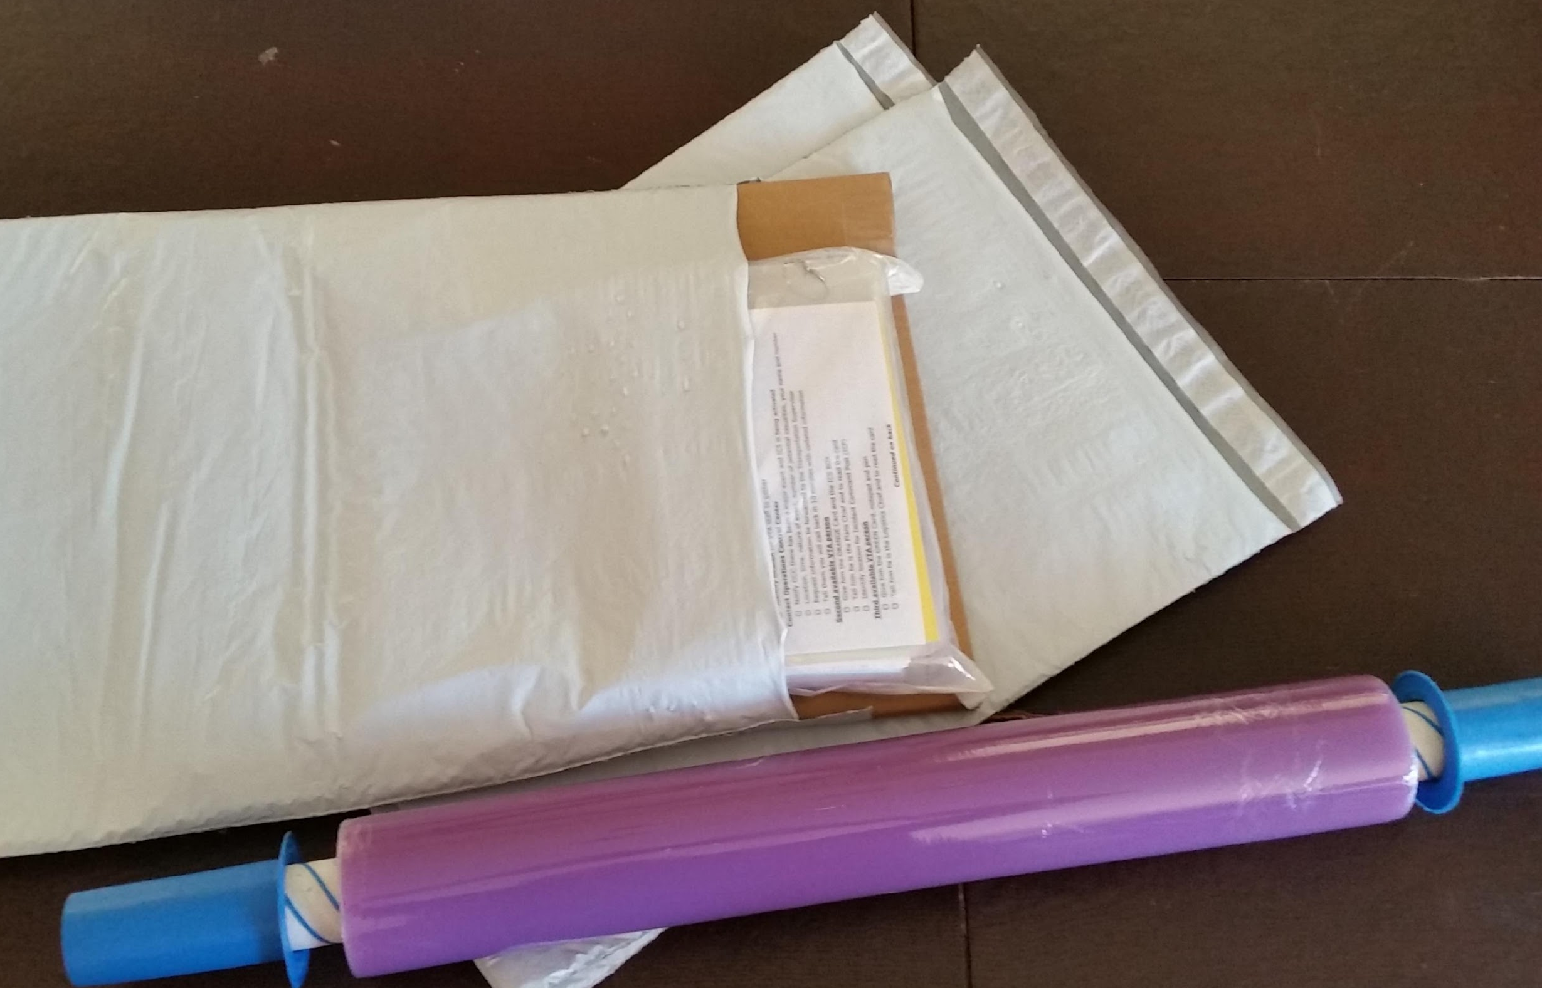
Protective measures &
Labeling/Branding
Bubble Lined Poly Mailer, XPAK725, 14.25" x 20“ https://www.amazon.com/gp/product/B00L8NNKFU/ref=oh_aui_search_detailpage?ie=UTF8&psc=1
Notes:
You can use stretch wrap to protect the folder when it is stored in your vehicle. You can use a stencil or a marker to identify the kit when it is stored.
Review the videos for details on assembly.

