Slide 1

ICS and Extreme Weather on the Railroad: Refreshers
Sponsored by
XYZ Railroad
Briefing Training
Scenarios with Rules Instructor’s Notes
Adapted from NCHRP 20‐59(30) ICS for Field-Level Transportation Supervisors and Staff
National Academies of Sciences, Engineering, and Medicine. 2016. Incident Command System (ICS) Training for Field Level Supervisors and Staff: NCHRP Web-Only Document 215. https://doi.org/10.17226/23411. Used with
permission from the National Academy of Sciences, Courtesy of the National Academies Press, Washington, D.C.

Slide 2

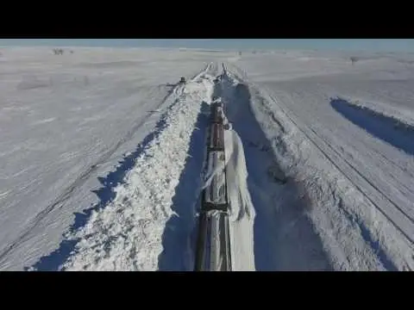
SAFETY
Incident Command
System and Extreme Weather for the Railroad
Source: Union Pacific, 2018

Slide 3

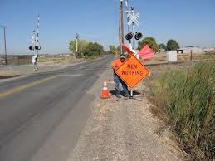
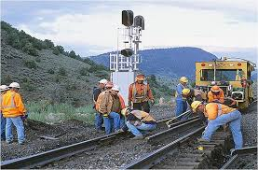
Safety in ICS
Personnel safety is the #1 objective of all ICS operations.
Source: Caltrans, 2010
Source: Union Pacific, 2020

Slide 4

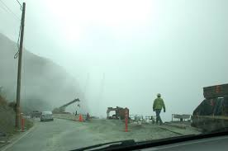
Safety in ICS
Incident Commander
Safety Officer
Public Information Officer
Liaison Officer
Source: Caltrans, 2010
Planning/ Intel Chief
Logistics Chief
Operations
Chief
Finance/
Admin Chief

Slide 5
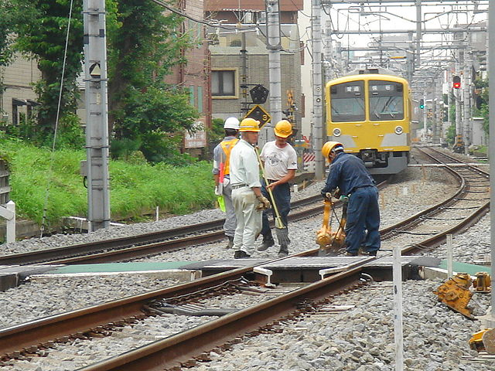
Safety in ICS
Incident Commander
Safety Officer
Public Information Officer
Liaison Officer
Planning/ Intel Chief
Logistics Chief
Operations
Chief
Finance/
Admin Chief
Source: Wikipedia, 2012

Slide 6
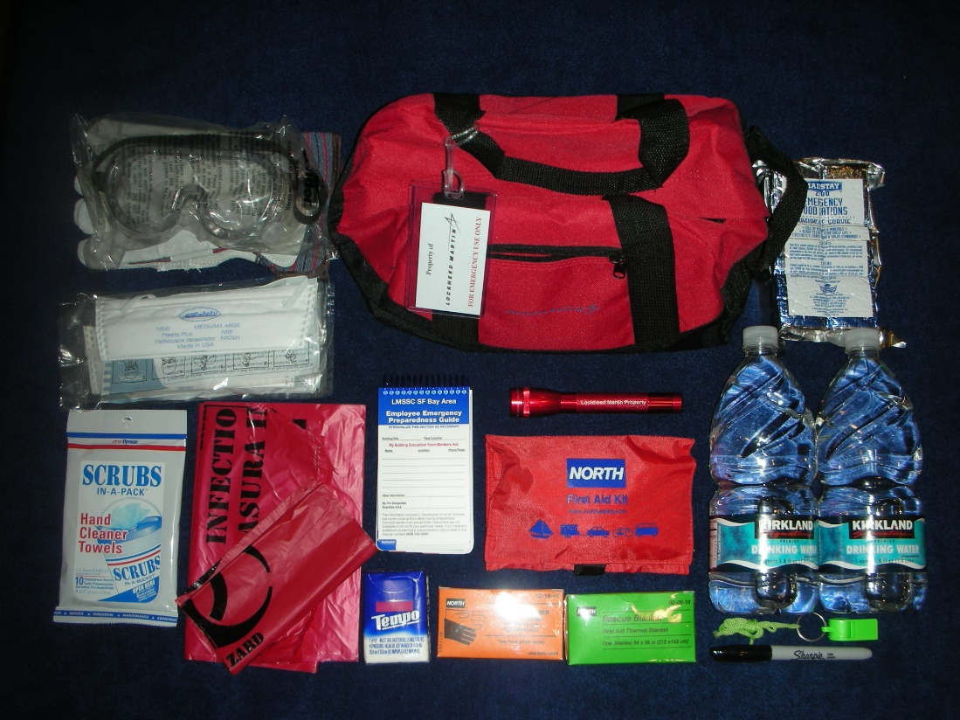
Safety in ICS
Incident Commander
Safety Officer
Public Information Officer
Liaison Officer
Planning/ Intel Chief
Logistics Chief
Operations
Chief
Finance/
Admin Chief
Source: Goodrich, 2015

Slide 7
Safety in ICS
Incident Commander
Safety Officer
Public Information Officer
Liaison Officer
Planning/ Intel Chief
Logistics Chief
Operations
Chief
Finance/
Admin Chief

Slide 8

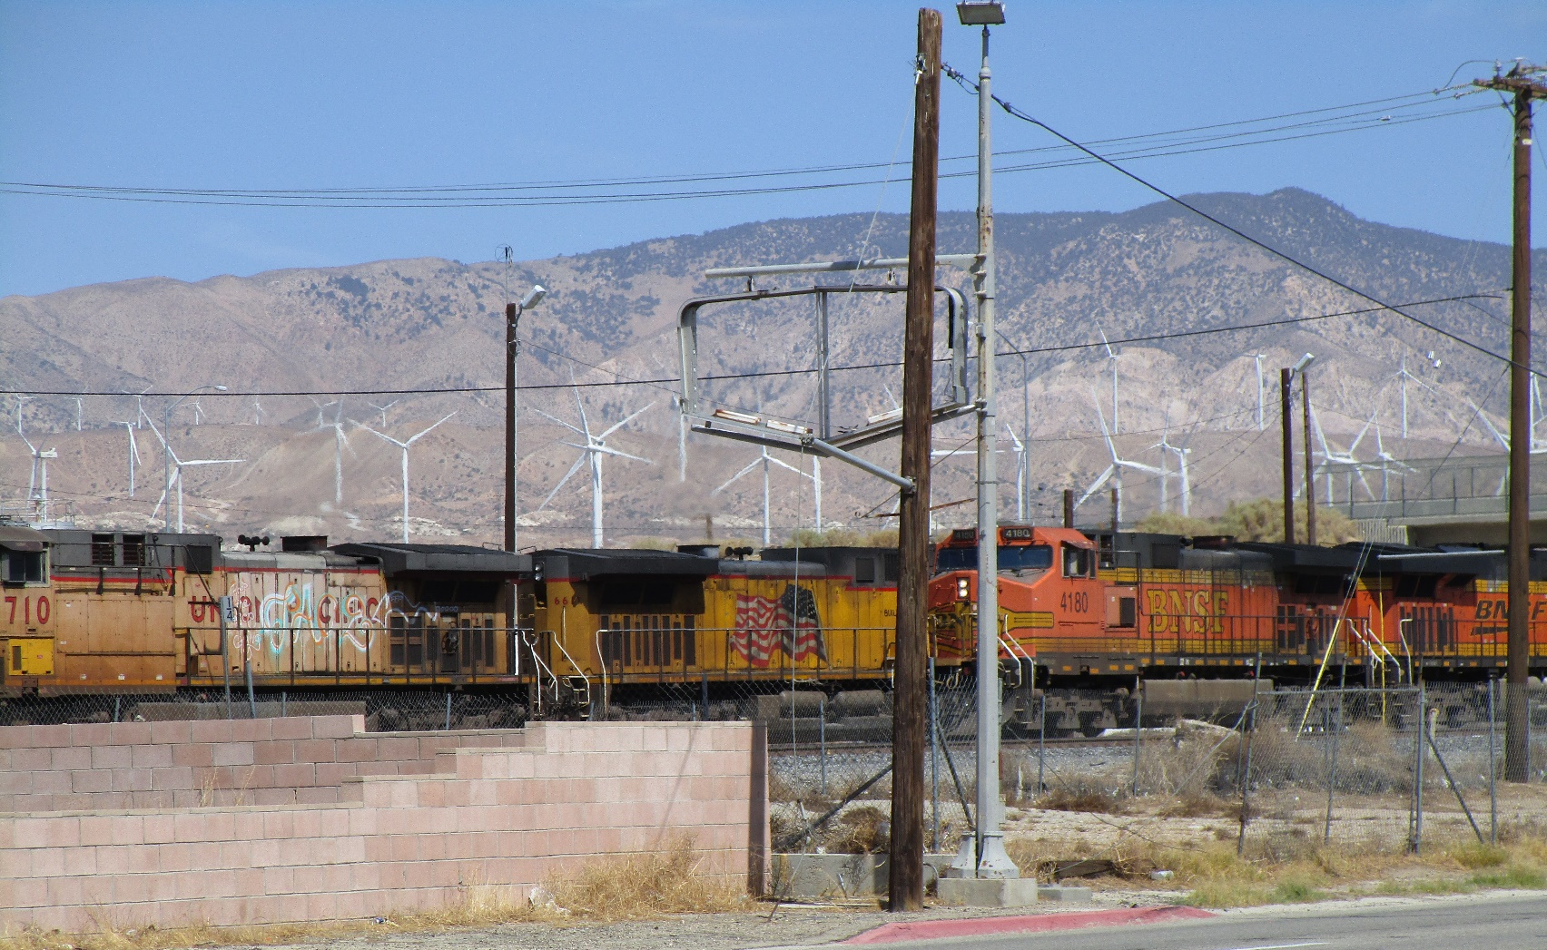
Questions?
Source: Edwards, 2021.

Slide 9
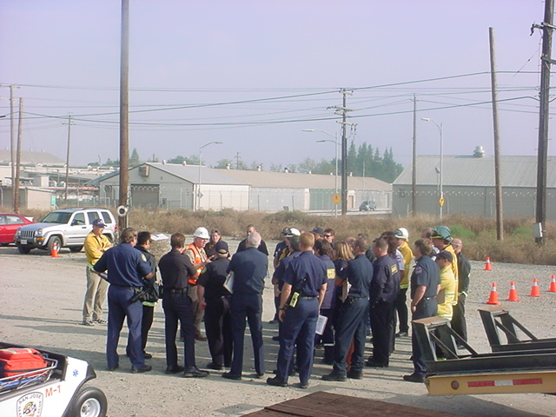
Collaboration with
Other Professions
Source: Edwards, 2005

Slide 10

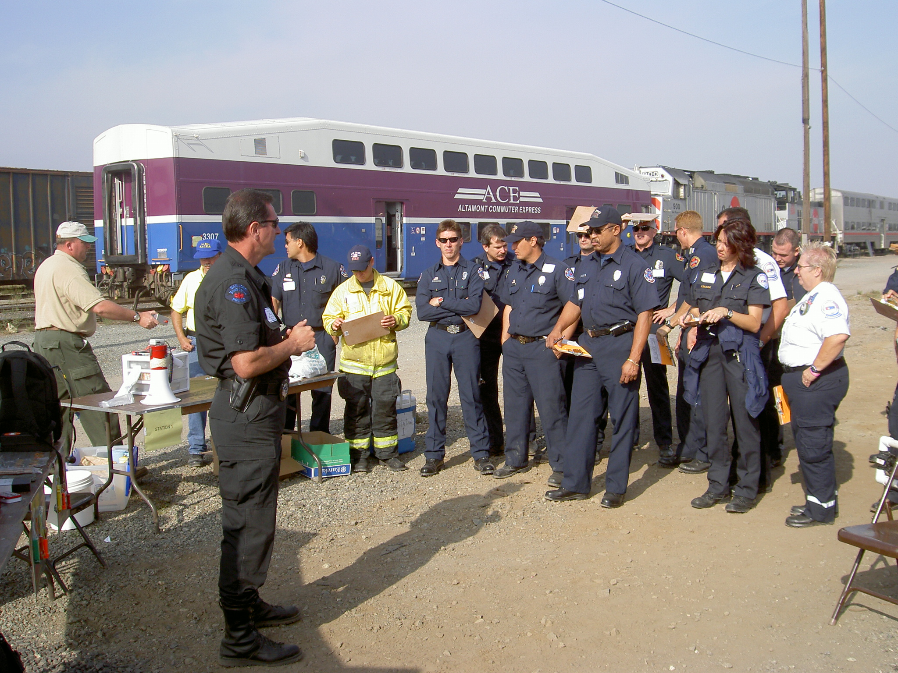
Collaboration with
Other Professions
Disasters require collaboration among many emergency response organizations to help the victims
  Law enforcement
  Fire
  EMS
  Road department
  Railroad
Source: Edwards, 2005

Slide 11
Collaboration with Other Professions
Roles for Transportation in ICS
Railroad personnel may
  Start Incident Command
    First on scene
    Transportation-only event
  Join Incident Command
    Agency Liaison
    Tech specialist
    Ops or Logistics
  Join Unified Command
    Multiple agencies with equal responsibility for the outcome
ICS
Ops
Unified Command

Slide 12
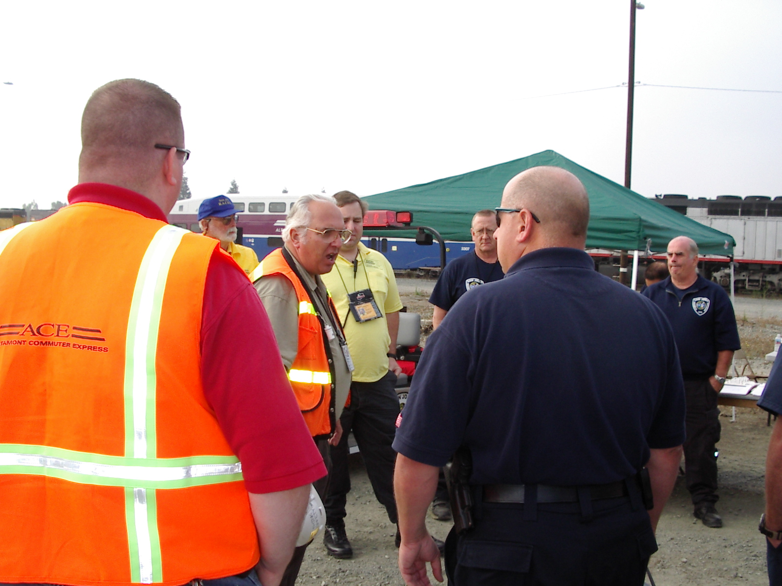
Collaboration with
Other Professions
Starting incident command
  First on the scene
  Turn over to other responders
  Transportation-only event
Source: Edwards, 2005

Slide 13
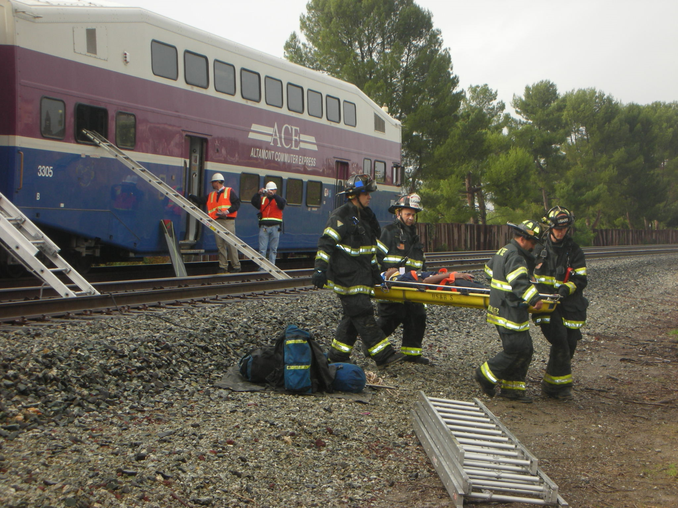
Collaboration with
Other Professions
Joining existing Incident Command
  As Agency Liaison
  As Technical Specialist
  In Operations
  In Logistics
  Accept IC from another agency
Source: Edwards, 2007

Slide 14
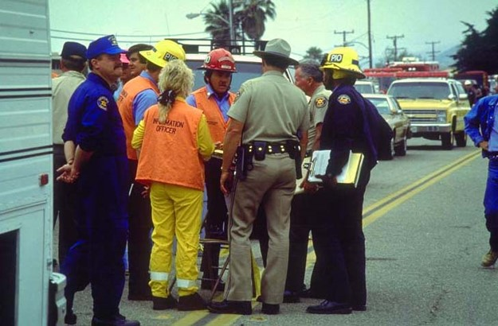
Collaboration with
Other Professions
Unified Command
  All professions have an equal role in developing the Common Objectives for the Incident Action Plan (IAP).
  “Unified Command is a team effort that allows all agencies with jurisdictional responsibility for an event…to participate in the management of the incident. Developing…a common set of incident objectives…without losing…authority, responsibility or accountability.” FEMA FOG, 2010, p. 6-2.
Source: FEMA, 2010

Slide 15
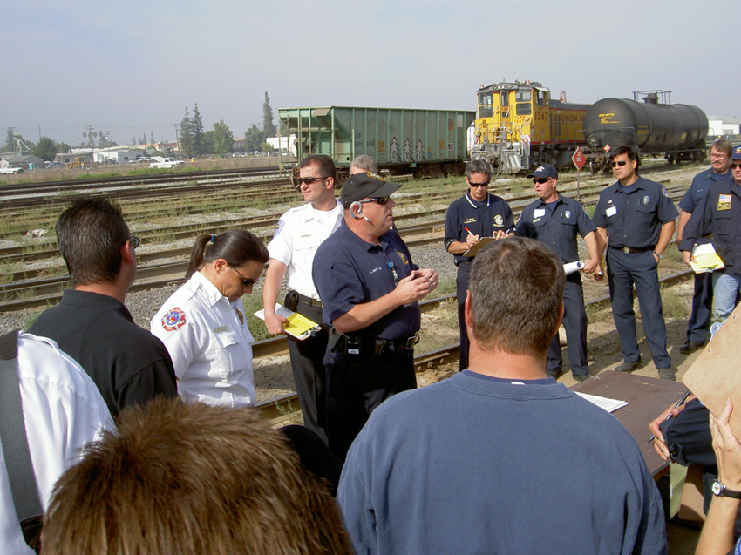
Collaboration with
Other Professions
ICS provides the framework for collaboration.
“A successfully managed multiagency incident will occur only when the participating agencies’ personnel have confidence in each other’s competencies, authorities, responsibilities and limitations as they relate to the incident.”
FEMA FOG, 2010, p. 6-3.
Source: Edwards, 2005

Slide 16
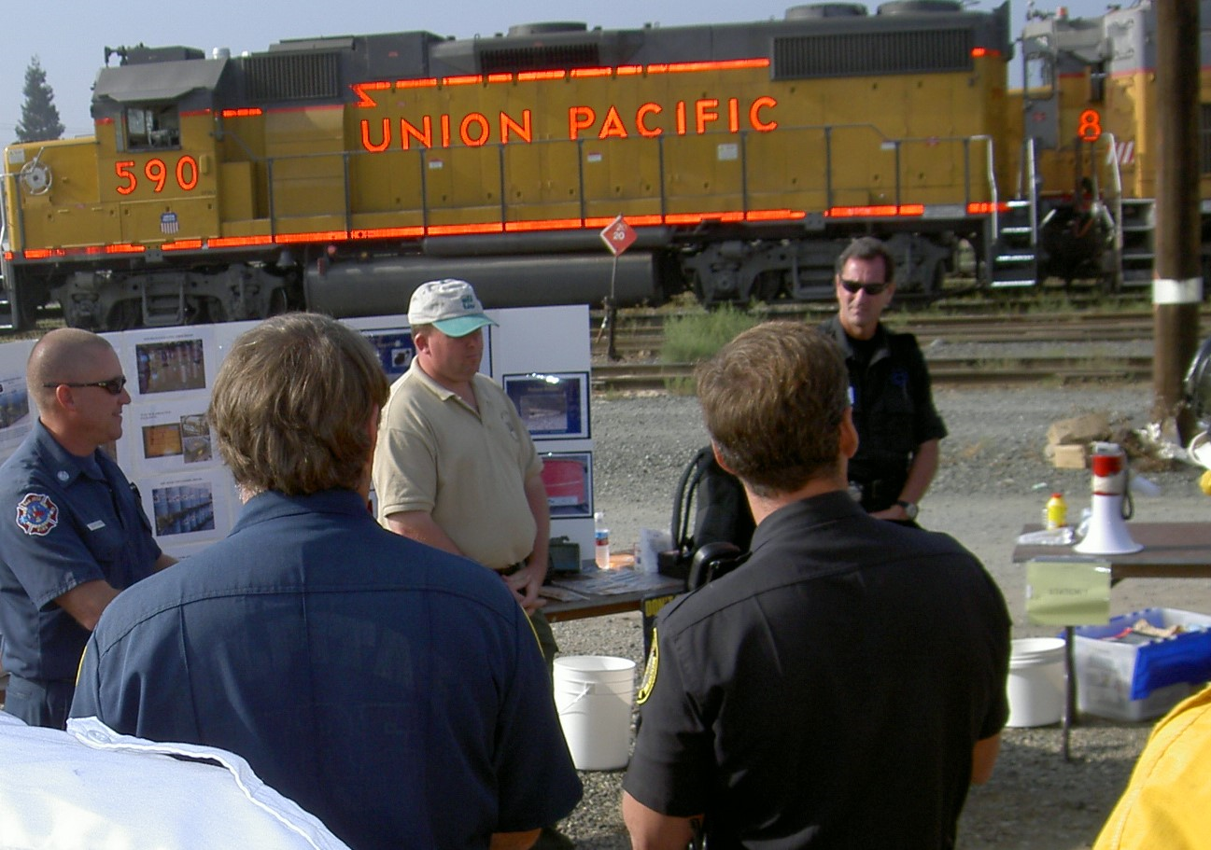
Collaboration with Other Professions
QUESTIONS?
Source: Edwards, 2005

