Slide 1
ICS and Climate Change on the Railroad: Refreshers
Sponsored by
XYZ Railroad
Briefing Training
Scenarios with Rules Instructor’s Notes
Adapted from NCHRP 20‐59(30) ICS for Field-Level Transportation Supervisors and Staff
National Academies of Sciences, Engineering, and Medicine. 2016. Incident Command System (ICS) Training for Field Level Supervisors and Staff: NCHRP Web-Only Document 215. https://doi.org/10.17226/23411. Used with
permission from the National Academy of Sciences, Courtesy of the National Academies Press, Washington, D.C.

Slide 2
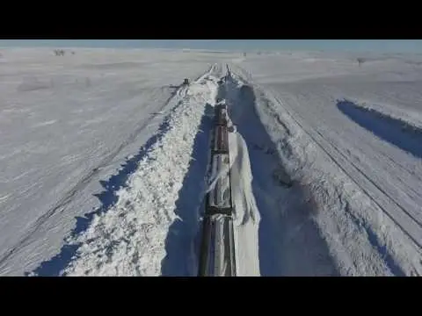
SAFETY
Incident Command System and Climate Change for the Railroad
Source: Union Pacific, 2018
Notes:
Today we are starting our shift with a brief review of the Safety elements of the Incident Command System. The safety of our personnel is the #1 objective of the railroad at all times. In normal working conditions, the methods for ensuring safety are well known and practiced.
However, under the stress of an emergency or disaster it might be easy to forget that your personal safety is still #1. If you rush in and behave in an unsafe manner, you may become another victim, which enlarges the emergency and denies a resource to the response.
ICS provides a system for ensuring that all personnel operate safely at all times.

Slide 3
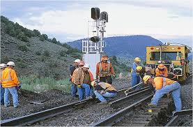
Safety in ICS
Personnel safety is the #1 objective of all ICS operations.
Source: Caltrans, 2010
Source: Union Pacific, 2020
Notes:
All ICS activities begin with the objective: “All personnel will work safely at all times.”
Safety begins with each worker using appropriate safety equipment and following appropriate safety rules.
Most railroad field work is done near a functioning railroad line, which is inherently dangerous. Dispatch will manage signals to ensure that the work track is not in active use.
In an emergency or disaster, these same precautions are even more important. All safety precautions must be used during emergency response.

Slide 4
Safety in ICS
Incident Commander
Safety Officer
Public Information Officer
Liaison Officer
Source: Caltrans, 2010
Planning/ Intel Chief
Logistics Chief
Operations
Chief
Finance/
Admin Chief
Notes:
The first person at the scene of an emergency is the Incident Commander. This person is in overall charge of the event. They should remove the Supervisor’s folder from their vehicle, access the laminated card set, and read the guidance for Incident Commander. Safety is the #1 objective for the Incident Action Period.
When a second person arrives, the Incident Commander designates the Incident Command Post and gives them the Safety Officer card. That person is now the Safety Officer, and must gather all personnel, conduct roll call, ascertain personnel health and safety status, and any potential areas of danger to avoid. The Safety Officer relays the roll call information to the Planning/Intelligence Section Chief, when appointed.
The Safety Officer is then responsible for ensuring that everyone in the ICS organization acts safely at all times. This includes wearing the required personal protective equipment, such as a hard hat, reflective vest, eye protection appropriate for the work environment, appropriate footwear, and any other safety equipment appropriate for the work being done.
The Safety Officer also ensures that all personnel are using the appropriate equipment for the task being performed, and that they are using the equipment safely. This is a continuous assignment that ends only when the incident is resolved.

Slide 5
Safety in ICS
Incident Commander
Safety Officer
Public Information Officer
Liaison Officer
Planning/ Intel Chief
Logistics Chief
Operations
Chief
Finance/
Admin Chief
Source: Wikipedia, 2012
Notes:
When a third person arrives on the scene, the Incident Commander gives this person the Planning/Intelligence Section Chief card. This person hangs up the Supervisor’s Folder, completes the initial forms in concert with the Incident Commander, and obtains the personnel roll call information from the Safety Officer to create initial check-in. They then obtain the names, contact information—radio or cell phone currently in their possession—and current work location and assignment within ICS from the personnel present.
As additional people arrive, they will check-in with the Planning/Intelligence Section Chief, and be given a specific assignment and a specific supervisor. The railroad workers will maintain these positions until the task is completed or command is turned over to another entity. When the initial assignment is complete, they will check out with the Planning/Intelligence Section Chief. If the emergency has not been completely mitigated, the P/I Chief will give the worker a new assignment and a new supervisor.
If the worker has completed their shift, they will sign out with the Planning/Intelligence Section Chief and provide their destination, whether back to the yard or home.
Through the P/I Chief’s management of the check-in/ check-out process the Incident Commander maintains control over the locations and safety of all personnel in the Incident Command System.

Slide 6
Safety in ICS
Incident Commander
Safety Officer
Public Information Officer
Liaison Officer
Planning/ Intel Chief
Logistics Chief
Operations
Chief
Finance/
Admin Chief
Source: Goodrich, 2015
Notes:
When a fourth person arrives on the scene, the Incident Commander gives this person the Logistics Section Chief card. This person’s role is to inventory all supplies and equipment that are currently available at the scene. These are items that have been brought by the workers in their vehicles, or items that had been delivered to the scene earlier for routine work.
The Logistics Chief’s initial focus for the inventory is quantities of items needed to support the safe operation of incident personnel: water, medical supplies, clothing, blankets and food. The next focus is tools, vehicles (availability and serviceability), radios, flashlights, batteries, signage and sanitation. This inventory checks whether the emergency has damaged or destroyed any of the items.
The Logistics Chief reports to the Incident Commander with a list of currently available personnel support items. Based on the Incident Commander’s estimate of time for the resolution of the emergency, or 24 hours if the length is unknown, the Logistics Chief and Incident Commander jointly determine a list of items and quantities that need to be ordered expeditiously to support continued safe operations.

Slide 7
Safety in ICS
Incident Commander
Safety Officer
Public Information Officer
Liaison Officer
Planning/ Intel Chief
Logistics Chief
Operations
Chief
Finance/
Admin Chief
Notes:
With the ICS established with four personnel, the overall safety of the operation is protected. As additional personnel arrive, they can be given Operations assignments to begin responding to the event. The Incident Commander can establish an Operations Section at any time when the combined duties of Incident Command and Operations Section Chief become too large for one person, or when the number of people being supervised exceeds seven, the mandated maximum span of control under ICS. A Finance/Administration Section can be established if needed.
The Safety Officer ensures that all workers are wearing the required safety equipment, and all work is being performed safely. The Planning/Intelligence Section Chief knows who is working at the emergency site and exactly where each has been assigned. The Logistics Section Chief knows what resources are available to support the safe operations of the emergency response, and what items have been ordered to augment the resources.
Remember that the Incident Commander retains all responsibilities not given to others. While the Planning/Intelligence Chief, Logistics Chief, and Safety Officer are doing their jobs, the Incident Commander is sizing up the situation, determining the type and extent of damage, the number of possible injuries and whether the situation is getting better or getting worse. The required work of the Incident Commander, Safety Officer, Planning/Intelligence Section Chief and Logistics Section Chief should be able to be accomplished by the four ICS positions simultaneously, requiring ten minutes or less, yet ensuring a safe work environment.

Slide 8
Questions?
Source: Edwards, 2021.
Notes:
Are there any questions about today’s briefing training on Safety and ICS?
Thank you for attending. Have a good day and always operate safely!

Slide 9
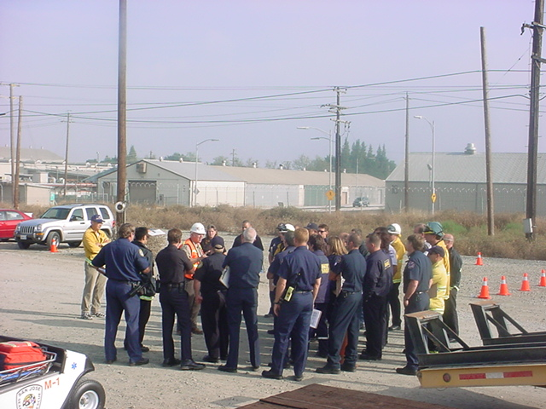
Collaboration with
Other Professions
Source: Edwards, 2005
Notes:
Today we are starting our shift with a brief review of the positions railroad personnel might hold when collaborating with other professions within the Incident Command System. The safety of our personnel is the #1 objective of the railroad at all times.
In many emergencies on or adjacent to the railroad, the rail personnel will be just one profession working to save lives, protect property and the environment, and prevent the emergency from growing. Success requires collaboration across professions.

Slide 10
Collaboration with Other Professions
Disasters require collaboration among many emergency response organizations to help the victims
Law enforcement
Fire
EMS
Road department
Railroad
Source: Edwards, 2005
Notes:
When there is an emergency—whether a derailment, vehicle collision, hurricane, or something else—rail personnel cannot usually resolve all aspects of the event alone. The #1 Objective of ICS is the safety of all personnel. The rest of the initial objectives—to save lives, protect property and the environment, and prevent the emergency from growing—will usually require collaboration with other professionals who provide rescue, care, and protection to any victims, the environment, and the community.
Railroad personnel frequently collaborate with other emergency response personnel when responding to hazmat spills or vehicle accidents. Law enforcement personnel direct traffic, fire personnel rescue people trapped in vehicles and provide initial mitigation of hazmat spills, and emergency medical services personnel provide field level expedient medical care to the injured. Highway department personnel provide supporting services like traffic control devices, highway signage for notification of the accident to other drivers, and lane closures during emergency operations. The local agency or railroad may engage a contractor to protect the environment and clean up any hazardous materials, including vehicle fuel and leaks during derailments.

Slide 11
Collaboration with Other Professions
Roles for Transportation in ICS
Railroad personnel may
Start Incident Command
First on scene
Transportation-only event
Join Incident Command
Agency Liaison
Tech specialist
Ops or Logistics
Join Unified Command
Multiple agencies with equal responsibility for the outcome
ICS
Ops
Unified Command
Notes:
Railroad personnel may be part of ICS at several levels. If railroad personnel are the first on the scene, especially in a remote area, they may establish ICS, notify dispatch of the emergency and ask for the line to be closed, conduct size up, ensure access for other emergency responders, and order additional resources. They may even provide exigent care to injured victims.
More often railroad personnel will join an existing ICS in any of several roles, including agency liaison, technical specialist, or as part of Operations or Logistics.
In large or long-term events, rail personnel may help to create a Unified Command.

Slide 12
Collaboration with Other Professions
Starting incident command
First on the scene
Turn over to other responders
Transportation-only event
Source: Edwards, 2005
Notes:
Railroad personnel may start ICS if they are the first emergency responders on the scene of an event, especially a vehicle accident in a remote area. If the train crew is the first on scene, the conductor would be the incident commander and start the response. If a railroad maintenance-of-way crew were first on scene, the person best trained in ICS would be the IC. The railroad staff will establish ICS, notify Dispatch of the event, appoint a Safety Officer, Planning/Intelligence Section Chief and a Logistics Section Chief, and begin size up of the event, perhaps even ordering additional resources.
Once another emergency response organization arrives, the rail personnel may turn over the Incident Command role to a Fire or Law Enforcement officer with more qualifications, certifications or experience. The railroad staff may then become part of the ICS, or may be relieved until all life safety issues have been resolved.
Some events only involve the failure of the rail infrastructure, with no life safety implications, and rail personnel may fully staff the ICS through the event until its resolution. Sometimes rail staff will use ICS to manage planned maintenance or a planned track closure for another purpose. Other professions may not be needed, and railroad personnel will manage all ICS roles throughout the event.

Slide 13
Collaboration with Other Professions
Joining existing Incident Command
As Agency Liaison
As Technical Specialist
In Operations
In Logistics
Accept IC from another agency
Source: Edwards, 2007
Notes:
Railroad personnel may be requested to assist with an existing ICS event. In some cases, the Incident Commander will request a railroad liaison to provide information on railroad assets and capabilities that might be needed as resources for the resolution of the problem. This could include the use of operators and equipment, or the application of specialized knowledge.
Some railroad personnel might be needed as technical specialists. They might be invited to join the Planning/Intelligence Section to provide information on the railroad operations, the construction of the track or infrastructure, or the design of a bridge or tunnel, including disaster resilient elements like wind and shaking resistance.
Railroad assets and personnel might be requested to join ICS in the Operations Section, when their capability is needed for rescue, track clearance, right of way access, or expedient repairs to provide emergency access to the accident scene for other responders.
Rail assets and personnel might be requested to join ICS in the Logistics Section, when personnel support equipment, communications equipment or power and lighting might need to be accessed.
In some cases railroad personnel might join the ICS, and then the most qualified and experienced railroad staff member present may assume Incident Command when all life safety issues have been resolved, but the railroad still needs clearance or repair before being reopened.

Slide 14
Collaboration with Other Professions
Unified Command
All professions have an equal role in developing the Common Objectives for the Incident Action Plan (IAP).
“Unified Command is a team effort that allows all agencies with jurisdictional responsibility for an event…to participate in the management of the incident. Developing…a common set of incident objectives…without losing…authority, responsibility or accountability.” FEMA FOG, 2010, p. 6-2.
Source: FEMA, 2010
Notes:
Many emergencies that involve the railroad require the cooperation of multiple agencies to manage and resolve the situation. Traffic control will usually be the responsibility of law enforcement, which may have initial Incident Command. If there are trapped or injured people, the fire department and emergency medical services personnel may be called to the scene to care for life safety issues. In many jurisdictions, the fire service has Incident Command until all life safety issues are resolved. If the event is in the railroad right of way, railroad personnel would normally have a supporting role in management, access and egress control, and debris management while the life safety issues are addressed. Utility workers might be needed to mitigate hazards like downed power lines or broken pipelines. If the emergency occurred at an overcrossing of a city street or county road, there could be other transportation personnel working at the scene.
When multiple professions or multiple jurisdictions have responsibilities for the management of the event, a Unified Command may be established. This allows the development of a common operating picture among the professions and jurisdictions, and the creation of a single Incident Action Plan with unified objectives that will guide the work of all the organizations present. Unified Command is collaboration among many emergency responders for the benefit of the victims, the community and the resolution of the emergency.

Slide 15
Collaboration with Other Professions
ICS provides the framework for collaboration.
“A successfully managed multiagency incident will occur only when the participating agencies’ personnel have confidence in each other’s competencies, authorities, responsibilities and limitations as they relate to the incident.”
FEMA FOG, 2010, p. 6-3.
Source: Edwards, 2005
Notes:
The Incident Command System provides a framework that allows emergency responders from multiple agencies to collaborate on resolving a common challenge. It allows for the structured interaction between multiple professions, and provides for each to use the personnel skills and resources at its disposal to assist with the resolution of the emergency.
Collaboration at an event is enhanced by holding joint training on ICS and by regular exercises of the ICS that include all the jurisdictions and professions that might be working together in an emergency. The railroad must be recognized as a full partner in response and recovery for all emergencies involving the railroad property.
“A successfully managed multiagency incident will occur only when the participating agencies’ personnel have confidence in each other’s competencies, authorities, responsibilities and limitations as they relate to the incident.”

Slide 16
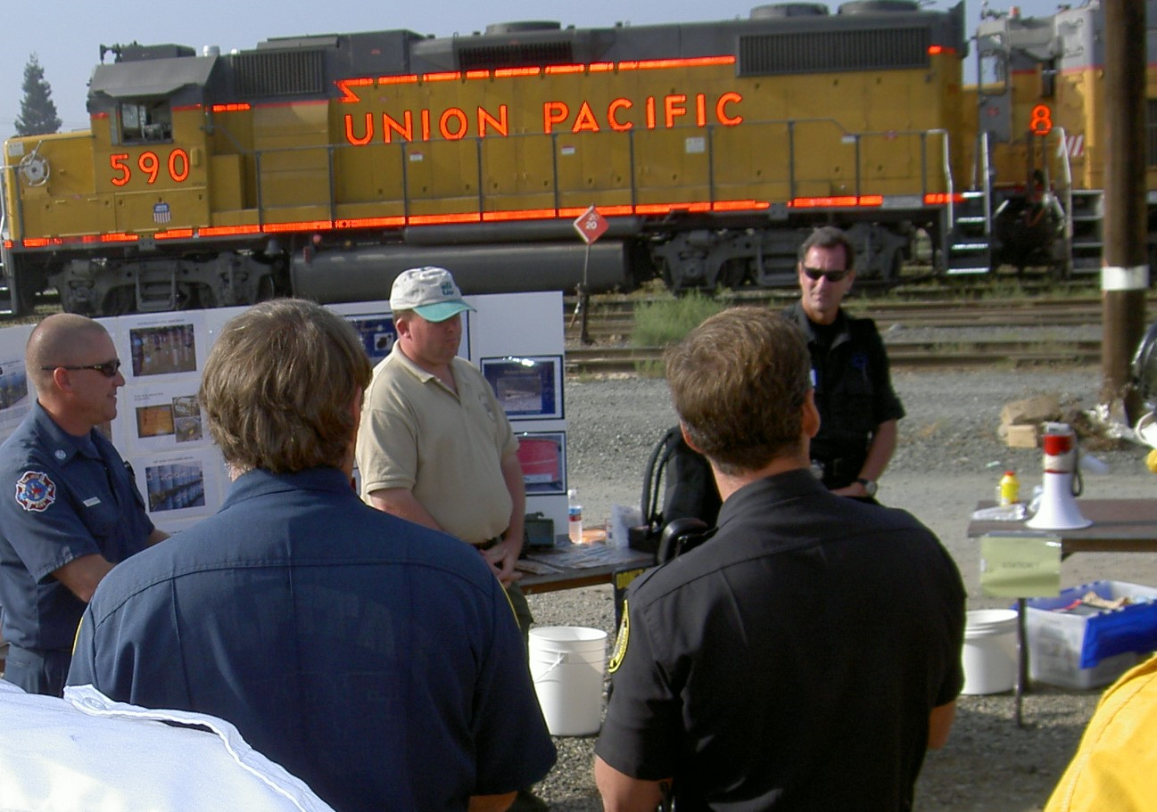
Collaboration with Other Professions
QUESTIONS?
Source: Edwards, 2005
Notes:
Are there any questions about today’s briefing training on Collaboration with Other Professions in ICS? Remember that the Supervisor’s Folder contains the ICS Quick Start Cards to guide the activities of each member of the Incident Command in the first 15 minutes.
Thank you for attending. Have a good day and always operate safely!

