Slide 1

Incident Command System and
Extreme Weather Events on the Railroad:
Training for Railroad Field Level Supervisors and Staff Rules Instructor’s Guide
[ Name]
[ Agency]
[ Contact Information]
National Academies of Sciences, Engineering, and Medicine. 2016. Incident Command System (ICS) Training for Field Level Supervisors and Staff: NCHRP Web-Only Document 215. https://doi.org/10.17226/23411. Adapted with permission from the National Academy of Sciences, Courtesy of the National Academies Press, Washington, D.C.

Slide 2

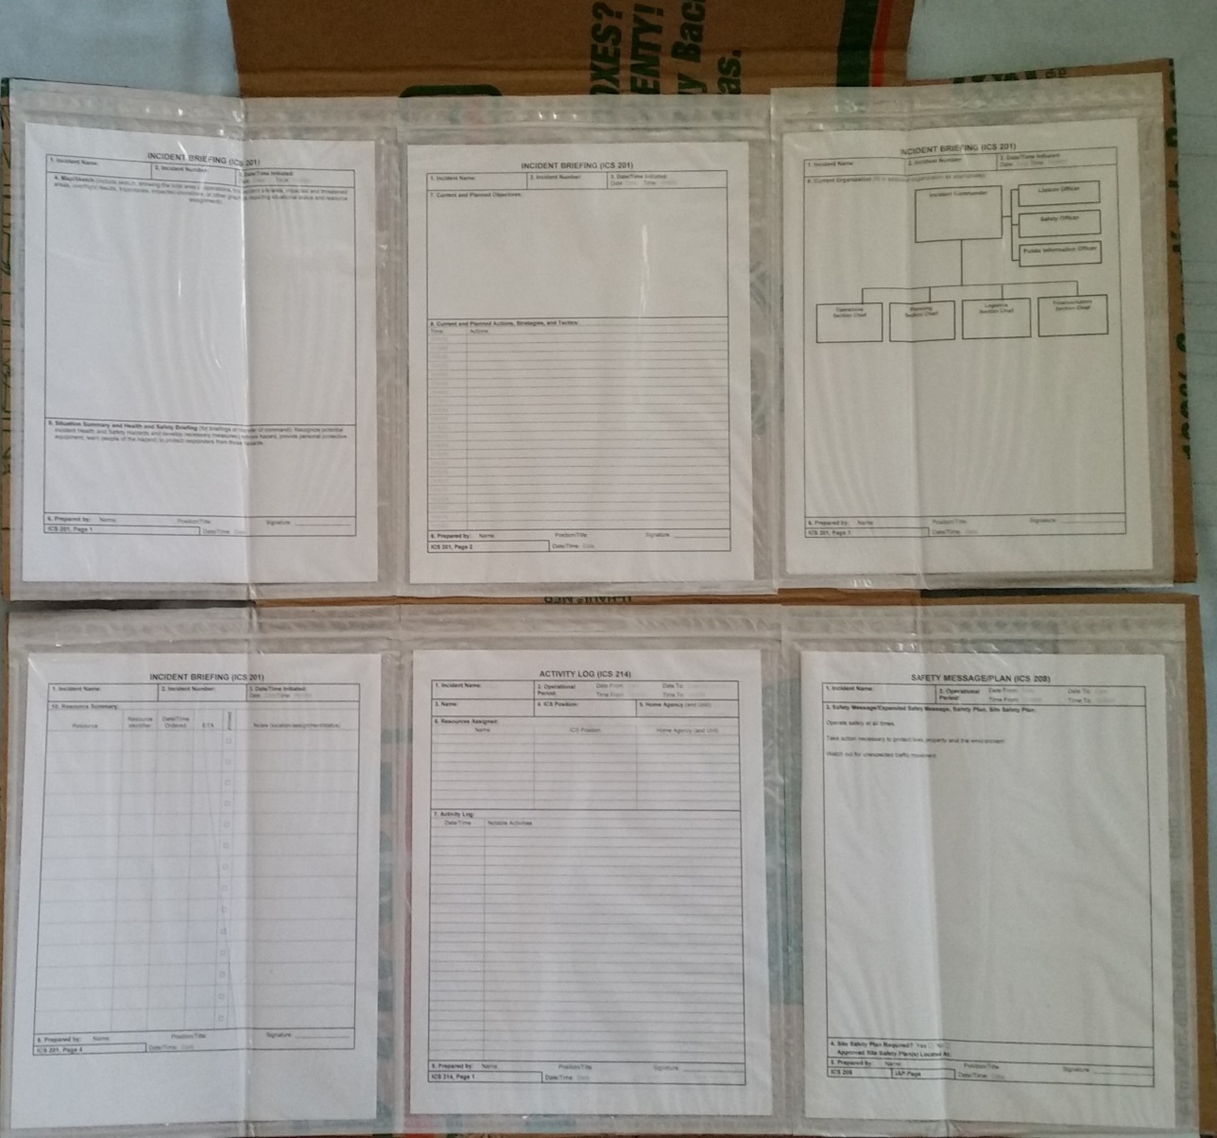
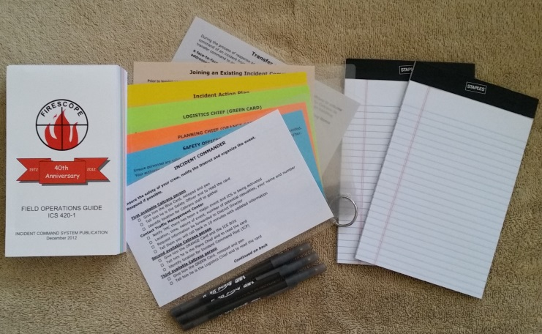
ICS and Extreme Weather
Introduction of ICS
Self-introductions of students
Workshop housekeeping
  Safety message
  Restrooms and breaks
Workshop materials
  PowerPoint slides
  ICS Quick Start Cards
  FOG
  Supervisor’s Folder

Slide 3

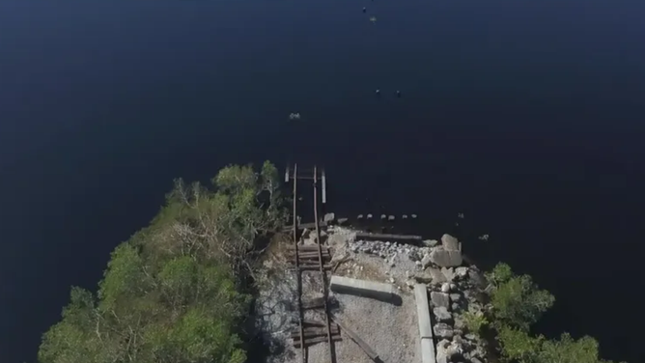
ICS and Extreme Weather:
Role of Rail In Emergency Management
Today’s learning goals:
  Review the role of railroads in Extreme weather-related emergencies
  Review ICS roles and terminology
  Consider the application of ICS to extreme weather situations on the railroad
  Introduction of ICS resources
    Supervisor’s folder
    Quick Reference Cards
    Sand table exercises
Florida freight rail bridge destroyed by Hurricane Ian, 2022. Source: Fox Weather, 10/5/22, https://www.foxweather.com/extreme-weather/florida-railroad-bridges-washed-away-supply-line-hurricane-ian

Slide 4
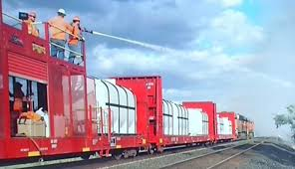
ICS and Extreme Weather
Key to all emergency response
  Pre-event evacuation
  Response
  Post-event recovery
Coordination with other emergency responders
  Railroads support response
    Delivery of first responders, supplies
    Safety Inspection- bridges, tunnels, and rails
    Debris removal for access
    Expedient repairs
BNSF Fire Train carrying first responder and fire fighting water supplies. Source: Wild Fire Today, 6/23/19, https://wildfiretoday.com/tag/fire-train/

Slide 5
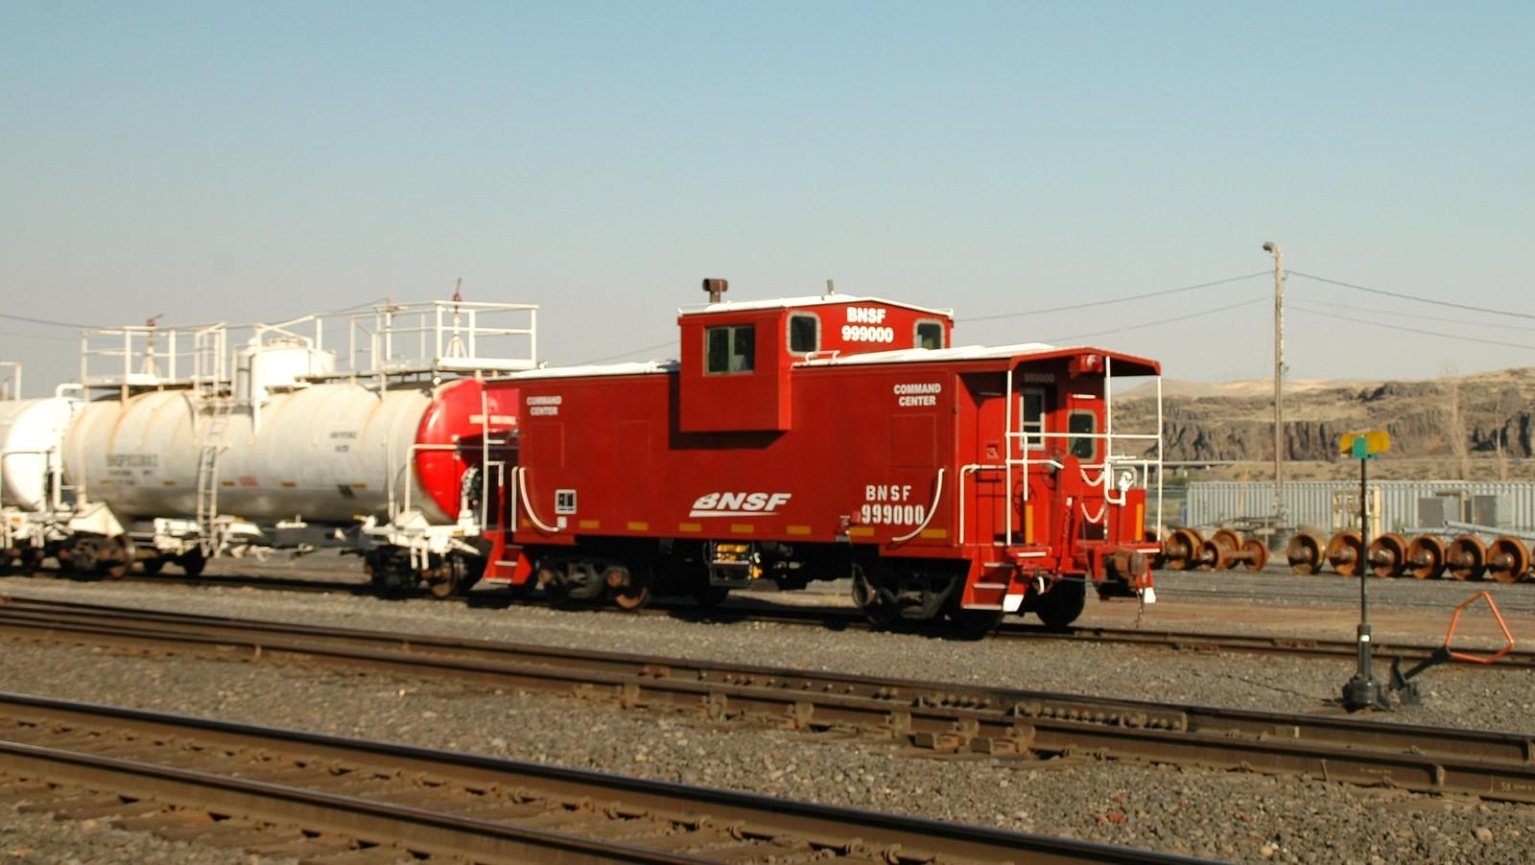
ICS and Extreme Weather
“Emergency Response Provider” includes rail personnel in ICS
  Homeland Security Act 2002
  Post-Katrina Emergency Management Reform Act 2006
“Critical transportation” = Core Capability under National Preparedness Goal
Older BNSF 999000 caboose Fire Train, retrofitted as command center for the fire train. 8/19/2010, https://www.flickr.com/photos/rbdal49/4909034564

Slide 6

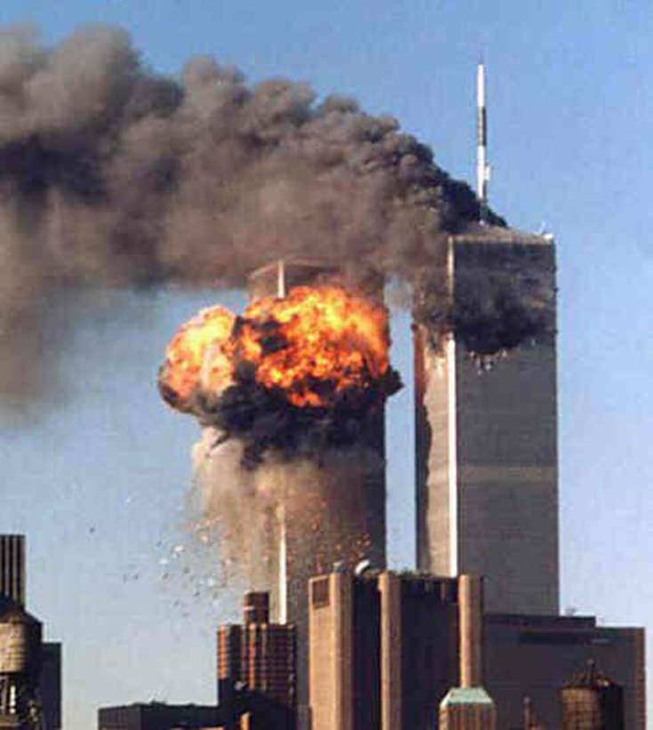
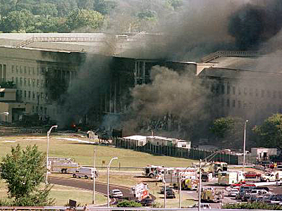
Incident Command
System (ICS)
1970s California FIRESCOPE
1980 National Fire Academy
2004 NIMS
  Homeland Security Presidential Directive-5 (HSPD-5), 2003
World Trade Center and Pentagon Attacked 9/11/2001

Slide 7

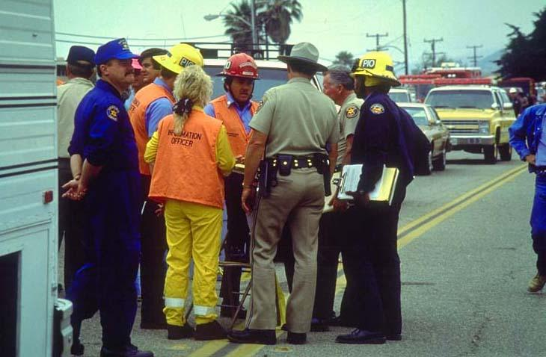
National Incident Management System (NIMS) Incorporates…
Incident Command System (ICS)
  Modular, flexible, span of control, unity of command
  Common Terminology
  Management by Objective
Unified Command
Multi-agency coordination system (MACS)
Mutual Aid Agreements

Slide 8
ICS for Railroads
Incident Commander
Functions of the Incident Command System in the Field
General Staff = Incident Commander, Planning/Intel Chief, Logistics Chief, Operations Chief, Finance/Administration Chief
Command Staff = Safety Officer Public Information Officer, Liaison Officer
Safety Officer
Public Information Officer
Liaison Officer
Planning/ Intel Chief
Logistics Chief
Operations
Chief
Finance/
Admin Chief

Slide 9
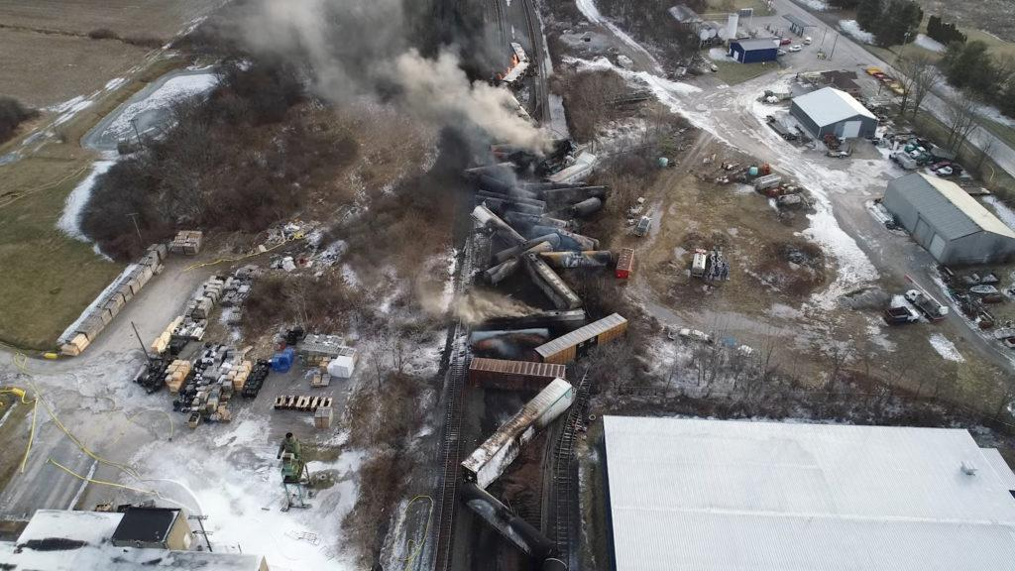
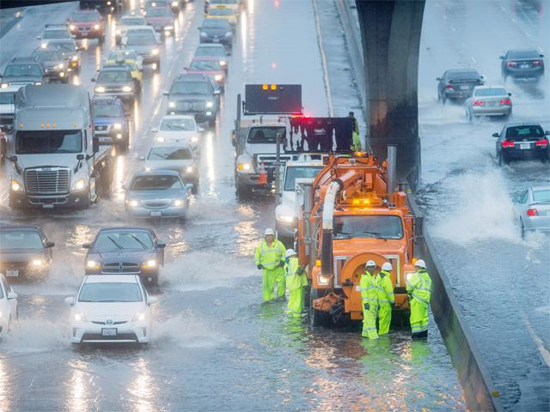
ICS for Railroads
ICS is flexible and scalable
  Use what you need, staff to meet span of control requirements
ICS can be used for emergencies, disasters and catastrophes
  Spilled potatoes
  Hurricane Sandy
ICS can be used for planned events
  Parades
  Sporting events
  Planned maintenance
Source: NTSB.gov
Source: Caltrans

Slide 10
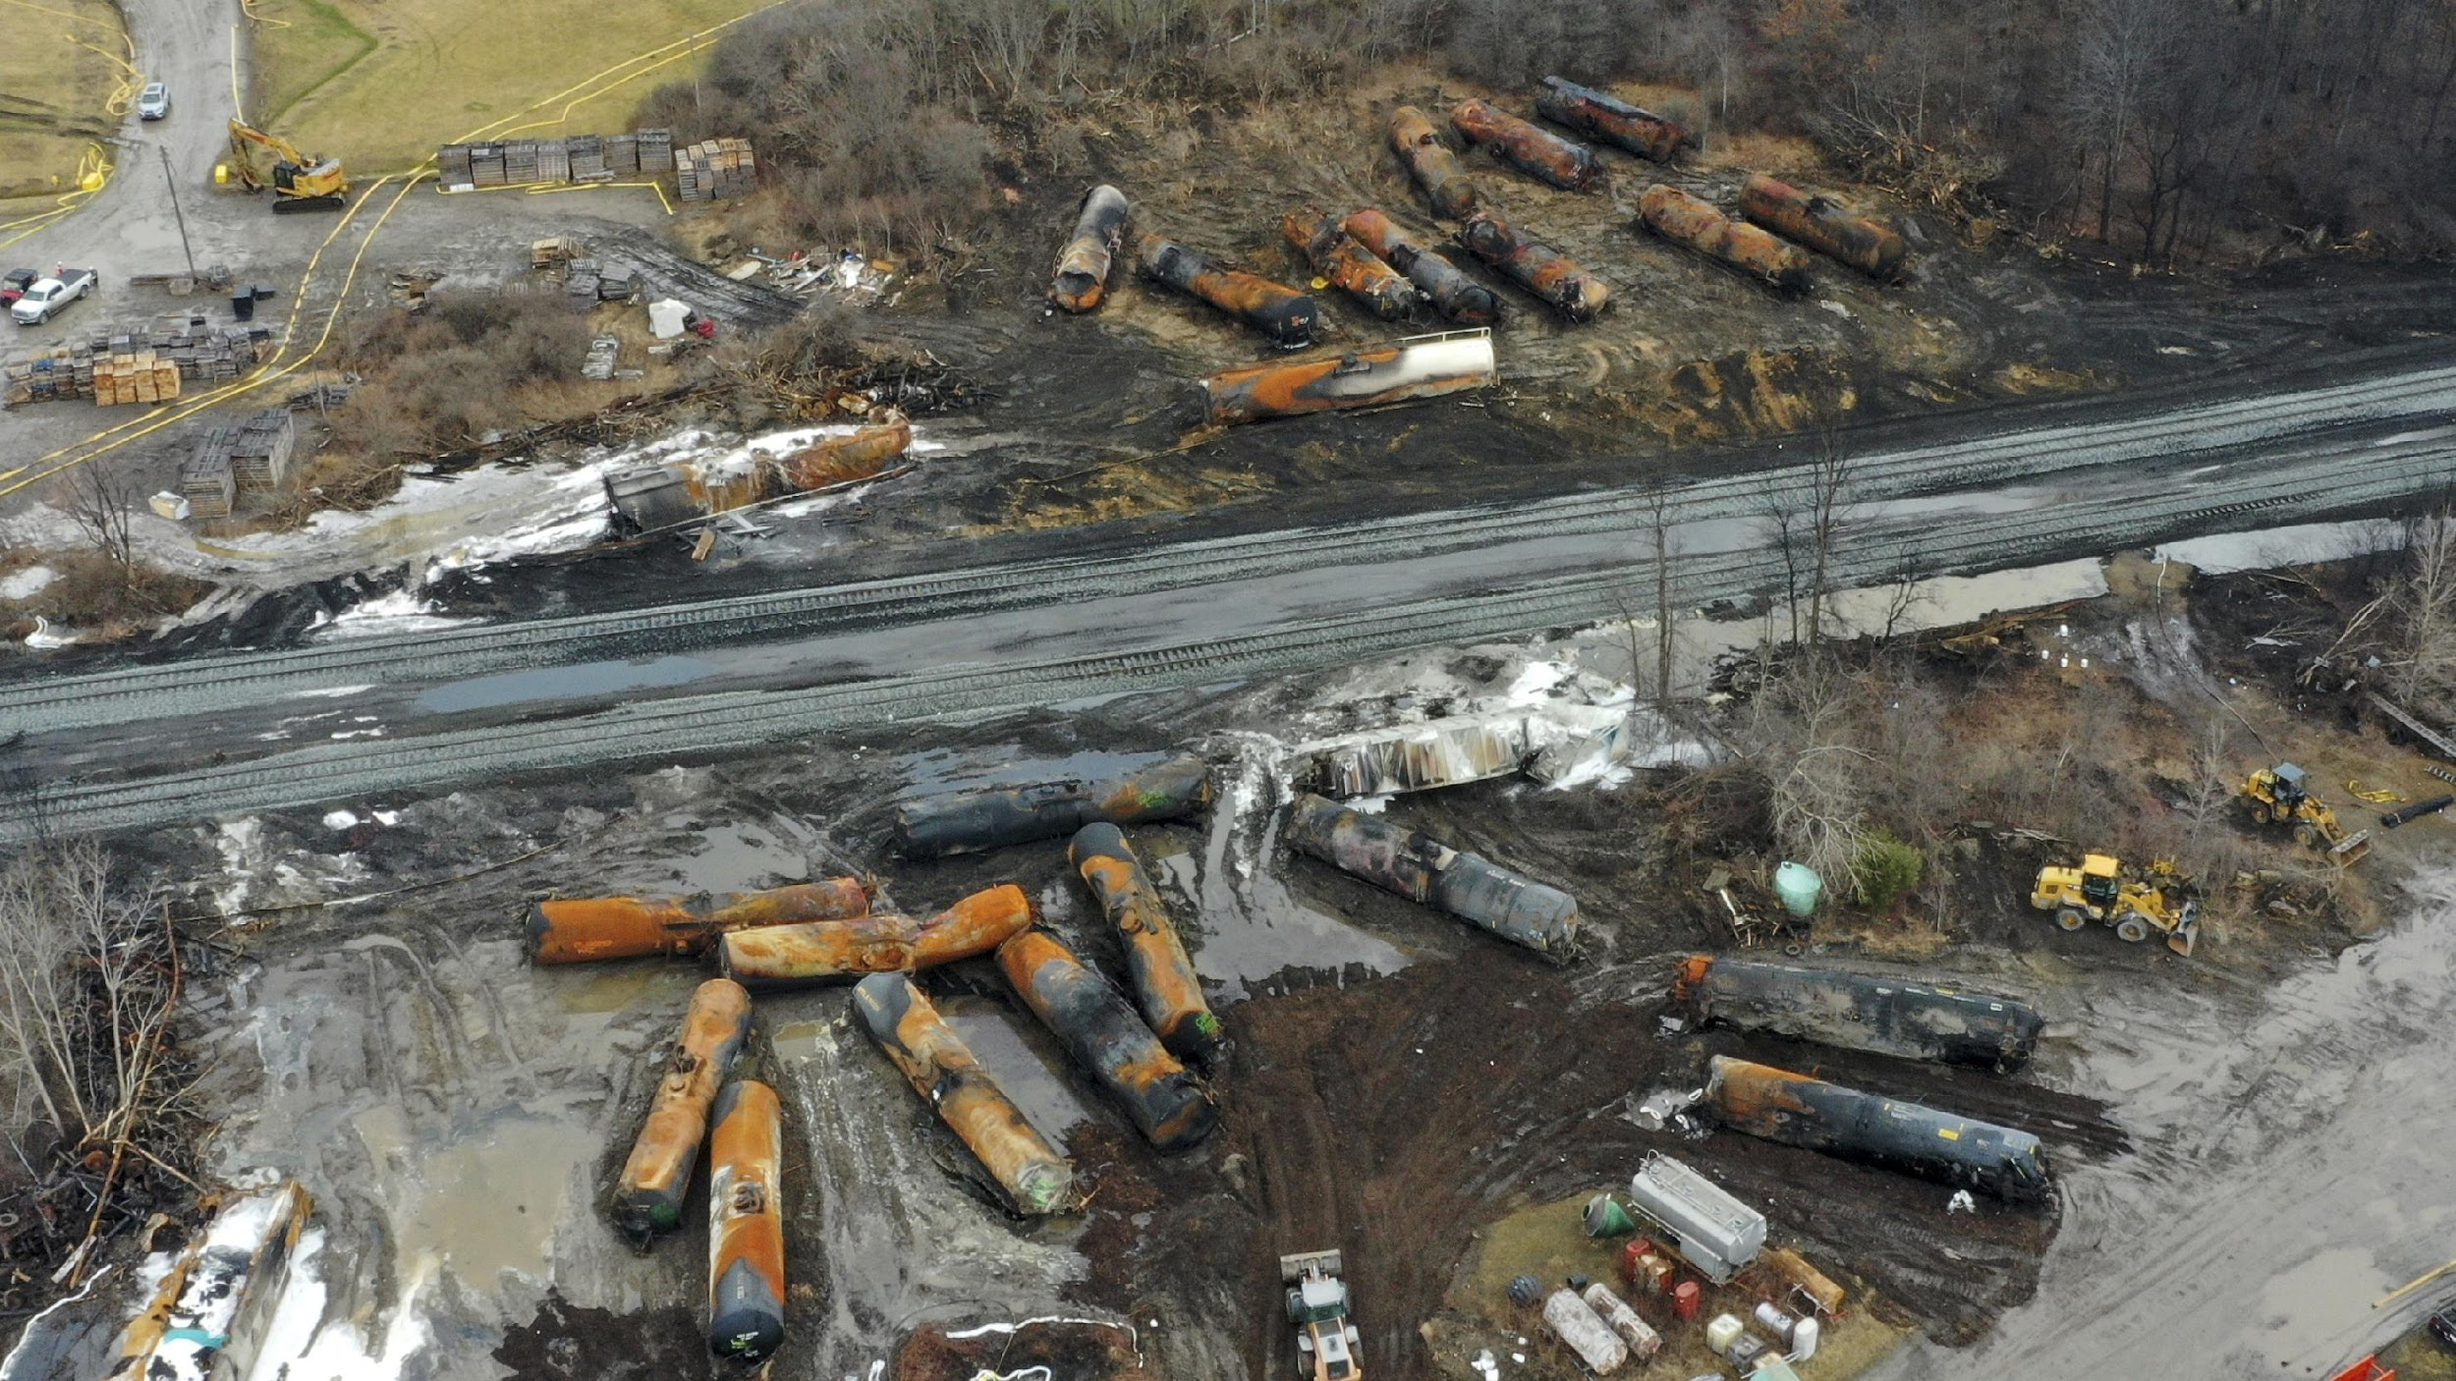
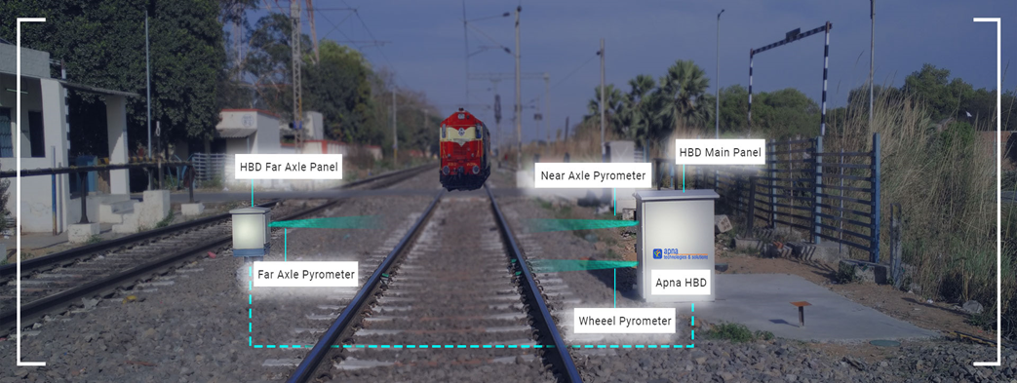
Practical Application of ICS in Rail Service
East Palestine, Ohio NS Derailment.
Source: NTSB, 2024.

Slide 11
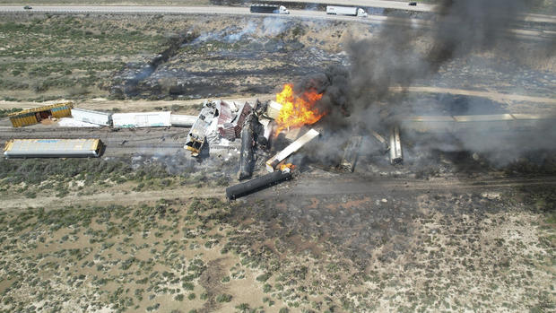
NIMS/ICS:
Perform Reliably
and Effectively
Goal of NIMS/ICS: Reliable and effective response to an event, emphasizing safety of DOT staff
Achieved through
  SAFETY
    Check-in
    Check-out
    Demobilization
  Personnel Accountability
Freight train derailment, 4/27/2024.
Source: Creative Commons

Slide 12
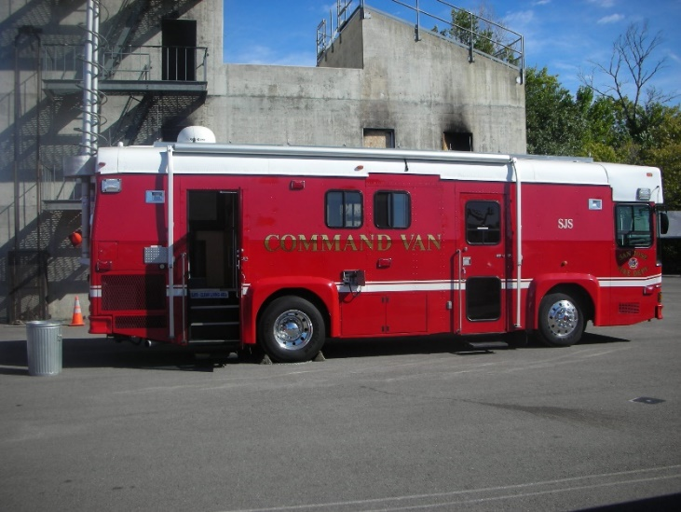

ICS for Railroad
Goals
  Safety
    Check-in
Examples of “T” Cards
Example of a fire department incident Command post.
Notes:
.

Slide 13
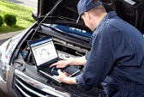
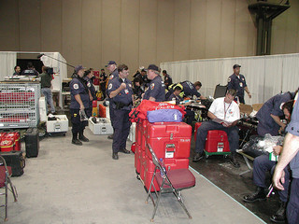
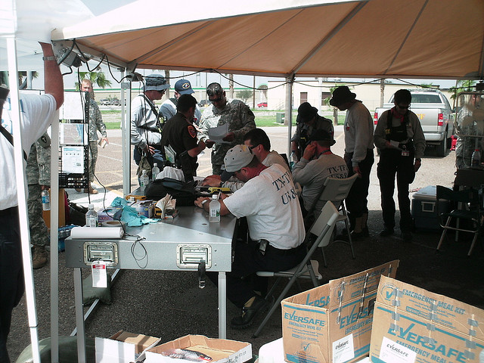
ICS FOR Railroad
Goals
  Safety
    Check out
    Demobilization

Slide 14

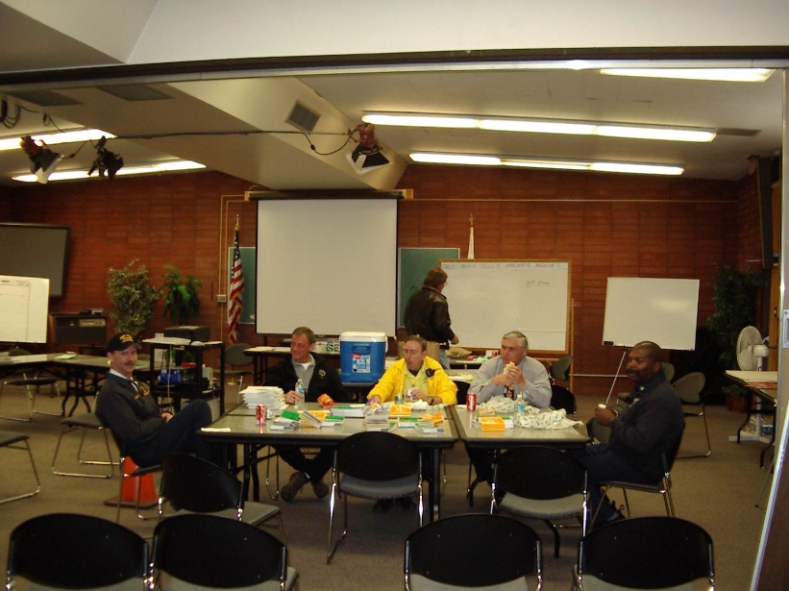

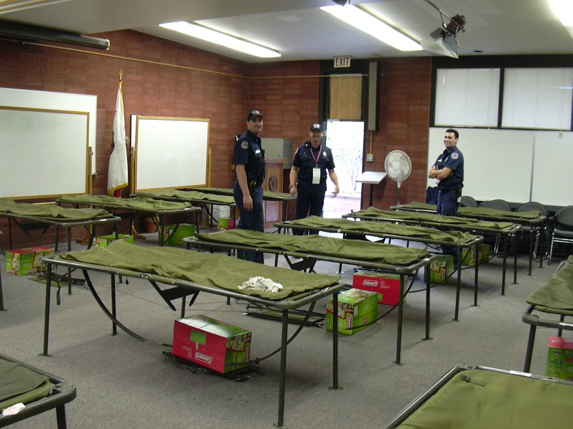
ICS FOR Railroad
Personnel accountability includes care
  Food, shelter
  Medical and mental health
  Family contacts

Slide 15

Can be handled internally.
May require documentation.
Transportation
Capability
Problem
Transportation Capability
Needs multiple organizations and a variety of resources to solve.
Will require use of ICS
Problem

Slide 16
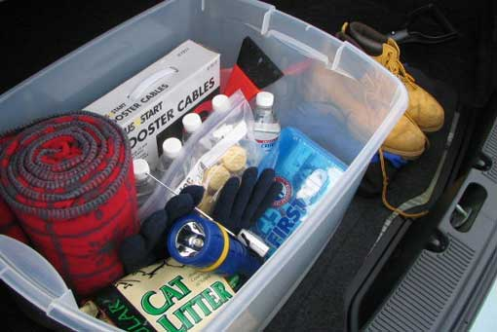
ICS for Railroad
Railroad maintenance staff may be sent to an emergency at any time.
Getting ready in advance will make for a more efficient response.
  Work vehicle kit
  Professional Drive Away Kit

Slide 17
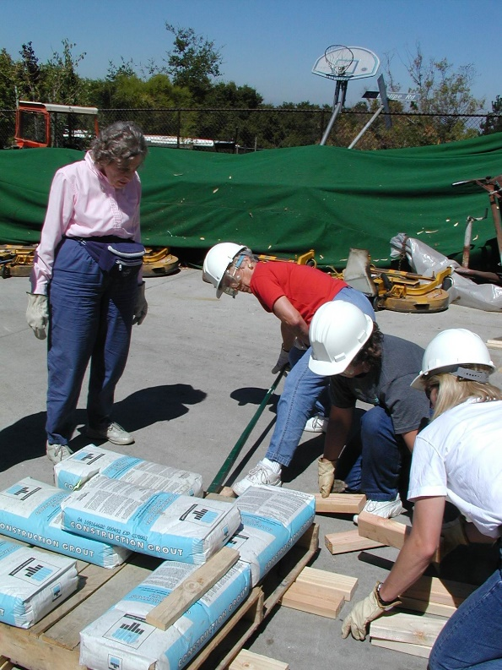
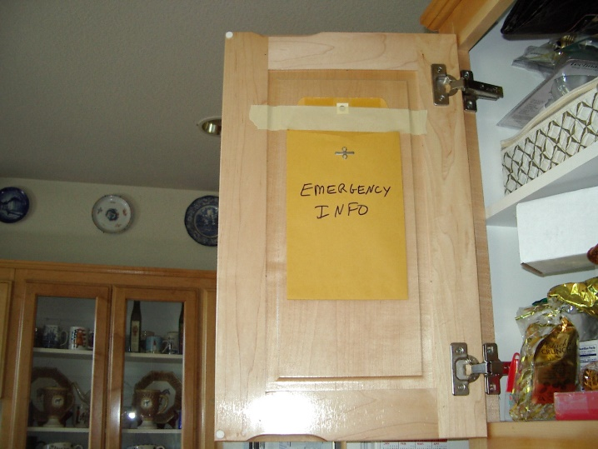
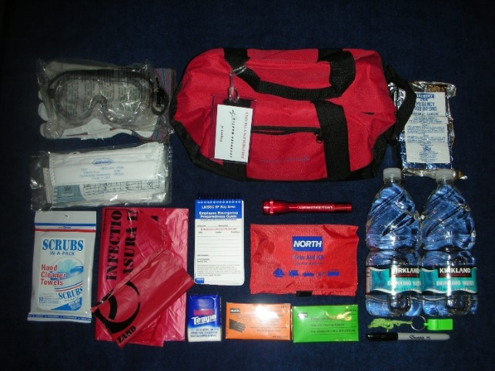
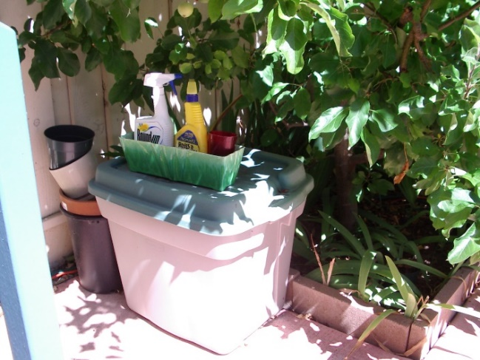
ICS for Railroads
Family preparedness
  Family plan
  Family car kit
  Family supplies at home
  Community Emergency Response Team (CERT)

Slide 18
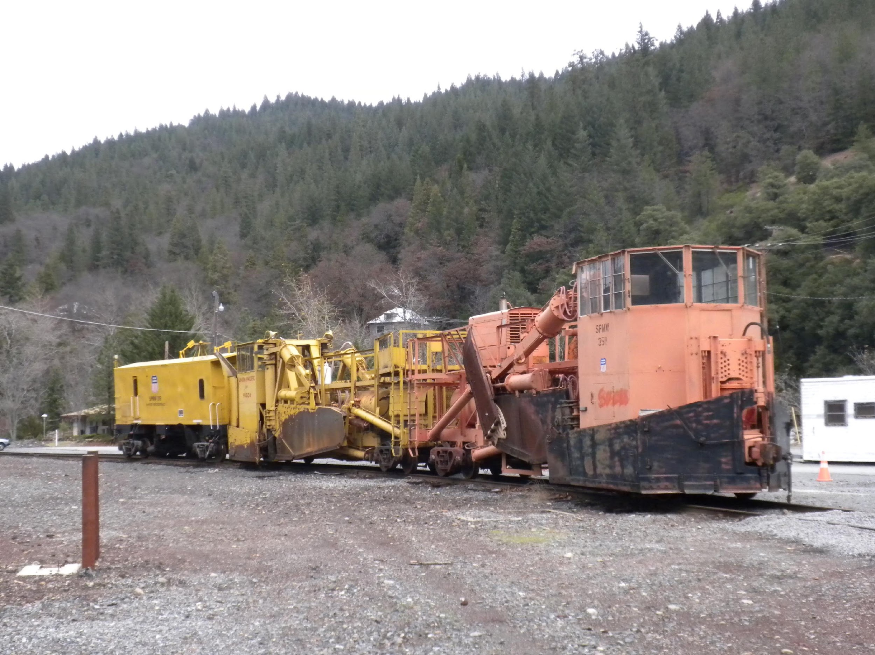
15 Minute BREAK
Union Pacific Snow Train. Source: Edwards, 2005.

Slide 19
Arguments for Using the Incident Command System
HazMat – EPA mandated use
Legal – Best Practice, good defense for civil litigation
Safety - primary reason why ICS was created in the first place.
  Do we cut corners when under pressure and/or tired?
Common Operational Picture

Slide 20
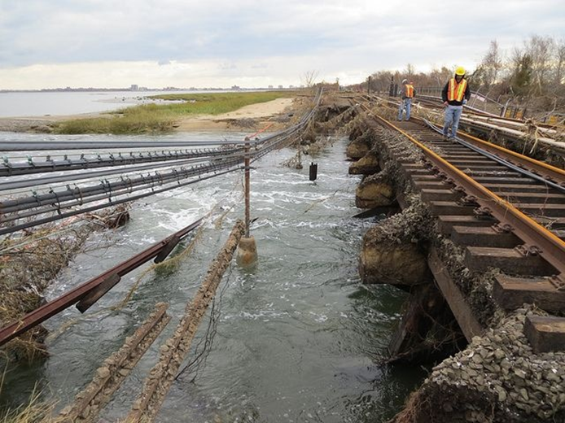
Five ICS Roles Possible for Rail Personnel
Join an existing ICS in Operations
  Wildland Fire
Join an existing ICS in Planning/Intelligence
  Subject matter expert in derailment
Unified Command
  In natural disaster: Hurricane Sandy, New York
Assume command
  Flash flood wash out of rail lines
Incident Commander
  Event occurs right in front of you
Long Island Railroad tracks in The Rockaways after Hurricane Sandy.
Source: Metropolitan Transit Authority.

Slide 21
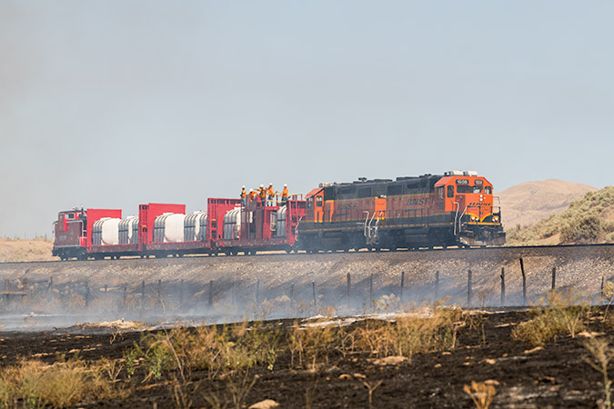
Wildland Fires
Minnesota estimates that trains cause 3% of all wildland fires in the state.
Extreme weather is causing hot weather to be experienced farther north, causing droughts and wind that can fan wildland fires.
Total cost of wildland fires is $2.5 billion/year and rising (Wildfire Mitigation and Management Commission, 2023).
Railroads have created fire trains that provide tanks of water, first responder transportation, and even a caboose as an emergency operations center.
BNSF Fire Train. Source: BNSF.

Slide 22
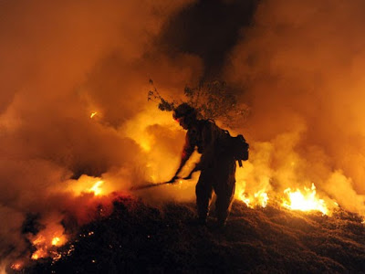
Join Existing Incident Command System
Railroad’s help would be requested by another agency, like a fire department
Railroad maintenance personnel would be dispatched from their normal duties to assist the requesting agency with access, right of way clearance, expedient repairs, or similar work.
Rail workers formally join the existing ICS through the check-in procedure, and get assigned to the Liaison Officer or to a supervisor to perform tasks related to rail capabilities.
A brief video Number 3 on joining an existing IC is available at https://vimeo.com/showcase/11005939
Incident Commander
Safety Officer
PIO
Liaison Officer
Planning/ Intel Chief
Logistics Chief
Operations
Chief
Finance/
Admin Chief

Slide 23
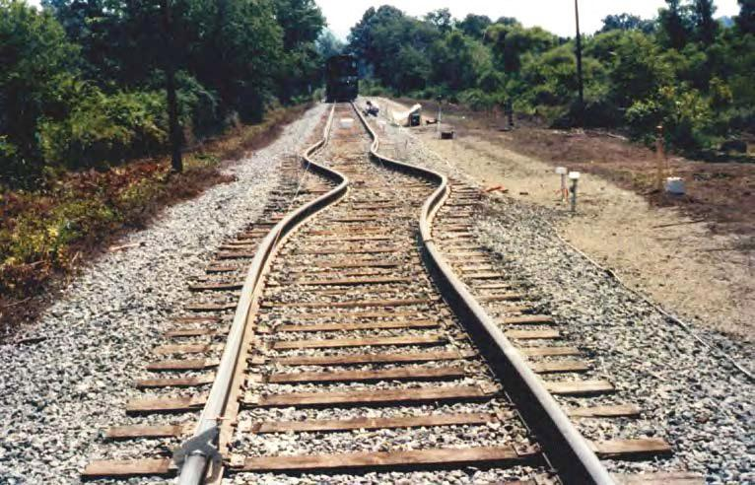
Heat Is Deforming Tracks
Extreme weather is making heat waves and heat domes more frequent and intense.
Rail track metallurgy is designed for expected regional temperatures, but hot periods are moving north and lasting longer.
Heat can cause tracks to deform—thermal buckling or “sun kinks”—possibly leading to derailments.
In 2022 BART tracks in San Francisco, usually operating at 115 degrees reached 140 degrees, causing them to warp, and result in a partial derailment (Freedman, 2022).
High heat caused buckling.
Source: US Department of Transportation (US DOT), 2019.

Slide 24
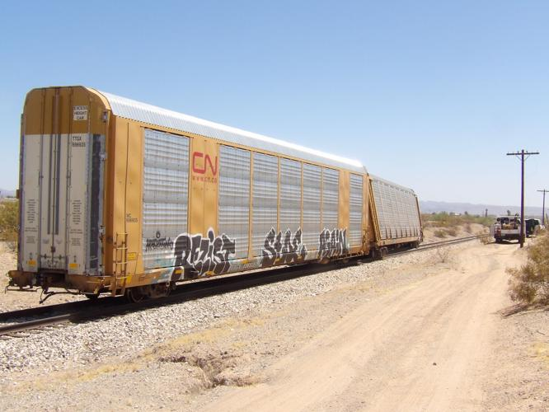
Transportation as a
Technical Specialist
Incident Commander
Safety Officer
PIO
Rail maintenance personnel or conductor (if a train is involved) may be tasked as technical specialist to the incident command.
Technical specialists are part of the Planning/Intelligence Section in ICS.
In a derailment, maintenance crew can explain rail operations to help the IC provide better response.
In a derailment with hazmat involvement, the conductor may have MSDS or other consist information that would help the IC develop a safe response.
Liaison Officer
Planning/ Intel Chief
Logistics Chief
Operations
Chief
Finance/
Admin Chief
California train derailment due to heat,
8/2/2020. Source: ParkerPioneer.net

Slide 25
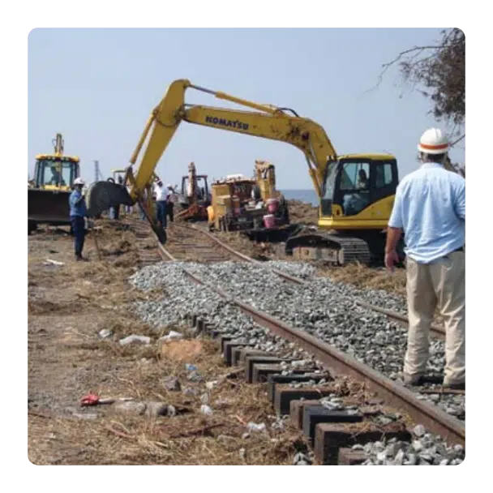
Natural Disasters: Hurricanes
Extreme conditions bring warmer oceans, providing energy for increased rainfall and wind speeds (SFI, 2011).
Rail lines along the East and Gulf Coasts will experience more damage from wind, water, debris.
Rail will remain a critical part of response to hurricanes, providing transportation for first responders, response equipment, community supplies and access to hard-to-reach areas, making rail a key partner in the unified command for response and recovery.
After Hurricane Katrina NS took only 16 days to lift 5 miles of track out of the water and back onto the Lake Pontchartrain Bridge (AAR, n.d.).
Post-hurricane ballast repair. Source: AAR, 2011.

Slide 26
Unified Command
“Unified command is a team effort that allows all agencies with jurisdictional responsibility for an incident, either geographical or functional, to participate in the management of the incident…developing and implementing a common set of incident objectives…without losing …agency authority, responsibility or accountability.” FEMA FOG, 2010, p. 6-2.
Type of incident example – hurricane
  Fire is the Incident Commander whenever human life or hazardous materials are involved.
  Law Enforcement provides traffic control, evidence protection, and scene access control.
  Rail supports critical supply chains; may require that railroad damage assessment and expedient repairs begin immediately, to permit access to the disaster and delivery of essential goods and personnel.
  May include EMS for life saving services
  May include EPA for hazmat management & clean-up
  May include Fish and Wildlife for environmental clean-up; Coast Guard for navigable waterways
Incident Commander
Unified Command:
Fire, Law, Transportation
Safety Officer
PIO
Liaison Officer
Planning/ Intel Chief
Logistics Chief
Operations
Chief
Finance/
Admin Chief

Slide 27
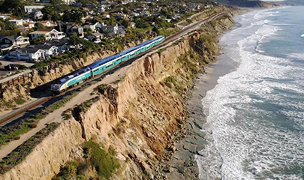
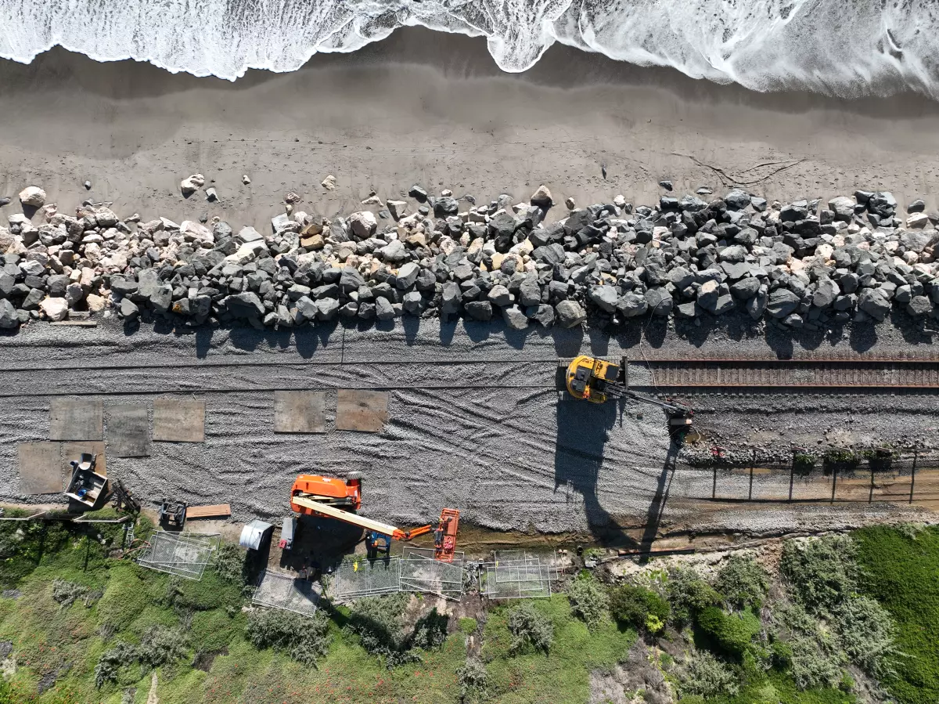
Flood washout of
rail lines
High water can weaken rail bridges, wash away ballast, and damage signals and trackside monitoring equipment (AAR, n.d.).
8 states along the Gulf Coast are already seeing damage from sea level rise; 38% of the US population lives in coastal counties (Solecki and Friedman, 2021).
Sea level rise and storm surge are already impacting west coast railroads, such as the Los Angeles to San Diego freight corridor that is experiencing mudslides from the hillsides and undermining from sea level rise.
Once the initial emergency is resolved and life safety assured, the Incident Command may pass to rail as the facility owner, coordinating with state and federal agencies to complete recovery and repairs.
LOSSAN corridor. Source: SANDAG, 2023 2023.20
LOSSAN at Mariposa Point. Source: Caltrans, 2023.

Slide 28
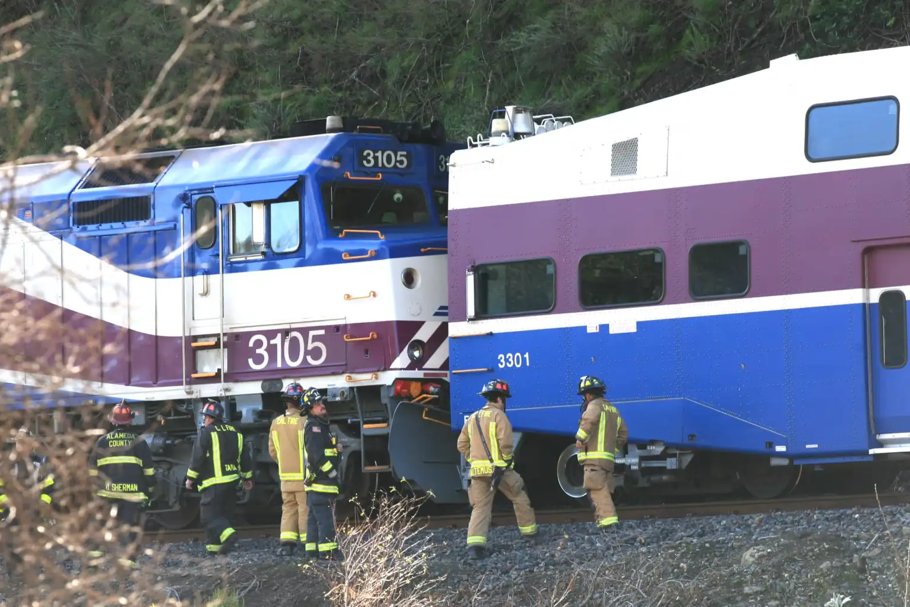
Assume Command: Transfer of Command
Report to existing Incident Commander
Assume command from another agency whose work is done
Continue the Incident Command until all railroad-related issues are successfully completed
Close out the Incident or transfer the command to another agency with responsibility for the remaining issues
For example, to EPA for environmental remediation
A brief video Number 2 on transferring IC is available at:
https://vimeo.com/showcase/11005939
ACE Train mudslide and derailment, 2023
Incident Commander
Safety Officer
PIO
Liaison Officer
Planning/ Intel Chief
Logistics Chief
Operations Chief
Finance/ Admin Chief

Slide 29
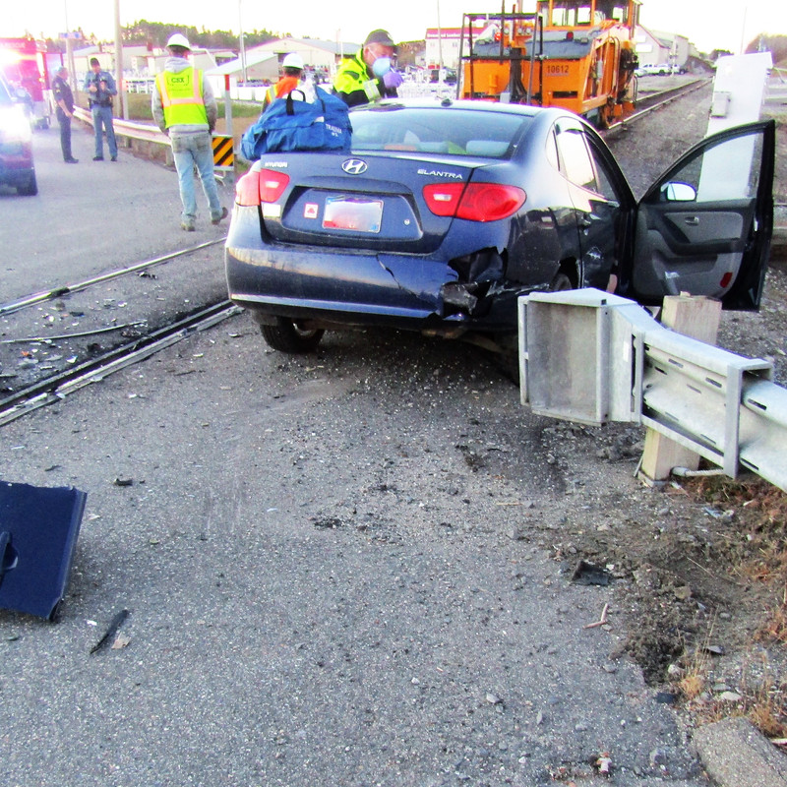
Disaster adjacent to
rail lines
In remote areas rail lines may run parallel to country roads, where public safety responders are few.
An accident on the country road may occur adjacent to where a rail maintenance crew is working. They might start ICS while awaiting the arrival of fire, medical and law enforcement personnel.
Car hits train tamper, assisted by railroad crew.
Source: Creative Commons.

Slide 30
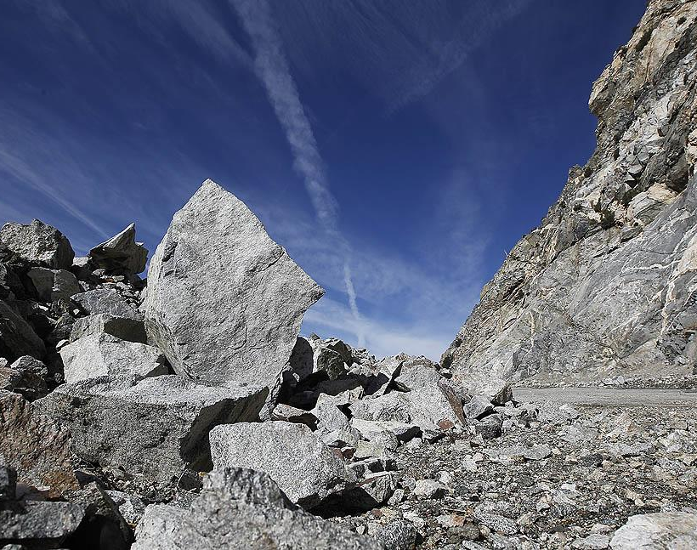
Incident Command:
Starting Incident Command
Event on an isolated road
Railroad personnel are first on the scene, there doing maintenance
Supervisor starts ICS using the folder
A brief video Number 1 on starting IC is available at:
https://vimeo.com/showcase/11005939
Incident Commander
Safety Officer
PIO
Liaison Officer
Planning/ Intel Chief
Logistics Chief
Operations Chief
Finance/ Admin Chief

Slide 31
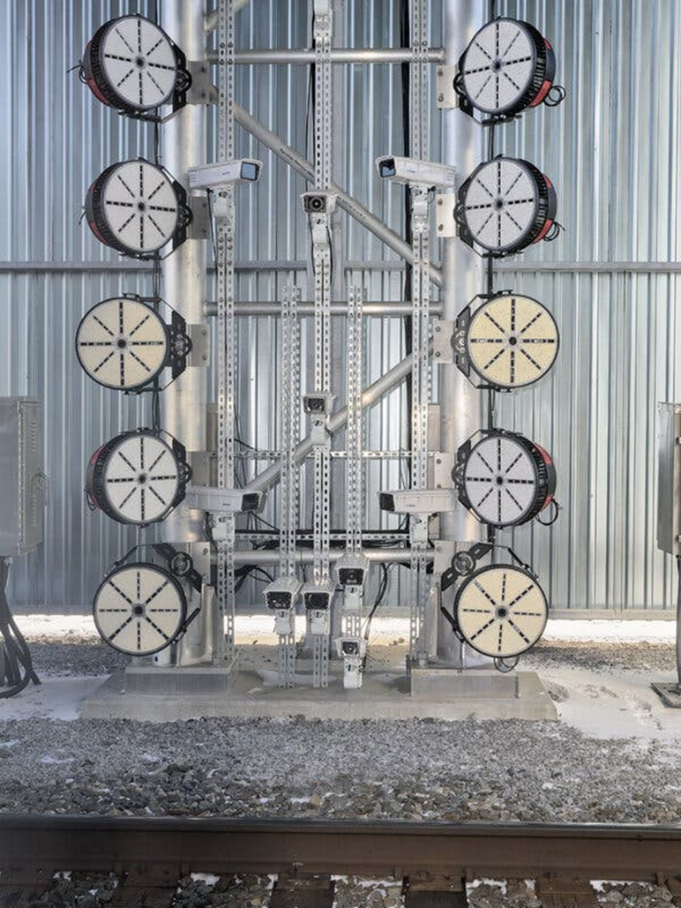
15 Minute BREAK
Digital inspection portal with 38 cameras.
Source: NTSB.gov.

Slide 32
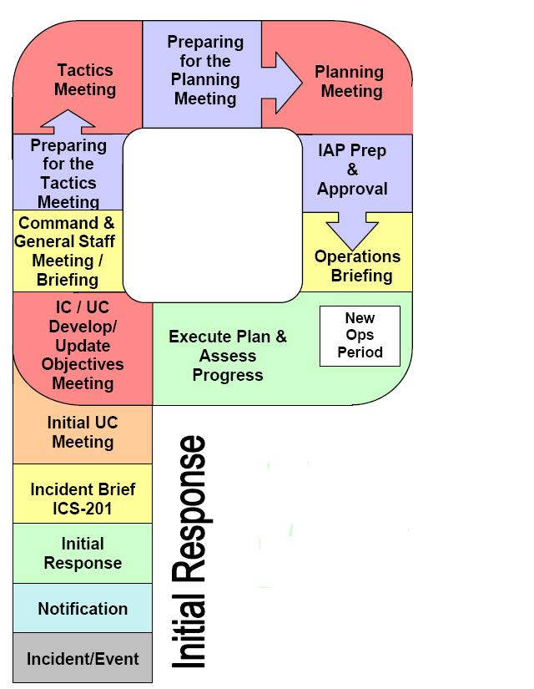
Planning P
How you look at the “P” and how much documentation is needed is dictated by the complexity and size of the event.

Slide 33
Problems and Decisions in ICS
Step 1 Recognize that you have a problem/issue
Step 2 Define what the problem/issue is
Step 3 Identify what the objective is for solving the problem/issue
Step 4 Identify all possible options/alternatives
Step 5 Use the options/alternatives to determine limitations and help clarify the objective (Step 3)
Step 6 Select the best option/alternative to meet the objective
Step 7 Convert option/alternative into a plan (who will do what in which order)
Step 8 Implement the plan
Step 9 Evaluate the overall situation.
Option 1 If the plan is failing to meet the objective, adjust it
Option 2 If the plan is clearly not capable of meeting the objective, select another option/alternative (Step 6)
Option 3 If no options/alternatives are viable, redefine the objective (Step 3)
Option 4 If objective is not obtainable, redefine the problem/issue (Step 2)
Step 10 Monitor environment for problems/issues.
Notes:
[Review the listed steps]

Slide 34
Quick exercise with the ICS cards
Divide into 3 teams, each team selects one of the scenarios on the next page. The person with the longest rail experience will be the IC for each team.
Mentally place the scenario in a location within your jurisdiction.
In all three,
  You are a field level person working with a crew performing railroad maintenance
  You are close enough to clearly see the event
  You are not in immediate danger
  Fire, law, and medical are not present
  It is in a rural area (increased response time)
  You have access to an ICS Supervisor’s Kit
  Use the ICS Card sheets behind the PPT slides to guide your response.

Slide 35
Scenario 1
A ½ ton truck is driving on a narrow country road that is parallel to the railroad tracks just off the right-of-way. You watch as it runs down, and over, two joggers. It then chases a third jogger off the path before continuing. You look back up the road and see at least one more body.
Scenario 2
You hear and then see a small explosion on the back of a flatbed truck in a commercial parking lot next to the tracks. Some 55-gallon drums have been scattered around the truck by the blast and several people can be seen choking, vomiting, and falling down.
Scenario 3
You are repairing rails at the incline when a hopper truck of aggregate hits the support column for the railroad overcrossing for the highway. The truck jackknifes, spilling its load across all lanes of the freeway. Debris has hit cars on both sides, resulting in multiple car accidents on both sides of the road.

Slide 36
Reports Back
Each team in turn will report on how they responded to the event. Each ICS member will report on his/her job and how he/she performed that function to support the event.
After each team report is complete, the other teams may comment on how the event was managed and how ICS was used.

Slide 37
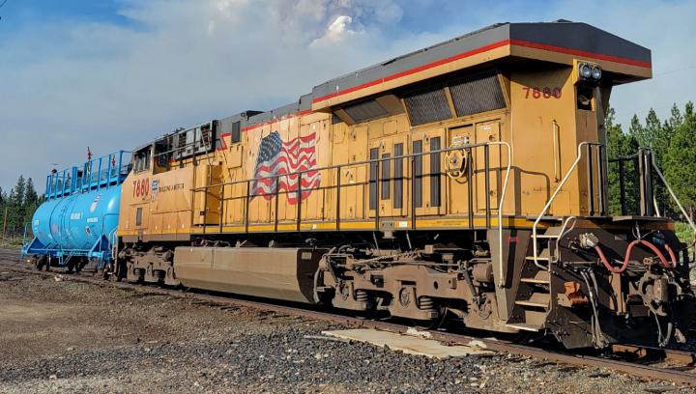
ICS FOR RAILROAD SUMMARY
Transportation is the key to all emergency response
ICS is the method required by the federal government to organize the response to a multi-jurisdictional, multi-profession emergency event
The five functions of ICS are used in the field by all emergency response personnel
Safety, accountability, and care for personnel are accomplished through check-in, check-out and demobilization
Put a work vehicle kit in your trunk and develop a professional drive-away kit for quick assembly.
Getting your home ready for an emergency and your family into CERT will give you peace of mind when you are deployed in a disaster to help the community.
Union Pacific Fire Train at Lava Fire, 2021.
Source: Union Pacific, 2021.
Notes:
Read the slide.

Slide 38
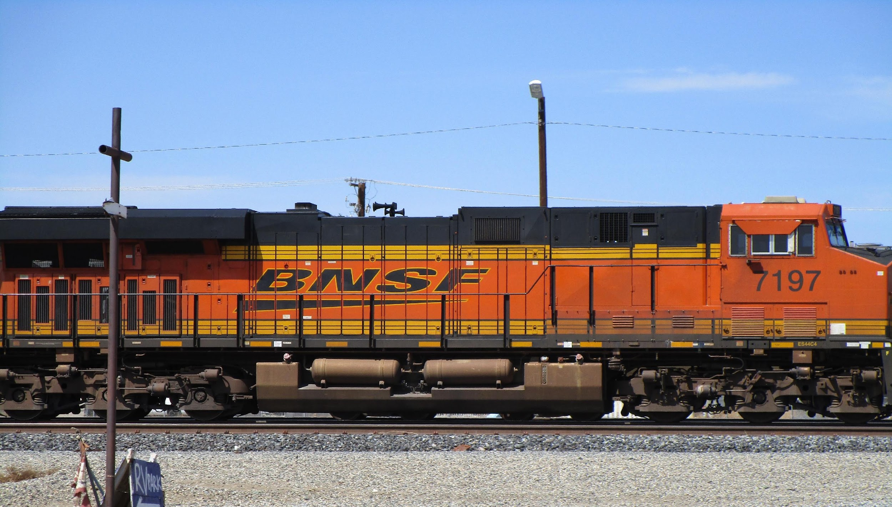
Wrap-Up
Questions?
Freight engine, Mojave, California. Source: Edwards, 2021.

