Slide 1
Incident Command System and Climate Change on the Railroad: Training for Railroad Field Level Supervisors and Staff Rules Instructor’s Guide
[ Name]
[ Agency]
[ Contact Information]
National Academies of Sciences, Engineering, and Medicine. 2016. Incident Command System (ICS) Training for Field Level Supervisors and Staff: NCHRP Web-Only Document 215. https://doi.org/10.17226/23411. Adapted with permission from the National Academy of Sciences, Courtesy of the National Academies Press, Washington, D.C.

Slide 2
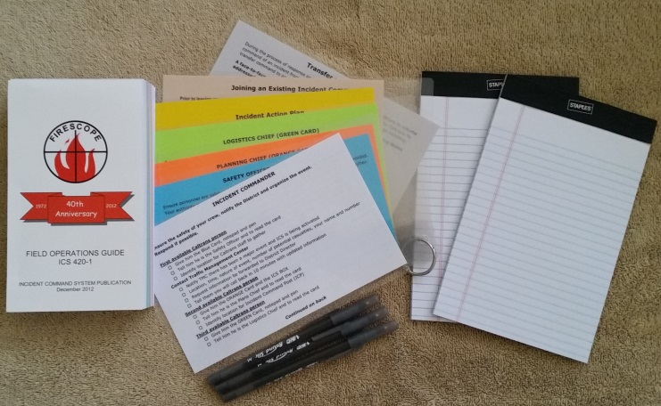
ICS and Climate Change
Introduction of ICS
Self-introductions of students
Workshop housekeeping
Safety message
Restrooms and breaks
Workshop materials
PowerPoint slides
ICS Quick Start Cards
FOG
Supervisor’s Folder

Slide 3
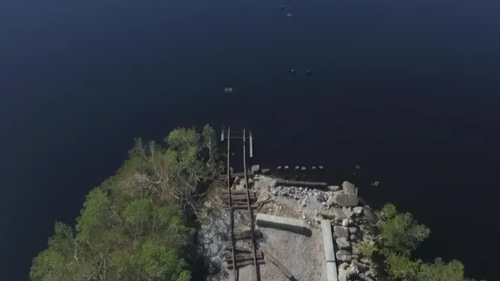
ICS and Climate Change: Role of Rail In Emergency Management
Today’s learning goals:
Review the role of railroads in climate change-related emergencies
Review ICS roles and terminology
Consider the application of ICS to climate change situations on the railroad
Introduction of ICS resources
Supervisor’s folder
Quick Reference Cards
Sand table exercises
Florida freight rail bridge destroyed by Hurricane Ian, 2022. Source: Fox Weather, 10/5/22, https://www.foxweather.com/extreme-weather/florida-railroad-bridges-washed-away-supply-line-hurricane-ian
Notes:
Thank you for coming to the “ICS and Climate Change for Railroads” class today. Some of you may have had Incident Command System training in the context of hazardous materials. The U.S. Department of Transportation’s Pipeline and Hazardous Materials Safety Administration has published Transportation Rail Incident Preparedness and Response: High Hazard Flammable Trains as a comprehensive guide to applying the incident command system to hazardous materials events on the railroad. Companies such as BNSF and CN have created training plans and held exercises with local first responders to prepare for such events using ICS. This course will build on that knowledge to extend the application of ICS to include climate-related events on the railroad. The student manual that accompanies this course describes many types of climate-related events that can lead to rail service disruptions and require a coordinated response with local first responders.
In the first segment we will describe the role of railroads in climate-related emergencies. Next we will conduct a brief review of the history, principles, and terminology used in the Incident Command System. Then we will describe the use of the Incident Command System by railroad field personnel to create a safe, integrated and efficient emergency response, regardless of the triggering event. Finally some practical application of ICS principles to railroad work during climate change events will be described, and some innovative tools which you have been given today will be reviewed.
It is expected that all students have completed the Incident Command System 100 course, and the National Incident Management System IS-700 course. Therefore the general ICS review will be brief. Remember that there is a glossary and acronym list available at the back of the student manual for your use in recalling the terminology that we will be using. Raise your hand at any time if the supervisor uses terminology that is unclear to you.

Slide 4
ICS and Climate Change
Key to all emergency response
Pre-event evacuation
Response
Post-event recovery
Coordination with other emergency responders
Railroads support response
Delivery of first responders, supplies
Safety Inspection- bridges, tunnels, and rails
Debris removal for access
Expedient repairs
BNSF Fire Train carrying first responder and fire fighting water supplies. Source: Wild Fire Today, 6/23/19, https://wildfiretoday.com/tag/fire-train/
Notes:
Transportation is the key to all aspects of emergency response, starting with pre-event activities, during the response and to facilitate recovery. Without transportation, no response is possible. While law enforcement and fire first responders may be the personnel who deliver disaster response services, they cannot reach the victims without the use of safe and debris-free transportation corridors. In some areas the rail system provides the only access to the emergency site.
Before an event has occurred, transportation—including mass transit and passenger rail—is key to the development and implementation of evacuation activities. The state transportation agency also collaborates with other modes to create an evacuation system using other assets, including heavy rail.
During a response, such as to a wildland fire, railroads may move public safety personnel to the scene of an event. For example, BNSF has a train with a caboose that serves as a mobile command center for first responders, and another caboose that is equipped to transport first responders to the scene of remote or difficult-to-access areas. These trains include tank cars that carry water that can be used to protect rail infrastructure from the heat and flames. Bridge, tunnel, and track inspection and debris removal—and sometimes even expedient repairs—are required before rail service can be restored, and often rail-based equipment is the only asset that can do these jobs.
Rail service is essential for disaster recovery. Supplies needed for community restoration may have to travel by rail. Repair and replacement equipment may be too heavy to travel on roads. Restoration of the supply chain demands a functioning rail system, including regional and short line systems. For example, Hurricane Ian damaged six railroad bridges, shutting down major supply lines for the Florida Gulf Coast.

Slide 5
ICS and Climate Change
“Emergency Response Provider” includes rail personnel in ICS
Homeland Security Act 2002
Post-Katrina Emergency Management Reform Act 2006
“Critical transportation” = Core Capability under National Preparedness Goal
Older BNSF 999000 caboose Fire Train, retrofitted as command center for the fire train. 8/19/2010, https://www.flickr.com/photos/rbdal49/4909034564
Notes:
The response to a disaster event involves collaboration among all emergency response providers. Each agency has its purpose in protecting the community and bringing it back to a functional state. Police, fire, and emergency medical services personnel interact directly with members of the public at a time of stress, while transportation resources provide assets to make that response possible. “Critical transportation” is a core capability under the National Preparedness Goal.
Several terms are used for the personnel who work to resolve a disaster, and it is important to understand the differences among the terms. “Emergency response provider” is used in Homeland Security Act 2002 and Post-Katrina Emergency Management Reform Act of 2006 to refer “to those who are first to respond to disasters or emergencies” (NCHRP, RRD 385, 2013). For example, in the immediate response to the World Trade Center on 9/11 police, fire, and EMS personnel were obvious with their uniforms, but did you know that there were more transportation personnel at the World Trade Center site than any other profession? The engineers who shored up the plaza to hold the heavy equipment that made rescue possible, the welders who cut the girders and the heavy equipment operators were all from rail-based mass transit agencies. So clearly transportation personnel are “emergency response providers.” The role of transportation is to provide the means for all emergency responders to access those in need and assist them in resolving their circumstances. You can argue that transportation therefore is actually THE FIRST RESPONDER, because it makes all other response possible.

Slide 6
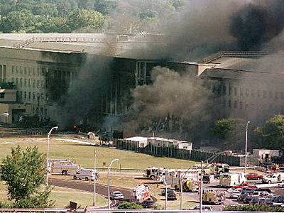
Incident Command
System (ICS)
1970s California FIRESCOPE
1980 National Fire Academy
2004 NIMS
Homeland Security Presidential Directive-5 (HSPD-5), 2003
World Trade Center and Pentagon Attacked 9/11/2001
Notes:
The Incident Command System was developed by the California fire service as a result of a series of wildland fires in Southern California in the 1970s that required a multijurisdictional response. This led to the creation of the FIRESCOPE organization that oversees the development of ICS today. In 1980 ICS was adopted by the National Fire Academy as a best practice for managing multi-agency, multi-jurisdiction fire and emergency events. ICS is now used by organizations at all levels of government and multiple professions, from small volunteer fire departments to the US Coast Guard, and it is mandated for the management of all hazardous materials accidents and incidents by the US EPA.
In 2001 the United States was attacked by terrorists who used airplanes as guided missiles, crashing into the World Trade Center in New York and the Pentagon near Washington, D.C. The Arlington, Virginia Fire Department used ICS to organize the response to the Pentagon attack, which is widely considered as a model disaster response, integrating local, state and federal assets for the rapid evacuation and care of the victims and mitigation of damage to the building. In Homeland Security Presidential Directive-5 in 2003 President George W. Bush ordered the creation of a National Incident Management System (NIMS), “institutionalizing the use of ICS across the entire response system.” The use of ICS is mandated for all agencies receiving federal disaster preparedness grants. This includes most state transportation agencies and mass transit systems.

Slide 7
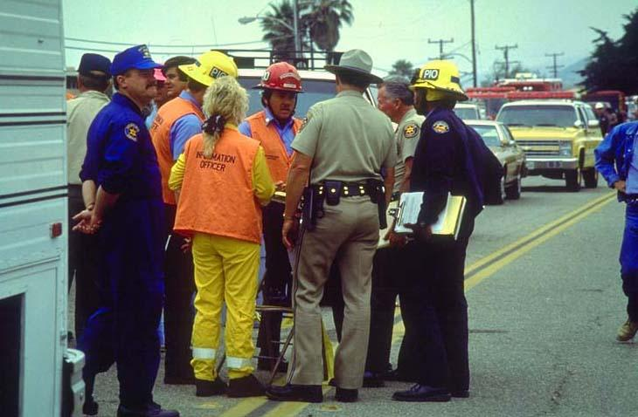
National Incident Management System (NIMS) Incorporates…
Incident Command System (ICS)
Modular, flexible, span of control, unity of command
Common Terminology
Management by Objective
Unified Command
Multi-agency coordination system (MACS)
Mutual Aid Agreements
Notes:
NIMS is based on three basic elements: ICS, MACS and Mutual Aid.
ICS uses a modular approach. As you will see in the next slide, there are five basic functions and three Command Staff functions, but one person can handle multiple tasks, or many people can handle one task, depending on the size and complexity of the event. A responder has only one supervisor (unity of command). A supervisor should have no fewer than 3 subordinates and no more than 7 to ensure a manageable span of control. Units, groups and branches can be created or collapsed to maintain the desired span of control. Common terminology ensures that appropriate resources are provided and the right person is contacted. The Incident Commander sets the objectives for each Incident Action Period – management by objective. In events with multiple responsible agencies, Unified Command is used, allowing the leaders of various agencies with equal responsibility for the resolution of an event to work together to create a common Incident Action Plan.
Second, response is based on multi-agency coordination, where first responder agencies with overlapping jurisdictions collaborate to develop resource and information sharing systems to support field operations and prioritize incidents.
Third, response is supported by Mutual Aid agreements through which different professions provide immediate assistance to jurisdictions whose resources have been overwhelmed by the emergency. These include not only fire and law enforcement professions, but also engineering, heavy equipment, and more than 20 others. The Emergency Management Assistance Compact has been signed by all 50 states, agreeing to provide assistance across state boundaries when requested.

Slide 8
ICS for Railroads
Incident Commander
Functions of the Incident Command System in the Field
General Staff = Incident Commander, Planning/Intel Chief, Logistics Chief, Operations Chief, Finance/Administration Chief
Command Staff = Safety Officer Public Information Officer, Liaison Officer
Safety Officer
Public Information Officer
Liaison Officer
Planning/ Intel Chief
Logistics Chief
Operations
Chief
Finance/
Admin Chief
Notes:
There are five functions in the Incident Command System: Command, Operations, Planning/Intelligence, Logistics and Finance/Administration. The three Command Staff work directly for the Incident Commander and their roles assist him or her.
The Incident Commander (IC) is in overall charge of the field level event, sets the goals and priorities for the Incident Action Plan (IAP), sets the length of the Incident Action Period, and appoints people to fill any other field level ICS position that is required to meet the needs of the event. Not all positions have to be filled for every event, but the IC keeps all positions for which no one else is appointed.
The command staff supports the IC in three specific ways. The Public Information Officer (PIO) handles all media releases with the approval of the IC. Only the PIO speaks to the media and the public. The Safety Officer ensures that everyone operates safely at all times, using the right equipment. The Liaison Officer manages representatives for other organizations that assist in the response, such as utility representatives or American Red Cross representatives.
The General Staff is made up of the leaders of the four other functions. The Operations Section Chief is in overall charge of the tactical response, based on the goals set by the IC. The Planning/Intelligence Section Chief manages check-in, accountability for personnel, situation status, creates reports and organizes demobilization. The Logistics Section Chief provides the supplies and services needed to support Operations. The Finance/Administration Section tracks time, costs, and receipt of purchases to support Operations.

Slide 9
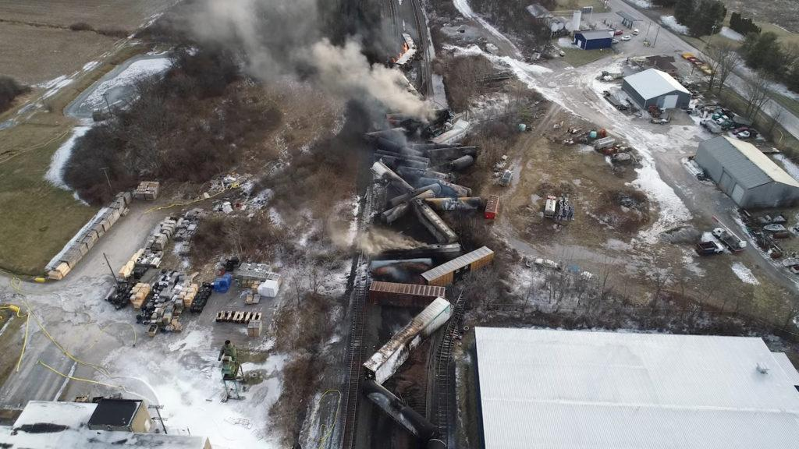
ICS for Railroads
ICS is flexible and scalable
Use what you need, staff to meet span of control requirements
ICS can be used for emergencies, disasters and catastrophes
Spilled potatoes
Hurricane Sandy
ICS can be used for planned events
Parades
Sporting events
Planned maintenance
Source: NTSB.gov
Source: Caltrans
Notes:
The Incident Command System can support a variety of transportation activities, not only catastrophic events. ICS allows the Incident Commander to activate the elements of ICS that will best support the resolution of the problem in the community, and to activate only the number of people needed to manage the event to resolution.
ICS can be used for emergencies like wildland fires, but it can also be used for smaller problems like roadway hazards. In Tennessee a truckload of potatoes was spilled on the roadway. Rather than wait for a team of convicts to be brought to the scene to clear the hazard by hand, the Department of Transportation quickly put ICS in place, set the objective of opening the road within 30 minutes, and used a grader to push the potatoes into a ditch where they could be retrieved later without tying up traffic. This same ICS system allowed the New Jersey State Patrol and New Jersey DOT to quickly create contraflow on the Atlantic City Expressway to evacuate seashore residents ahead of Hurricane Sandy.
ICS can be used for parades, sporting events and other planned activities that will negatively impact traffic flow. Using ICS for planned events helps to familiarize transportation personnel with many aspects of ICS, such as using the terminology, and seeing how the functions collaborate.

Slide 10
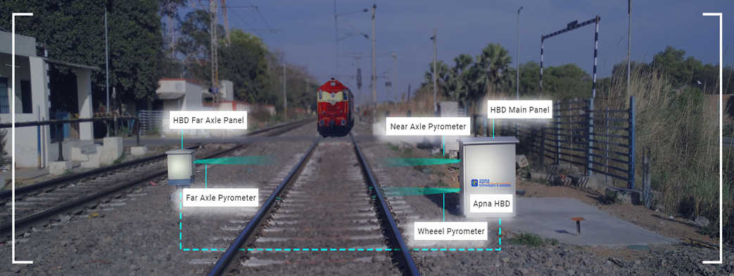
Practical Application of ICS in Rail Service
East Palestine, Ohio NS Derailment.
Source: NTSB, 2024.
Notes:
On February 3, 2023 a Norfolk Southern train with three locomotives and 149 cars, 17 of which were carrying hazardous materials, derailed in East Palestine, Ohio near the Pennsylvania border. The L1 wheel bearing on car 23 caught fire and deformed the wheel, causing 38 cars to derail. Although the trackside detector alarmed, railroad office staff determined that the reported temperature of 103 degrees was not critical. Unfortunately, the sensor’s temperature reading was faulty, and it was actually at 253 degrees. Three tank cars were breached and leaking as a result of the derailment. The local fire chief contacted Norfolk Southern (NS) for the identification of the haz mats, but did not get an answer for over an hour. They applied water to the burning cars. At 10 pm NS told the local fire department that they planned to “vent and burn” the vinyl chloride cars, causing toxic smoke. More than 2,000 residents of East Palestine – 40% of the population - had to be evacuated (NTSB, 2024).
Five of the derailed cars carried vinyl chloride. While they did not catch fire, they were exposed to heat from the burning cars and released material from the pressure relief valves. The first responders included the local fire department and railroad representatives. Because there were multiple entities with responsibility for responding and resolving the derailment, hazardous materials issues and the recovery, a unified command was formed that included representatives of the fire department, NS and NS’s contractor to create a unified incident management plan. NS hired a contractor as an on-site adviser, and the contractor conducted the “vent and burn” procedure on the vinyl chloride cars, which was unnecessary (NTSB, 2024). Ultimately, 110,000,000 residents in 16 states were impacted by the pollution caused by the burning vinyl chloride (Hutchinson, 2024).

Slide 11
NIMS/ICS: Perform Reliably
and Effectively
Goal of NIMS/ICS: Reliable and effective response to an event, emphasizing safety of DOT staff
Achieved through
SAFETY
Check-in
Check-out
Demobilization
Personnel Accountability
Freight train derailment, 4/27/2024.
Source: Creative Commons
Notes:
Emergency response can be organized in many ways, but the Incident Command System is designed specifically to ensure that all personnel are safe and that there is continuous accountability for personnel in the field.
The Safety Officer and the Planning/Intelligence Section Chief ensure the overall safety of the personnel at the event. The Safety Officer is concerned with the proper use of equipment and the use of appropriate personal protective equipment by responders.
The Planning/Intelligence Section Chief maintains the check-in/check-out function, through which he/she gathers information on the location of every person at the event for personnel accountability. He or she accomplishes this through the use of T cards with name and contact information. Each card is placed in the ICS organization board showing the supervisor for each person. At the end of an event, demobilization allows for the collection of loaned equipment, and checks in personnel and equipment to ensure that they are unharmed, or that harm or damage is recorded and proper care or coverage is provided.
All the sections cooperate with the Finance/Administration Section Chief to ensure that supplies are ordered properly, expenses are accounted for and receipts are safeguarded. They also collaborate to document the work of the response to ensure that expenses are tied to appropriate damage, rescues and other field work.

Slide 12
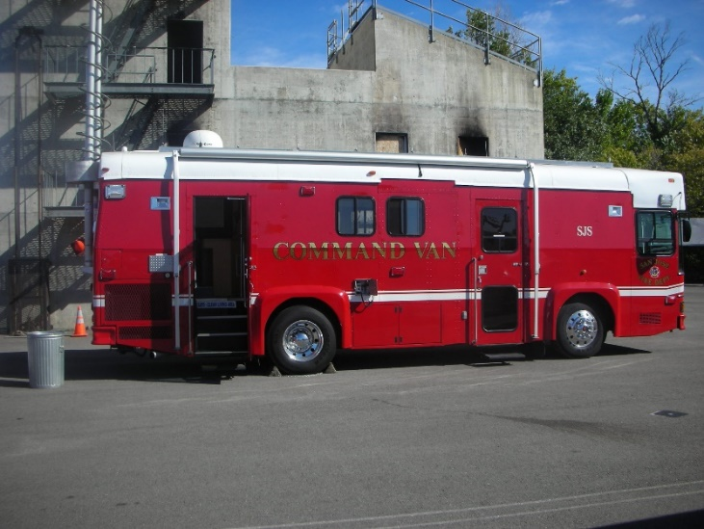
ICS for Railroad
Goals
Safety
Check-in
Examples of “T” Cards
Example of a fire department incident Command post.
Notes:
Safety begins with the Check-in process. When a person is assigned to an event he/she begins by checking in with the P/I Section Chief at the Command Post. The P/I Chief creates a “T” card for each person or work unit with their personal information, duty assignment and communication contact information. It is through check-in that responders get counted for food, sleeping space and other personal support at the incident. Most important, it is through Check-in that the Incident Commander knows where his subordinates are at all times to ensure that they receive all safety messages and information about an evolving situation.
After checking in with the P/I Chief at the Incident Command Post the person may be assigned to a division or group, and they will check-in again with that supervisor and join the field activity.
Sometimes after check-in a person or work unit will be assigned to staging. Staging is a location where people and equipment wait for an assignment. The person signs in with the staging manager, and waits in the staging area until they are assigned to a field group or division, often at the next shift change. Sometimes the person may be assigned to a base or camp to rest or eat while awaiting an assignment.
Once the person is assigned to a field task they check out with the staging manager, or base or camp manager, and checks in with the field supervisor. In this way there is continuous tracking of each person working at the event. This ensures that this person is counted for meals and beds, but more importantly, they are notified if the situation changes and they need to move to a safer location.
As the person completes one assignment and moves to the next, they check out with the supervisor they are leaving , and checks in with the P/I Chief to get a new assignment. In this way the person keeps their location and supervisor information up to date.

Slide 13
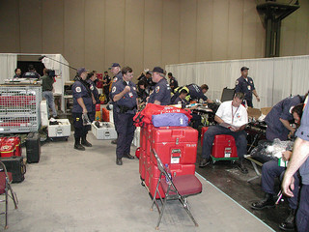
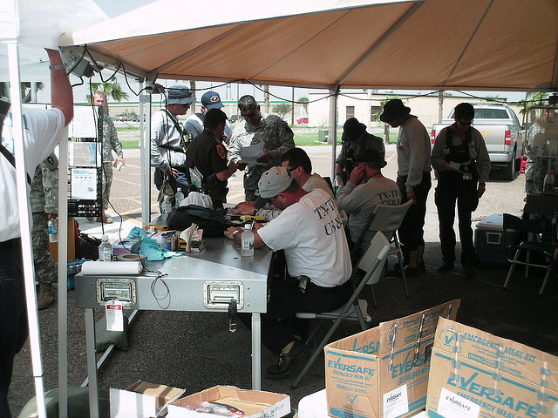
ICS FOR Railroad
Goals
Safety
Check out
Demobilization
Notes:
Checkout occurs at each change of field assignment. A person may check out when an assignment is completed, or when the shift has ended. They check out with the field supervisor and then with the Planning/Intelligence Chief at the Command Post. If they are going to a base or camp to eat or sleep, the person will tell the P/I chief their destination, and check-in there. The next day they would check out of the base or camp and check in with the P/I chief at the Command Post again.
Check out at the end of the assignment period completes the safety oversight of that person. When the person is leaving the event, they check out with the field supervisor and then with the P/I Chief, giving the location of their destination and a contact phone number there. The person is then sent to demobilization.
The demobilization process ensures that all equipment is returned, all reports and subordinate evaluations are completed, and all vehicles are safe for the trip home. Vehicles may have been exposed to fire, heat, freezing or other austere conditions that could damage their equipment. A mechanic checks over the mechanical systems, brakes and tires to ensure that the vehicle is roadworthy before the person leaves the ICS assignment.

Slide 14
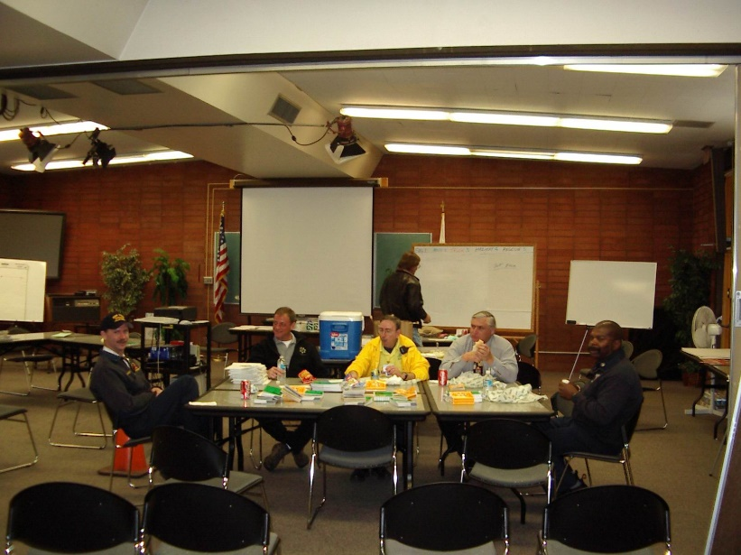
ICS FOR Railroad
Personnel accountability includes care
Food, shelter
Medical and mental health
Family contacts
Notes:
Personnel accountability is the second purpose of the ICS. Through the P/I chief the IC knows at all times where all personnel are located, what field work groups and divisions have been organized, and how many people are in each. This allows the IC and the Operations Chief to ensure that the span of control for supervisors is kept to no more than 7 people per supervisor. Groups and divisions are created when the span of control becomes too large.
ICS also provides for the care of personnel in the field. Through the check-in procedure, the IC knows how many people are working at the site. This number is used for ordering meals, portable restrooms and shelters. In an extended event it is used to order sleeping facilities, showers and laundry facilities, as well.
ICS also provides for the medical and mental health needs of the responders. The number of personnel working determines the level of medical oversight that will be at the scene, and the kinds of emergency medical equipment that will be readily available. During especially stressful events, the work period may end with a critical incident stress defusing among those who shared the experiences on that shift. During the demobilization process each person is asked whether they suffered any medical or mental health injuries, and participants may be assigned to Workers Compensation for treatment, including critical incident stress counseling.
ICS provides for a family contact when possible. A liaison will generally be available to receive messages from families and relay messages to families when personnel are deployed over several days in areas with little communications capability. Often the amateur radio community supports the family communication system. These radio operators may be organized through RACES or ARES, or as a club supported by an employer, like Caltrans’ CARS amateur radio organization.

Slide 15
Can be handled internally.
May require documentation.
Transportation
Capability
Problem
Transportation Capability
Needs multiple organizations and a variety of resources to solve.
Will require use of ICS
Problem
Notes:
Most day to day events can be handled as they have been in the past, but with the change in reimbursement requirements for FTA and FEMA, it may become necessary to start using Incident Command to document an incident to ensure that FTA and FEMA requirements for documentation are met to protect the maintenance budget.
Then there are times when an event overwhelms not only rail’s day to day capability, but affects other responders as well, requiring coordination between the different organizations to resolve the problems. Under these circumstances, the Incident Command System is critical in bringing those organizations together, developing a common operating picture, identifying resources needed, and how they will be used, and in particular keeping responders safe and capturing data—through documentation—to ensure reimbursement.

Slide 16
ICS for Railroad
Railroad maintenance staff may be sent to an emergency at any time.
Getting ready in advance will make for a more efficient response.
Work vehicle kit
Professional Drive Away Kit
Notes:
Transportation personnel may be sent to an emergency with little or no notice. Therefore it is wise to develop support materials to ensure your safety and capability to do your job. While personnel support may be provided in long term events, localized emergencies may leave you on your own as you accomplish emergency repairs.
Everyone should have a work car kit in the vehicle used during the work day and a professional drive-away kit assembled or ready to be assembled. Two flyers have been provided in the student resources folder to guide you as you make the kits.
The most important element is drinking water. You can get along without food for a few days, but drinking water is essential for your health. You should keep one gallon of water per person in your work vehicle. The second critical element is medication. Law forbids employers from dispensing any medications, even over the counter items. Keep a 30 day supply of essential prescription drugs, allergy medications, headache remedies or other over the counter medications that you use on a regular basis in your backpack, briefcase, or purse. Never store medications in the car as the heat variance will damage most medications. Sturdy shoes or steel-toed boots and a blanket are other essential items. Review the suggested items in the kit and make a kit that is appropriate to your location, activities, and personal medical requirements. Consult your physician regarding appropriate food if you have medical issues.
The professional drive-away kit flyer includes suggestions for augmenting your work vehicle kit, such as weather-related gear, communications and computer equipment, and plans and maps. Use the flyer as a guide in developing your own kits. Put the work vehicle kit in your trunk and have it there every day. Know where your professional drive away kit items are kept and be ready to assemble them quickly following the checklist and based on weather conditions and assignments.

Slide 17
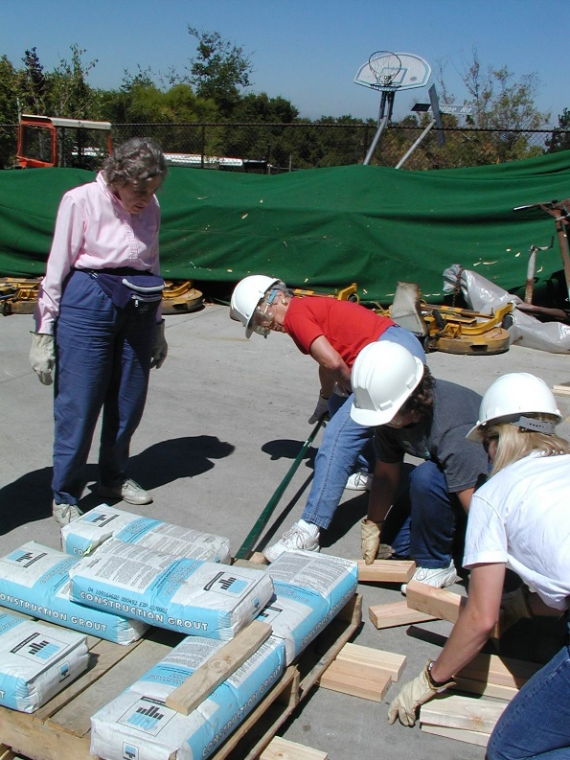
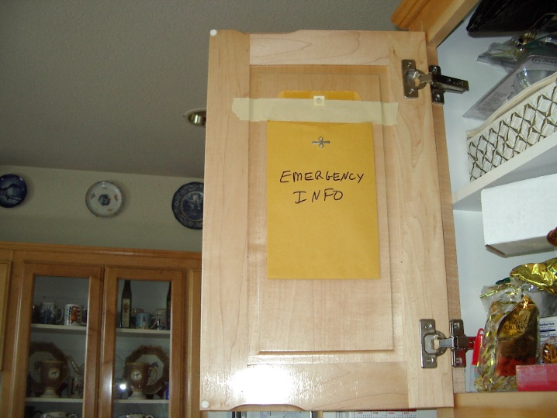
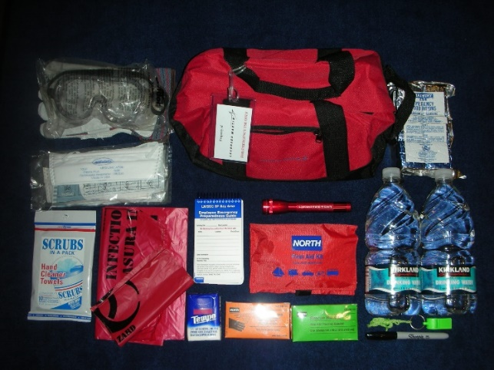
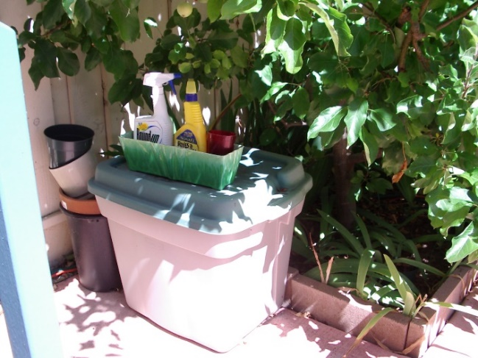
ICS for Railroads
Family preparedness
Family plan
Family car kit
Family supplies at home
Community Emergency Response Team (CERT)
Notes:
Railroad workers may have to go to emergency events with little or no notice and be gone for several days. These events may impact the whole community, including where workers’ families live. The workers and their families need to plan in advance for community emergencies to ensure that the families are prepared and safe while workers are absent fulfilling their professional roles.
Make a family emergency plan and prepare for the most likely emergencies in your community—floods, wildfires, hurricanes, or earthquakes, for example. Work with your family to create kits for the home and each family car. Make lists of vital information and check on plans at your child’s school or daycare, or your parents’ assisted living facility. Be sure to keep your emergency contact cards current so that an authorized person can help your child or loved one if you are unavailable.
Then join with the Community Emergency Response Team in your neighborhood to share skills and assistance with those who live nearby. If you are called to work you have peace of mind knowing that your family is part of a network of disaster support while you are gone. If you do not have a neighborhood CERT team, contact your local Office of Emergency Services or Fire Department to start one.

Slide 18
15 Minute BREAK
Union Pacific Snow Train. Source: Edwards, 2005.

Slide 19
Arguments for Using the Incident Command System
HazMat – EPA mandated use
Legal – Best Practice, good defense for civil litigation
Safety - primary reason why ICS was created in the first place.
Do we cut corners when under pressure and/or tired?
Common Operational Picture
Notes:
There are several reasons for using the Incident Command System at multi-agency events. First, the US EPA requires the use of ICS at all accidents involving the management of hazardous materials. These requirements are described in the US DOT’s Transportation Rail Incident Preparedness & Response: High Hazard Flammable Trains. BNSF, Canadian National and Norfolk Southern have detailed instructions for the use of ICS in hazardous materials events, for example.
Second, the use of ICS for multi-incident events is required under HSPD-5. It is recognized as a best management practice, so it provides some defense against allegations of negligence in civil litigation.
ICS focuses on personnel safety, the reason it was originally developed. Following the ICS procedures ensures continuous oversight of all personnel at an emergency event. It provides comprehensive checklists that prevent important actions from being overlooked.
The use of ICS forms leads to the development of a common operational picture for all the participating agencies, and for the collection of information that can be passed to agency leadership to ensure that all participating parties understand the event. The Planning/Intelligence Section is the focal point for the collection of event details.

Slide 20
Five ICS Roles Possible for Rail Personnel
Join an existing ICS in Operations
Wildland Fire
Join an existing ICS in Planning/Intelligence
Subject matter expert in derailment
Unified Command
In natural disaster: Hurricane Sandy, New York
Assume command
Flash flood wash out of rail lines
Incident Commander
Event occurs right in front of you
Long Island Railroad tracks in The Rockaways after Hurricane Sandy.
Source: Metropolitan Transit Authority.
Notes:
Transportation has at least five distinct roles in a disaster. The railroad may be integrated into an existing ICS structure in the Operations Section, it may be a technical specialist in the Planning/Intelligence Section, it may be part of a unified command, it may assume command once other problems are resolved, or it may be the Incident Commander in a rapid onset emergency event that occurs on or near the railroad right-of-way.

Slide 21
Wildland Fires Are Becoming
More Frequent
Minnesota estimates that trains cause 3% of all wildland fires in the state.
Climate change is causing extremely hot weather to be experienced farther north, causing droughts and wind that can fan wildland fires.
Total cost of wildland fires is $2.5 billion/year and rising (Wildfire Mitigation and Management Commission, 2023).
Railroads have created fire trains that provide tanks of water, first responder transportation, and even a caboose as an emergency operations center.
BNSF Fire Train. Source: BNSF.
Notes:
The risk of large wildland fires is increasing with global temperatures. The changing climate results in heavier rain in the winter, encouraging the growth of grasses that then dry out as the heat increases. These dry grasses provide tinder for fires to start from dry lightning, from a stray spark from power equipment, or from power lines that touch and arc. The high heat stresses trees, making them less resilient to the bark beetle and other pests, and they die, adding fuel to the forest.
Wildland fires that stay on the forest floor can usually be contained, and may even be beneficial to some species, like the bristle cone pine. However, dead trees act as wicks to raise the fire into the canopy of the forest. Once a fire gets into the canopy it is very hard to contain or stop until the fuel is burned. Canopy fires require intensive responses with aerial water and fire retardant drops, and the creation of fire breaks.
Railroads like BNSF and Union Pacific have created fire trains that include tank cars of water and water spraying equipment. Some such trains have cabooses that have been converted to emergency operations centers, or to transport fire personnel. The trains are stationed in the northern prairie states and the Pacific Northwest for quick response.

Slide 22
Join Existing Incident Command System
Railroad’s help would be requested by another agency, like a fire department
Railroad maintenance personnel would be dispatched from their normal duties to assist the requesting agency with access, right of way clearance, expedient repairs, or similar work.
Rail workers formally join the existing ICS through the check-in procedure, and get assigned to the Liaison Officer or to a supervisor to perform tasks related to rail capabilities.
A brief video Number 3 on joining an existing IC is available at https://vimeo.com/showcase/11005939
Incident Commander
Safety Officer
PIO
Liaison Officer
Planning/ Intel Chief
Logistics Chief
Operations
Chief
Finance/
Admin Chief
Notes:
Sometimes events occur that require the assistance of railroad personnel and the use of railroad equipment. The appropriate personnel from the area are dispatched from their normal duties to assist the requesting agency with railroad inspections, railroad damage assessment, expedient repairs or related work to provide access by rail or to restore the critical supply chain.
Upon arrival the rail workers formally join the existing ICS system by checking-in at the Incident Command Post with the Planning/Intelligence section chief. They receive an assignment within Incident Command System’s existing Incident Action Plan, and are either assigned to the Liaison Officer or to a division supervisor, in which case they travel to the site to meet the supervisor. They get a briefing on the existing situation status, location of their work site, and a safety briefing, at a minimum.
In a multi-day incident the railroad workers might receive food, lodging, and other support through the ICS.

Slide 23
Heat Is Deforming Tracks
Climate change is making heat waves and heat domes more frequent and intense.
Rail track metallurgy is designed for expected regional temperatures, but hot periods are moving north and lasting longer.
Heat can cause tracks to deform—thermal buckling or “sun kinks”—possibly leading to derailments.
In 2022 BART tracks in San Francisco, usually operating at 115 degrees reached 140 degrees, causing them to warp, and result in a partial derailment (Freedman, 2022).
High heat caused buckling.
Source: US Department of Transportation (US DOT), 2019.
Notes:
Over the past 50 years the average temperatures in the US have increased about 2 F degrees. It is expected that heat trapping greenhouse gasses (GHGs) will continue to push up temperatures globally, even with mitigation steps being taken by many nations.
Rail metallurgy is designed for the historic average daily temperature of a region. Thus rails in the Mojave Desert are designed for sustained high heat, but rails in the cooler Pacific Northwest are not. As the hot temperatures move further north, rails may experience thermal buckling or “sun kinks” as pictured here. In 2022 high heat in the usually cool San Francisco area caused the tracks to warp and a BART train to derail.
In such a case, rail personnel might join an existing IC as technical specialists, to advise on the safety of passengers, the resolution of the derailment, and the care of crew or cargo as the General Staff develops the Incident Action Plan to resolve the event. They would also be information conduits for the railroad to the Incident Command as it determines how to address the replacement of the damaged rails.

Slide 24
Transportation as a
Technical Specialist
Incident Commander
Safety Officer
PIO
Rail maintenance personnel or conductor (if a train is involved) may be tasked as technical specialist to the incident command.
Technical specialists are part of the Planning/Intelligence Section in ICS.
In a derailment, maintenance crew can explain rail operations to help the IC provide better response.
In a derailment with hazmat involvement, the conductor may have MSDS or other consist information that would help the IC develop a safe response.
Liaison Officer
Planning/ Intel Chief
Logistics Chief
Operations
Chief
Finance/
Admin Chief
California train derailment due to heat,
8/2/2020. Source: ParkerPioneer.net
Notes:
In some events railroad engineers, surveyors, geologists and other specialists may be called on for their unique expertise that is needed by another entity. Most often this would be a city or county public safety staff, road department, or a special district.
The appropriate railroad management would select an employee with the proper qualifications and certifications to fulfill the request. That employee would go to the Incident Command Post as a single resource, check-in, and serve as a technical specialist under the Planning/Intelligence Section. Some Technical Specialists might be assigned to Operations Section groups or to other ICS organizational units. The guidance for Technical Specialists is on page 9-9 of the FEMA FOG, 2016.

Slide 25
Natural Disasters: Hurricanes
A warming climate brings warmer oceans, providing energy for increased rainfall and wind speeds (SFI, 2011).
Rail lines along the East and Gulf Coasts will experience more damage from wind, water, debris.
Rail will remain a critical part of response to hurricanes, providing transportation for first responders, response equipment, community supplies and access to hard-to-reach areas, making rail a key partner in the unified command for response and recovery.
After Hurricane Katrina NS took only 16 days to lift 5 miles of track out of the water and back onto the Lake Pontchartrain Bridge (AAR, n.d.).
Post-hurricane ballast repair. Source: AAR, 2011.
Notes:
Climate change is accelerating the rate of natural hazards, floods, heatwaves and wildland fires occur more frequently. A hurricane is a combination of very heavy rain and very strong winds. These natural forces do damage across a region, destroying much of the built environment.
Railroads are victims of hurricanes, which cause damage to bridges, wash out ballast and damage or destroy the signal system and trackside sensors. These regional events damage residential, commercial and government property, often leaving entire communities in ruins. The public safety, utilities and transportation sectors must work together to protect the public and recover from the damage. Rail is a critical part of the transportation sector, transporting goods needed for recovery, including heavy equipment. As a partner in the response and recovery process, railroad personnel should be included in a community’s unified command as plans are made for restoring critical services. Rail can be an asset for moving people and goods into and out of the disaster area, but its needs must be considered as service restoration priorities are set. For example, access to electricity and wireless service are essential to rail operations. If a community wants the benefit of rail services, it must consider rail’s operational needs among the most important.

Slide 26
Unified Command
“Unified command is a team effort that allows all agencies with jurisdictional responsibility for an incident, either geographical or functional, to participate in the management of the incident…developing and implementing a common set of incident objectives…without losing …agency authority, responsibility or accountability.” FEMA FOG, 2010, p. 6-2.
Type of incident example – hurricane
Fire is the Incident Commander whenever human life or hazardous materials are involved.
Law Enforcement provides traffic control, evidence protection, and scene access control.
Rail supports critical supply chains; may require that railroad damage assessment and expedient repairs begin immediately, to permit access to the disaster and delivery of essential goods and personnel.
May include EMS for life saving services
May include EPA for hazmat management & clean-up
May include Fish and Wildlife for environmental clean-up; Coast Guard for navigable waterways
Incident Commander
Unified Command:
Fire, Law, Transportation
Safety Officer
PIO
Liaison Officer
Planning/ Intel Chief
Logistics Chief
Operations
Chief
Finance/
Admin Chief
Notes:
In a complex event involving the whole transportation system, railroad personnel may become part of a unified command. According to the ICS Field Operations Guide, “Unified command is a team effort that allows all agencies with jurisdictional responsibility for an incident, either geographical or functional, to participate in the management of the incident…developing and implementing a common set of incident objectives…without losing …agency authority, responsibility or accountability.” (FEMA FOG, 2016, p. 6-2)
A hurricane is a good example of when unified command would be needed. Fire would generally be the Incident Commander, overseeing life safety services like search and rescue and emergency medical care. Law enforcement would be protecting lives and property, and managing limited traffic resources. Rail might need to repair the railroad infrastructure so Logistics can order essential supplies and equipment for delivery to the disaster area. To open the railroad, expedient repairs might need to be made to bridges, guard rails or other damaged portions of the railroad infrastructure, and utilities provided expeditiously, so the Unified Command would need to understand the requirements and prioritize them.
Hurricanes often include spilled hazardous materials from broken pipes or containers. The state’s environmental protection agency would have to collaborate with the whole community including the railroad to oversee the clean-up of materials on the rail property. If hazardous materials got into storm drains or waterways from runoff, the Fish and Wildlife agency might oversee environmental clean-up in wildlife areas. The Coast Guard would participate in cleanup plans for navigable waterways.

Slide 27
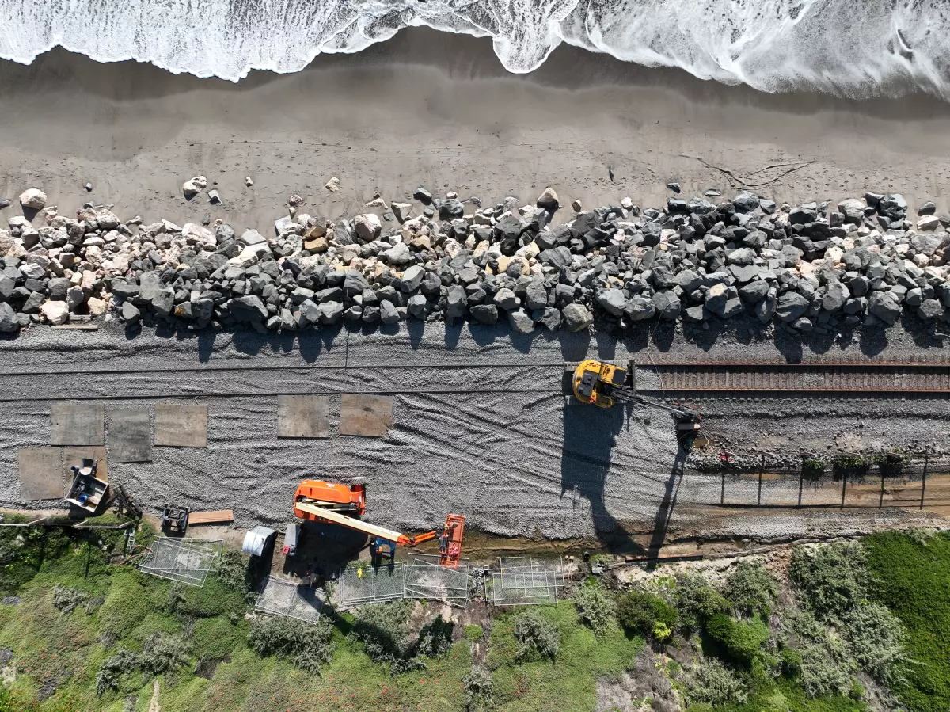
Flood washout of
rail lines
High water can weaken rail bridges, wash away ballast, and damage signals and trackside monitoring equipment (AAR, n.d.).
8 states along the Gulf Coast are already seeing damage from sea level rise; 38% of the US population lives in coastal counties (Solecki and Friedman, 2021).
Sea level rise and storm surge are already impacting west coast railroads, such as the Los Angeles to San Diego freight corridor that is experiencing mudslides from the hillsides and undermining from sea level rise.
Once the initial emergency is resolved and life safety assured, the Incident Command may pass to rail as the facility owner, coordinating with state and federal agencies to complete recovery and repairs.
LOSSAN corridor. Source: SANDAG, 2023 2023.20
LOSSAN at Mariposa Point. Source: Caltrans, 2023.
Notes:
Climate change brings higher levels of water into a community along a coast or river. Sea level rise along America’s coasts threatens large cities like New York, New Orleans and Houston, San Francisco and Seattle. Scientists estimate that the sea level could rise between 8 inches and 2 feet by the year 2100. Sea level rise also increases storm surge, sending waves further inland, damaging infrastructure including railroad tracks.
With so many large US cities along the coasts, the number of communities at risk continues to rise. Rail lines often run along shorelines and river banks, the heritage of seaborne commerce and multi-modal shipping. Major freight rail lines connect ports to inland consumers, often running along waterways.
In a flood or hurricane the community might resolve the life safety issues along the railroad in a few weeks, but the rail infrastructure might need repairs that take longer. In that case the IC might turn over command for the local incident to the railroad so they could continue to coordinate with utilities and permitting agencies to effect the repairs to the rail lines and supporting equipment.

Slide 28
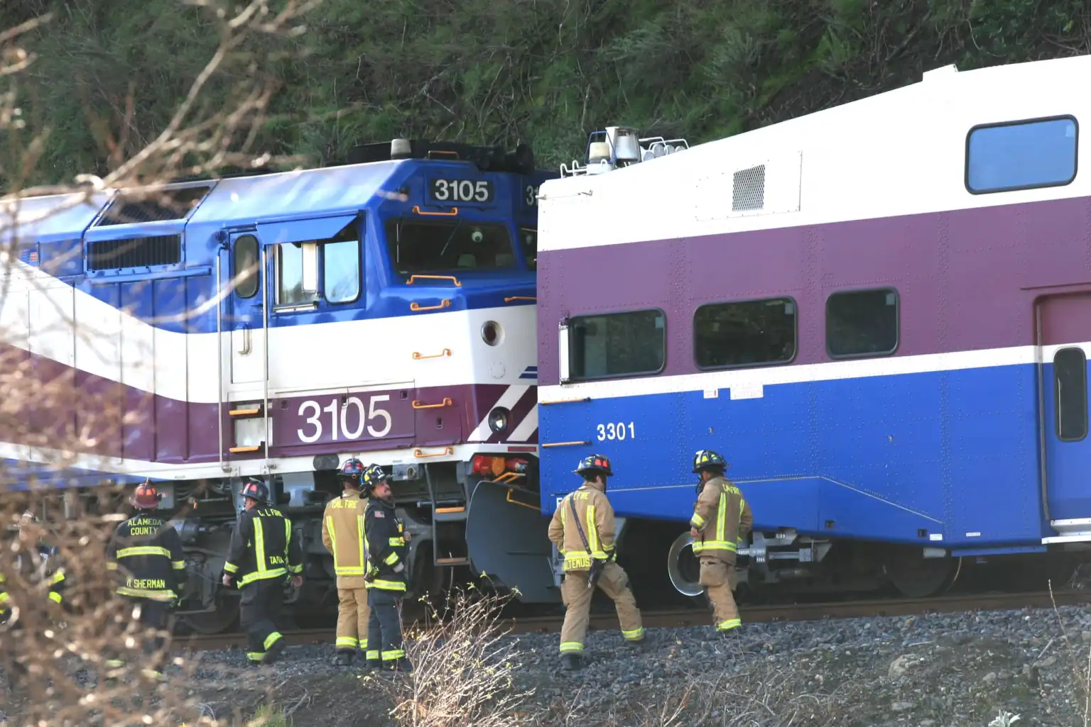
Assume Command: Transfer of Command
Report to existing Incident Commander
Assume command from another agency whose work is done
Continue the Incident Command until all railroad-related issues are successfully completed
Close out the Incident or transfer the command to another agency with responsibility for the remaining issues
For example, to EPA for environmental remediation
A brief video Number 2 on transferring IC is available at: https://vimeo.com/showcase/11005939
ACE Train mudslide and derailment, 2023
Incident Commander
Safety Officer
PIO
Liaison Officer
Planning/ Intel Chief
Logistics Chief
Operations Chief
Finance/ Admin Chief
Notes:
The railroad’s senior representative to the ICS might assume command from an existing Incident Commander whose work is completed. For example, when there was a mudslide near the LOSSAN corridor during heavy rains in 2023 the Fire Department was initial Incident Commander, as the life safety issues resolved. As soon as the rescues of passengers and crew had been completed, the command passed to the railroad to investigate the geotechnical issues causing the mud slide, remediate the track damage and coordinate with public agency geologists, Caltrans and the California EPA regarding the design of expedient repairs to get the railroad opened before the morning commute.
As a critical transportation link for Vandenburg Air Force Base and Camp Pendleton Marine Corps Base, the railroad had to be restored to functionality, and then longer term plans were made for relocating the tracks under the railroad’s collaboration with Caltrans, SANDAG and other partners. As the planning evolved, a unified approach was used.
Each time command is passed all the records for the event have to be turned over to the new Incident Commander for use in After Action Review and the eventual reimbursement and close-out process. This includes all the ICS forms completed to date, all the Incident Action Plans and all receipts. If there is Logistics support of personnel needed, the Incident Commanders have to determine how those services will continue to be provided. Requests for additional agency involvement can be made if the new Incident Commander lacks the capacity to staff all the needed ICS positions. For example, the railroad could request Planning/Intelligence support from Fire.

Slide 29
Disaster adjacent to
rail lines
In remote areas rail lines may run parallel to country roads, where public safety responders are few.
An accident on the country road may occur adjacent to where a rail maintenance crew is working. They might start ICS while awaiting the arrival of fire, medical and law enforcement personnel.
Car hits train tamper, assisted by railroad crew.
Source: Creative Commons.
Notes:
Many parts of America are sparsely populated, even though interstate roadways pass through them. Prairies often have 2-lane roads with little traffic. Communities may be many miles apart with limited public safety resources. Maine transportation leaders reported that most of their fire responders were volunteers who had to leave their jobs, change their clothes and drive to the emergency in their personal vehicles without lights and sirens, slowing their progress. A transportation official in Idaho said there were many areas along the interstate that had highway patrol resources spread thin, and that the backup was usually a deputized rancher living in the area. Railroad tracks were notably present in these areas. Under such circumstances, having ICS trained railroad personnel available to assist would be valuable.
Maintenance crews work all along the railroad’s right of way, and might be the first people able to reach a road accident scene. Knowing how to report the event and begin the collection of information could speed the response once public safety personnel arrive. Greeting the public safety personnel with information about the location of any injured people or dangerous goods, a list of available first aid and support resources, and a written incident description would allow the public safety responder to immediately organize the personnel to do the most good at the scene.

Slide 30
Incident Command: Starting Incident Command
Event on an isolated road
Railroad personnel are first on the scene, there doing maintenance
Supervisor starts ICS using the folder
A brief video Number 1 on starting IC is available at: https://vimeo.com/showcase/11005939
Incident Commander
Safety Officer
PIO
Liaison Officer
Planning/ Intel Chief
Logistics Chief
Operations Chief
Finance/ Admin Chief
Notes:
When a disaster occurs near a rail right of way, the rail personnel may be the first on the scene, or the first personnel able to manage the event. On a major state highway there may be regular highway patrol beats that bring an officer to the scene quickly, but in more remote parts of the state it may be hours before highway patrol personnel are available. If railroad workers were already in the area they may be the first emergency responders to arrive at the scene who can organize the response, communicate situation status information to their headquarters and start to organize emergency response. This may be as simple as determining what resources are needed to resolve the event, or as complex as providing first aid to injured motorists.

Slide 31
15 Minute BREAK
Digital inspection portal with 38 cameras.
Source: NTSB.gov.

Slide 32
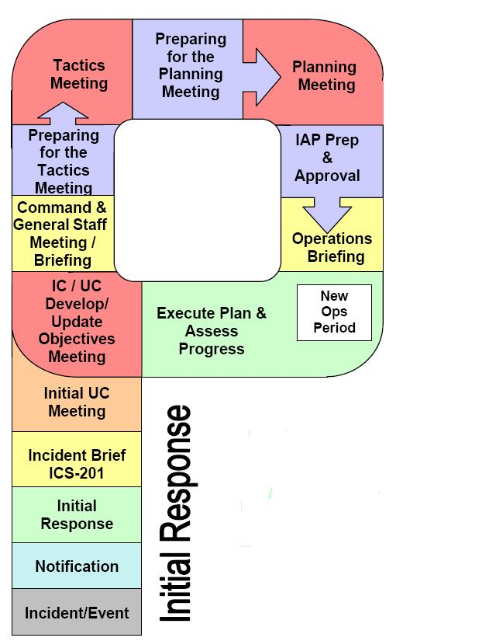
Planning P
How you look at the “P” and how much documentation is needed is dictated by the complexity and size of the event.
Notes:
You were introduced to the Planning P in the on-line ICS courses. The ICS Quick Start cards provide a checklist that follows the planning process.
Make a plan, execute the plan, determine whether the plan is working, modify the plan as needed.

Slide 33
Problems and Decisions in ICS
Step 1 Recognize that you have a problem/issue
Step 2 Define what the problem/issue is
Step 3 Identify what the objective is for solving the problem/issue
Step 4 Identify all possible options/alternatives
Step 5 Use the options/alternatives to determine limitations and help clarify the objective (Step 3)
Step 6 Select the best option/alternative to meet the objective
Step 7 Convert option/alternative into a plan (who will do what in which order)
Step 8 Implement the plan
Step 9 Evaluate the overall situation.
Option 1 If the plan is failing to meet the objective, adjust it
Option 2 If the plan is clearly not capable of meeting the objective, select another option/alternative (Step 6)
Option 3 If no options/alternatives are viable, redefine the objective (Step 3)
Option 4 If objective is not obtainable, redefine the problem/issue (Step 2)
Step 10 Monitor environment for problems/issues.
Notes:
[Review the listed steps]
These are the steps in making decisions – everyday and in an emergency.

Slide 34
Quick exercise with the ICS cards
Divide into 3 teams, each team selects one of the scenarios on the next page. The person with the longest rail experience will be the IC for each team.
Mentally place the scenario in a location within your jurisdiction.
In all three,
You are a field level person working with a crew performing railroad maintenance
You are close enough to clearly see the event
You are not in immediate danger
Fire, law, and medical are not present
It is in a rural area (increased response time)
You have access to an ICS Supervisor’s Kit
Use the ICS Card sheets behind the PPT slides to guide your response.

Slide 35
Scenario 1
A ½ ton truck is driving on a narrow country road that is parallel to the railroad tracks just off the right-of-way. You watch as it runs down, and over, two joggers. It then chases a third jogger off the path before continuing. You look back up the road and see at least one more body.
Scenario 2
You hear and then see a small explosion on the back of a flatbed truck in a commercial parking lot next to the tracks. Some 55-gallon drums have been scattered around the truck by the blast and several people can be seen choking, vomiting, and falling down.
Scenario 3
You are repairing rails at the incline when a hopper truck of aggregate hits the support column for the railroad overcrossing for the highway. The truck jackknifes, spilling its load across all lanes of the freeway. Debris has hit cars on both sides, resulting in multiple car accidents on both sides of the road.

Slide 36
Reports Back
Each team in turn will report on how they responded to the event. Each ICS member will report on his/her job and how he/she performed that function to support the event.
After each team report is complete, the other teams may comment on how the event was managed and how ICS was used.

Slide 37
ICS FOR RAILROAD SUMMARY
Transportation is the key to all emergency response
ICS is the method required by the federal government to organize the response to a multi-jurisdictional, multi-profession emergency event
The five functions of ICS are used in the field by all emergency response personnel
Safety, accountability, and care for personnel are accomplished through check-in, check-out and demobilization
Put a work vehicle kit in your trunk and develop a professional drive-away kit for quick assembly.
Getting your home ready for an emergency and your family into CERT will give you peace of mind when you are deployed in a disaster to help the community.
Union Pacific Fire Train at Lava Fire, 2021.
Source: Union Pacific, 2021.
Notes:
Read the slide.

Slide 38
Wrap-Up
Questions?
Freight engine, Mojave, California. Source: Edwards, 2021.

