Slide 1


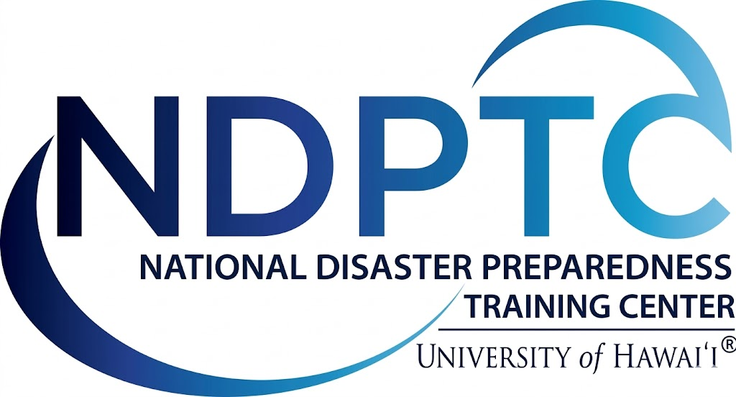

Wildfire Risk & Preparedness for Urban Rail Operators Supporting Large Stadium Events
May 2026
Notes:
Welcome the attendees and frame the training in the context of large stadium events (with upcoming FWC and Olympics games as useful examples)
Provide overview of what this course offers at a high level
Emphasize that the training is a pilot course (if that is the case)
If taught virtually, encourage attendees to engage in the chat

Slide 2



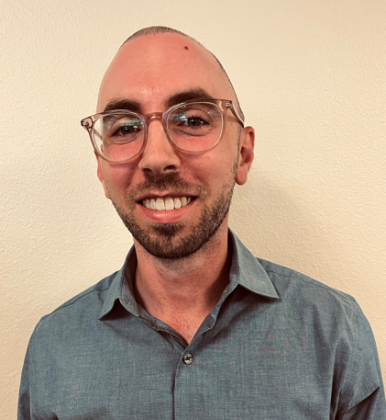
Instructors
Daniele Spirandelli, PhD
Senior Climate Resilience
Specialist
Laura Hanson
Senior Project Manager
David Rother, PhD
Project Geoscientist
Notes:
Provide introductions for the instructors

Slide 3
Course Goals
Build a foundational understanding of how wildfire hazards affect rail systems infrastructure and operations and equip operators with tools and best practices for proactive
risk management.
Notes:
State who the course is designed for and the overall objective of the course
The content of this course applies to all large stadium events (football, soccer, baseball, concerts, etc.), however there is a focus here on the upcoming World Cup games.
Goal of this course is to introduce participants to foundational concepts of wildfire science that will help them understand on a deeper level the risks that wildfire poses to rail infrastructure. Building on these concepts, participants will then learn how wildfire hazards may impact urban rail transit operations/infrastructure during large stadium events (with an emphasis on preparedness, situational awareness, and response/evacuation).

Slide 4

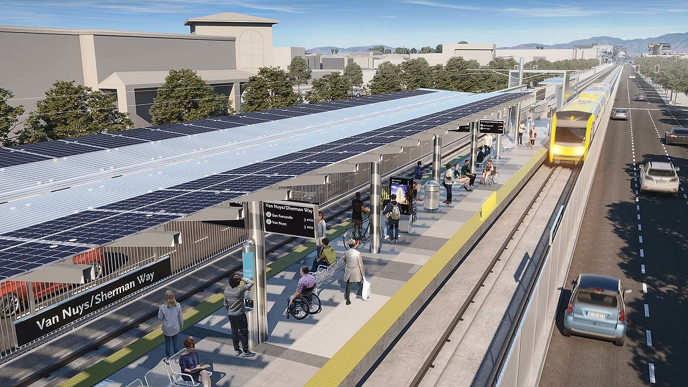
Learning Objectives
Target Audience: rail operators, transit agencies, emergency managers, city and state government transportation departments
Participants will be able to:
Understand foundational wildfire science concepts and how they apply to urban rail systems and large stadium events
Identify tools and best practices for proactive wildfire risk management, including preparedness planning and situational awareness
Apply concepts through scenario-based learning and real-world examples
Notes:
Photo credit: https://www.gensler.com/projects/la-metro-integrated-station-design-solutions
Learning objectives include:
Understand wildfire science basics
Identify two-way risk: rail as ignition source and rail as exposed infrastructure
Identify operations/infrastructure vulnerabilities and how to prepare for/mitigate them, but also how to function during event surge conditions
Apply wildfire science, rail vulnerability, and preparedness/event readiness knowledge to a real-world, game-day hazard scenario at SoFi Stadium
Participants will be able to:
Understand foundational wildfire science concepts and how they apply to urban rail systems and large stadium events
Identify tools and best practices for proactive wildfire risk management, including preparedness planning and situational awareness
Apply concepts through scenario-based learning and real-world examples

Slide 5

Agenda
Title | Duration
Welcome, Introduction, Administration | 10 minutes
Module #1: Foundations of Wildfire Risk in Urban Rail and Stadium Event Context | 45 minutes
Module #1: Breakout Session | 10 minutes
Module #2: Risk to Rail: Infrastructure and Operations | 45 minutes
Module #2: Breakout Session | 10 min
Break | 10 min
Module #3 Planning: Preparedness and Event Readiness | 45 min
Module #3: Breakout Session | 10 min
Module #4 Delivery: Day of event and implementation activities / SoFi Case Study | 45 min
Wrap Up & Discussion | 10 min
Notes:
Quick overview of the structure of course, including what each module will cover, when breakout sessions occur, when the case study will happen and what to expect.
Discuss how there will be an in-depth case study/scenario-planning interactive walkthrough and analysis at the end (and how it will help synthesize the concepts covered in training)
Outline the overall timeline of the course, how long to expect for each session and when the breaks are
Talk about what to expect during breakout sessions

Slide 6

Module #1: Foundations of Wildfire Risk in Urban Rail and Stadium Event Context
Urban Rail Systems
Wildfire Science
Wildland Urban Interface
Quantifying wildfire exposure
Notes:
Objective: build foundational understanding of wildfire science and its relevance to urban rail systems, with emphasis on how stadium events change exposure, consequence, and decision making
This goal of this module is to introduce participants to key wildfire science concepts that will help them understand rail vulnerabilities to wildfire hazards on a deeper level (direct exposure of flames/embers, smoke hazards)
This module will answer questions such as:
What is wildfire?
What are the primary drivers of wildfire activity?
What is the WUI and how does wildfire spread in these zones?
How do we quantify or measure wildfire exposure?

Slide 7
Overview: The Urban Rail System
What is it?: a multimodal transportation network that includes light and heavy rail and other rail transit options, regionally known as metro or subway
Why is it important?: the urban rail system reduces congestion on roadways and provides mobility to people that cannot or do not want to drive
How are they used?: people opt to skip parking lots and congestion, utilize park-and-rides near stations, and use direct service lines to events at low cost
What are the sensitive components?: catenary systems, third rail, track components, power systems, signaling equipment, stations and platforms, maintenance and storage yards
Notes:
This slide provides an overview of what is referred to as the Urban Rail System in this training
Urban rail systems consist of multiple modes of transportation including light rail, heavy rail, and commuter rail
The entire system also contains the critical infrastructure that allows the system to function, including trackform (embedded track or ballasted track), viaducts and bridges, stations and platforms, tunnels and underground works, depots and maintenance yards, substations
This system is important, especially in the context of large stadium events because it reduces congestion on the roadways and provides mobility to people that cannot or do not want to drive. They also provide lower cost alternatives to ride share and allow for direct service lines to events
However, there are characteristics and features of the urban rail system that cause them to be sensitive to impacts of extreme weather hazards, including wildfire. These characteristics include, but are not limited to, catenary systems, third rail, track components, power systems, signaling equipment, stations and platforms, and maintenance and storage yards
Sources:
What is light rail: Pontech – Light Rail Transit (LRT): Structural Design and Technical Requirements (https://pontech.vn/light-rail-transit-lrt-structural-design-technical-specs/)
What are the sensitive components: LA Metro Climate Action Plan (https://libraryarchives.metro.net/DB_Attachments/2019-0489_Attachment_A_Draft_Final_2019_CAAP.pdf)
What are the sensitive components: Sound Transit Climate Risk Reduction Project (https://www.bing.com/ck/a?!&&p=a06203e43bfd985037006513c4d6f4843ca0c5125f98ac0a0ef278ae14fe6adeJmltdHM9MTc3ODAyNTYwMA&ptn=3&ver=2&hsh=4&fclid=2c8df95d-7e03-6cec-192e-ecf17f916df9&psq=sound+transit+risk+reduction+project&u=a1aHR0cHM6Ly93d3cudHJhbnNpdC5kb3QuZ292L3NpdGVzL2Z0YS5kb3QuZ292L2ZpbGVzL0ZUQTAwNzVfUmVzZWFyY2hfUmVwb3J0X1N1bW1hcnlfMC5wZGY)
How they are used: Go Metro to the World Cup (https://www.metro.net/riding/world-cup/)
What is it?: LA Metro – Next Stop: More Rail (https://www.metro.net/documents/2025/01/lgea_railmodes-2pdf/#:~:text=Light%20Rail,At%20peak%20times%2C%20Metro%20trains:)

Slide 8
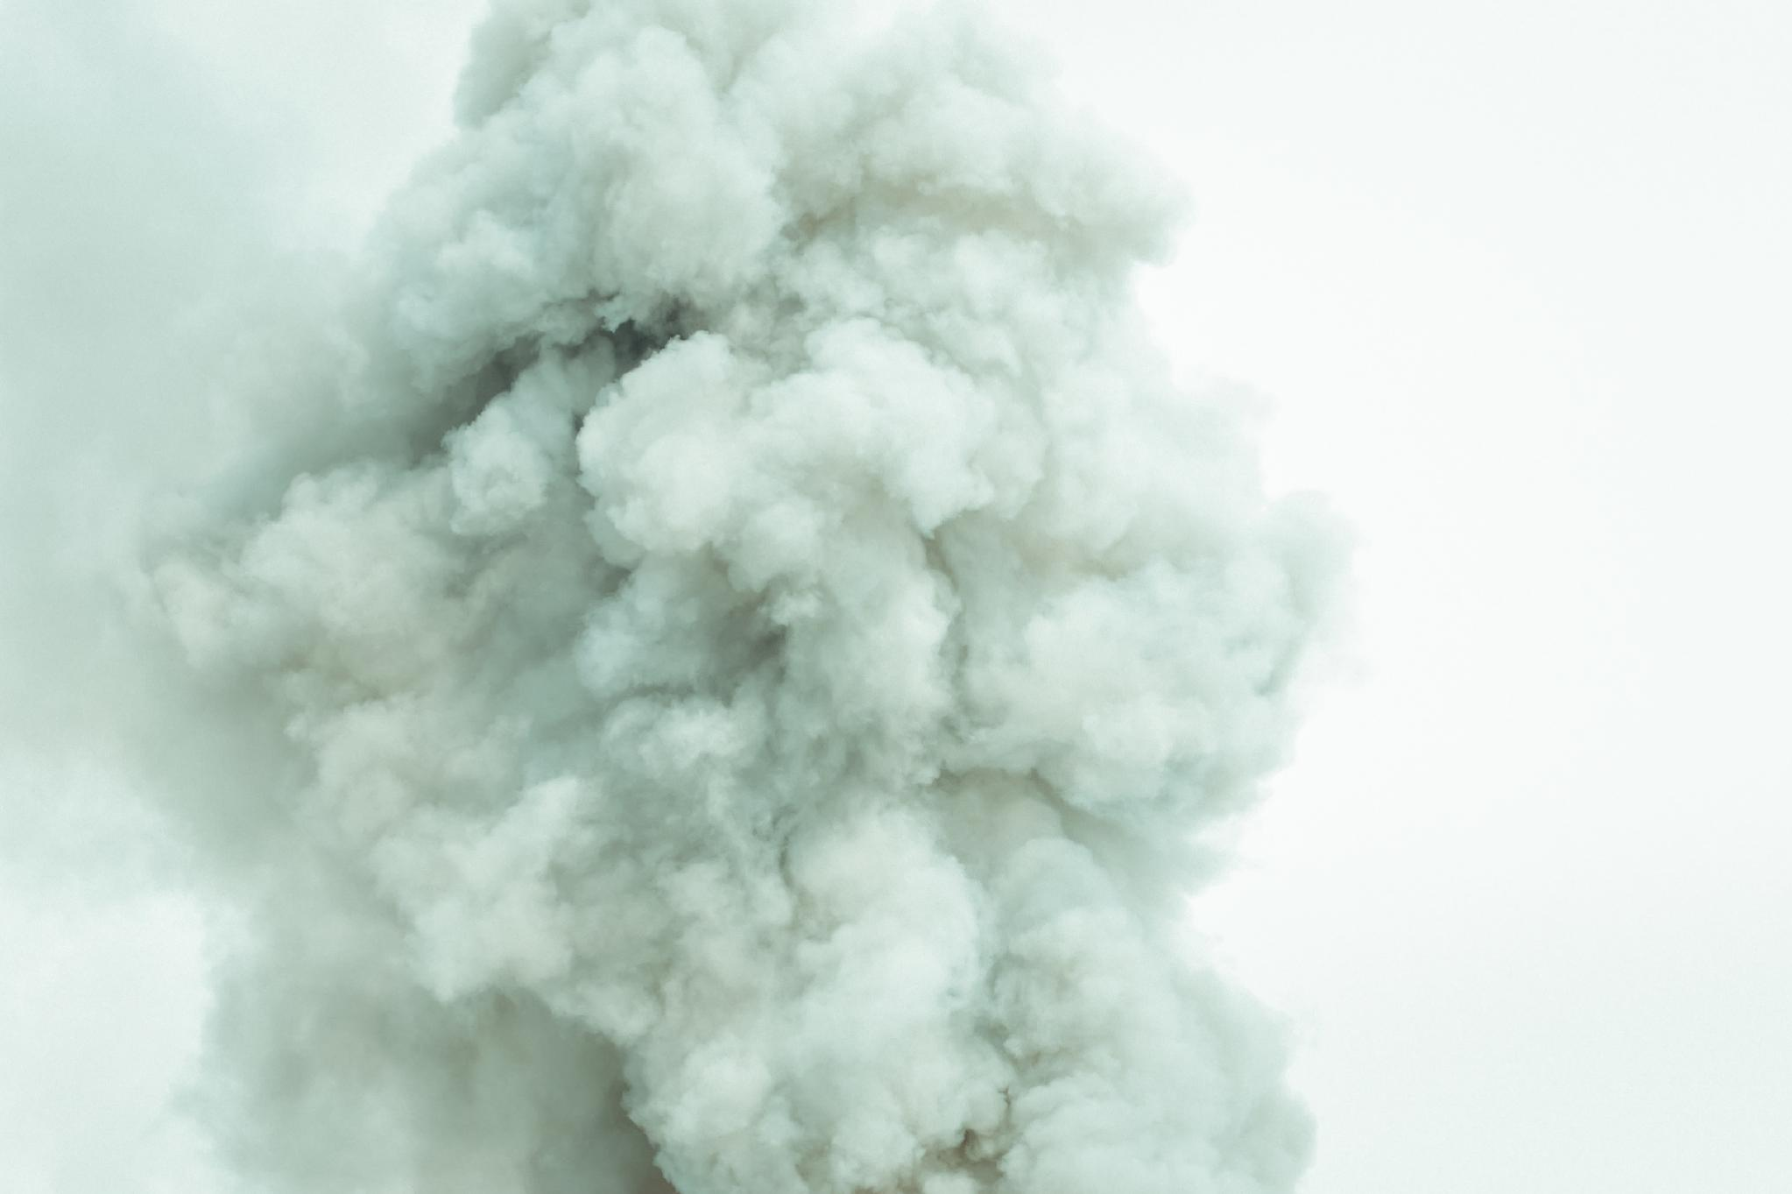

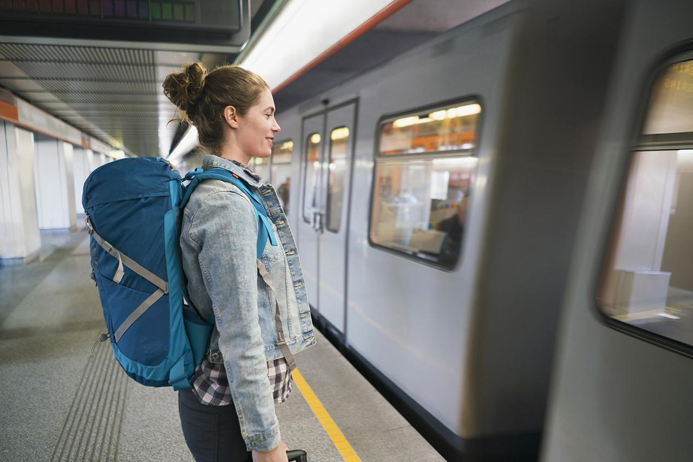

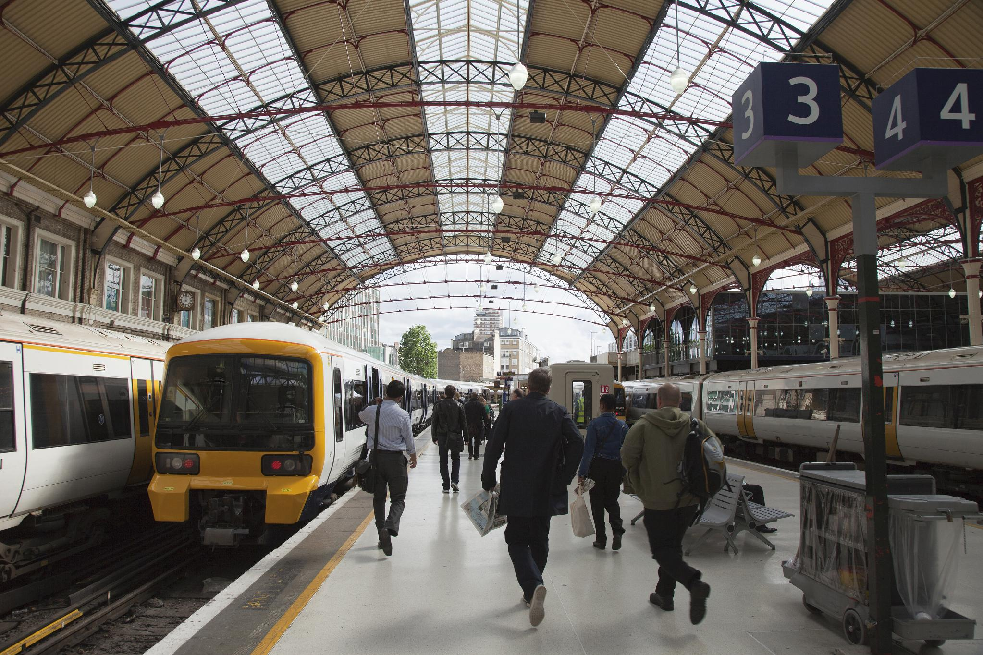
Why Wildfire Risk Matters During Major Event Operations
Smoke and poor air quality
Heightened Operational Complexity
Increased Passenger Volumes
Low Tolerance for Disruption (e.g. fixed kick-off)
Single point failures – reliance on 1-2 stations
Notes:
Photos are stock images from Powerpoint
This slide is designed to establish motivation and provide background on why wildfire risk matters (start to shift the conversation towards wildfire risk):
The stakes are high during large stadium events (public health, reputational and financial potential impacts). There are more people utilizing services and greater public scrutiny for delays and cancellations.
Smoke and poor air quality can impact rail operations (Dense Smoke Advisory due to poor visibility can impact scheduling, lead to re-routes and delays, cancellations), passenger safety (exposure to particulate matter, inadequate ventilation onboard train and in/on platform waiting areas)
Heightened operational complexity (communications with emergency services, situational awareness (hazard monitoring), health and safety concerns, crowd management, first/last mile coordination, contingency planning)
Increased passenger volumes - event service produces high concentrations of riders on few platforms (pre-event ingress, post-event egress)
Low tolerance for disruption (fixed kickoff times/end times, limited rebooking options)
Single point failures – event depends on few stations (closure cascades systemwide)

Slide 9

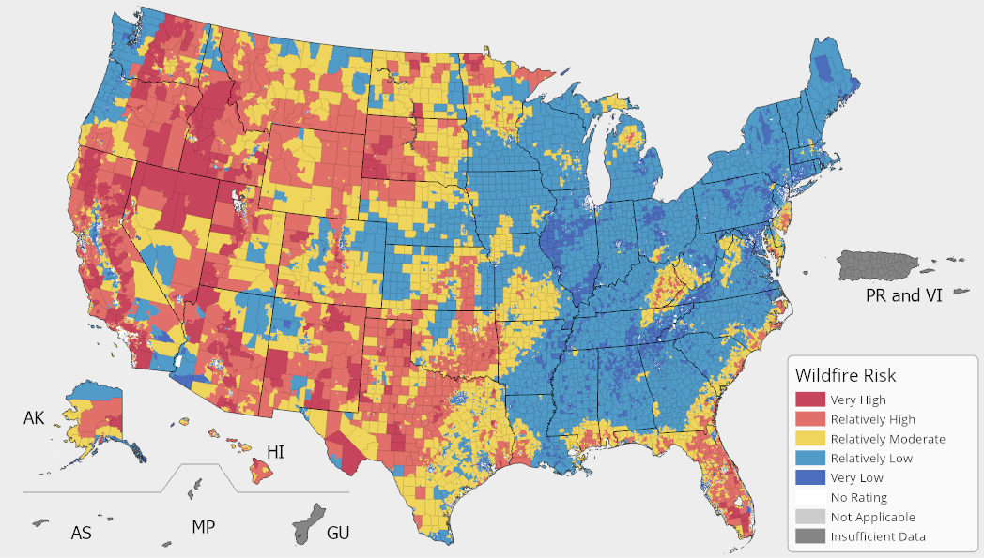
What is Wildfire?
An unplanned fire burning in natural or wildland areas such as forests, shrub lands, grasslands, or prairies.
High temperatures
Dry conditions
High winds
Ignition sources
    Natural (lightning)
    Human-caused
FEMA National Risk Index, Wildfire Hazard
Notes:
This slide is meant to begin the introduction of fundamental wildfire science concepts needed to support risk interpretation. The goal is to start connecting wildfire concepts with event operations.
Provide the definition of wildfire
Distinguish between fires burning in wildland versus those burning in an urban setting (primarily man-made structures and vehicles)
Take a moment to explain the figure on the right. The figure shows the FEMA National Risk Index for Wildfire. The map shows that risk is concentrated in the western and central states, as well as Florida and along the edge of the east coast. The color-coded legend represents relative risk, with reds and yellows representing higher risk for wildfire and blues representing lower risk.
Explain the types of weather or meteorological conditions that define extreme fire weather conditions and a can lead to a greater probability of ignition and rapid spread:
High temperatures
High Wind
Dry conditions (low relative humidity)
Ignition of fire comes from natural causes (lightning) and human caused fires (arson, utility failures, fireworks, accidental, vehicles, railroad, firearms)
Sources:
FEMA National Risk Index: https://www.fema.gov/flood-maps/products-tools/national-risk-index

Slide 10

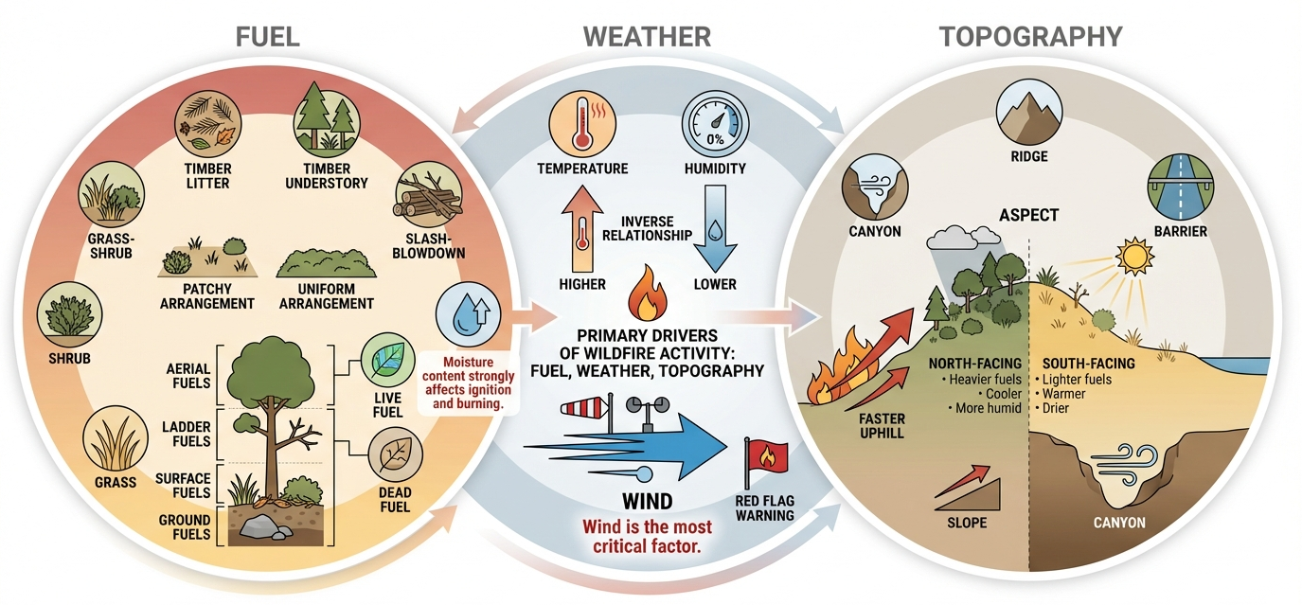
Drivers of Wildfire Activity
Notes:
This slide discusses three primary drivers of wildfire activity: fuel, weather, and topography
Fuel:
Types include grass, shrub, grass-shrub, timber litter, timber understory, slash-blowdown
Arrangement is the spatial distribution and orientation of fuel
Horizontal (uniform and patchy fuels)
Vertical (ground, surface, ladder, aerial)
Moisture content is the single most important factor in determining how well a fuel will ignite and burn (Source: S-190 Intro to Wildland Fire Science)
Live fuel and dead fuel
Weather:
Temperature and relative humidity have an inverse relationship (i.e. temperature goes up, RH goes down; typically peaks around mid-day to 2pm)
Critical levels of RH may trigger a red flag warning (location dependent, usually around 15-20%)
Wind is the most critical factor affecting wildland fire behavior (difficult to predict and variable in time/space, poses difficult control problems)
Topography:
Features are things like canyons, ridges, natural or constructed barriers
Characteristics:
Slope: fires move faster uphill (fuel above the fire is preheated ahead of approaching fire)
Aspect: cardinal direction that hill faces
North facing slopes have heavier fuels, lower temps and higher humidity (less fire risk)
South facing slopes have lighter fuels, higher temps, and lower RH
Sources:
S-190 Introduction to Wildland Fire Behavior: https://apps.usfa.fema.gov/nfacourses/catalog/details/10623

Slide 11
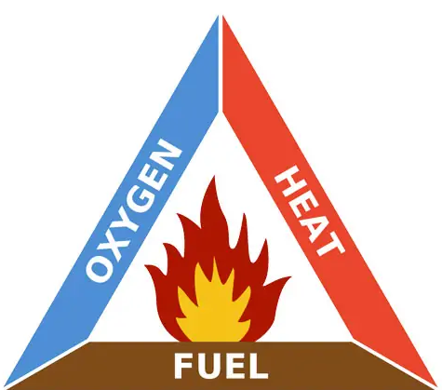
Breaking the Fire Triangle
Supports the process of combustion
Responsible for initial ignition and needed to maintain spread
Material that is burning
Notes:
Photo credit: https://www.scutumsoutheast.co.uk/help-advice/basics-fire-triangle/
The fire triangle is a simple way to understand components of fire.
Three elements make up fire triangle, remove any one and the fire will not burn. A fire can be put out, prevented or the impacts reduced by removing, reducing, or separating these elements.
A fire can be suffocated by removing the oxygen that feeds the fire (done with water or dirt)
Fuels are the materials that are burning (can be anything combustible, wildland fuels, structures, vehicles, etc) - can be removed from the path of the fire by digging firelines or prescribed fire (before an event)
Heat (for ignition) can come from lightning or a human caused occurrence – water from fire engine, helicopter, rain/snow can remove heat
For rail operators, this connects to practical actions such as fuel reduction, ignition control, and protecting exposed assets.
Emphasize that the fire triangle is a simplified model, but it is useful for understanding why risk reduction often focuses on fuel management (fuels), ignition prevention (heat), and rapid response (break the fire triangle).
Source:
Northwest Fire Science (https://www.nwfirescience.org/sites/default/files/publications/FIREFACTS_Triangles.pdf)
S-190 Introduction to Wildland Fire Behavior: https://apps.usfa.fema.gov/nfacourses/catalog/details/10623

Slide 12
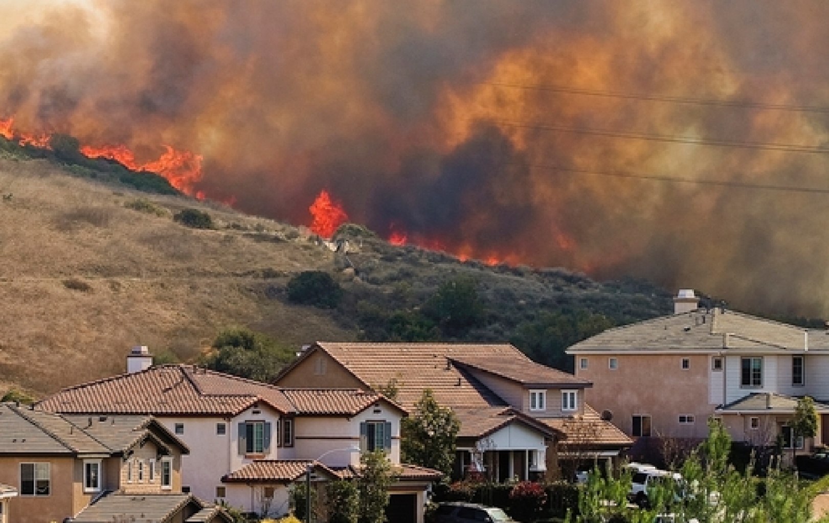
Wildland Urban Interface (WUI)
The zone of transition where structures and other human development meet or intermingle with undeveloped wildland or vegetative fuels (USFA/FEMA)
Photo: FEMA
Notes:
Photo credit: https://cpo.noaa.gov/unique-smoke-emissions-from-wildland-urban-interface-fires/
This slide introduces the Wildland-Urban Interface (WUI) as an important wildfire science concept, and an important element of overall wildfire risk.
How is the WUI defined?
WUI areas are often delineated using human presence (housing density), wildland vegetation (% of land coverage), and proximity to wildlands (buffer distance)
There are three different types of WUI area: interface, intermix, and occluded
These definitions consider human presence (housing density) and vegetation (% land covered)
In this context, critical rail infrastructure, including rail corridors, stations, yards, access roads may be located in the WUI.
Regardless of if stadiums are located in the WUI, important rail infrastructure might be, and if impacted, may lead to cascading impacts that can impact passenger safety, scheduling and delays/cancellation if maintenance is required or trains need to be rerouted (this leads into the visualization shown on the next slide)
Sources:
United States Fire Administration- What is the WUI? (https://www.usfa.fema.gov/wui/what-is-the-wui/)
National Institute of Science and Technology, Hazard Mitigation Methodology (https://www.nist.gov/programs-projects/wildland-urban-interface-wui-fire-data-collection-parcel-vulnerabilities/hazard-0)

Slide 13
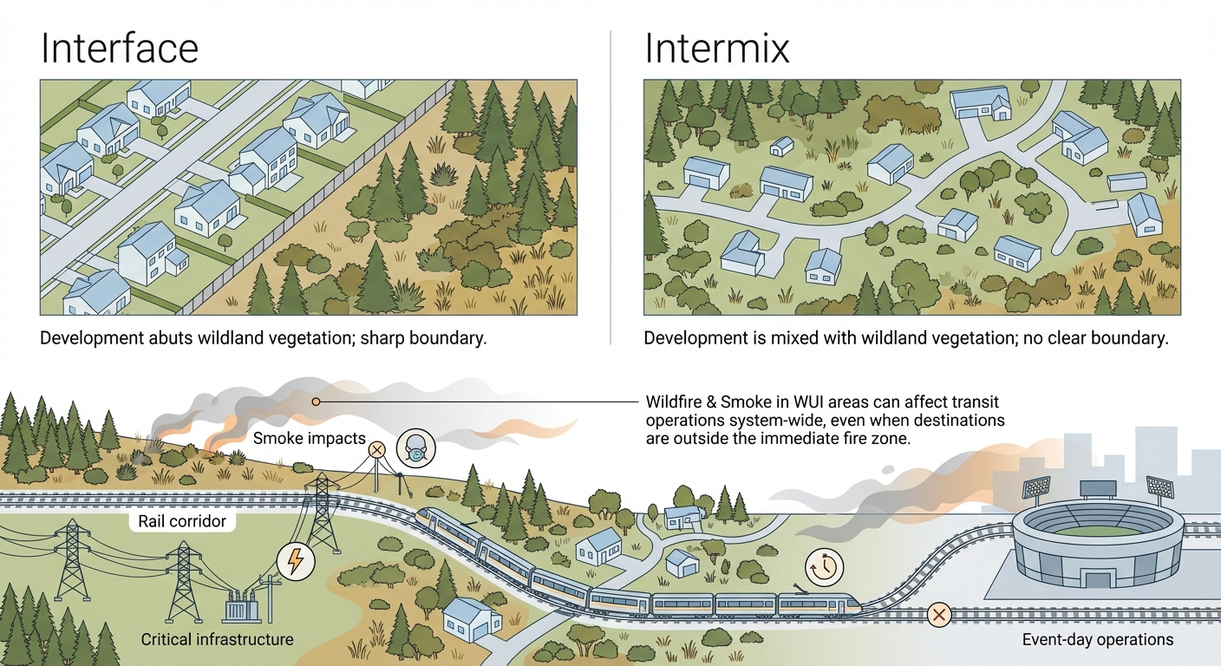
Wildland Urban Interface (WUI)
Notes:
This slide shows a visualization of the difference between interface and intermix
Interface = clear line of demarcation between residential, business, and public structures and wildland fuels; wildland fuels do not generally continue into the developed area
Intermix = No clear line of demarcation; wildland fuels are continuous outside of and within the developed areas
There is another type called Occluded (which refers to islands of wildland vegetation surrounded by developed areas)
Why is the WUI important for us to understand in the context of this training course?
Rail lines pass through WUI zones that may experience fire in the days leading up to (or on) event day
Depending on wind speed and direction, smoke from nearby wildfires occurring in WUI zones can travel and disrupt operations/pose a public health threat to riders
Fires in nearby WUI zones may affect scheduling on game day, lead to forced rerouting, delays, cancellations
Given a fire of sufficient size and the right wind speed and direction, all stadiums have some level of risk for exposure to wildfire smoke.
Sources:
United States Fire Administration- What is the WUI? (https://www.usfa.fema.gov/wui/what-is-the-wui/)
National Institute of Science and Technology, Hazard Mitigation Methodology (https://www.nist.gov/programs-projects/wildland-urban-interface-wui-fire-data-collection-parcel-vulnerabilities/hazard-0)

Slide 14
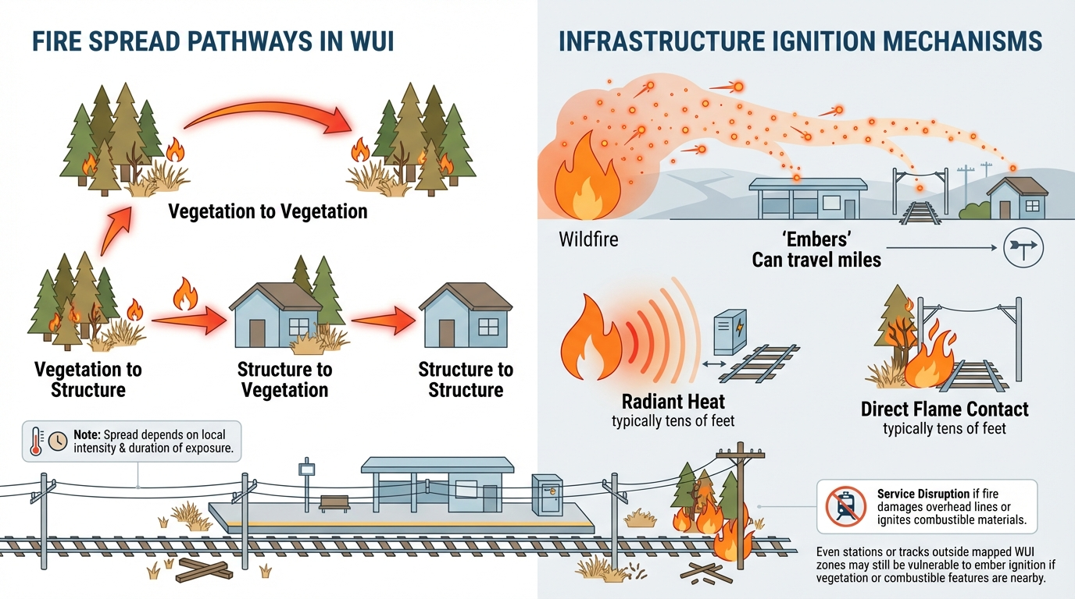
WUI Fire Spread Pathways
Notes:
This slide details the four fire spread pathways and the three mechanisms by which a fire can spread.
Remember the fire triangle. In order for a material or fuel to combust, it has to meet the requirements for sustained combustion. If a fuel does not ignite, it cannot burn – which is a simple statement but has important implications for wildfire mitigation.
Vegetation and structures can ignite through radiant heat (the heat you feel standing next to a fire), direct flame contact, or embers.
Embers can travel several miles and initial low to moderate ember exposure can impact entire communities
Embers are the leading cause of ignition of structures – ignition depends on vulnerabilities present on the structure and the intensity/duration of local ember exposure.
Fire exposures (radiant heat and direct flame) impact potential fuel in the range of tens of feet (unlike embers that can travel miles)
Fire spreads in one of four ways in the WUI (veg to vegetation, vegetation to structure, structure to vegetation, structure to structure)
Structure survivability is the result of the relationship between structure construction and local intensity and duration of fire and ember exposure
Wildfire mitigation is about hardening structures (roof, windows, gutters, eaves, doors, etc) to withstand high exposure (ember showers, radiant heat) and decoupling fuel sources from the asset (remove, reduce, relocate)
Key stations and rail/light rail track may not be located within defined WUI zones, but there may be physical characteristics about them that may increase the chance of ignition from embers
Combustible materials used in construction, vegetation near station or track
Fire can damage catenary lines and disrupt service
Sources:
United States Fire Administration- What is the WUI? (https://www.usfa.fema.gov/wui/what-is-the-wui/)
National Institute of Science and Technology, Hazard Mitigation Methodology (https://www.nist.gov/programs-projects/wildland-urban-interface-wui-fire-data-collection-parcel-vulnerabilities/hazard-0)

Slide 15
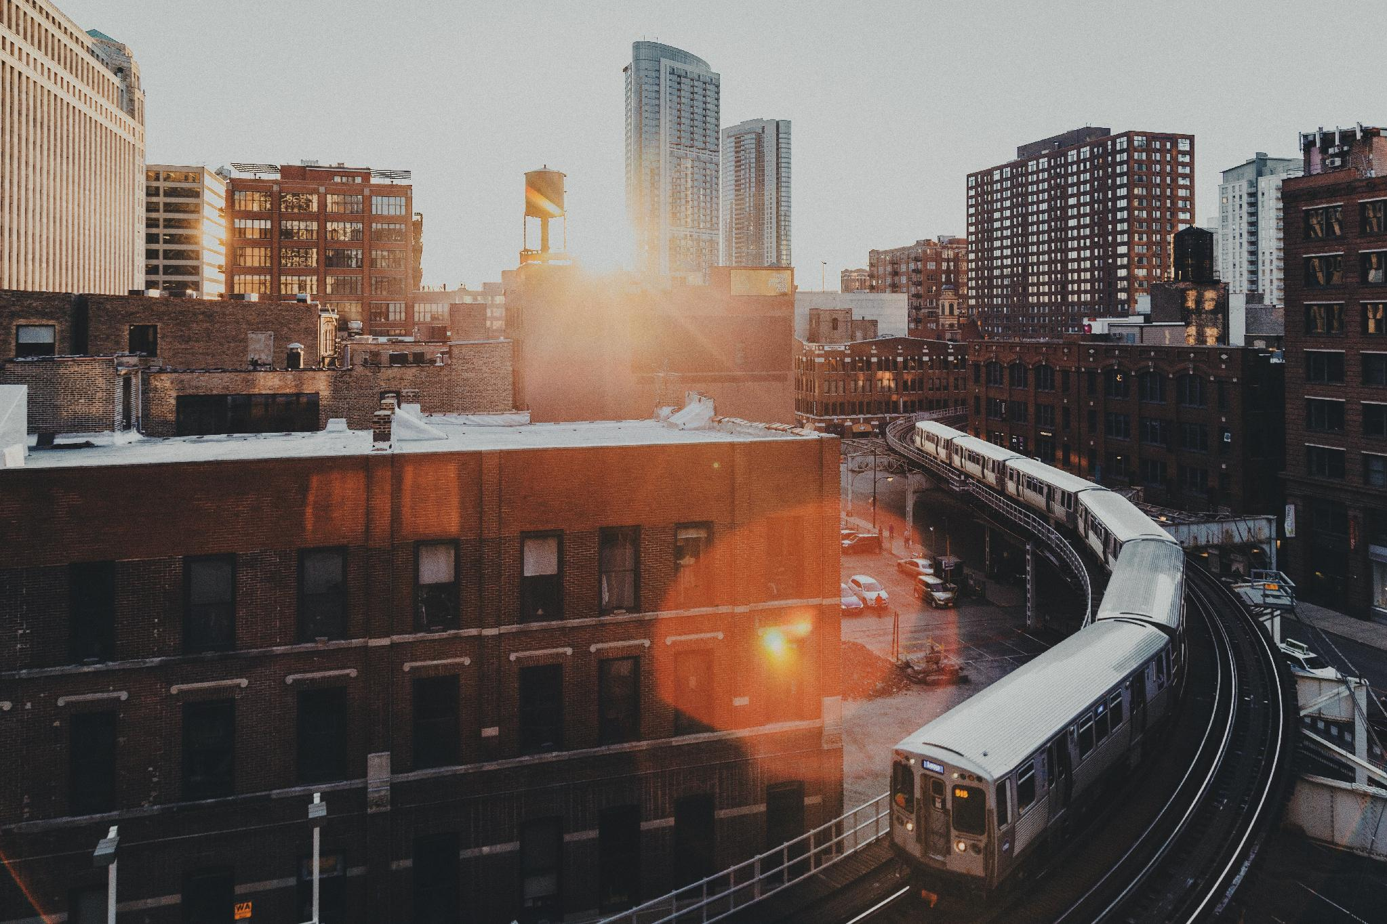
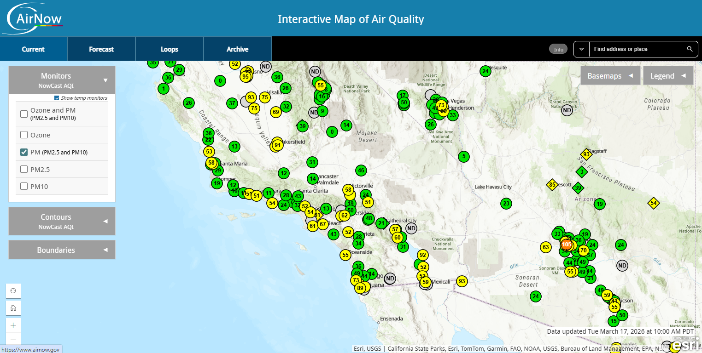
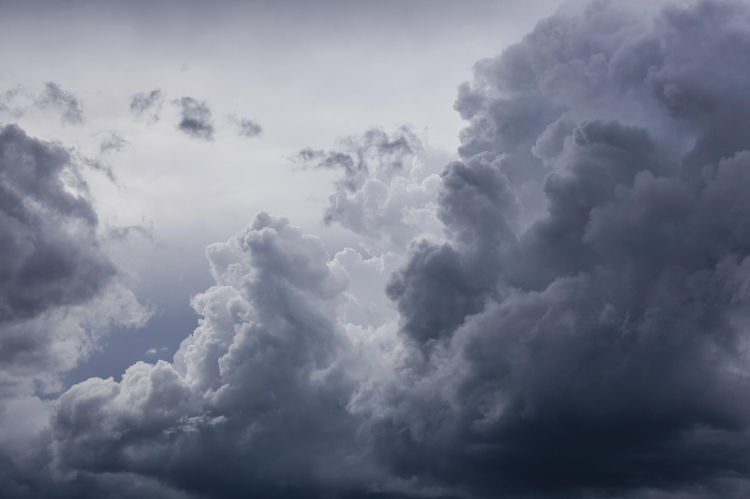

Quantifying Wildfire Exposure:
How Do We Use Data to Understand Risk?
Hazard Forecasting
  USGS Fire Danger Forecast
  National Significant Wildland Fire
  Potential Outlook
Watches, Warnings, and Advisories
  Red Flag Warning
  Air Quality Index (AQI)
Publicly available online tools
  Wildfire Risk to Communities
  AirNow
AirNow, U.S. Environmental Protection Agency
Notes:
Characterizing wildfire exposure requires gathering information on the location (area impacted), the frequency (consider previous occurrences and probability of future events), and the extent (magnitude or strength).
Hazard forecasting
The United States Geological Survey provides a 7 day fire danger forecast that combines forecast weather data and satellite observations to develop several products depicting the risk for large fire activity across the US
The NWS provides an 8 day Fire Weather outlook that is intended to delineate areas of the continental US where pre-existing fuel conditions, combined with forecast weather conditions, will result in significant threat for the ignition and/or spread of wildfires.
The National Interagency Fire Center provides two different wildfire outlooks, including the National Significant Fire Potential Outlook and the 7-Day Significant Fire Potential Outlook.
The National Weather Service use a series of weather indicators to identify and categorize adverse weather conditions:
Weather Advisory -> issued when a hazardous weather event is occurring or has a very high probability of occurrence. Advisories describe hazardous weather events that cause significant inconvenience but are not life threatening if caution is exercised.
Weather Watch -> issued when the risk of a hazardous or severe weather event has increased significantly, but its occurrence, location, and/or timing is still uncertain.
Weather Warning -> issued when a hazardous weather event is occurring, imminent, or has a high probability of occurring. Warnings are used for weather conditions posing a threat to life and property.
Warnings, Watches, Advisories use location-specific criteria to mark thresholds for triggering alerts (e.g. Red Flag Warning)
Publicly available online tools
Modelled hazard simulations are typically conducted by university researchers, consultants, or government agencies (i.e., NOAA, USGS, or FEMA). This information is often publicly available and can be used in conducting your own hazard assessment.
The Wildfire Risk to Communities data suite (hosted by USDA and USFS) is a free, easy to use website with interactive maps, charts, and resources to help communities understand, explore, and reduce wildfire risk. Available datasets include burn probability, risk to potential structures, exposure type, flame length, wildfire hazard potential, conditional risk to potential structures
AirNow is a publicly available online tool that updates hourly using readings from thousands of monitors across the country (ozone, PM2.5 and PM10)
Sources:
National Weather Service Advisories, Watches and Warnings: https://detroitmi.gov/departments/homeland-security-emergency-management-detroit/severe-weather-warnings-safety-tips-and-resources/national-weather-service-advisories-watches-and
National Weather Service Fire Weather Outlooks: https://www.drought.gov/data-maps-tools/national-weather-service-fire-weather-outlooks#:~:text=The%20National%20Weather%20Service%20(NWS,and/or%20spread%20of%20wildfires.
USGS Fire Danger Forecast: https://www.usgs.gov/fire-danger-forecast
National Interagency Fire Center Fire Outlooks: https://www.nifc.gov/nicc/predictive-services/outlooks

Slide 16
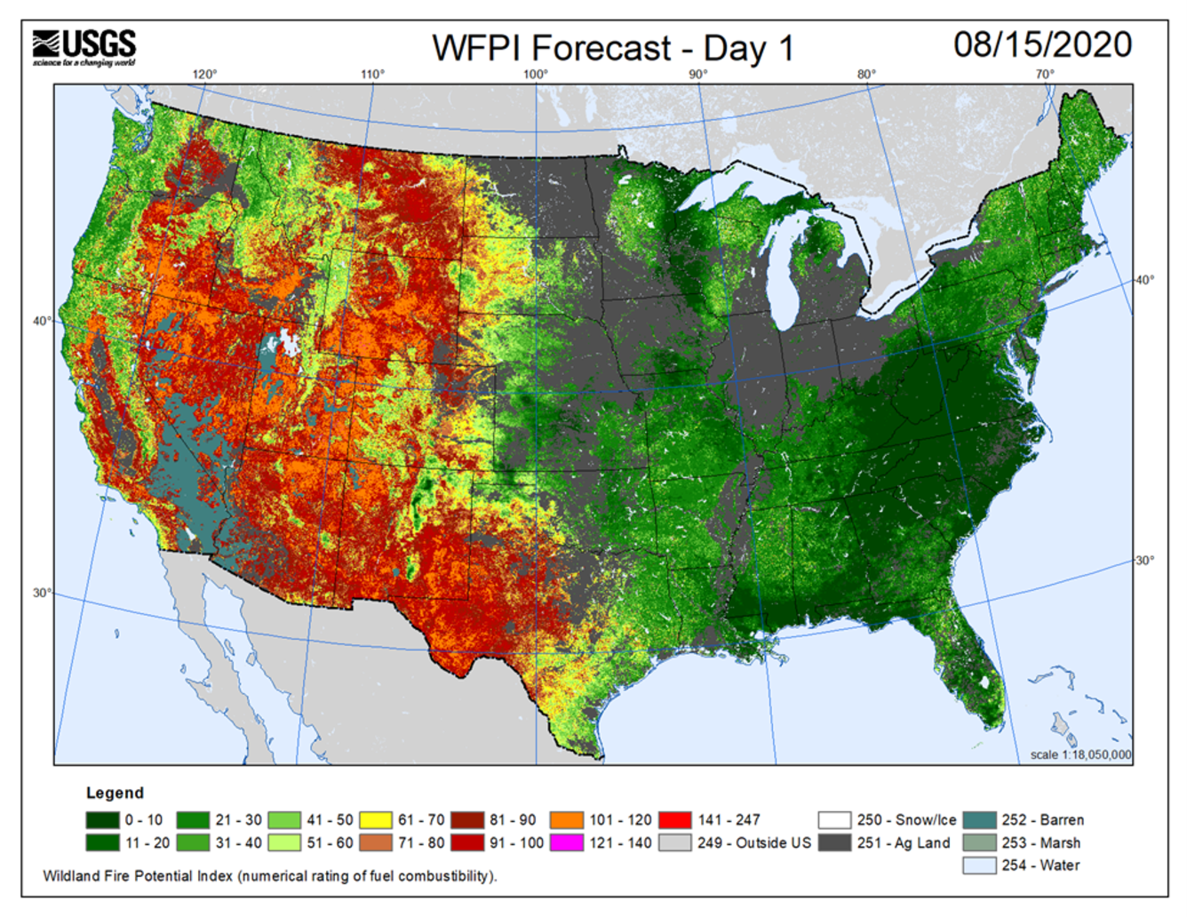
Quantifying Wildfire Exposure
United States Geological Survey (USGS) 7-Day Fire Danger Forecast
Combines weather data and satellite observations to depict risk for large fire activity across the United States – unitless number (0-150), relates to flammability
Inputs include:
Fuel moisture and rain
Wind speed
Fuel model
Notes:
The USGS is a federal agency that produces datasets that help us understand hazard exposure
One example is this 7 day wildfire danger forecast
Wildland Fire Potential Index is developed using an algorithm that describes the ratio of live to dead fuel and includes variables for wind speed, dry bulb temperature, and rainfall.
Unit-less number that ranges from 0-150 and relates to vegetation flammability
Historically, higher number of large fires (>500 acres) have occurred at the highest levels of WFPI
Figure: shows an example day in August 2020 when much of the western US was lit up as high WFPI
On August 15 2020, a dry lightning storm sparked hundreds of wildfires across California. - https://www.fire.ca.gov/incidents/2020/
2020 was a record-setting year for wildfires in California – 8,648 fires burned 4.3 million acres, 33 fatalities, and over 11k structures destroyed
August Complex Fire burned over 1 million acres in 7 counties (started on August 16, 2020)
Source:
USGS Fire Danger Forecast: https://www.usgs.gov/fire-danger-forecast/wildland-fire-potential-index-wfpi
Article about 2020 Fire season in CA: https://www.gov.ca.gov/2025/08/15/five-years-since-devastating-2020-fire-siege-heres-how-california-is-better-prepared-for-catastrophic-wildfire/#:~:text=On%20August%2015%2C%202020%2C%20an,and%20ecosystems%20changed%20for%20generations.

Slide 17
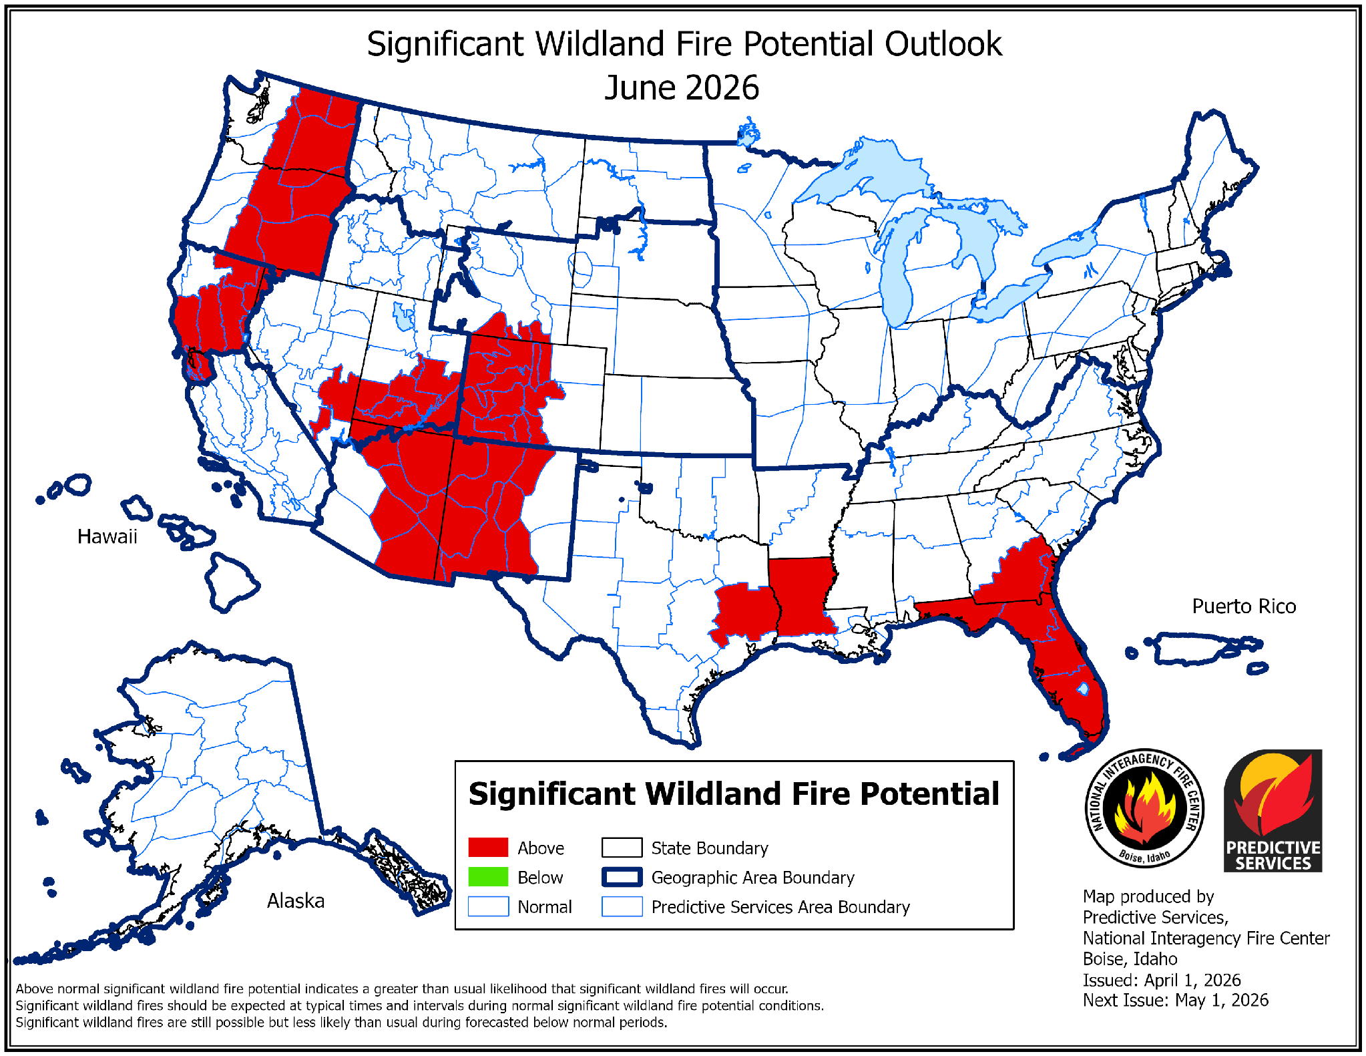
Quantifying Wildfire Exposure
National Interagency Coordination Center (NICC) – Fire Potential Outlook
7-Day Significant Fire Potential
National Significant Wildland Fire Potential Outlook
National Interagency Coordination Center, Issued: April 1, 2026
Notes:
7-Day Outlook -> defined as “the likelihood that a wildland fire event will require mobilization of additional resources from outside the area in which the fire situation originates (function of fuel conditions, weather, and resource availability). It assesses the daily probability for occurrence of a new large fire and/or the daily potential for significant new growth of existing fires.”
National Significant Wildland Fire Potential Outlook -> The outlook identifies areas by month for the next four months with above, below, and near normal significant fire potential.
Explain the map on the right. Red shading indicates areas that are anticipated to experience above average fire potential, green shading indicates below normal.
The main objectives of the National Significant Wildland Fire Potential Outlooks are to improve information available to fire management decision makers. These assessments are designed to inform decision makers for proactive wildland fire management, thus better protecting lives and property, reducing firefighting costs and improving firefighting efficiency.
These maps help translate regional fire weather, fuel conditions, and drought patterns into a planning-level fire forecast.
They are useful for understanding whether the broader region around an event may face elevated wildfire activity.
“Every state in the West is expected to face an above-normal threat of wildfire this summer. Citing an ongoing snow drought, rapid snowmelt, and a recent unprecedented heatwave, the latest maps show wildland fire potential above normal across the southwest and into the Rockies, PNW, and northern CA.” - Terrifying New Maps Show the Entire West is Facing an Extreme Wildfire Threat This Summer
Source:
National Interagency Fire Center Fire Outlooks: https://www.nifc.gov/nicc/predictive-services/outlooks

Slide 18
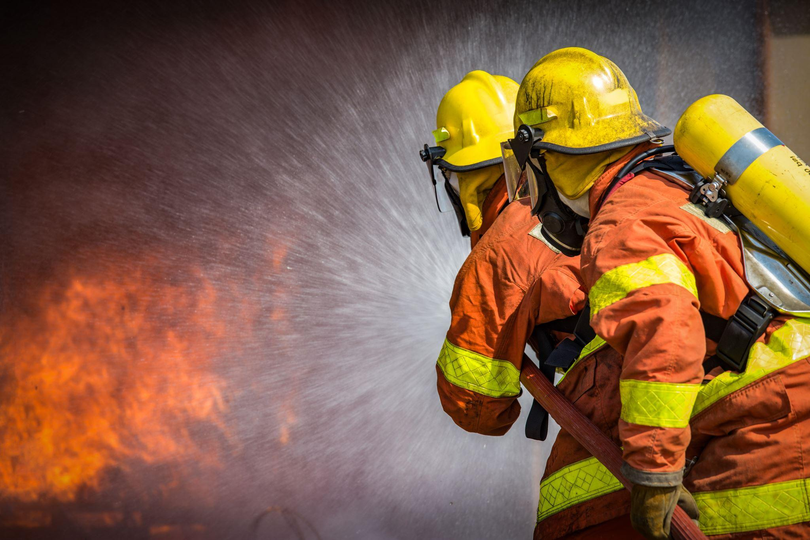
Quantifying Wildfire Exposure
Red Flag Warning: issued by the National Weather Service when the combination of dry fuels and weather conditions support extreme fire danger
Relative Humidity ≤ 15%
Wind Sus ≥ 25 mph or Gust ≥ 35 mph
6+ hours
Notes:
Photo from powerpoint image library
Understanding your agency’s wildfire hazard at key stations/assets requires evaluating exposure in those areas
Hazard, Risk, and vulnerability assessments are often conducted using publicly available data and interactive online tools (data is generated by state/federal agencies, university researchers, others)
The National Weather Service has forecast offices all over the country with region-specific Watch, Warnings, and Advisory criteria
This RFW criteria is for the Los Angeles area
If conditions with relative humidity AND wind AND a 6 hr duration occur, then a RFW is issued
Red Flag warnings have different criteria depending on the location
Related is the Fire Weather Watch which is issued when there is possible development of RFW conditions in the next 24-72 hours
Another important implication of Red Flag Warnings are that utility companies use them when making decisions on implementation of Public Safety Power Shutoffs (PSPS), which can have indirect impacts on transit and stadium event operations.
For urban rail operators, a Red Flag Warning can be used as a trigger to increase monitoring and readiness.
Red Flag Warnings can also support public messaging about avoiding ignition sources, monitoring air quality, and preparing for possible service changes.
Source:
NWS, Fire Warnings: https://www.weather.gov/lot/firewx_definition#:~:text=A%20Fire%20Weather%20Watch%20or,watches%20and%20red%20flag%20warnings.

Slide 19
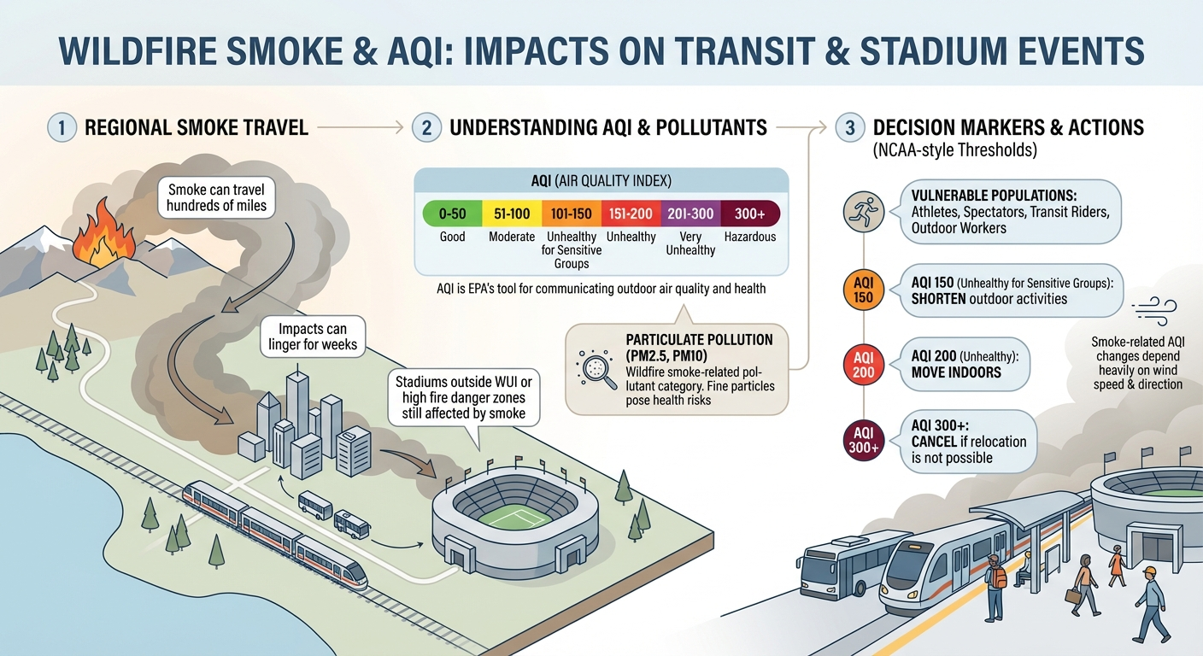
Quantifying Wildfire Exposure
Notes:
Many of the stadiums hosting World Cup games are located outside of WUI and high fire danger zones.
However, in a scenario where a wildfire is occurring in the region, participants at the game and in transit could experience impacts from wildfire smoke
Wildfire smoke can travel hundreds of miles (well outside the immediate fire zone) and can linger for weeks
Impact of wildfire smoke on health can be significant, especially for vulnerable populations (elderly, children, people active outdoors, athletes)
Air Quality Index (AQI) is EPA’s tool for communicating outdoor air quality and health.
a standard public health metric tied to public health impacts – helps support health messaging and protective actions
Five major pollutants include: ground-level ozone, particulate pollution (PM2.5 and PM10 – this is where wildfire smoke falls), carbon monoxide, sulfur dioxide, and nitrogen dioxide
Bubbles shown in slide are based on NCAA guidelines that state that you should shorten outdoor activities at 150, move indoors at 200, and cancel (if you cannot relocate) at 300.
Changes in AQI related to wildfire activity are heavily dependent on wind speed and direction
AQI thresholds can help agencies decide when to increase monitoring, adjust staffing, issue health messages, or activate protective actions.
For urban rail, poor air quality can affect passengers, outdoor staff, platform operations, and first and last mile movement.
Example decision markers may include AQI levels that trigger staff briefings, mask availability, adjusted outdoor work, or public alerts.
Sources:
Western Fire Chief’s Association, How Far Can Wildfire Smoke Travel?: https://wfca.com/wildfire-articles/how-far-can-wildfire-smoke-travel/#:~:text=Although%20it%20depends%20on%20the,and%20can%20linger%20for%20weeks.&text=The%20impact%20of%20wildfire%20smoke%20on%20one's%20health%20can%20be%20significant.
AQI guidelines from NCAA: https://www.ncaa.org/sports/2017/9/14/air-quality.aspx

Slide 20
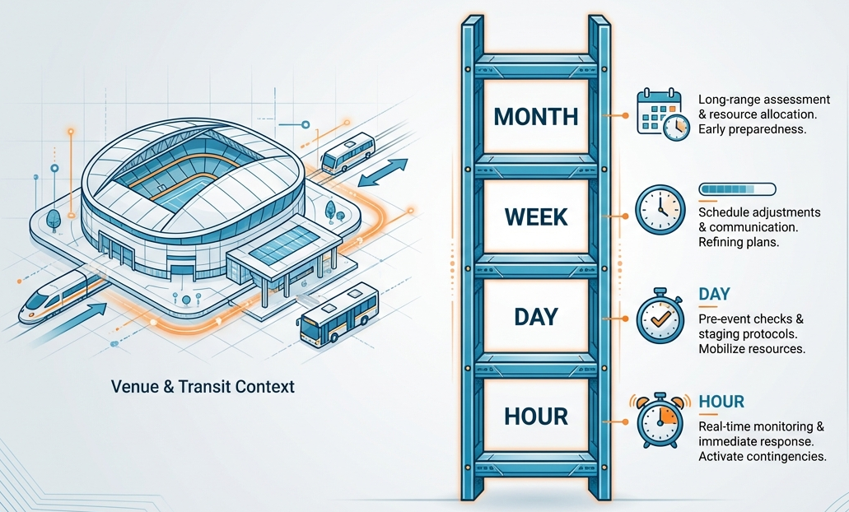
Wildfire-Air Quality Forecast-Driven Action Ladder
Timeframe | Phase | Key Actions
1-3 Month Out | Planning & Preparedness Module #3 | - Monitor seasonal wildfire risk outlooks - Develop event-specific trigger points - Update air quality communication protocols - Coordinate with local emergency management
10 Days Out | Planning & Preparedness Module #3 | - Check localized fire weather outlooks - Alert staff to increased readiness - Pre-stage air quality monitors, review shelter-in-place protocols - Prepare public messaging templates
1–3 Days Out | Delivery Game-Day Implementation Module #4 | - Monitor wildfire activity, local AQI closely - Coordinate with public health - Stockpile N95 masks
Hours Before | Delivery Game-Day Implementation Module #4 | - Activate air quality monitoring inside/outside - Issue real-time alerts to all staff/attendees
Notes:
This slide connects the earlier forecasting discussion to practical decision-making. The goal is to turn forecast information into a readiness framework.
Linking timeframes to actions helps agencies know what to do, when to do it, and who needs to be involved.
This framing as an action ladder also helps to manage uncertainty, as early forecasts are often less precise, but can still be used to support planning and readiness.
Think about “what should we be ready to do given particular forecasts?”
We discussed different forecasting tools that are available for different periods of time into the future (ie forecast window or lead time)
At longer timeframes, such as 1-3 months out, agencies can monitor seasonal wildfire outlooks and start/refine event-specific trigger points, update air quality communication protocols, and coordinate with local emergency management.
10 days out, certain forecasts become more confident, and agencies can continue checking localized fire weather outlooks, alert staff to increased readiness, and prepare public messaging templates
1-3 days out agencies can coordinate with public health officials and start to stockpile PPE.
In the hours before, given conditions that warrant, activate air quality monitoring inside/outside and issue real-time alerts to all staff/attendees.
Sources:
LA Metro Special Event Transportation – Guidance and Opportunities (SetGo) Playbook: https://aptapassengertransport.com/la-metro-setgo-playbook-helps-agencies-plan-for-mega-events/

Slide 21
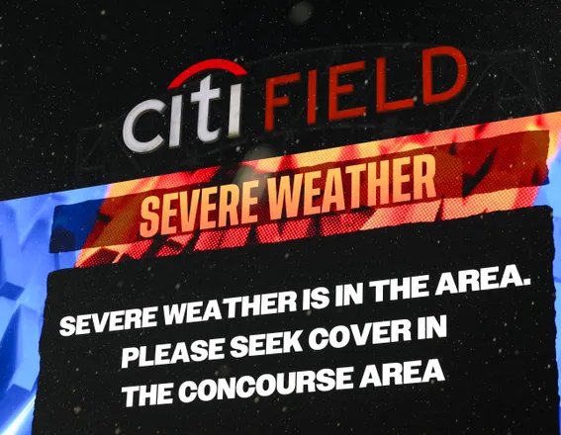
Module #1: Breakout
Share any experiences you have had with wildfire smoke or fire-related service disruptions.
What challenges had the biggest effect on operations, communications, and rider movement?
How does the wildfire outlook/forecast impact decision-making in the days or hours leading up to a large stadium event?
Notes:
Photo: Severe storm in New York delays Yankees-Mets Subway Series matchup (June 2024)
https://thelistwire.usatoday.com/story/news/2024/06/27/storm-new-york-yankees-mets-subway-series-thunderstorm-rain-delay-mlb/80920363007/
Goals:
Engage with peers and discuss personal experience with wildfire smoke and fire-related service disruptions. What did you do? Was your agency prepared?
Peer learning, identify common pain points, and set the stage for the preparedness strategies later in the course
Identify large event factors – surge, bottlenecks, messaging
Bring the group back together and ask for people to provide a brief read-out from their group.

Slide 22
Module #2: Risk to Rail: Infrastructure and Operations
Electrified systems and rail
Wildfire risks to and from rail systems
Operational impacts
Passenger and workforce safety
Notes:
Objective: understand how wildfire hazards affect rail systems and service continuity, with emphasis on urban rail/WUI environments and the added consequence of serving large stadium venues.
This module discusses what makes rail infrastructure sensitive to the impacts of wildfire and how direct impacts can lead to operational challenges (scheduling, crowd management, and health and safety)
We will dive into the two way risk relationship between rail infrastructure and wildfire (wildfire risk to and risk from)
We will explore what characteristics of the rail system are sensitive to wildfire (and extreme fire weather – which includes an extreme heat component), as well as the downstream effects of a wildfire on operations (especially during surge conditions)

Slide 23
Wildfire Risk to Urban Rail
Tracks and rail components
Electrical systems and electrified rail
Indirect impacts: power outages, damage to communication and cell towers, and ashfall
Notes:
We will discuss three primary wildfire risks relevant to the rail system – these include:
Tracks and rail components (wooden ties and bridges, metal/steel rails warping in extreme heat)
Electrical systems and electrified rail (catenary lines melting/sagging, overheating electrical equipment)
Indirect impacts: power outages, damage to cell towers and comms that interrupts service, ashfall on equipment can damage it
Sources:
Los Angeles County Climate Vulnerability Assessment: https://ceo.lacounty.gov/wp-content/uploads/2021/10/LA-County-Climate-Vulnerability-Assessment-1.pdf
Los Angeles County Metropolitan Transportation Authority Climate Action and Adaptation Plan: https://libraryarchives.metro.net/DB_Attachments/2019-0489_Attachment_A_Draft_Final_2019_CAAP.pdf
Federal Transit Administration Sound Transit Climate Risk Reduction Project: https://rosap.ntl.bts.gov/view/dot/29294/dot_29294_DS1.pdf
Santa Clara Valley Transportation Authority Climate Action and Adaptation Plan: Appendix D Climate Vulnerability Assessment and Adaptation Analysis: https://www.vta.org/sites/default/files/documents/2020-06/Appendix%20D%20Climate%20Vulnerability%20Assessment%20and%20Adaptation%20Analysis.pdf

Slide 24
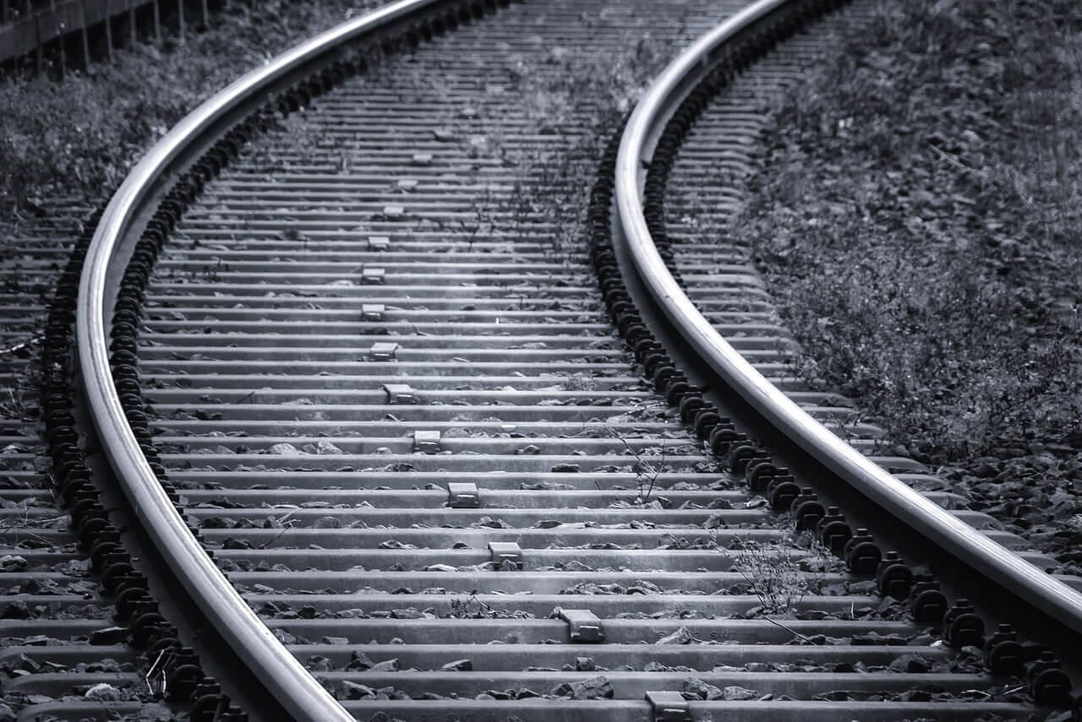
Wildfire Risk to Urban Rail: Tracks and Rail Components
Wooden construction of rail ties and bridges can increase likelihood of ignition
Extreme heat can cause rails to buckle and form “sun kinks”
Potential damage to infrastructure with increased maintenance and costs
Notes:
Photo credit: https://rstrackinc.com/which-railroad-ties-to-use/
This slide highlights how wildfire and extreme heat can affect the physical rail.
Rail assets are exposed to both direct fire impacts and heat-related stress.
Direct flame contact and radiant heat can damage combustible components, especially wooden rail ties, bridges, and nearby vegetation.
Poorly maintained fuels along the right-of-way can allow fire to spread toward or away from track areas.
Extreme heat can cause rails to expand, kink, warp, or buckle.
Heat-related track deformities are often called sun kinks and can create derailment risks if not identified and managed.
Rail buckling can lead to speed restrictions, increased inspections, repairs, service delays, or temporary closures.
Heat can also stress supporting components, including ties, ballast, rail anchors, expansion joints, and special trackwork.
Transportation agency assessments show that exposed, at-grade, aboveground, and high-sun areas may be more sensitive to heat-related track impacts.
During a stadium event, even a localized track issue can have larger consequences because of high passenger volumes and limited tolerance for delay.
Sources:
Los Angeles County Climate Vulnerability Assessment: https://ceo.lacounty.gov/wp-content/uploads/2021/10/LA-County-Climate-Vulnerability-Assessment-1.pdf
Los Angeles County Metropolitan Transportation Authority Climate Action and Adaptation Plan: https://libraryarchives.metro.net/DB_Attachments/2019-0489_Attachment_A_Draft_Final_2019_CAAP.pdf
Federal Transit Administration Sound Transit Climate Risk Reduction Project: https://rosap.ntl.bts.gov/view/dot/29294/dot_29294_DS1.pdf
Santa Clara Valley Transportation Authority Climate Action and Adaptation Plan: Appendix D Climate Vulnerability Assessment and Adaptation Analysis: https://www.vta.org/sites/default/files/documents/2020-06/Appendix%20D%20Climate%20Vulnerability%20Assessment%20and%20Adaptation%20Analysis.pdf

Slide 25
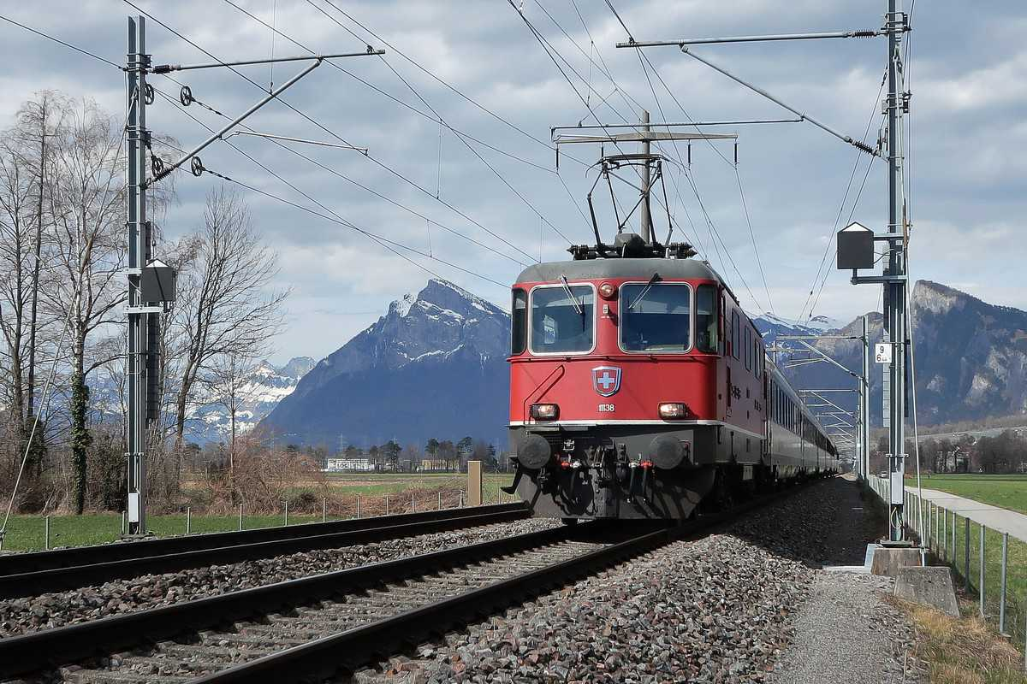
Wildfire Risk to Urban Rail:
Electrical Systems and Electrified Rail
Overhead wiring from electrified rail can increase risk of ignitions
Catenary sagging, pulley failures, switch and signal failures
Wildfire can melt catenary lines, burning sensitive equipment
Notes:
Photo Source: https://www.freightwaves.com/news/is-electrifying-the-freight-rail-network-cost-prohibitive
Light rail systems are highly dependent on electricity, so wildfire-related power outages can have significant service impacts.
Extreme heat can affect key electrified rail components, including the overhead catenary system, brakes, track, signal equipment, and traction power systems.
Heat-related impacts may include catenary sagging, brake system overheating, sun kinks, and equipment failures.
Wildfires can damage light rail infrastructure by melting catenary lines, burning sensitive equipment, and damaging track work.
Most of the rail system may not be highly exposed to wildfire, but exposed segments can be high risk.
Power outages can disrupt rail operations, elevator service at stations, cooling systems, safety systems, and monitoring equipment.
Signal houses, signal bungalows, small signal boxes, traction power substations, uninterruptible power supply batteries, ticket vending machines, and other naturally ventilated or sun-exposed equipment may be sensitive to heat.
Loss of power and damage to cell towers can also disrupt communications during and after a wildfire event.
Expected operational impacts may include more frequent inspections, increased cooling demand, higher maintenance costs, slow orders, short-term cancellations, and service disruptions during repairs.
Potential adaptation actions include more frequent testing and maintenance, passive cooling measures, increased ventilation, OCS monitoring, OCS set point adjustments, longer guide rods, taller poles, and climate-informed asset management metrics.
Sources:
Los Angeles County Climate Vulnerability Assessment: https://ceo.lacounty.gov/wp-content/uploads/2021/10/LA-County-Climate-Vulnerability-Assessment-1.pdf
Los Angeles County Metropolitan Transportation Authority Climate Action and Adaptation Plan: https://libraryarchives.metro.net/DB_Attachments/2019-0489_Attachment_A_Draft_Final_2019_CAAP.pdf
Federal Transit Administration Sound Transit Climate Risk Reduction Project: https://rosap.ntl.bts.gov/view/dot/29294/dot_29294_DS1.pdf
Santa Clara Valley Transportation Authority Climate Action and Adaptation Plan: Appendix D Climate Vulnerability Assessment and Adaptation Analysis: https://www.vta.org/sites/default/files/documents/2020-06/Appendix%20D%20Climate%20Vulnerability%20Assessment%20and%20Adaptation%20Analysis.pdf

Slide 26
Wildfire Risk to Rail: Indirect Effects of Wildfire
  Damage to cell towers, which can disrupt communications during and after a wildfire event
  Power outages; Red flag conditions may prompt energy utilities to implement Public Safety Power Shutoff (PSPS)
  Ashfall on light rail tracks may cause adhesion issues with vehicles on grade
  Ash could affect equipment performance and would require additional cleaning.
Notes:
Wildfire impacts are not limited to direct flame contact. Indirect effects can also disrupt rail operations and passenger safety.
Extreme heat and Red Flag conditions can trigger Public Safety Power Shutoffs or rolling blackouts.
Power disruptions may affect emergency lighting, elevators, escalators, public address systems, CCTV systems, and other station systems.
These impacts are especially important at larger platforms and grade-separated stations where emergency egress may depend on powered systems.
Loss of power to facilities and charging stations can also ground all-electric fleets.
Wildfire smoke may affect electrical equipment in cabinets. If traffic signal controllers go down, delays can occur.
Ash buildup at stations and transit centers can affect equipment performance and require additional cleaning.
Some rail systems have redundancy for essential rail operations, but backup power may be limited for support buildings or behind-the-scenes operational systems.
Power outages can also disrupt safety and monitoring equipment at construction sites.
Sources:
Los Angeles County Climate Vulnerability Assessment: https://ceo.lacounty.gov/wp-content/uploads/2021/10/LA-County-Climate-Vulnerability-Assessment-1.pdf
Los Angeles County Metropolitan Transportation Authority Climate Action and Adaptation Plan: https://libraryarchives.metro.net/DB_Attachments/2019-0489_Attachment_A_Draft_Final_2019_CAAP.pdf
Federal Transit Administration Sound Transit Climate Risk Reduction Project: https://rosap.ntl.bts.gov/view/dot/29294/dot_29294_DS1.pdf
Santa Clara Valley Transportation Authority Climate Action and Adaptation Plan: Appendix D Climate Vulnerability Assessment and Adaptation Analysis: https://www.vta.org/sites/default/files/documents/2020-06/Appendix%20D%20Climate%20Vulnerability%20Assessment%20and%20Adaptation%20Analysis.pdf

Slide 27
Operational Impacts
Passenger and workforce health risks: respiratory issues, vulnerable populations
Operational challenges: reduced visibility for train operators, service disruptions due to forced re-routing, detours, cancellations
Crowd safety: diminished wayfinding, increased anxiety, and potential for crowding hazards during egress
Notes:
This section shifts from infrastructure impacts to how wildfire and smoke conditions can affect day-to-day operations.
The focus is on what these hazards mean for people, service delivery, and crowd movement.
First, wildfire smoke can create health risks for passengers and workers, especially people with respiratory conditions or other vulnerabilities.
Second, wildfire and smoke conditions can create operational challenges, including reduced visibility, service disruptions, re-routing, detours, or cancellations.
Third, smoke, poor visibility, stress, and service changes can affect crowd safety during station access, transfers, and event egress.
These impacts are especially important during stadium events because large crowds, fixed event times, and limited travel routes can reduce flexibility.

Slide 28
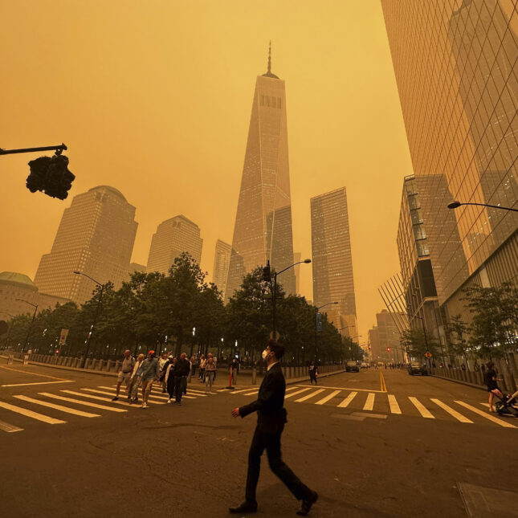
Operational Impacts: Passenger and Workforce Health Risk
Smoke reduces air quality in transportation service area
Unsafe working conditions outdoors during large fire events
Ventilation and air filtration may be inadequate during high AQI events
Vulnerable populations: accessibility needs, medically sensitive riders, non-local visitors unfamiliar with transit system
Notes:
Photo cred: https://www.statnews.com/2023/06/07/air-quality-canadian-wildfires-protection/
Wildfire smoke and extreme heat (a common factor in extreme fire weather) can create health risks for both passengers and employees.
Smoke can affect air quality in stations, vehicles, and surrounding areas, especially as doors open and close during service.
HVAC and filtration systems may need more frequent maintenance as smoke and poor air quality increase system demand.
Riders walking to stations or waiting without shade may face heat-related health impacts or be exposed to wildfire smoke.
Hazards may have greater impacts on riders with disabilities or access and functional needs, especially those who depend on paratransit.
Agencies may also see increased requests for paratransit or other support services during hazard events.
Workforce impacts may include slower outdoor work, heat-related illness, work-related injuries, and challenges reporting to work safely (exposure to wildfire smoke)
Staff may also face increased stress or difficult interactions with the public during disruptions.
Sources:
Los Angeles County Climate Vulnerability Assessment: https://ceo.lacounty.gov/wp-content/uploads/2021/10/LA-County-Climate-Vulnerability-Assessment-1.pdf
Los Angeles County Metropolitan Transportation Authority Climate Action and Adaptation Plan: https://libraryarchives.metro.net/DB_Attachments/2019-0489_Attachment_A_Draft_Final_2019_CAAP.pdf
Federal Transit Administration Sound Transit Climate Risk Reduction Project: https://rosap.ntl.bts.gov/view/dot/29294/dot_29294_DS1.pdf
Santa Clara Valley Transportation Authority Climate Action and Adaptation Plan: Appendix D Climate Vulnerability Assessment and Adaptation Analysis: https://www.vta.org/sites/default/files/documents/2020-06/Appendix%20D%20Climate%20Vulnerability%20Assessment%20and%20Adaptation%20Analysis.pdf

Slide 29
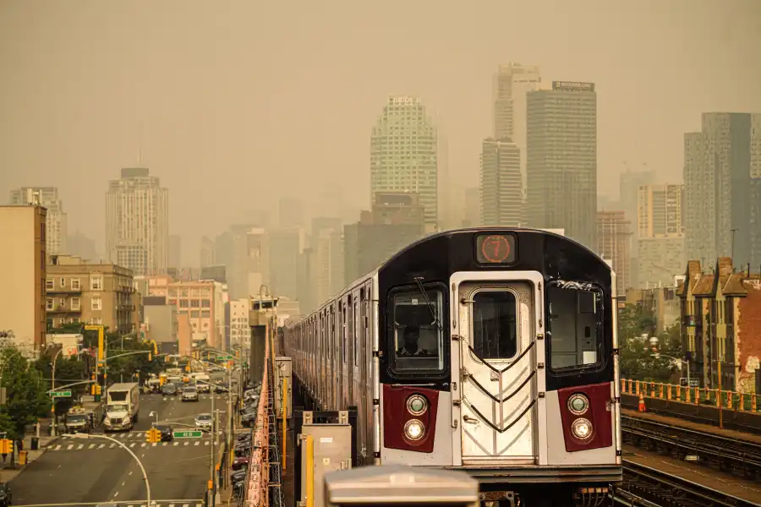
Operational Impacts: Operational Challenges
  Service disruptions caused by temporary shutdowns due to fire proximity or smoke advisories
  Visibility thresholds may trigger Dense Smoke Advisory and impact transit schedules
  Speed restrictions, station closures
Notes:
Photo cred: https://www.amny.com/news/smoke-canadian-wildfires-nyc-days/
Wildfire, smoke, and heat can affect an agency’s ability to deliver normal service.
Loss of operational facilities can limit the ability to put service into operation or perform repairs.
Smoke and poor air quality can affect platforms, bus stops, field staff, and service workers.
Opening vehicle doors during service makes it difficult to fully keep smoke out of vehicles.
Agencies may face increased operating costs, including costs for N95 masks for operators and field staff.
Transit agencies may also be asked to support mutual aid or evacuation operations during wildfire events.
Sources:
Santa Clara Valley Transportation Authority Climate Action and Adaptation Plan: Appendix D Climate Vulnerability Assessment and Adaptation Analysis: https://www.vta.org/sites/default/files/documents/2020-06/Appendix%20D%20Climate%20Vulnerability%20Assessment%20and%20Adaptation%20Analysis.pdf

Slide 30
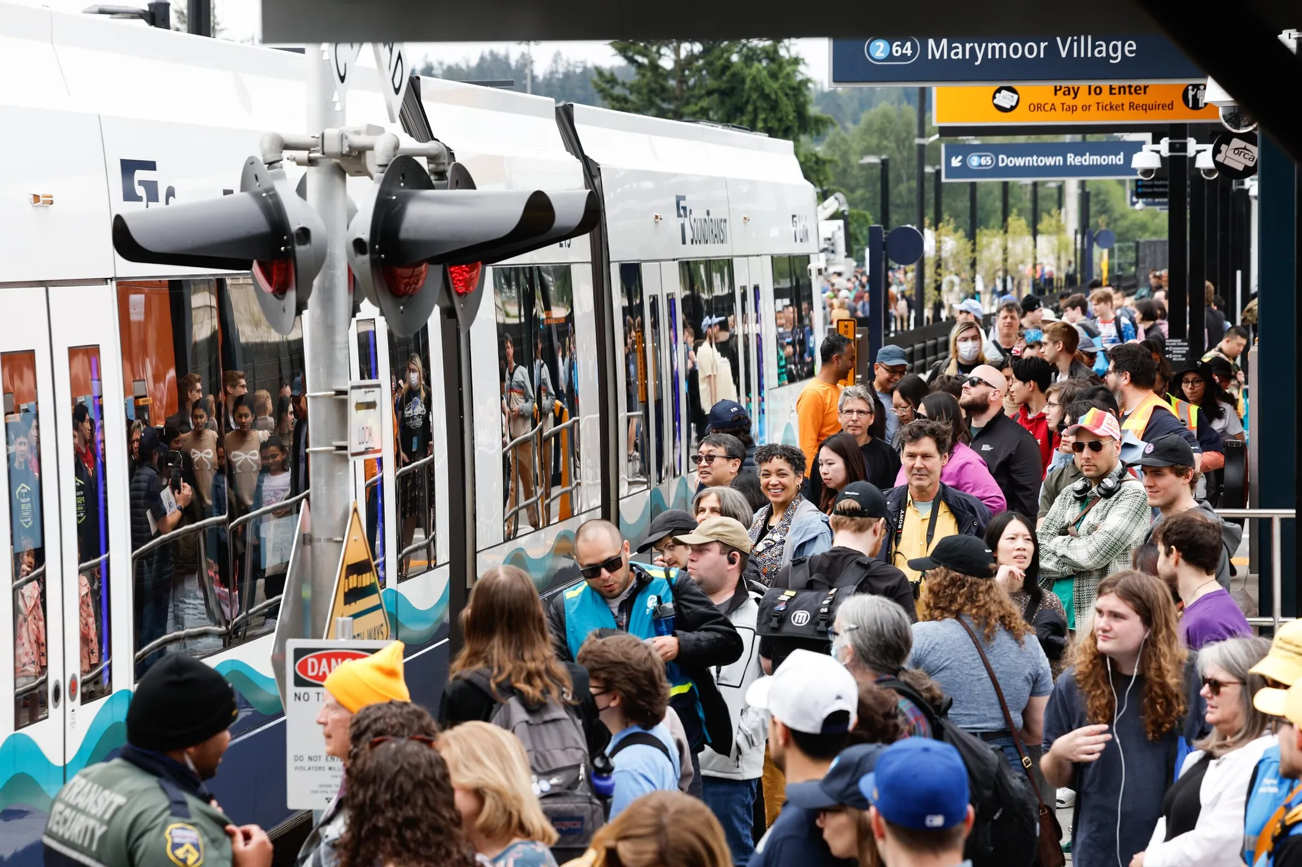
Operational Impacts: Crowd Safety
Event day consequences include platform crowding, queuing, elevated risk for crowd management incidents during constrained egress
Evacuation challenges in crowded urban stations
Coordination challenges with alternative transportation providers: buses, shuttles, rideshare, pedestrian routes
Notes:
Photo cred: https://www.seattletimes.com/seattle-news/transportation/light-rail-grand-opening-in-redmond-draws-big-crowds/
Wildfire, smoke, and extreme heat can affect how crowds move through stations, platforms, and transfer points.
If light rail service is disrupted, agencies may need to rely more on bus bridges or regular bus service.
Bus service may not be able to replace all rail routes and may require substantial operator resources.
Increased bus demand can also affect regular bus service.
Smoke and heat can make waiting at platforms and stations less comfortable, which may affect ridership and crowd behavior.
Children, older adults, and other at-risk riders may be more affected by heat, smoke, delays, or crowding.
Slower rail speeds can increase missed connections and create passenger buildup at stations.
Service changes may shift peak loads to different times of day, including more evening ridership.
Clear communication is essential so riders can plan around service disruptions and climate-driven service changes.
Sources:
Los Angeles County Climate Vulnerability Assessment: https://ceo.lacounty.gov/wp-content/uploads/2021/10/LA-County-Climate-Vulnerability-Assessment-1.pdf
Los Angeles County Metropolitan Transportation Authority Climate Action and Adaptation Plan: https://libraryarchives.metro.net/DB_Attachments/2019-0489_Attachment_A_Draft_Final_2019_CAAP.pdf
Federal Transit Administration Sound Transit Climate Risk Reduction Project: https://rosap.ntl.bts.gov/view/dot/29294/dot_29294_DS1.pdf
Santa Clara Valley Transportation Authority Climate Action and Adaptation Plan: Appendix D Climate Vulnerability Assessment and Adaptation Analysis: https://www.vta.org/sites/default/files/documents/2020-06/Appendix%20D%20Climate%20Vulnerability%20Assessment%20and%20Adaptation%20Analysis.pdf

Slide 31
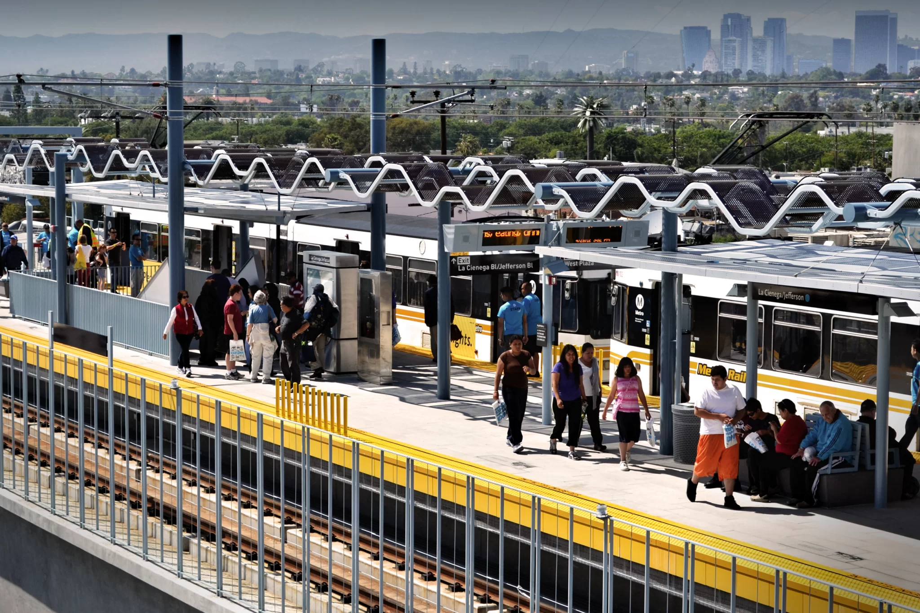
Module #2: Breakout
What systems protocols does your organization have for wildfire-specific threats? Where do you see gaps?
What characteristics of the urban rail system have proven to be most sensitive to wildfire, smoke, or extreme fire weather (e.g. high temperatures)?
In your experience, what are the biggest challenges related to crowd management that can occur during a wildfire event?
Notes:
Source for photo: Does light rail reduce traffic? The case of LA Expo line
https://transfersmagazine.org/magazine-article/issue-2/does-light-rail-reduce-traffic/
This breakout is meant to connect the technical concepts from the previous slides to participants’ own systems and operating environments.
Move from general wildfire impacts to agency-specific strengths, sensitivities, and planning gaps.
Encourage participants to think about both direct impacts, such as infrastructure damage, and indirect impacts, such as power loss, smoke, staffing challenges, and service disruptions.
The discussion should also identify which assets or functions are most sensitive during wildfire smoke or extreme fire weather.
For the crowd management question, focus on what happens when service changes, stations become crowded, visibility drops, or passengers need clear direction during stressful conditions.
Participants should consider how wildfire risk changes during large events, when ridership is higher and fewer disruptions can be absorbed.
The desired outcome is to identify practical lessons, common challenges, and areas where additional planning or coordination may be needed.

Slide 32
Module #3: Planning: Preparedness and Event Readiness
Pre-season planning
Smoke management
Sensitive Groups
Situational awareness
Notes:
This slide is for introducing Module 3 and briefly highlighting the main topics that will be covered.

Slide 33
Operational Preparedness:
Pre-Season Planning, Event Readiness
Identify “event critical” assets
Develop event-specific trigger points
Relative Humidity (≤ 15%)
Wind (Sus ≥ 25 mph, Gst ≥ 35 mph)
Geographic landmark (“The fire has reached Interstate 5”.)
Can you name another measurable trigger point?
Notes:
This slide shifts from identifying impacts to preparing for them before wildfire season and before major events.
A key step is identifying event-critical assets: stations, control centers, communications systems, yards, choke points, and other locations that are essential to service delivery.
Criticality depends on ridership, transit dependency, connectivity, redundancy, emergency response value, and economic importance.
For stadium events, assets with limited redundancy or high crowd volumes may need extra attention in preparedness planning.
Trigger points are predefined, measurable cues that tell an agency when to reassess conditions and consider action.
Examples of trigger points could relate to forecast conditions (such as the examples shown in the slide which relate to Red Flag Warnings), air quality (AQI), power reliability, asset status, or crowding conditions.
Could also involve using a geographic landmark such as a freeway or particular intersection or structure
Ask the participants at some point to consider if there are other kinds of trigger points.
Pre-season planning gives agencies time to address actions that cannot be completed during an event week.
Longer-term actions may include inspections, maintenance, weather monitoring, plan updates, shade improvements, power redundancy, backup generators, microgrids, and improved rider communication.
Event readiness focuses on confirming that plans, roles, communication channels, and partner coordination are ready before conditions become urgent.
Source:
National Wildfire Coordinating Group, Proper Use of Trigger Points: https://www.nwcg.gov/6mfs/weather-fire-behavior/proper-use-of-trigger-points
Los Angeles County Climate Vulnerability Assessment: https://ceo.lacounty.gov/wp-content/uploads/2021/10/LA-County-Climate-Vulnerability-Assessment-1.pdf
Los Angeles County Metropolitan Transportation Authority Climate Action and Adaptation Plan: https://libraryarchives.metro.net/DB_Attachments/2019-0489_Attachment_A_Draft_Final_2019_CAAP.pdf

Slide 34
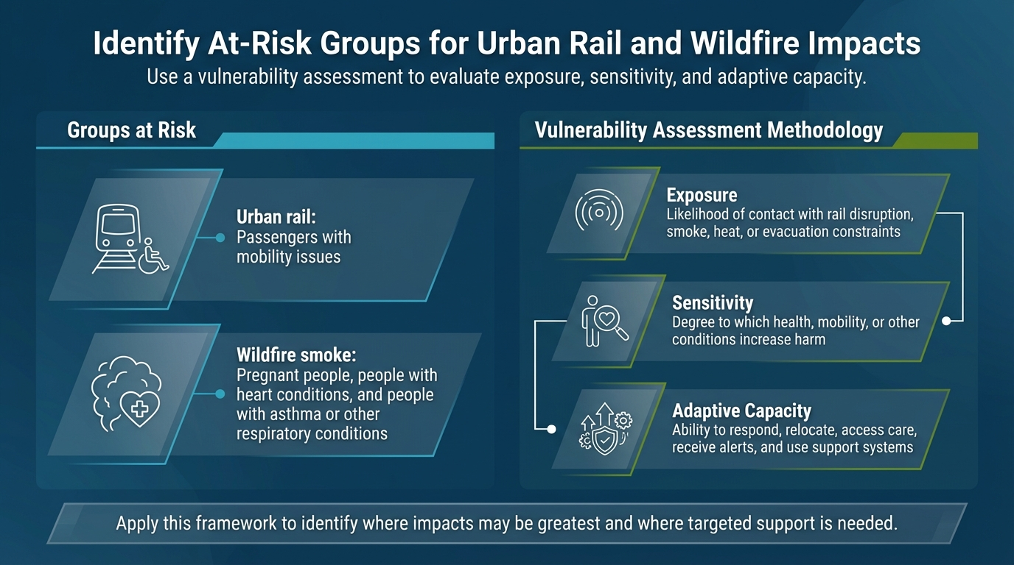
Operational Preparedness: At-Risk Groups
Notes:
This slide focuses on identifying who may experience greater impacts during wildfire, smoke, heat, or service disruption events.
At-risk groups may include people with respiratory or cardiovascular conditions, children, older adults, pregnant people, people with disabilities, and people with access and functional needs.
Transit-dependent riders may also face greater impacts if service is disrupted or alternatives are limited – also passengers with mobility issues.
A vulnerability assessment can help identify where targeted support may be needed.
The assessment looks at three factors: exposure, sensitivity, and adaptive capacity.
Exposure assesses the likelihood of contact with rail disruption, smoke, heat, or evacuation constraints.
Sensitivity assesses the degree to which health, mobility, or other conditions increase harm.
Adaptive capacity assesses the ability to respond, relocate, access care, receive alerts, and use support systems.
For urban rail, this helps agencies plan communication, staffing, paratransit support, cooling options, accessibility needs, and service alternatives.
Sources:
Federal Highway Administration, Climate Change Vulnerability Assessment and Adaptation Framework (3rd Edition): www.fhwa.dot.gov/environment/sustainability/resilience/adaptation_framework/

Slide 35
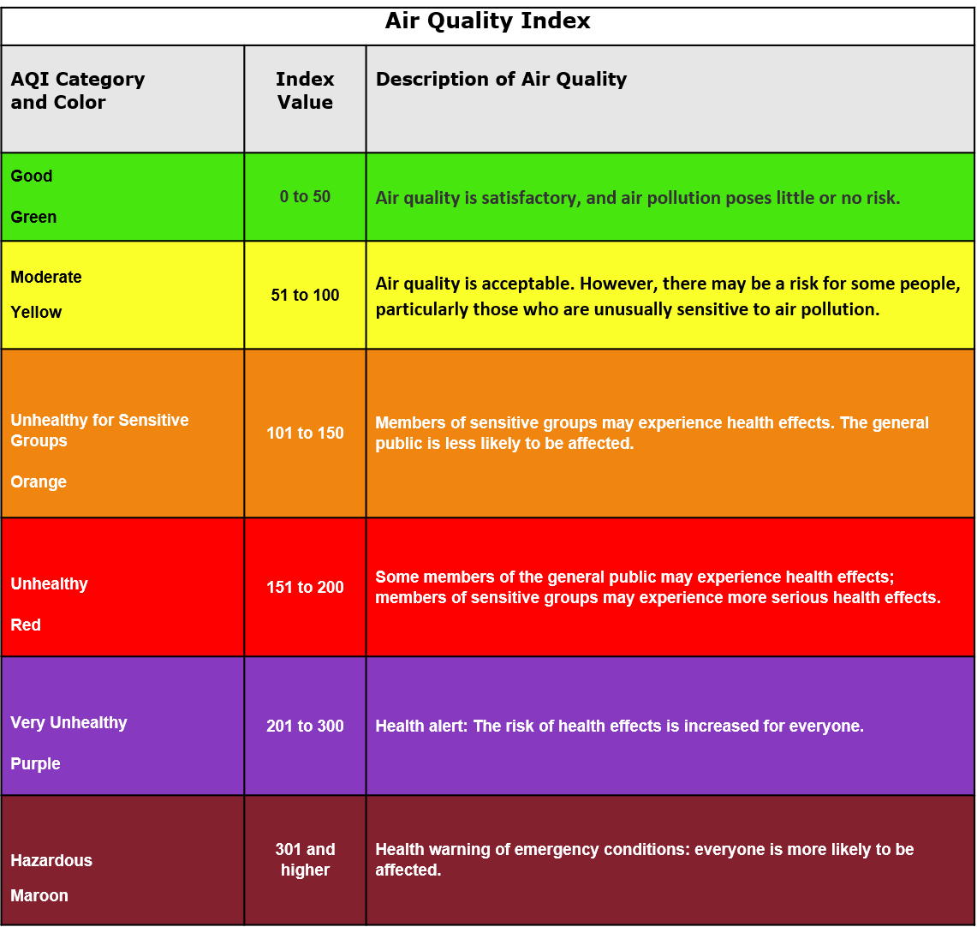
Operational Preparedness: Wildfire Exposure for Sensitive Groups
Act sooner on the AQI scale and take more protective measures
51
Sensitive Groups: take caution
Sensitive Groups at risk: Begin Protective Action
100
Sensitive Groups at risk: Avoid Outdoor Activity, Seek Indoor Clean Air
151
Sensitive Groups at more serious risk: Indoor Clean Air Environments Only
201
Notes:
This slide connects AQI levels to operational decisions for sensitive groups.
AQI provides a simple way to communicate air quality conditions and potential health concern.
Sensitive groups may experience health effects at lower AQI levels than the general population.
These groups may include children, older adults, pregnant people, people with heart or lung conditions, and people with access and functional needs.
The key point is to act earlier and consider more protective measures when sensitive groups may be affected.
Protective actions may include earlier messaging, reduced outdoor exposure, mask availability, indoor waiting areas, adjusted staff assignments, or additional support for passengers.
For stadium events, acting early matters because large crowds and fixed event times can make last-minute changes difficult.
AQI thresholds can help agencies make consistent decisions about when to monitor, communicate, and activate protective measures.
Source:
AQI guidelines from NCAA: https://www.ncaa.org/sports/2017/9/14/air-quality.aspx
Journal of the COPD Foundation, “Improving Wildfire Readiness Among Patients with COPD and Asthma: Applying a Population Health Approach to Climate Change”: https://pubmed.ncbi.nlm.nih.gov/38838252/

Slide 36
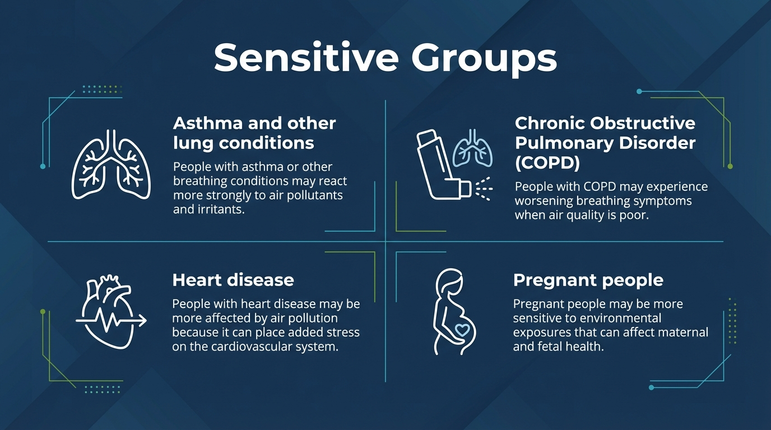
Operational Preparedness: Sensitive Groups
Notes:
Wildfire smoke can affect people differently, and some groups may experience health effects earlier or more severely.
Sensitive groups may include people with asthma, chronic obstructive pulmonary disease, other lung conditions, heart disease, pregnant people, children, and older adults.
Preparedness plans should account for these groups early, not only after air quality worsens.
This may mean earlier alerts, clearer health messaging, indoor waiting options, mask availability, adjusted outdoor staffing, and coordination with medical or accessibility partners.
Mitigation strategies should be designed so sensitive groups can safely receive information, access transit, wait for service, and complete their trips.
Planning should avoid assuming that one message or one protective action works for everyone.
Questions to ask during planning:
Who may be affected sooner or more severely by wildfire smoke?
Are alerts available in accessible formats and multiple languages?
Can staff identify and support passengers with respiratory, cardiac, mobility, or access needs?
Are masks, water, shade, cooling areas, or other supports available where they are most needed?
Do service changes preserve access for riders who depend on transit or paratransit?
Have health, accessibility, venue, and emergency management partners been included in planning?
Important notes from the sources:
- People with heart disease can experience high blood pressure (due to vasoconstriction), irregular heartbeat (arrihythmias triggered by pollutants) and even heart attack or stroke (in severe pollution events) as a result of exposure to air pollution. Symptoms can include: fatigue, chest pain, breathlessness.
- Pregnant people can experience respiratory issues, low birth weight, preterm birth, neurological impacts and cardiovascular concerns as a result of exposure to air pollution
Sources:
Artemis Hospitals, Poor AQI impact on lungs and heart: www.artemishospitals.com/blog/poor-aqi-impact-on-lungs-and-heart
Only My Health, How does pollution impact pregnancy and fetal health?: https://www.onlymyhealth.com/how-does-pollution-impact-pregnancy-and-foetal-health-12977819035

Slide 37
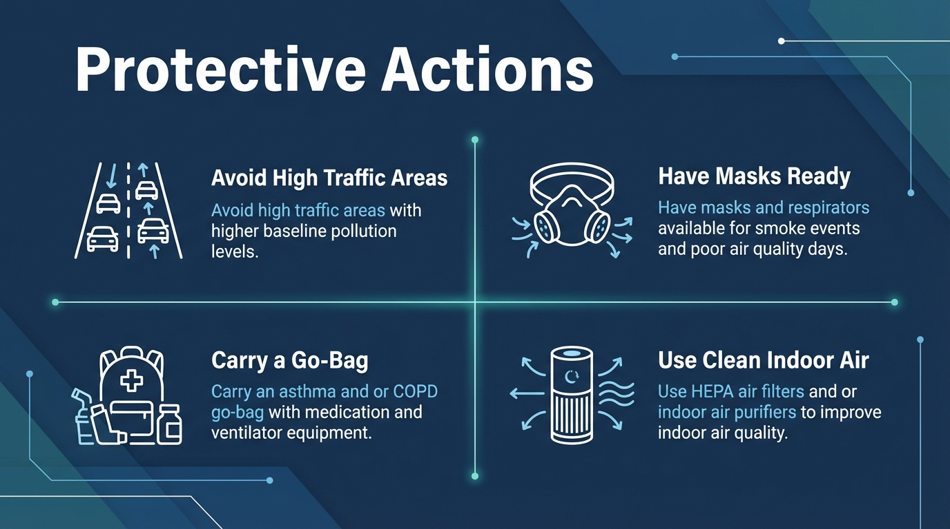
Operational Preparedness: Adaptive Capacity
Notes:
Remember from the previous slide that Adaptive Capacity assesses the ability to respond, relocate, access care, receive alerts, and use support systems.
It also refers with the ability to cope with and recover from impacts of a hazard.
For sensitive groups, adaptive capacity depends on access to information, supplies, transportation options, medical needs, and safe indoor spaces.
Protective actions may include avoiding high-traffic areas where baseline pollution may already be higher.
Masks should be ready and available for smoke events or poor air quality days.
People with asthma or chronic obstructive pulmonary disease may need a “go bag” with medication and ventilator equipment.
HEPA filters or indoor air purifiers can help improve indoor air quality in waiting areas, workspaces, or homes.
For transit and stadium planning, the goal is to make protective actions easier to take, especially for people who may need support.
This can include early messaging, clear instructions, accessible resources, and coordination with venue, health, and emergency partners.

Slide 38
Operational Preparedness: Internal and External Communication
Establish open, real-time communication channels with key partners and operational staff
Coordinate with local emergency services prior to event
Collaborate with venue operators to monitor crowd flows and adjust transit service accordingly
Ensure a central point of contact or internal command structure
Establish clear protocols for escalating service disruptions and safety concerns
Notes:
Strong communication starts before event day, not during the disruption.
The goal is to establish clear, real-time communication channels with operations staff, venue partners, emergency services, and local jurisdictions.
A central point of contact or internal command structure helps reduce confusion and supports faster decisions.
Agencies should define how service disruptions, safety concerns, crowding, or changing conditions will be escalated.
Coordination with local jurisdictions is important for street closures, signage, access needs, enforcement, and construction impacts near stations or venues.
Venue operators can help monitor crowd flows and support transit service adjustments.
Mobility partners, including bike share, ride share, and parking operators, should be included in first and last mile planning.
Communications, customer experience, and safety teams should coordinate with external counterparts on joint messaging and on-site logistics.
Questions to ask during planning:
Have all key external partners been identified and engaged early?
Are communication protocols and meeting schedules established with recurring venues or city departments?
Is there a clear point of contact for urgent decisions?
Are transit, venue, emergency services, and local jurisdictions aligned on street closures, access needs, and crowd management?
Are customer-facing messages coordinated across agencies and partners?
Source:
LA Metro, SETGO Industry Playbook: https://www.railwayage.com/wp-content/uploads/2025/10/LAMetro-SETGO_Industry-Playbook_2025_09122025.pdf

Slide 39
Operational Preparedness: Workforce Training
Identify all staff and contractors that require training
Develop standard operating procedure for service adjustments
Do training materials address emergency procedures and coordination with other agencies?
Is training being offered in multiple formats and languages if necessary?
Update training materials to reflect lessons learned and improve readiness
Plan training sessions with lead time and consider multiple formats
Notes:
Workforce training helps make sure staff and contractors know what to do before conditions become stressful or fast-moving.
Training should include operators, frontline workers, security teams, ambassadors, supervisors, contractors, and other event-support staff.
Staff need clear, practical guidance on service changes, emergency procedures, crowd management, communication, and customer support.
Standard operating procedures should define how service adjustments are made and who has authority to make decisions.
Training should be cross-functional so operations, safety, communications, customer experience, and partner agencies are aligned.
Event-specific training should cover threat detection, de-escalation, transit service plans, key contacts, and contingency plans.
In-person dry runs and tabletop exercises can help staff understand their roles, assigned locations, and response procedures.
Training should be planned with enough lead time and offered in formats that work for different staff groups.
Training materials should be updated after events to reflect lessons learned and improve future readiness.
Source:
LA Metro, SETGO Industry Playbook: https://www.railwayage.com/wp-content/uploads/2025/10/LAMetro-SETGO_Industry-Playbook_2025_09122025.pdf

Slide 40
Operational Preparedness: Crowd Management
Site Assessment
  Conduct site assessments of each key station to identify crowd pinch points and queueing needs.
Are there designated teams responsible for platform crowd control and wayfinding?
Signage
  Develop clear wayfinding and signage plans tailored to each station and anticipated crowd movement.
Multiple channels and languages
  Apps, station displays, social media
  Multi-lingual and accessible messaging
Have critical stations been assessed for crowd flow and queuing?
Clear and direct communications
  Prepare messaging templates for service disruptions and safety advisories:
    1. Source 2. Hazard 3. Location 4. Time 5. Guidance
Notes:
Crowd management is central to safe and reliable transit service during major stadium events.
Large events can create sudden ridership spikes, including first-time riders, visitors, and people unfamiliar with the transit system.
Crowd planning should cover more than platforms. It should include entrances, fare gates, queueing areas, public rights-of-way, crossings, and access routes.
Site assessments help identify pinch points, queueing needs, platform access issues, and areas where additional staff or barriers may be needed.
Signage and wayfinding should be tailored to each station and the expected direction of crowd movement.
Communication should use multiple channels, including apps, station displays, social media, and on-site staff.
Messaging should be multilingual and accessible where needed.
Agencies should prepare message templates before the event for advisories, service disruptions, reroutes, and post-event egress changes.
Clear messages should identify the source, hazard, location, time, and specific guidance.
Crowd management requires coordination across operations, safety and security, customer experience, public communications, law enforcement, and venue security.
Source:
LA Metro, SETGO Industry Playbook: https://www.railwayage.com/wp-content/uploads/2025/10/LAMetro-SETGO_Industry-Playbook_2025_09122025.pdf

Slide 41
Operational Preparedness: Smoke Management
Mask/respirator distribution policy
  Stock respirator PPE for staff
  Pre-plan standard operating procedure for attending to medical needs
Has the agency identified and documented all major risks associated with this event?
Managing queues and dwell times
  Pre-plan internal clean-air shelter locations
  Ensure adequate ventilation in stations and trains
Are staff prepared to shift to backup operations seamlessly if needed?
Fire weather and air quality monitoring
  Identify AQI thresholds for altering operations (e.g. AQI ≥ 200)
  Review fire weather thresholds and integrate them into decision triggers
Notes:
Smoke management focuses on reducing exposure for passengers, staff, and event-support personnel.
Agencies should define a mask or respirator distribution policy before the event.
This includes stocking appropriate personal protective equipment for staff and identifying when and how it will be distributed.
Standard procedures should also address how staff will respond to passengers or employees with medical needs.
Queue and dwell time management is important because longer outdoor waits can increase smoke exposure.
Agencies should identify clean-air shelter locations before the event where passengers or staff can move if conditions worsen.
Ventilation in stations and trains should be considered as part of smoke exposure planning.
Fire weather and air quality monitoring should be tied to decision triggers.
AQI thresholds, such as AQI greater than 200, can help agencies decide when to alter operations or increase protective actions.
Fire weather thresholds should also be reviewed and integrated into operational decision-making.
Source:
LA Metro, SETGO Industry Playbook: https://www.railwayage.com/wp-content/uploads/2025/10/LAMetro-SETGO_Industry-Playbook_2025_09122025.pdf

Slide 42
Operational Preparedness:
Situational Awareness
Fire detection technologies
Emergency operations center (EOC)
Have clear protocols been established for inter-agency data sharing and decision-making?
Automated alert systems
Agency integration in external EOCs or regional command
What situational awareness technologies are available to your agency and are people prepared/trained to use them?
Notes:
Situational awareness means maintaining a current picture of conditions that could affect service, safety, and crowd movement.
Includes monitoring weather, fire activity, air quality, infrastructure status, and field conditions.
Fire detection tools can include alert applications, satellite systems, cameras, and smoke detection technologies.
Automated alert systems can help agencies receive timely updates and share information quickly with operations staff and partners.
An Emergency Operations Center can help centralize information, track incidents, coordinate resources, and support consistent decisions.
Agencies may also need to integrate with external EOCs or regional command structures during larger incidents.
Weather resiliency is part of situational awareness. Agencies should monitor risks tied to the season, event schedule, and location.
Agencies should confirm weather-protected areas for queues, passenger waiting, and staff staging.
Crowd routing plans should be flexible if outdoor queues or access routes are affected by heat, smoke, or other conditions.
Questions to ask:
What tools are being used to monitor fire, smoke, weather, and field conditions?
Who is responsible for turning monitoring information into operational decisions?
Are service plans adaptable to heat-related slowdowns or wildfire-related detours?
Are weather-protected and accessible areas identified for staff and riders?
Source:
LA Metro, SETGO Industry Playbook: https://www.railwayage.com/wp-content/uploads/2025/10/LAMetro-SETGO_Industry-Playbook_2025_09122025.pdf

Slide 43
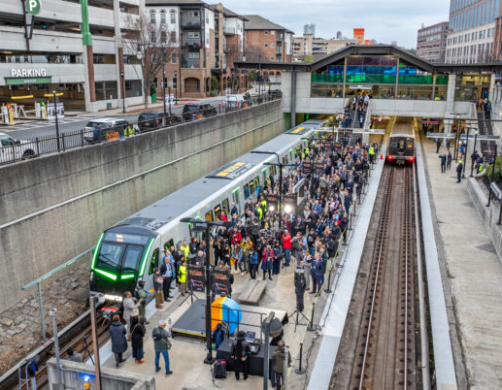
Module #3: Breakout
How does your organization communicate internally and externally during large events? What technology is missing that could improve processes?
How does your organization use hazard trigger points/thresholds in its decision-making?
What is one practice you believe is missing and how would it improve event-readiness?
Notes:
Source for photo: MARTA displays new rail cars
https://www.rtands.com/passenger/marta-displays-new-rail-cars/
This breakout asks participants to connect the preparedness concepts from this module to their own agency practices.
The goal is to discuss what currently works, where gaps exist, and what improvements could strengthen event readiness.
The first question focuses on communication: how information moves internally, how partners are notified, and how the public receives updates.
Encourage participants to think about missing tools or technologies that could improve speed, consistency, or coordination.
The second question focuses on trigger points and thresholds. Discuss whether decisions are tied to measurable conditions, such as AQI, fire weather, service disruption, or crowding.
The third question invites participants to identify one practical improvement, such as better training, clearer escalation protocols, improved wayfinding, stronger partner coordination, or better real-time monitoring.

Slide 44
Module #4: Delivery: Day of Event and Implementation Activities
Contingency Plan Implementation
Weather Resiliency
Emergency Operations Center
First/Last Mile
Notes:
- This slide introduces Module 4 and brings to attention the 4 main topics that will be covered.

Slide 45
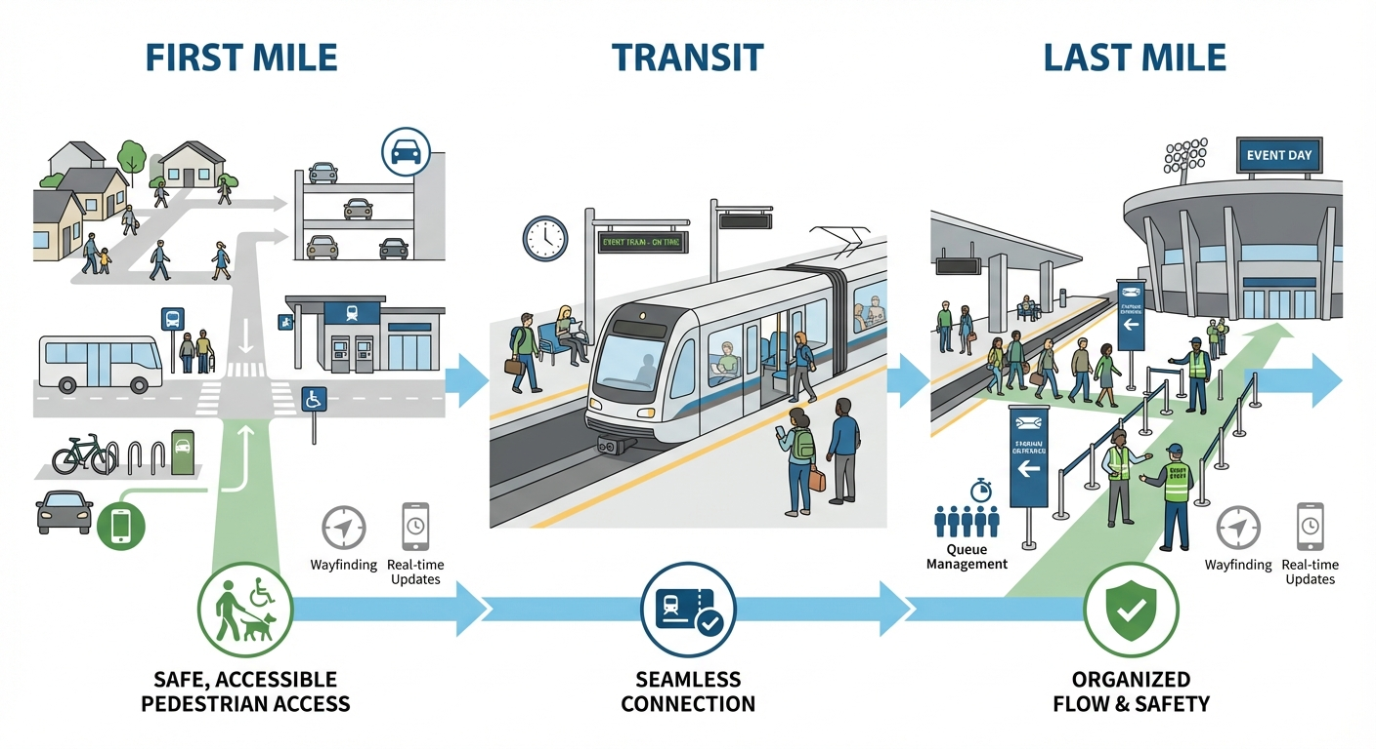
Game-Day Implementation: First/Last Mile
Notes:
First and last mile coordination helps shape the overall customer experience.
It supports safe, accessible, and seamless movement between transit stations, venues, and surrounding neighborhoods.
A strong first and last mile strategy helps reduce congestion at key access points.
It also supports multimodal connections and helps keep transit an attractive and reliable option for event attendees.
Safe streets and sidewalks are critical so people can connect to transit easily.
First and last mile connections include the parts of the trip where riders walk, bike, roll, shuttle, or use ride share to get to or from transit.
Planning should define permitting, curb management, designated pickup and drop-off areas, shuttle queues, and ride-share zones in advance.
During the event, agencies need to actively monitor pedestrian routes, curbside activity, platform crowding, queueing areas, and security screening zones.
Field staff, signage, and real-time communication are key tools for supporting a smooth customer experience.
Conditions may shift quickly due to crowd surges, traffic congestion, unexpected road closures, or security changes.
Agencies should coordinate with local police, traffic control, ride-share operators, venue staff, and other partners.
Wayfinding signage should direct passengers toward shuttle queues, transit access points, and ride-share pickup zones after the event.
Staff should document changes or challenges to support mid-event adjustments and post-event evaluation.
Source:
LA Metro, SETGO Industry Playbook: https://www.railwayage.com/wp-content/uploads/2025/10/LAMetro-SETGO_Industry-Playbook_2025_09122025.pdf

Slide 46
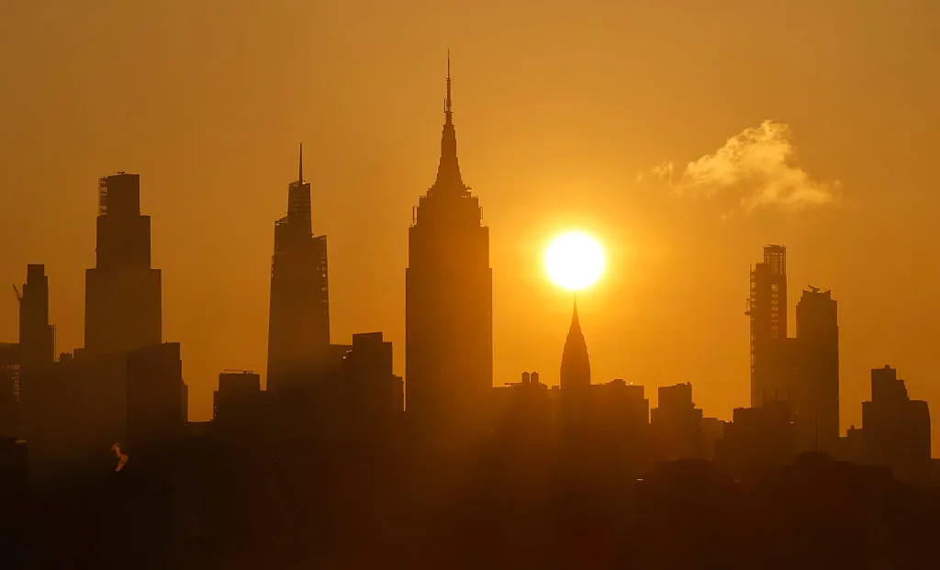
Game-Day Implementation: Weather Resiliency
  Monitor weather forecasts continuously and use thresholds (e.g. temperature, wind speed) to trigger contingency actions.
  Activate cooling buses, shade tents as needed
  Adjust vehicle headways and vehicle types based on weather related demand and equipment performance.
Notes:
Photo cred: https://time.com/7305946/cities-tackling-extreme-heat/
During the event, weather monitoring and flexibility are critical.
Conditions can change quickly and may require adjustments to staffing, communications, service levels, or passenger support.
Agencies should monitor forecasts continuously and use thresholds, such as temperature or wind speed, to trigger contingency actions.
A designated weather liaison should be responsible for real-time updates and alerts.
Useful tools include hourly forecasts for the event location, contact with the local National Weather Service, communication channels with key decision-makers, and a process to activate the weather safety plan.
Weather-related actions may include cooling buses, shade tents, adjusted vehicle headways, or changes in vehicle types based on demand and equipment performance.
Pre-notification helps riders and staff prepare for unusual or changing conditions.
Alert methods may include PA systems, two-way radios, social media, TV monitors, scoreboards, sirens, or mass notification systems.
Questions to ask:
Are contingency plans being activated based on weather conditions?
Are frontline staff prepared and equipped for weather-related needs?
Are customer wait areas safe, accessible, and weather-protected?
Are customers being notified promptly about weather-related delays or reroutes?
Source:
LA Metro, SETGO Industry Playbook: https://www.railwayage.com/wp-content/uploads/2025/10/LAMetro-SETGO_Industry-Playbook_2025_09122025.pdf

Slide 47
Game-Day Implementation: Emergency Operations Center (EOC
Active monitoring and communication
  Maintain ongoing communication with field staff, data collection and tracking, and CCTV monitoring
Is the EOC fully staffed and operating with up-to-date information from a variety of sources?
Real-time decision-making
  Ensure EOC staff are empowered to make real-time decisions or escalate them quickly
Activation Levels
Are decisions being communicated clearly with all relevant internal and external partners?
  Based on nature of the event, decide what level of activation is needed (Level I-III)
Notes:
During the delivery phase, the Emergency Operations Center, or EOC, should support active monitoring, communication, and coordination.
The EOC should be staffed with trained personnel who can track incidents, deploy resources, and communicate with frontline staff, operations control centers, and the public.
Active monitoring may include vehicle tracking data, CCTV footage, field updates, and other real-time tools.
Rapid updates from the field should feed into the EOC to support quick and effective decisions.
EOC staff should be empowered to make real-time decisions or escalate decisions quickly.
An activated EOC supports service adjustments, emergency response, and unified messaging across stakeholders.
Emergency information from the EOC should be communicated to passengers in real time when needed.
The EOC should also maintain communication with other command posts, including operations control centers and a Joint Information Center, if applicable.
Agencies should decide the appropriate EOC activation level based on the nature and risk profile of the event.
Source:
LA Metro, SETGO Industry Playbook: https://www.railwayage.com/wp-content/uploads/2025/10/LAMetro-SETGO_Industry-Playbook_2025_09122025.pdf
Metropolitan Transportation Commission, Bay Area Regional Transit Expansion Program: 2018 Update: https://mtc.ca.gov/sites/default/files/MTC%20Bay%20Area%20RTEMP%202018%20Update.pdf?cb=2a6007b7

Slide 48
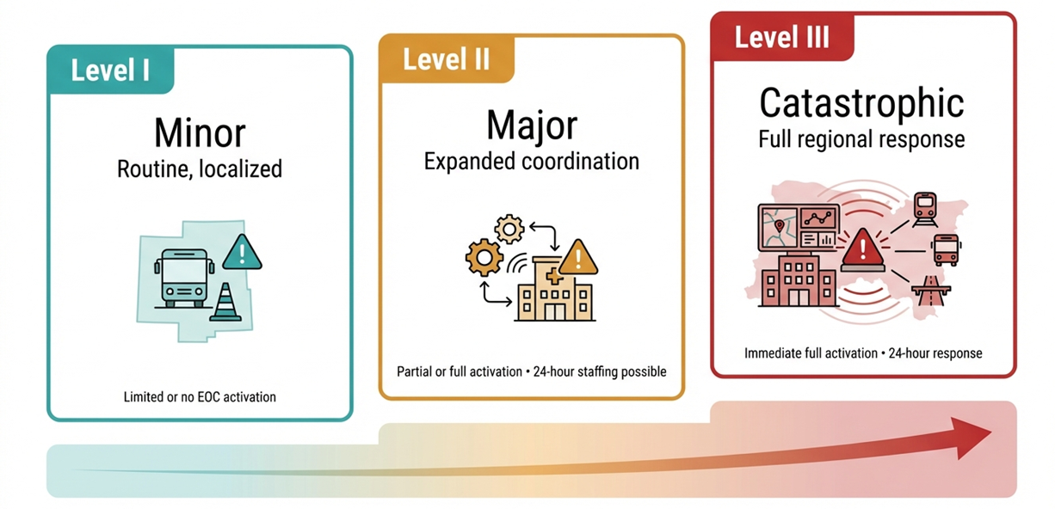
Game-Day Implementation: Emergency Activation
Three levels of emergency activation for transportation agencies, adapted from the San Francisco Bay Area Regional Transportation Emergency Management Plan (March 2018).
Notes:
This slide shows how emergency activation can scale based on the severity and complexity of the incident.
The main idea is that not every event requires full Emergency Operations Center activation.
Level I is generally routine or minor. Communication usually happens through normal channels, and the EOC is typically not activated.
Level II is more moderate. The EOC may be partially or fully activated, depending on the incident and resource needs.
Level III is the highest level. It requires immediate activation and full staffing of the EOC.
Activation levels can change as more information becomes available.
An incident may be upgraded if conditions worsen or downgraded after the agency assesses the emergency.
For wildfire or stadium event planning, the value of this framework is that it helps agencies match coordination, staffing, and decision-making structures to the scale of the situation.
Source:
Metropolitan Transportation Commission, Bay Area Regional Transit Expansion Program: 2018 Update: https://mtc.ca.gov/sites/default/files/MTC%20Bay%20Area%20RTEMP%202018%20Update.pdf?cb=2a6007b7

Slide 49
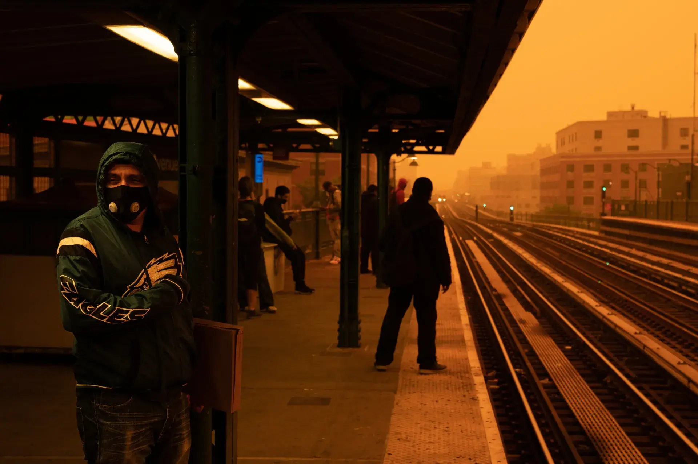
Game-Day Implementation: Contingency Plans
Activate alternate routes, supplemental bus bridges, or platform crowd management measures as needed
Make adjustments quickly to signage, service announcements, and ambassador briefings to reflect live changes
Ensure maintenance, operations, and enforcement teams remain flexible and on-call throughout the event.
Notes:
Photo credit: Wildfire smoke is bad for kids’ health. Vital Signs, https://vitalsigns.edf.org/story/wildfire-smoke-health-effects-and-how-to-protect-your-family
The delivery phase is when contingency plans move from planning into implementation.
Agencies should continuously monitor live conditions and stay ready to activate alternate service strategies.
Contingency actions may include alternate routes, supplemental bus bridges, or platform crowd management measures.
Adjustments to signage, service announcements, and ambassador briefings should happen quickly as conditions change.
Maintenance, operations, and enforcement teams should remain flexible and on-call throughout the event.
Standby resources should be positioned strategically so vehicles and staff can be deployed quickly.
Scaling up staffing helps address increased ridership, operational complexity, surges, disruptions, or security incidents.
Coordination with law enforcement, event partners, transit control centers, and regional support networks is critical.
Real-time updates should be shared with the public across communication channels.
Questions to ask:
Are contingency fleets and operations staff deployed or on standby in the right locations?
Is there continuous communication between operations, law enforcement, and control centers?
Have any conditions triggered contingency activation, and was the response timely?
Are staff receiving current guidance as conditions evolve?
Source:
LA Metro, SETGO Industry Playbook: https://www.railwayage.com/wp-content/uploads/2025/10/LAMetro-SETGO_Industry-Playbook_2025_09122025.pdf

Slide 50
Scenario Planning: What is Scenario Planning?
  Scenario planning is a strategic, proactive process of imagining, modeling, and preparing for multiple plausible future hazards—such as natural disasters or cyber threats—to build resilience and inform response strategies.
  Steps: define objectives, develop scenarios, analyze impacts, identify response strategies, test and refine
  Each group will receive a scenario for SoFi Stadium in Los Angeles and develop a four-phase preparedness plan at one month, 10 days, 1-3 days, and hours before the event
Notes:
This exercise shifts from concepts and tools to applied decision-making.
Scenario planning is a way to think through plausible future hazards before they occur.
The goal is not to predict exactly what will happen, but to prepare for different conditions that could affect operations.
Scenario planning helps teams practice how they would assess risk, make decisions, communicate, and coordinate across agencies.
The basic steps are to define the objective, develop the scenario, analyze impacts, identify response strategies, and test or refine the plan.
In this exercise, each group will work through a SoFi Stadium scenario in Los Angeles.
Groups will develop a four-phase preparedness plan for one month out, 10 days out, one to three days out, and the hours before the event.
The exercise is meant to bring together the full training: wildfire risk, smoke exposure, trigger points, transit operations, first and last mile planning, communications, and day-of-event implementation.
Source:
American Planning Association, The Use of Foresight and Scenario Planning in Hazard Mitigation and Climate Adaptation Planning: https://www.planning.org/pas/memo/113/the-use-of-foresight-and-scenario-planning-in-hazard-mitigation-and-climate-adaptation-planning/#:~:text=Defining%20Scenario%20Planning,Lincoln%20Institute%20of%20Land%20Policy)
FEMA, Local Mitigation Planning Handbook: www.fema.gov/sites/default/files/2020-06/fema-local-mitigation-planning-handbook_03-2013.pdf
Meegle, Scenario Planning for Natural Disasters: https://www.meegle.com/en_us/topics/scenario-planning/scenario-planning-for-natural-disasters

Slide 51
Scenario Planning: Exercise Setup and Instructions
Each group receives: FIFA World Cup 2026 Venue, packet of data tools and risk thresholds, scenario type assignment
Each group develops a four-phase preparedness plan organized by planning horizon
One month, 10 days, 1-3 days, and hours before the tournament
Each phase covers: risk thresholds, mitigation actions for venue, communication protocols, and multi-agency coordination
Notes:
Each group will receive a venue packet, data tools and risk thresholds, and a scenario type assignment.
Use these materials to develop a four-phase preparedness plan for SoFi Stadium.
The plan should be organized by planning horizon: one month out, 10 days out, one to three days out, and the hours before game day.
For each timeframe, identify which risk thresholds matter and what decisions they trigger.
Then identify the mitigation actions that apply to the venue, transit system, passengers, and staff.
Each phase should also include communication protocols and multi-agency coordination needs.
Think about which actions are realistic at each timeframe. Some actions are linked to weeks of lead time/forecast windows, while others will be activated close to game day.
The goal is to practice linking forecast information and risk thresholds to clear, coordinated preparedness actions.

Slide 52
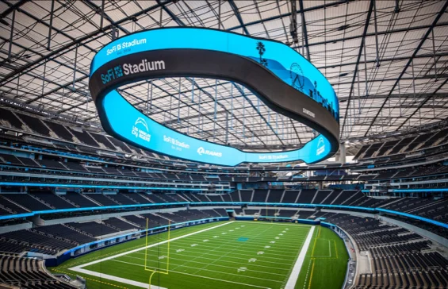
Scenario Planning: Exercise Timing
Setup and instructions: 5 minutes
Group work: 10 minutes
Presentations and after-action discussion: 15 minutes (approximately 4 minutes per group)
SoFi Stadium
Notes:
Photo cred: https://www.sofistadium.com/
This slide is used to explain to participants the logistics of the exercise and how long they are expected to spend in their groups working through the exercise.

Slide 53
Scenario Planning: Build Your Scenario and Response Plan
For each of the four planning horizons (one month, 10 days, 1-3 days, hours):
  Apply risk thresholds: Which thresholds matter? What decisions do they trigger?
  Identify mitigation actions: Which venue and transit measures apply now?
  Develop your preparedness plan: Define communication, coordinate agencies, and outline actions.
Consider: How would actions differ if there is low uncertainty compared to high uncertainty in the hazard forecast?
Notes:
For each planning horizon, work through the same basic decision process.
Start with the risk thresholds. Identify which thresholds matter for your scenario and what actions they should trigger.
Then identify mitigation actions that are appropriate for that timeframe.
Consider both venue measures and transit measures, including service, staffing, passenger support, and first and last mile needs.
Build the preparedness plan around three pieces: communication, agency coordination, and specific actions.
Some actions are feasible one month out, while others only make sense in the final days or hours.
Also consider forecast uncertainty. If confidence is low, actions may focus on monitoring and readiness.
If confidence is high, actions may shift toward activation, public messaging, staffing changes, or operational adjustments.
The goal is to show how risk information becomes a phased, practical response plan.

Slide 54
Case Study Example: SoFi Stadium, Los Angeles
Low probability, high consequence scenario:
Game Day: July 18, 12pm kickoff
A wildfire is reported approximately 20 miles north of the stadium, and game day temperatures are forecast to reach 98-102 degrees F.
1 month
- Infrastructure planning
10 Days
- Tabletop exercises
1-3 Days
- Short range forecasts
- Go / no go decisions
- Activation of mitigation measures
Hours Before
- Real-time monitoring
- Procurement
- Inter-agency agreements
- Review seasonal outlooks
- Communication testing
- Resource prepositioning
- Monitor forecast trends
- Implement protective actions
- Adjust operations and messaging
Notes:
This example shows how a low-probability, high-consequence scenario can be organized across planning horizons.
The scenario combines wildfire proximity with extreme heat on game day, which creates both smoke and heat-related concerns.
At one month out, teams may focus on planning, coordination, staffing, and confirming resources.
At 10 days out, teams may conduct tabletop exercises, communication testing, resource prepositioning, and monitoring of forecast trends.
At one to three days out, teams may check short range forecasts, review go/no go decisions, and assess activation of mitigation measures.
In the hours before the event, teams may activate real-time monitoring, passenger alerts/messaging, cooling measures, crowd management, or service adjustments.
Use the example to think about what is practical in your own jurisdiction and what barriers may exist.
Consider whether current plans address wildfire, smoke, heat, first and last mile access, and sensitive groups.
Also think about timing: which actions require early preparation, and which can only be activated in the final week or final hours.
Takeaway messages:
Focus on what information is needed at each stage, who needs to be involved in particular decisions.
Be specific about trigger points. Identify which thresholds would trigger actions.
Match actions to the right planning horizon. Anything requiring staffing, contracts, equipment, permits, or partner coordination likely needs to start ahead of game day.
Look for common gaps related to unclear ownership, backup communications, sensitive group support.
Build in uncertainty. Lower confidence forecasts may trigger monitoring and readiness, while higher confidence forecasts closer to game day may trigger activation, public messaging, or service adjustments.

Slide 55
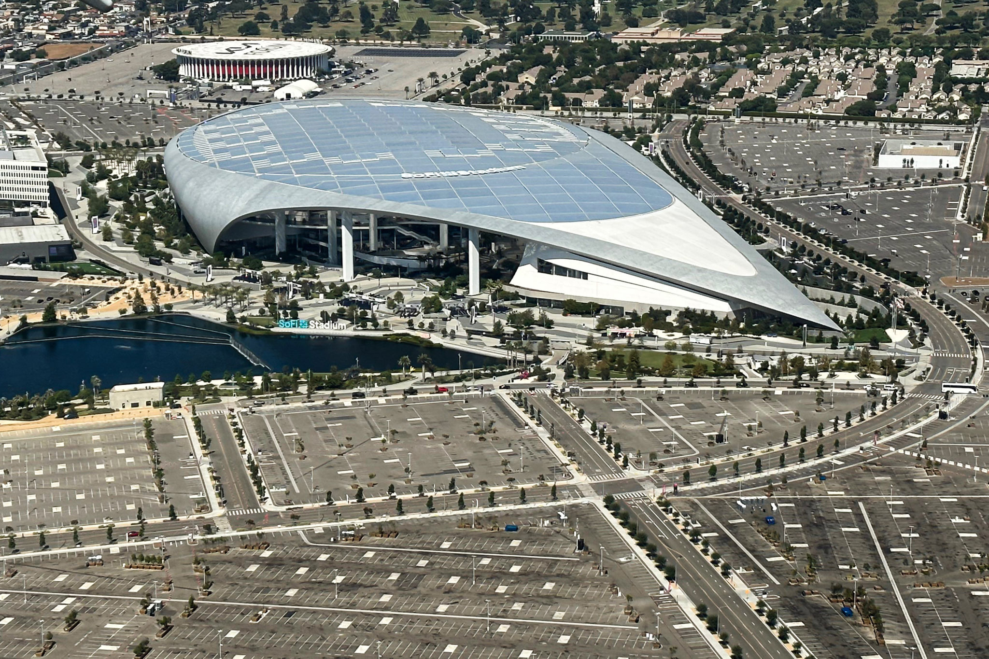
Scenario Planning: Group Presentations and
After-Action Discussion
Each group presents their four-phase preparedness plan (approximately 4 minutes per group)
Questions for discussion:
  Were the right risk thresholds identified at each planning horizon?
  Were mitigation actions practical across all three phases?
SoFi Stadium and parking
Notes:
Photo credit: https://commons.wikimedia.org/wiki/File:NRG_Park_-_Yellow_Lot.jpg
Each group will briefly present its four-phase preparedness plan.
Focus on thresholds, mitigation actions, communications, and coordination needs at each planning horizon.
Listen for how groups matched actions to timing.
Ask yourself if the selected risk thresholds were clear, measurable, and tied to specific actions.
Use the after-action discussion to identify common gaps, strong practices, and ideas that participants can bring back to their own agencies.

Slide 56
Call to Action
Additional FEMA courses to take:
  Sport and Special Event Enhanced Risk Management and Assessment (MGT-466)
  Enhanced Sports and Special Events Incident Management (MGT-440)
  Sport and Special Event Public Information and Emergency Notification (MGT-467)
  Crowd Management for Sport and Special Event (MGT-475)
Shortlist of emergency planning documents to consult:
  CPG 201: Threat and Hazard Identification and Risk Assessment (THIRA) and Stakeholder Preparedness Review (SPR) Guide
  CPG 101: Developing and Maintaining Emergency Operations Plans

Slide 57
Contacts:
Karl Kim, Ph.D.
Email: karlk@hawaii.edu
Eric Yamashita, Ph.D.
Email: ericyama@hawaii.edu
Daniele Spirandelli, Ph.D.
Email: dspirandelli@haleyaldrich.com
Hannah Sawyer
Email: hsawyer@haleyaldrich.com
Slides & a follow up survey will be sent out to attendees following the training!

Slide 58
Data Sources
NOAA, NWS, Climate Prediction Center (CPC), Three-Month Outlook: https://www.cpc.ncep.noaa.gov/products/predictions/long_range/seasonal.php?lead=1
NOAA, NWS, CPC Monthly Temperature Outlook: https://www.cpc.ncep.noaa.gov/products/predictions/30day/
NWS, HeatRisk Index: https://www.wpc.ncep.noaa.gov/heatrisk/
FEMA National Risk Index: https://www.fema.gov/flood-maps/products-tools/national-risk-index
High-Resolution Rapid Refresh (HRRR) Smoke Model: https://rapidrefresh.noaa.gov/hrrr/HRRRsmoke/
Airnow EPA: https://www.airnow.gov/
National Interagency Fire Center, 7-Day Significant Fire Potential: https://www.nifc.gov/nicc/predictive-services/outlooks
National Interagency Fire Center, National Significant Wildland Fire Potential Outlook: https://www.nifc.gov/nicc/predictive-services/outlooks
NOAA, NWS, Storm Prediction Center, Fire Weather Outlook: https://www.spc.noaa.gov/products/exper/fire_wx/
NOAA, NWS, Storm Prediction Center, Severe Weather Outlook: https://www.spc.noaa.gov/products/exper/day4-8/
NOAA, NWS, High Wind Warning: https://www.highwindwarn.com/
ProbSevere – LightningCast: https://cimss.ssec.wisc.edu/probsevere/lc/map/
NOAA, NWS, Excessive Rainfall Forecast: https://www.wpc.ncep.noaa.gov/qpf/excessive_rainfall_outlook_ero.php
NOAA, NWS, Storm Prediction Center, Today’s Convective Outlook (Tornado): https://www.spc.noaa.gov/products/outlook/
Notes:
List of helpful forecasting tools for participants to explore on their own and use in their own mitigation action ladders.

