Slide 1

Resiliency in the
Face of Disaster:
The Role of
Transportation
Frannie Edwards, MUP, PhD, CEM
Deputy Director
National Transportation Safety & Security Center
Mineta Transportation Institute

Slide 2
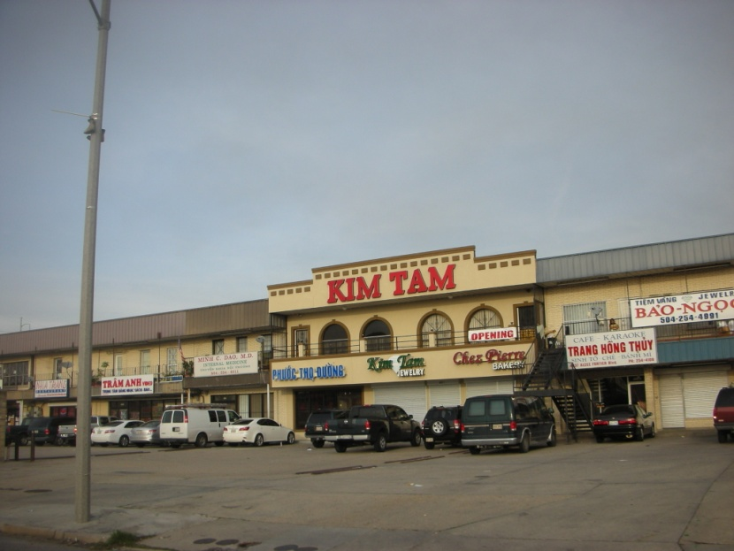
WHAT IS RESILIENCE?
National Academies of Science =
  To adapt to stress …so that it may continue to function, or quickly recover its ability to function, during and after stress.”(14)
  The ability of groups, such as communities and cities, to withstand hazards or to recover from such disruptions as natural disasters. Building and maintaining resilience depend on the ability of a group to monitor changes and to modify its plans to deal with adversity appropriately.”(14)
Coles and Buckle =
  Community participates fully in the recovery process and … it has the capacity, skills and knowledge to make its participation meaningful.”
“
“
“

Slide 3
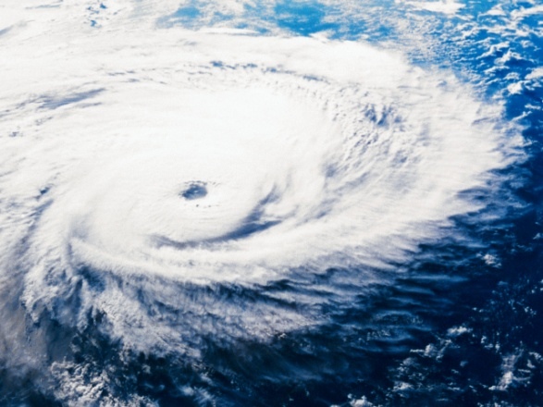
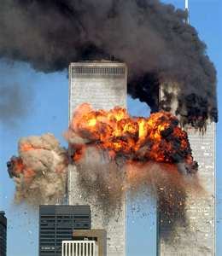
Hallmarks of Resiliency
Prepare for the identified hazards
  Natural hazards
    Weather, seismic
    Fire
    Disease- human, plant, animal
  Technological hazards
    Hazardous material, transportation, power outage, infrastructure failure
  Human-caused hazards
    Crime, terrorism

Slide 4
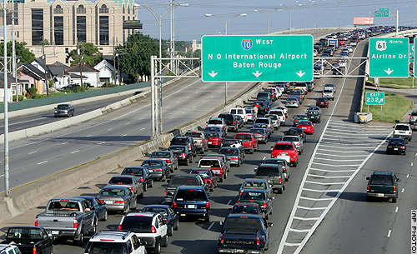
Hallmarks of Resiliency
Mitigation
  Physical mitigation
  Planning
  Education
  Insurance
Preparation
  ICS/NIMS training, exercises
  Hazards education in the K-12 curriculum
  Car kits, family kits
  School/ day camp supplies for children
  Hospital and nursing home shelter-in-place/evacuation plans and exercises
Engagement
  All community approach to emergency planning and business continuity planning means every sector has a role

Slide 5
Role of the Transportation Sector
1. All disasters are local
  Collaborate with local governments on emergency planning
    Don’t want to meet in the parking lot of a disaster!
    Establish common expectations of transportation sector’s roles
    Agree on reimbursements, who is responsible for what paperwork: FHWA/FEMA, MAP-21 impacts
2. No roads, no codes
  Bridge Inspection
  Debris removal – how many lanes are “emergency” restoration, MAP-21 impacts
  Rapid repairs- road surface, culverts, drainage
  Overweight permits

Slide 6
Role of the Transportation Sector
3. Evacuation
  Legal authority to call for evacuation
  Legal authority to call for contraflow
    Plan in place that includes one lane in opposite direction for emergency vehicles- police, fire, ambulance, gas trucks
    Who has barricades, signage; who blocks entrances at local streets?
  Plans for towing, repairs, gas – only expressway gas stations? Plans to boost supply in advance of evacuation? Payments? Price gouging?
  Destination?
    South Jersey Transit – plenty of entry points but what is exit point? Only Philadelphia?
  Shelters?
    Who provides support enroute ? – restrooms, diapers, water, food, medical care (heart attack, stroke, labor, asthma attack, allergic reaction)

Slide 7
Role of the Transportation Sector
4. Logistics
  Collaborate with the private sector – “whole community” – Walmart EOC is 24/7 monitoring roads, other “big box”
  Rolling stock to support the emergency response
    School busses, paratransit, airport busses, public busses, commuter rail
    Courier trucks, specialty trucks, plows, crane
  Goods by shortest route after disaster – may be different than before disaster
    Use GPS, road sensors, HAM radio/CB radio reports, traffic cameras
    Information coordination is role for Transportation EOC
  First responders to the disaster sites
    Police, fire, EMS, hospital medical personnel
    Staging areas?
    Who requests that people be transported? 9/11 problem.
    Problem of credentials, self-dispatching

Slide 8
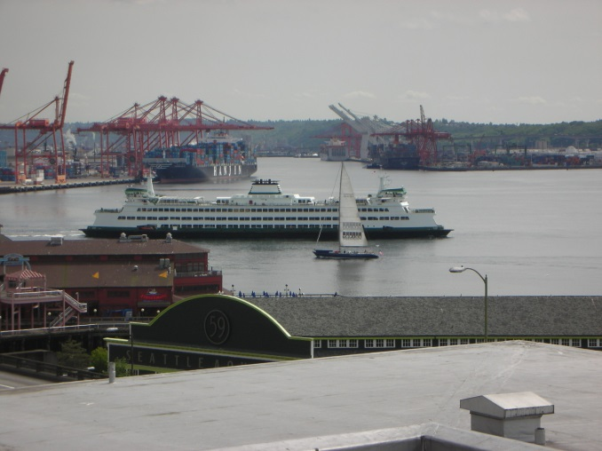
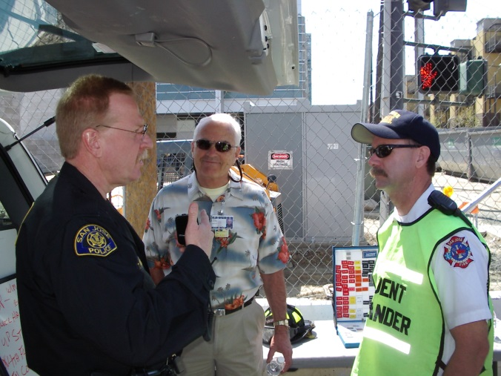
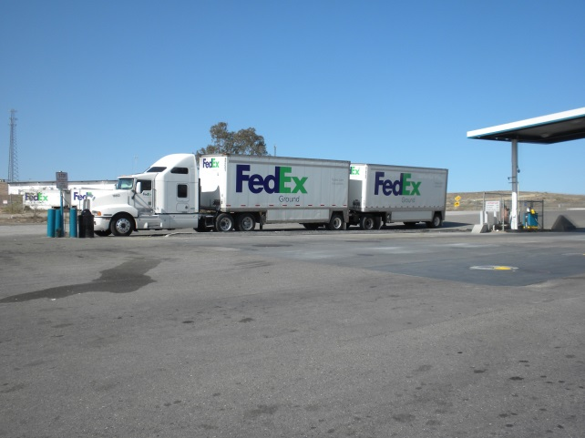
Role of the Transportation Sector
Conclusion
  Transportation is the key to all disaster response
  Resiliency requires rigorous inter-agency planning before the event
  The whole community has to participate in developing the plan, and in executing it when needed

Slide 9

Resources
A Whole Community Approach to Emergency Management: Principles, Themes, and Pathways for Action http://www.fema.gov/media-library-data/20130726-1813-25045-0649/whole_community_dec2011__2_.pdf
Building Community Disaster Resilience through Private-Public Collaboration http://www.nap.edu/catalog/13028.html
Coles and Buckle, Developing community resilience as a foundation for effective disaster recoveryhttp://www.em.gov.au/Documents/DevelopingCommunityResilience.pdf
California Resiliency Alliance Disaster Assistance Registry http://www.caresiliency.org/

Slide 10
Contact Information
Frannie Edwards, MUP, PhD, CEM
Deputy Director, National Transportation Safety & Security Center
Mineta Transportation Institute
Frances.Edwards@sjsu.edu
http://www.transweb.sjsu.edu
408-806-7937

