Slide 1
Developing Exercises
An outcome and task-oriented training webinar
December 17, 2014
Presented by: Frannie Edwards & Dan Goodrich
Mineta Transportation Institute
Notes:
Good afternoon and welcome to the California Emergency Services Association training webinar series.
Today, we’ll be talking about developing HSEEP-compliant exercises for your organization.

Slide 2

Moderator
George Whitney
  CESA member
  Former local, state and federal EM
  Founder of Complete EM
  george@complete-em.com
Notes:
My name is George Whitney. I’m a CESA member, a former local, state and federal emergency manager, and founder of Complete EM. I’ll be moderating the webinar today.
By now you should see a PowerPoint slide deck on your screen. If you cannot, please follow the link and the instructions you received via email. If you run into trouble, send me an email and I’ll see what I can do, once I finish this webinar introduction.
You should not have to install any software to participate in the webinar, but you may choose to do so. Installing the software allows you to use your computer’s speakers to listen in.
This meeting is being recorded so that people who are not here with us today can view the webinar later. We’ll explain how to do that near the end of the webinar.

Slide 3
CESA’s training webinars
Offered on the third week of every month
Conducted during the noon hour
Designed and presented by CESA volunteers
Focused on outcomes, tasks, and resources
Includes both presentation and Q&A
Archived on CESA website
Benefits from member participation
Notes:
This is the fifth in a series of CESA webinars designed to support members and to promote development of the emergency management profession.
Webinars are conducted monthly, during the noon hour, so they do not interfere with most work schedules.
These webinars are developed and presented by CESA volunteers, so please be kind and consider volunteering your time and information if you have something to share.
Our webinars focus on emergency management considerations, outcomes, tasks and resources... good, simple stuff that you’ll need to succeed in your job.
We’ll have time today for both a presentation and a Q&A session. If you have a question hang on to it for just a few minutes.
We’re developing an interactive web forum where you can download and share information, and engage in an ongoing dialog about exercise development and other topics. We’ll talk more about that later too.
Finally, our webinars benefit greatly from member participation. Please help us to share good information by providing feedback, insight, support, and referrals to others who may need it.

Slide 4
Let’s get started
Webinar outline
  Introduction
  Presentation
  Questions and Answers
  Wrap-up
Notes:
It’s important to note that this webinar is neither intended as a basic course in emergency management nor an exhaustive, technical treatment of exercises as a topic. This and other CESA webinars are really about sharing as much good information as we can with members.
In a couple of moments, you’ll see and hear a 30-minute presentation on developing an effective HSEEP-compliant exercise. After that presentation, we’ll take 15 minutes to answer questions before we wrap-up. Our webinar is scheduled to run from approximately 12:05 to 12:55.
During the presentation, please use the comment feature in our webinar software to send us questions. We’ll answer them if we can during the webinar. If we cannot, we’ll post the questions and answers in the web forum.
One way or another, we’ll try to get all of your questions answered.

Slide 5
Today’s webinar topic supports:
Outcome: | Understanding of HSEEP and how to create exercises.
Goals: | 1. History/overview of new HSEEP documents. 2. Identification of tools and tasks for exercise creation 3. Next steps in exercise development.
Notes:
Today’s webinar is intended to get you started with your HSEEP-compliant exercise program. In today’s limited time we will be focusing only on the development of the exercise, not the implementation or evaluation, each of which is also an important element of an exercise program.
Today we will examine the types of exercises that can be used to evaluate the organization’s capability to activate its plans during a real emergency. The tasks related to this activity include selecting the plan element to exercise, getting the participation of the organization’s leadership and employees, creating meaningful goals for the exercise that will allow you to evaluate the selected plan element, and selecting an appropriate scenario around which to build the exercise.

Slide 6

Presenter
Frannie Edwards, PhD, CEM
  Professor, San Jose State U.
  Deputy Director, National
  Transportation Safety and
  Security Center, Mineta
  Transportation Institute
  Director, OES, San Jose
  1991-2006
  Emergency Services
  Coordinator, Irvine
  1986-1991
  CESA member
Notes:
Our presenters today are Frannie Edwards and Dan Goodrich.
Frannie is a professor at San Jose State University, Director of the Master of Public Administration Program where she teaches emergency management, and the Deputy Director of the National Transportation Safety and Security Center at the Mineta Transportation Institute, where she also teaches emergency management in the Master of Science in Transportation Management program. Her recent research has focused on exercise design, and has led to the development of the Exercise Handbook for the US Department of Transportation. She and Dan Goodrich recently helped to design an active shooter exercise for San Jose State University
Previously Frannie was the Director of Emergency Preparedness for the City of San Jose for fourteen years, and the Emergency Services Coordinator for Irvine for eight years. She was the Director of the San Jose Urban Area Security Initiative, and the San Jose Metropolitan Medical Task Force, a federally funded terrorism response organization that held exercises every six months. Frannie was the Governor’s appointee to the California Seismic Safety Commission from 1991 through 1995, and was a member of the committee led by Dr. Richard Andrews, State OES Director, that created SEMS. She has a Master of Urban Planning and PhD in Public Administration from New York University, and a Certificate in Hazardous Materials Management from UC Irvine. She is a Certified Emergency Manager and Professional Continuity Practitioner.

Slide 7

Presenter
Dan Goodrich, MPA, CEM, MEP
  Lecturer, San Jose State U.
  Research Associate,
  Mineta Transportation
  Institute
  Emergency management
  positions with Lockheed
  Martin Space Systems,
  County of Santa Clara and
  City of San Jose
  CESA member
Notes:
Our second presenter today is Dan Goodrich.
Dan is a lecturer at San Jose State University at the Mineta Transportation Institute, where he teaches homeland security in the Master of Science in Transportation Management program. He is also a Research Associate at the Mineta Transportation Institute.
Dan’s most recent research has been in exercise design, leading to the Exercise Handbook for the US DOT. He was a member of the Active Shooter Exercise Committee for the San Jose State University Police Department, and served as the Exercise’s Chief Controller for their July 2014 multi-agency exercise. He has also helped to develop a pandemic flu exercise for the San Jose State University emergency operations center staff, a contra-flow exercise for Caltrans, and an exercise-based EOC training program delivered in all twelve Caltrans districts.
Previously Dan has been an emergency management specialist for Lockheed Martin Space Systems, Santa Clara County Department of Public Health and the City of San Jose Office of Emergency Services. He has a Master of Public Administration from San Jose State University. He served in the US Marine Corps for ten years, including Security Forces duty, and in the US Army Reserve Military Police for six years. He is a Certified Emergency Manager, a Professional Continuity Practitioner and a Master Exercise Practitioner.
Welcome, Frannie and Dan, and thank you for agreeing to present today.

Slide 8
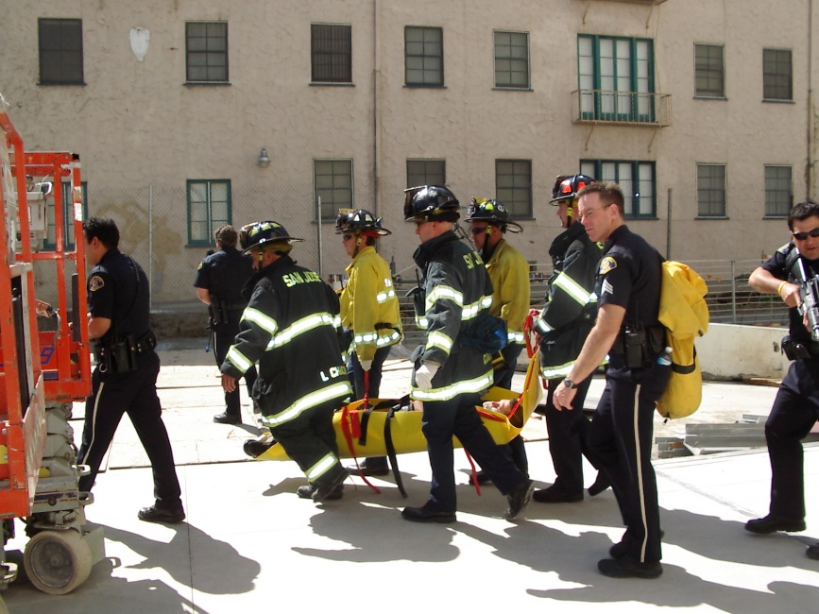
The outcome we desire…
Participants will be able to develop an HSEEP-compliant exercise based on one of the organization’s plans that will evaluate the organization’s capability to activate the plan in a real emergency
Notes:
Thanks, George, and thanks to all for participating today.
Today’s presentation is in response to interest expressed in the survey taken of CESA members. The topic of exercise design is a necessary skill for all emergency managers at all levels of government. It is important to be able to explain to local officials why exercises are important and how they contribute to community safety.
As a California emergency manager for over twenty years I have had occasion to create and direct exercises for local, state and federal organizations involving personnel from across first responder and supporting agencies. The key to a successful exercise is an engaged leadership team and involved response personnel. The exercise needs to be based on the organization’s plans, with clear goals that can be achieved during exercise play. The scenario has to be selected to support those goals.

Slide 9
Reasons we want this outcome...
Ensure that the organization’s resources are aligned to provide effective emergency response to the community
  Plans, personnel, equipment, facilities
Enable the development of plan revisions, employee training and material resources to support readiness
Meet requirements of SEMS and federal emergency preparedness grants
Until you exercise you cannot know if your plans and training are workable
Notes:
Read the slide

Slide 10
Acknowledgements
Rod Diridon, Sr. and Dr. Karen Philbrick for their support of the development of the US DOT Exercise Handbook
San Jose State University Police Department, San Jose Fire Department, San Jose Police Department and Caltrans, our exercise partners
CESA Training Committee, including Masha Hovey, Jerry Quinn, George Whitney, Bob Cascone, Ray Riordan, Keith… [add]
Notes:
Before we go any further, I’d like to take a moment to acknowledge several people and organizations who contributed to this presentation.
Rod Diridon, Sr., Executive Director Emeritus and Dr. Karen Philbrick, Executive Director of the Mineta Transportation Institute for their support of our research on exercise design that led to the new US DOT Exercise Handbook, and much of the information that we will share today.
Many colleagues from the San Jose State University Police Department, San Jose Fire Department, San Jose Police Department and California Department of Transportation (Caltrans) for their partnerships in exercises over the years, during which we learned some strategies for successful exercises.
The CESA Training Committee members who have made helpful suggestions in the development of this presentation, including Marsha Hovey, Jerry Quinn, George Whitney, Bob Cascone, Ray Riordan, Keith …. [George – please complete list as appropriate

Slide 11
PPD-8 Changes
PPD-8 (3/30/11)
  Replaces HSPD-8, locally driven training and exercise programs and “whole community” involvement.
National Preparedness Goal (Sept., 2011)
  Removed color codes, replaced TCL with CC
  Focus on terrorist attack, cyber attack, pandemic and catastrophic natural disaster- no technological like power outage
  Whole Community involvement in emergency management
THIRA drives new capability targets
  Required at state level, generates threat list
  Local communities select planning/preparedness focus based on local threats – no longer “all terrorism all the time”
Core Capability List
  Based on the community’s threats, it orients its investments to acquire the core capabilities needed
Notes:
The changes to HSEEP derive from the new Presidential Policy Directive 8- National Preparedness, which replaces the Bush Administration’s HSPD-8 based on the events of 9/11. The new National Preparedness Goal removed the color code, replaced the Target Capability List with the Core Capabilities List, and “replaced the all-terrorism all the time” focus with a range of scenarios including terror attack, cyber attack, pandemics and catastrophic natural disasters. Communities are expected to handled routine natural disasters without federal help. The scenarios also exclude technological events like power outages. The new approach emphasizes that government cannot manage emergencies alone, and that the private sector and NGOs are an integral part of the emergency planning process.
The exercise program is now based on threat analysis that is required to be performed by each state and Urban Area in the UASI program called THIRA – Threat and Hazard Identification and Risk Assessment. This system, which is useful for local governments as well, replaces the federal “back box” that assigned threat risk to a community, and instead allows local communities to assess their own greatest threats.
The new Core Capabilities include a wider range of preparedness areas, such as critical transportation and long term vulnerability reduction.
The HSEEP was changed to match this new multi-hazards focus and local government orientation including whole community involvement.

Slide 12
What is HSEEP?
Homeland Security Exercise and Evaluation Program
  Revised 4/16/12 to align with PPD-8, National Preparedness Goal and National Preparedness System
  Reduced to 2 volume guidance- see fact sheet
  HSEEP System
    Discussion-based: Seminar, workshop, game, tabletop.
    Action-based: drill, functional, full-scale
    Others as designed locally such as facilitated – see Exercise Handbook
Notes:
The Homeland Security Exercise and Evaluation Program has recently been revised to be more flexible. On March 30, 2011 President Obama issued “Presidential Policy Directive-8- National Preparedness” that refocused national homeland security programs to a more locally driven model. Thus HSEEP was revised on April 16, 2012 to be more flexible and less driven by HSEEP doctrine, which derived from a military model whose demands were not attainable in the civilian community with the time and financial resources available to first responder agencies.
HSEEP’s framework still provides a good model for developing exercises at the local and state levels, allowing organizations to focus on emergency plan development and improvement over the plan revision cycle. HSEEP describes seven types of exercises that can be used to reinforce training, evaluate plan products and increase participant knowledge and skills, which are either discussion based or action based. The discussion models are seminars, a teaching model; workshops, a plan discussion and development model; games, where a limited scope event is worked using computers or other simulation mechanisms; and tabletops, where participants describe their own work within a scenario. The action based models are drills, where one skill is practiced; functional exercises, where participants perform their roles with outside stimulus through message traffic; and full-scale exercises, where participants enact their disaster roles within a complex scenario across several professions and often several jurisdictions. This should be the culmination of a planning, training and exercise cycle to confirm capability. Detailed information about each exercise type is available in our free, downloadable Exercise Handbook, whose URL is at the end of this presentation.

Slide 13
Key tasks…
Select an exercise committee that is representative of each department within the organization and each outside agency participating in the exercise
Select an element of a plan or a process to evaluate
Obtain the participation of the appropriate “players” from within the organization and its supporting elements
Select an exercise type that is appropriate to your level of training
Create meaningful exercise goals
Select a scenario last, so that it will appropriately exercise the plan, so that it can be evaluated against the goals
Notes:
We will now discuss the six key tasks in HSEEP-compliant exercise development. First select a committee that represents the departments in your organization that need to be part of the exercise, and be sure to include appropriate outside agencies that would be your partners in a real event.
Next select an element of a plan to evaluate through the exercise.
Third, obtain the participation of appropriate “players” from the participating organizations.
Fourth, select from among the exercise types under HSEEP the type that is appropriate to your level of training and resource capacity.
Fifth, create meaningful exercise goals that will exercise the plan effectively.
Finally, only then select a scenario that will allow the organization’s capabilities to be exercised so the plan can be evaluated effectively against the goals.
Dan will discuss these six key points in a few minutes.

Slide 14
What is driving this exercise?
Boss is suddenly interested in disasters
Political interest in photo op, participation
Contractual or grant mandate
Needs driven: agency reorganization, personal estimate of need to prepare, new partners
Plan driven: new plan, updated plan
Training driven: validate training levels, find gaps
Notes:
The decision to create an exercise may derive from several sources. The “driver” of the exercise may help to determine some characteristics of the exercise that will influence the exercise planning.
Some exercises are created because a leader is concerned about the organization’s disaster preparedness, as when a new mayor is elected or new city manager or other department head is appointed; or when a disaster has occurred in a nearby community. Sometimes a politician wants a “photo op” with first responders to seem proactive. Some grants or contracts require the recipient to demonstrate the outcome of the funding with an exercise.
Sometimes the emergency manager recognizes the need for an exercise because of an agency reorganization, his or her personal estimate of a need to prepare specific elements of the organization better, such as the EOC staff, or there may be new partners in the community, like RACES or CERT, who need to be integrated into the response system.
Ideally exercises would be cyclical and either planning or training driven. You can use the exercise as part of the planning cycle to validate new plans or updated plans. Similarly, the training cycle could be a driver, using an exercise to validate training levels and identify gaps and future training needs.

Slide 15
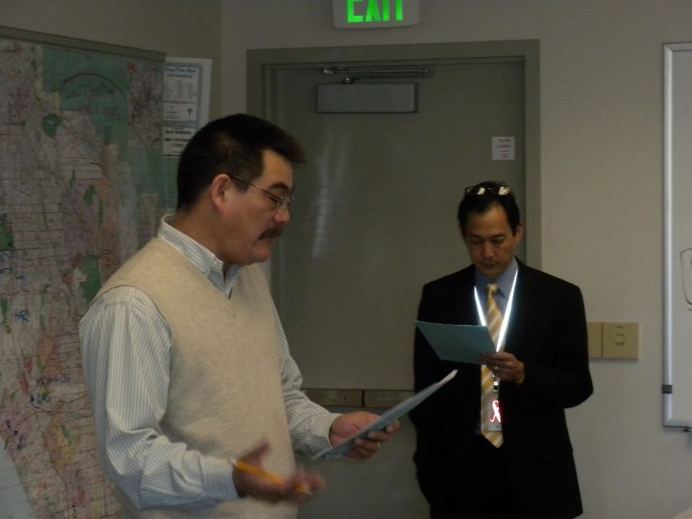
Executive Buy-In
Executive support for the exercise
  Understand how the organization will benefit from the exercise
Executive resource commitment to the exercise
  Memo to department heads and players
  Funding for overtime
  Funding for exercise materials
Notes:
Executive buy-in is essential for a successful exercise. Depending on your organization’s structure you may have to develop the support of several levels of supervision to get the players whom you need for a meaningful exercise. Carefully explain the overall benefits to the organization in being prepared to care for the community during unexpected events. It does not have to be a disaster to require the activation of alerting and warning systems, or the use of alternate communications systems. An experienced emergency management team can response to localized events or regional catastrophes.
Be prepared to create a memo summarizing the purpose of the exercise, the focus of the exercise, the goals to be achieved, the plan, training or capability to be evaluated, and the exact resources needed for a successful outcome. Note if a grant or contract will be paying for the out of pocket costs of supplies, equipment and overtime, or if this expense needs to be included in the next fiscal year’s budget.
Dan will now discuss the elements of exercise development.

Slide 16
Things to consider when
putting an exercise together.
Initiate | Plan | Execute | Monitor/Control | Close
What is driving this? | Exercise Committee creation | Cold start or pre-stage | C&E comm plan | Hot Wash
What is the funding source? | Goals | Positioning of C&E's | Authority to change MSEL | C&E debrief
Is there a commitment to a certain exercise type? | What plan / procedure is being evaluated? OR | Document start and end | Adding/subtracting injects | After Action Report
Is everyone using the same definitions? | Is this experimentation/learning opportunity? |  |  | Improvement Plan
Where is the organization in its training & planning? | Location for exercise (inc. ingress & egress) |  |  | Memorialize Documentation
Who inside/outside the organization is participating? | Logistical support (food, trash, signage)
Who are the Controllers and Evaluators (C&E)? | Meetings (C&E min.)
What does "success" look like? | Unavoidable artificialities
Objective | Timeline for exercise incl. setup & teardown
 | Injects and contengency messages/situations
 | Scenario creation
 | Supporting documents (Explan, MSEL, etc.)
Each exercise has its own peculiarities.
As with ICS, use only what you need.
Notes:
Yes, the middle of this slide is too small, complex and therefore confusing. The initial appearance of putting an exercise together can appear complex. Some have used the analogy of directing a play or organizing a wedding to describe exercise design.
The middle portion of the slide includes exercise design questions and tasks organized into Project Management process groups. They help to identify and organize the issues, and map connections and dependencies. The Exercise Handbook that we will discuss later uses this process expanded into a checklist driven approach for each exercise type. You will notice that a few of the issues in the middle portion are larger and bolder. These topics will be discussed in the next few slides.
Different planning approaches are required to ensure exercise continuity, such as logical progression, parallel development and backwards planning. Planning involves not only the environment for exercise play but also the support to maintain that environment and the mechanisms to capture what transpired in exercise play.
Like the exercise participants who use the exercise to evaluate and improve a plan or procedure, the Exercise Committee uses the exercise to develop and enhance future exercises. Skill and confidence in creating and executing more complex exercises is thus developed.
For both the participant and designer it is initially recommended to keep the focus of exercises narrow and as straightforward as possible. Add complexity only when needed.

Slide 17
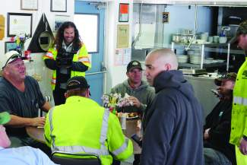
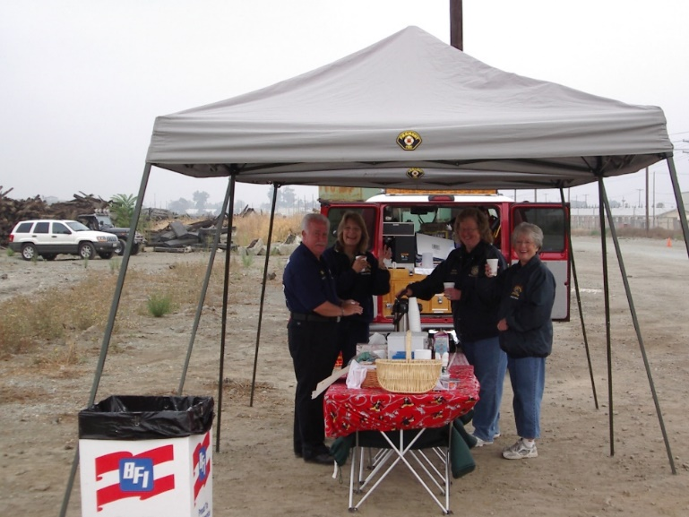
Select an exercise committee
That is representative of each department within the organization
That includes each outside agency participating in the exercise
Notes:
Public agencies are experiencing retirements and staff turn-over, meaning that the most experienced exercise designers may be gone. Developing a capable exercise design team is the first step in designing a good exercise. Ensure that all departments in your organization are represented, and that any outside organizations participating in the event are also part of the exercise committee. These may include mutual aid partners and community-based organizations like the American Red Cross or Salvation Army that may be supporting the exercise with services within the exercise design, or with real-world rehab for exercise players.
The exercise staff includes evaluators for each element of the exercise. They need to be brought into the exercise design process as early as possible so that as exercise goals are considered they can assist with developing appropriate exercise elements and activities that will enable evaluation of the specific goals.

Slide 18
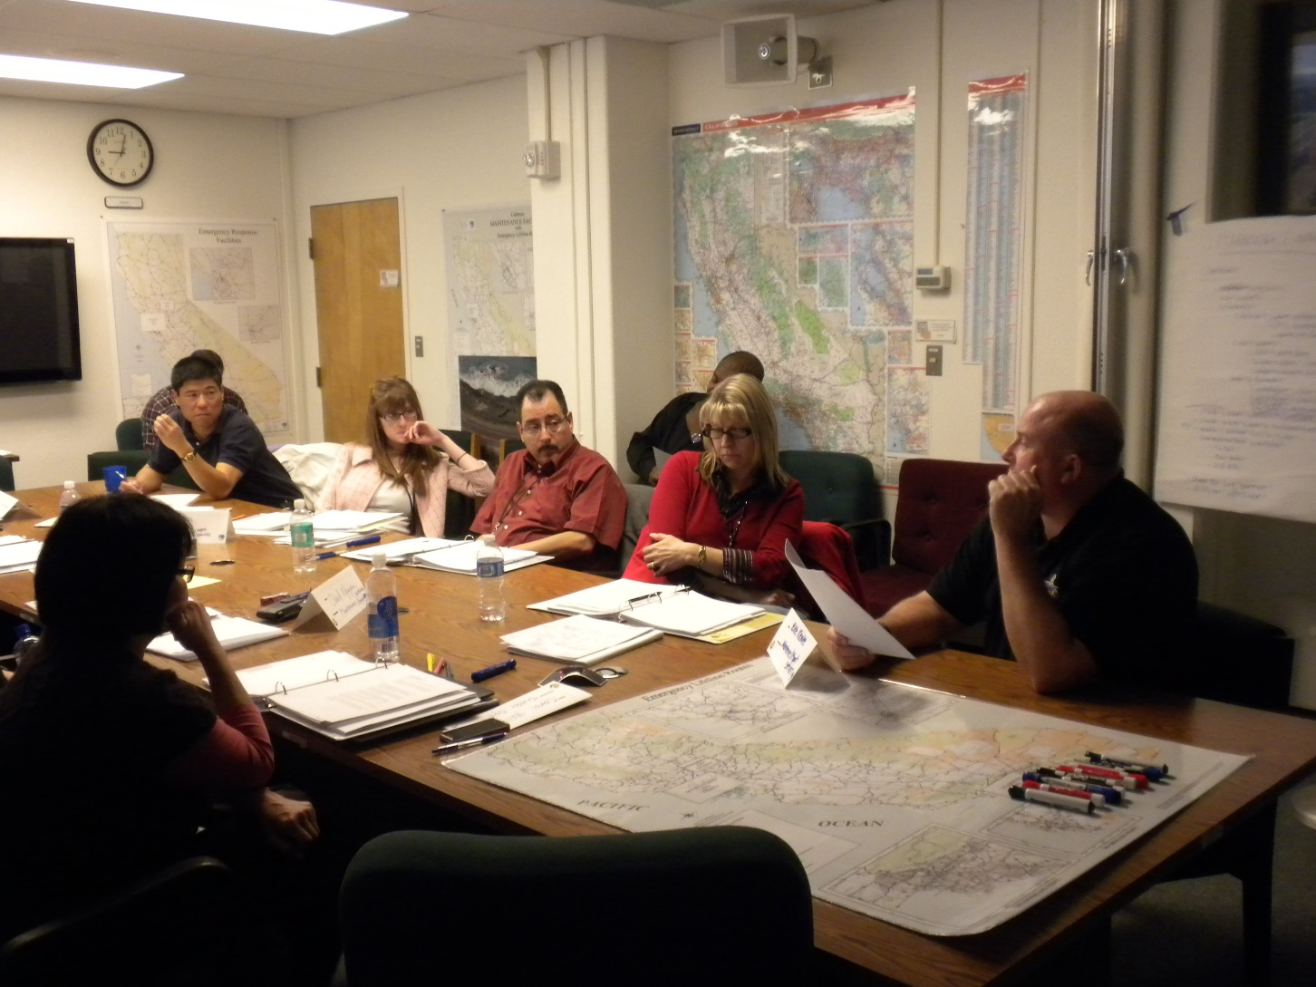
Select an Element of a Plan, Training or Capability to Evaluate
Notes:
The exercise committee should begin by selecting the focus for the exercise. Ideally it would be one element of one plan, recent training, or one key task, skill or activity, such as activation of the EOC, or public information dissemination. The selection of the focus for the exercise can be based on recent plan revisions, recent training, or coming seasonal specific skill sets. For example, in the fall a community might want to exercise all the functions in the Flood Annex of the Emergency Operations Plan in preparation for the winter storm season. April is the anniversary of California’s worst earthquake, the 1906 San Francisco event, so an exercise of the EOC operations element of the Emergency Operations Plan might be appropriate.
Be sure to understand why this exercise is appropriate at this time. Is it part of an externally required cyclical review of core capabilities and universal tasks, or an internally driven concern about the organization’s ability to respond to a topical event (Ebola, active shooter, pandemic flu, for example), or a periodic skills test for responders?

Slide 19

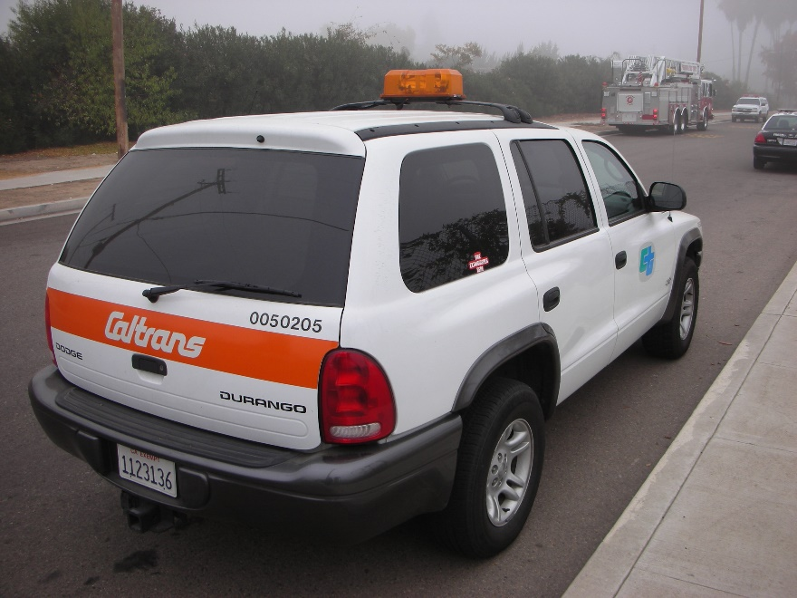
Obtain the participation of the appropriate “players” from within the organization and its supporting elements
Notes:
Determine which personnel need to be part of the exercise.
Get the support of the organization’s executive for this use of personnel time by explaining the benefits of practicing seldom-used skills periodically to ensure that personnel can do their jobs in time of need. It is important to develop senior management’s support for the exercise so that other staff members recognize its value. Request that the executive send a memo to all employees emphasizing the importance of the exercise to the organization.
Obtain the participation of the players by reminding them of the benefits of practicing seldom-used skills, and of personal familiarity with others who will be part of a real response. You do not want to meet your emergency response partners for the first time at the emergency!

Slide 20
Select the Exercise Type
Each type of exercise supports a different focus, scope and outcome
Each type of exercise requires different resource sets
Discussion-Based | Action-Based
Seminar | Drill
Workshop | Functional
Game | Full scale
Tabletop
Notes:
Selection of an exercise type can be driven by grants or contracts, exercise committee experience or resource capacity.
Sometimes grants and contracts require your participation in a specific regional or inter-departmental exercise. That will determine the type of exercise you will develop.
Members of the exercise committee may have experience with specific exercise types and only feel comfortable developing one of those types.
Communities may have limited personnel time to devote to exercising, and may not have funding for overtime for first responder participants, or for exercise materials and equipment purchase or rental. The demands on the emergency manager’s time may preclude him or her from organizing a large event.
Discussion-based exercises can be inexpensive and developed collaboratively by a few partner organizations. For example, the public works director might be willing to speak for an hour at a seminar on winter storm preparedness for the EOC staff. Or the EOC’s PIOs might hold a 2 hour workshop to develop pre-made messages for the winter storm season. The only cost for these events is personnel time, and since most participants would be exempt employees, it is a lost opportunity cost, rather than an out of pocket expense.
Drills can be organized in a few days and completed in an hour. Using the call back list is a good drill on EOC activation. Or have the Logistics Section go to the EOC for one hour and work through a list of resource requests to determine if they have adequate vendor information.
A functional exercise should follow a series of successful discussion-based exercises and drills. A full scale exercise should only be held when all players have been trained, participated in discussion-based exercises and know the plan they are following.

Slide 21
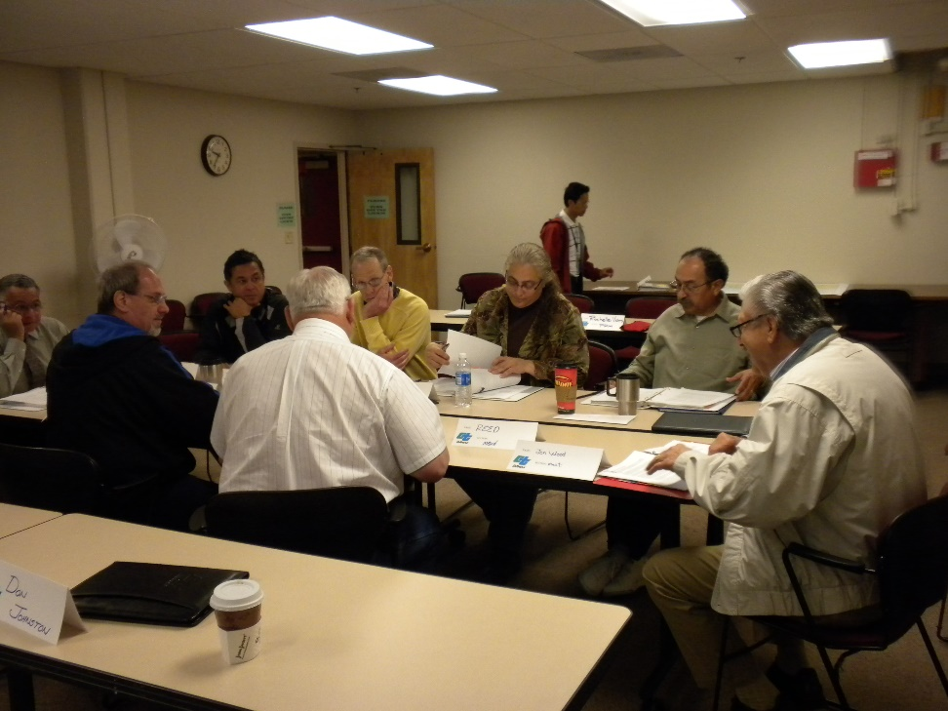
Create Meaningful Exercise Goals
Alert Notification | To demonstrate the ability to alert, mobilize, and activate the personnel, facilities, and systems required for emergency response, and for subsequent staffing for the next shift to maintain 24-hour operations.
Communications | To determine the ability to establish and maintain communications essential to support response to an incident/accident and the immediate recovery, including establishing interoperable communications with first responder agencies.
Emergency Public Information | To determine the capability of the emergency public information system to disseminate timely and accurate emergency response information in languages and methods appropriate to the community; evaluate the ability to work with the media and maintain media monitoring and rumor control; evaluate the adequacy of the electronic signboards, travel information radio, 5-1-1 system, and agency website for maintaining timely travel information to the public.
Notes:
Determine what elements of the plan you and your organization need to practice. Define your goals by plan area, such as alerting and warning, communications and emergency public information. The complexity and number of goals should be appropriate to the type of exercise and the planning time available to the organization.
Remember that adults learn best by doing.
People learn more from doing a few things well than from failing at a confusing number of simultaneous tasks.

Slide 22
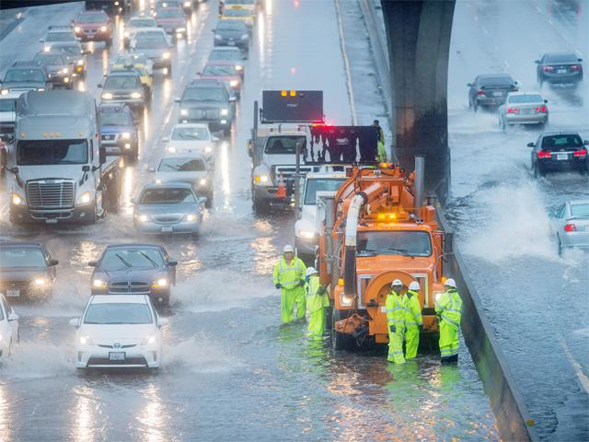
Select a Scenario
Select a recent real event from your community or a nearby community that provides the scope to meet the exercise goals.
Ensure that the scenario offers a manageable set of challenges for the players. Failure generates enemies.
Notes:
Select a scenario that will drive your players to use the skills needed to achieve the exercise goals. Choose a recent event in your community or an adjacent community, or that has been widely reported in the media, and design a locally-based scenario around it. Use local street names and community features for greatest credibility among players. Minimize artificialities in the scenario’s design, such as weather conditions, time compression and the use of resources that would not be available to the community. If people believe that the event could happen in their community they will be serious about their participation, skill use and emergency plan knowledge.
Elected officials will frequently want to have a “photo opportunity” with first responders and request a specific scenario as the basis for the exercise, but the exercise should be based on a plan element that will be practiced and evaluated, not a fictional challenge. Including elected officials in the exercise may engender greater support for the exercise program, but ensure that the scenario is selected for the benefitted of the players and their learning, not its value as a “photo op.”

Slide 23
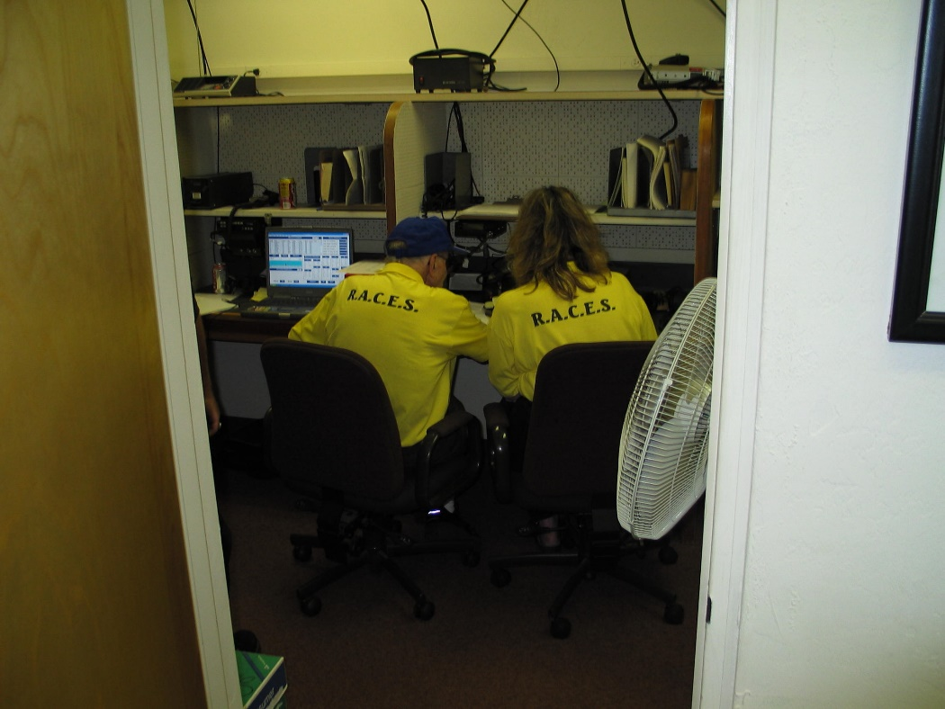
Tools used to achieve outcome…
Edwards and Goodrich Exercise Handbook
HSEEP Guidance
FEMA Independent Studies
Notes:
Fortunately there are a number of tools available to assist the exercise designer. We will review three of them.

Slide 24
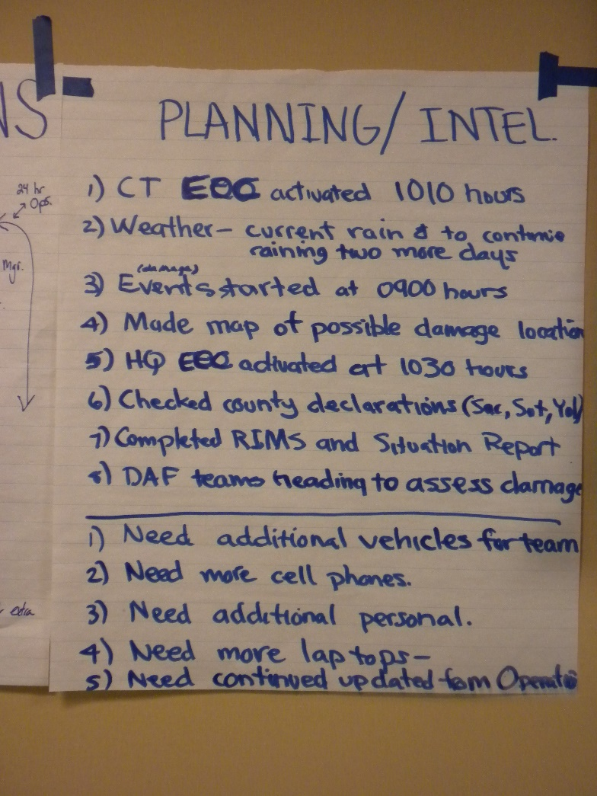
Tools: HSEEP Guidance
Federal guidance document for exercises
Reduced to 2 volumes for easier use
Describes all aspects of exercise development from the federal perspective
Notes:
The official HSEEP guidance document has recently been completely revised. It provides the legal background for why you are exercising and how you have to document your exercise to get credit from FEMA for your grant requirements. Any organization receiving federal emergency preparedness grant funding is required to have an exercise cycle plan developed and regularly executed. This is the document to cite in your staff report requesting the time and funding for the exercise.

Slide 25
Tools: HSEEP Guidebook
HSEEP Volumes I-III and V have been consolidated into HSEEP Guidebook
  Chapters aligned to each phase of the exercise planning cycle.
Acronyms and Glossary in one list
Sample exercise material and templates provided in HSEEP Volume IV.
  Documents will be aligned to each chapter and posted to the HSEEP Resource Center
Notes:
The five volumes have been recompiled into two volumes. The first incorporated the information from volumes 1 through 3 and volume 5. The chapters are aligned to the exercise planning cycle to make it easier to follow, from the initial decision to hold an exercise through the evaluation process. The new volume includes a consolidated acronym list and glossary. The URL for this document is in the resource list at the end of this webinar. Volume IV will have exercise materials and templates, but it not available yet.

Slide 26
Edwards and Goodrich, Exercise Handbook
Free, downloadable .pdf book
Project management format
    HSEEP 2013 version uses some PM concepts
  Checklist oriented
  Understanding of “drivers”
  Real world scenarios, not fantasy
  Structuring the exercise around what you can do/will need
  Identification of what resources would be needed for the different exercise types
    Ruled out software due to too many options (160+ project management software programs)
Part II is available as a Word document for easy use in designing exercises
  Project management checklists for each type of exercise
  Exercise types and planning determinants
  FEMA Independent Study training information,
  Detailed exercise goals and outcomes
  Example Improvement Matrix
Notes:
Frannie and I wrote the Exercise Handbook for the US Department of Transportation, but it is useful for any emergency management program. It is based on the Project Management approach and checklist-oriented for easy use. It begins by identifying what is driving the decision to have an exercise now. It emphasizes using real world scenarios, not “Godzilla Rises from the Bay” fantasies. It assists you in structuring your exercise around what you can do and will need to resolve the emergency. It identifies what resources are needed for different types of exercises. For example, a good drill can be designed in a week at little cost and held in an hour. A full-scale exercise takes six or more months to plan, consumes most of a workday, and is both costly and engenders liability for victim safety.
Part I of the Exercise Handbook covers the research issues and the history of the exercise program and its evolution. Part II is the practical portion with the checklists, scenarios and examples. This portion is available to download as a Word document for easy use in developing your own exercises with minimal re-typing.
In a subsequent presentation we’ll walk you through the handbook to develop an exercise.

Slide 27
Tools: Exercise Handbook
Simplified guide to developing, holding and evaluating exercises
Part II = practical tools on Word format
Checklist for creating each exercise type
Step by step process using project management principles
Scenario format for each exercise type
Controller and evaluator roles
Guides to After Action Review and Report, Improvement Matrix, Sample AAR/IM
Specific hints and advice Glossary and acronym list
6 home and personal preparedness fliers
Notes:
The free, downloadable Exercise Handbook is intended as a simplified guide to developing, holding and evaluating exercises to meet HSEEP requirements
Part II provides practical tools, and can be downloaded as Word document to limit retyping of forms and scenarios.
The Handbook begins with a checklist for creating each type of HSEEP exercise.
It then provides a step by step process for creating the exercise, using project management principles.
There is also a generic scenario format followed by a scenario format for each exercise type. This section suggests sources for realistic exercise details.
Next is a section on controller and evaluator roles. This can be used in conjunction with HSEEP’s exercise evaluation guides if they are available.
This is followed by guides to developing the hot wash, the After Action Review and Report, and the Improvement Matrix, including a Sample AAR/IM from an actual exercise. This is one reason that the handbook is so long.
An important result of our research was the development of a section of specific hints and advice from the 14 respected exercise experts from across the nation whom we interviewed. This segment provide practical help for all aspects of exercise development and implementation.
Following the glossary and acronym list is a set of 6 home and personal preparedness fliers for use in participant training. One important outcome of every exercise is the participants’ understanding of the need to get their families ready so they can stay at work to meet community needs.

Slide 28
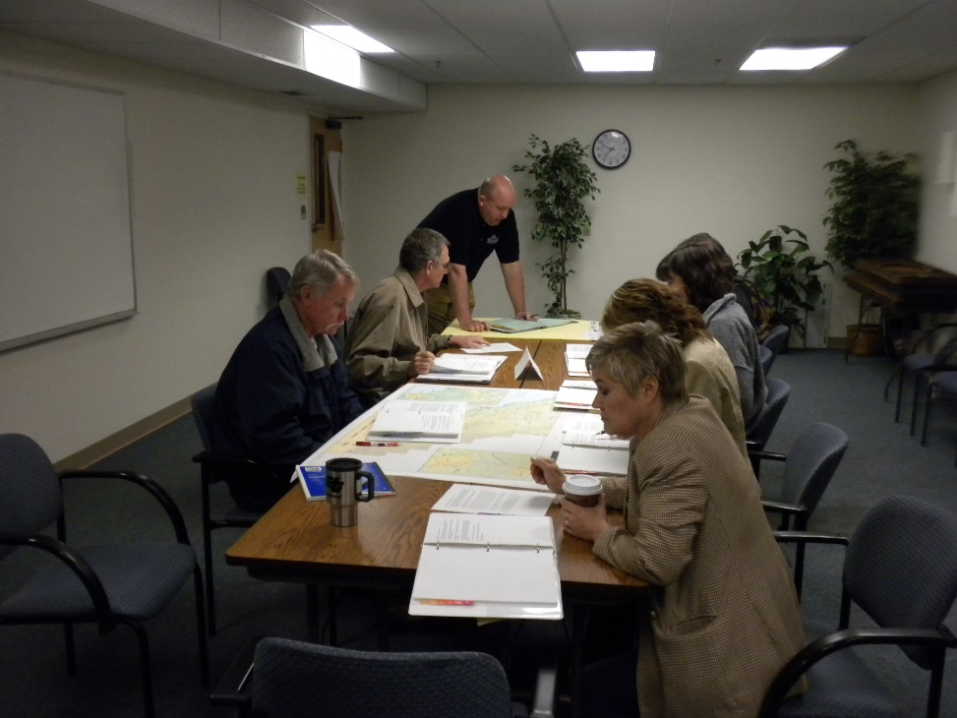
FEMA Independent Studies
FEMA offers over 200 on-line independent study courses
  IS-120 = Introduction to Exercises
  IS-130 = Exercise Evaluation and Improvement
  IS-139 = Exercise Design
Notes:
FEMA’s on-line courses give you a good background in exercise design and implementation. Some of these courses are required for anyone wishing to take the Master Exercise Practitioner credential through FEMA, as I have. They are available on-line at no cost, and can generate lower division college credit for people working toward a degree. We hope that many of you took IS-120 in preparation for today’s presentation, but IS-130 and IS-139 provide more information on the specifics of exercise design and evaluation.
We have provided the URLs in the following few slides.

Slide 29
Questions
We’ve got 15 minutes for questions
If you have not already done so, type your question into the webinar chat panel now
Please keep questions on-topic
We’ll read questions and answer those we can
Other questions and answers will be posted at http://em-issues.org
Notes:
That concludes our presentation, so I’ll turn this webinar back to George to help us move through some questions.
Thanks, Frannie and Dan.
If you joined us after the introduction and wish to ask a question, please use your webinar tool to type your question now. Please keep it related to exercise development.

Slide 30
Wrap-up
[Thank presenter]
[Solicit evaluations]
[Remind about webinar archive and ongoing Q&A forum]
[Solicit new webinar topics and outreach to new emergency managers]

Slide 31
Where to go for more info and help…
Edwards, F.L. and Goodrich, D.C. (2014). Exercise Handbook, Report 1103, http://transweb.sjsu.edu/project/1103.html
  Free .pdf download provides step by step exercise design guidance for all types of HSEEP exercises, including sample goals, scenarios and checklists for exercise development. Includes explanation of PPD-8 and list of resources.
FEMA Independent Study Program, notably IS-130 and IS-139. http://www.training.fema.gov/is/courseoverview.aspx?code=IS-130 and http://www.training.fema.gov/is/courseoverview.aspx?code=IS-139
  Free on-line classes on exercise design.

Slide 32
Where to go for more information and help…
HSEEP 2013. Homeland Security Exercise and Evaluation Program. http://www.fema.gov/media-library-data/20130726-1914-25045-8890/hseep_apr13_.pdf
  New HSEEP guidance.
Obama, Barack. 2011. Presidential Policy Directive 8 (PPD-8): National Preparedness. Washington, DC: The White House, March 30, 2011
  New National Preparedness doctrine.

Slide 33
Where to go for more information and help…
THIRA (Threat and Hazard Identification and Risk Assessment) Fact Sheet. (2012). http://www.fema.gov/media-library-data/20130726-1842-25045-8735/nic_faqs_thira_final.pdf
Core Capabilities List. (2014). https://www.fema.gov/core-capabilities

Slide 34
Go forth, do well, and share…
TrainingWeb@cesa.net

