Slide 1
ICS for Rail Rules Instructor’s Guide
Part 3
Hazmat tanker. Source: Creative Commons
National Academies of Sciences, Engineering, and Medicine. 2016. Incident Command System (ICS) Training for Field Level Supervisors and Staff: NCHRP Web-Only Document 215. https://doi.org/10.17226/23411. Adapted with permission from the National Academy of Sciences, Courtesy of the National Academies Press, Washington, D.C.

Slide 2
For Rules Instructors: a few ideas
The full ICS for Transportation train-the-trainer curriculum is available as a free download at: https://nap.nationalacademies.org/catalog/23411/incident-command-system-ics-training-for-field-level-supervisors-and-staff
The material was developed under the National Cooperative Highway Research Program, so the focus is on road maintenance personnel, but the principles and implementation have many similarities with the railroad maintenance crew uses for ICS.
The videos noted in the class materials are also part of this training package. They provide a teaching resource for demonstrating how the different applications of ICS work.

Slide 3
Validity of the ICS Kits
Field personnel must see value and use the kit.
Mandating use will not work
Must be tailored to them (every organization is unique)
Must adapt to organizational change or will stagnate
Field personnel must be involved in the modification and composition of the kit.
Consult with fire personnel for guidance in regional adaptations and ICS compliance.
Notes:
The Quick Start Cards are provided in naïve Word format for easy customizing. The instructions should match the procedures of your organization.

Slide 4
ICS Refresher Resources
Briefing training
Designed for ICS refresher during a 30-minute indoor start-of-the-workday meeting with AV support.
Safety
Collaboration with Other Professions
Each topic is introduced with several slides to stimulate response from the audience; examples are in the ICS Support Materials folder.
Discussion-Based Training
Designed for ICS refresher during a 30-minute outdoor start-of-the-workday meeting without AV support; can be used as the basis for a sand table exercise; examples are in the ICS Support Materials folder.
Wildland fire – Railroad staff Joins ICS
Hurricane – Railroad staff as a technical specialist in Planning/Intelligence
Flooding – Railroad staff in Unified Command
Bridge Collapse – Railroad staff Assumes Command
Notes:
The training materials include two kinds of refresher training. One is for indoor events like training days, with AV support. The other is for “tailgate” training with just discussion. These are just examples of how you can develop organization-specific materials for your staff.

Slide 5
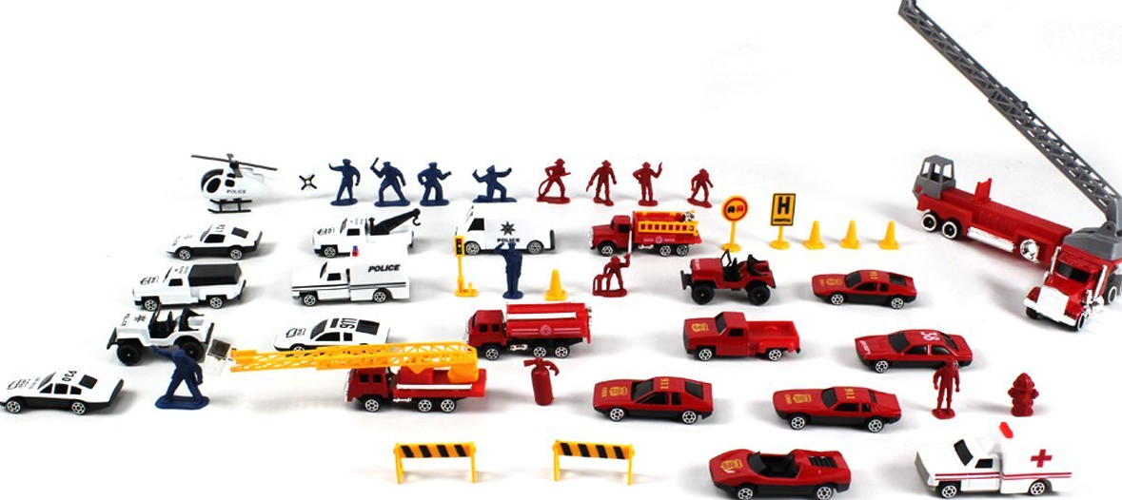
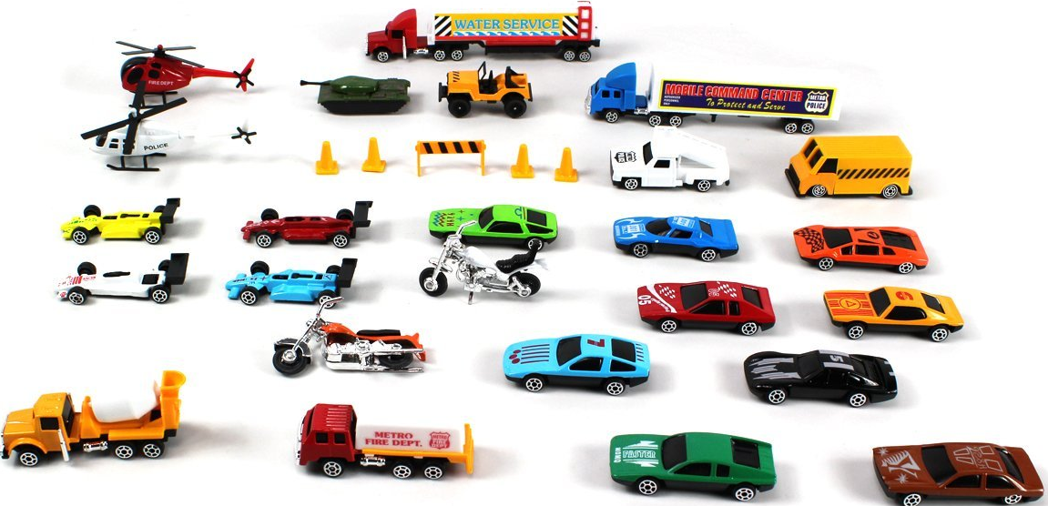
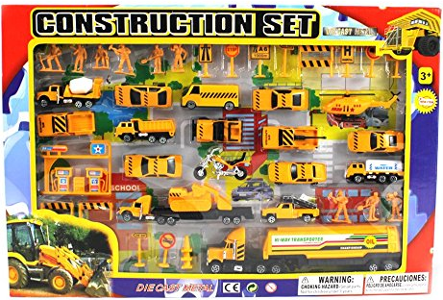
The Sand Table Exercise
Civil Engineer Tape https://www.amazon.com/s/ref=nb_sb_noss_1/147-7788883-5946355?url=search-alias%3Daps&field-keywords=civil+engineer+tape
Semis and Cars
HO trains
Police & Fire Vehicles
Construction Equipment
Sources: Garage sales, your kid’s old toys…just watch out for collectables.
Videos Number 5, 6, & 7 explaining how to use a sand table exercise are available at https://vimeo.com/showcase/11005939
Notes:
Use what you have, improvise.
Do not make custom vehicles with your agency’s logo, as they will disappear after the first training event!
Use the videos for ideas about setting up a sand table, and how to conduct an exercise using the sand table and Quick Start Cards.

Slide 6
Adult Learning…People do not fit in a box.
Co-operate, don’t dominate
Make the process interactive
Allow critical reflection and application
Participants have significant life experience
What is their background and experience?
What is the organization’s culture?
Link known to unknown
Sequence information for direct, immediate application
Notes:
Offering training for adults is different from teaching children. The ICS Support Materials folder has some information about how to succeed with adult students.

