Slide 1
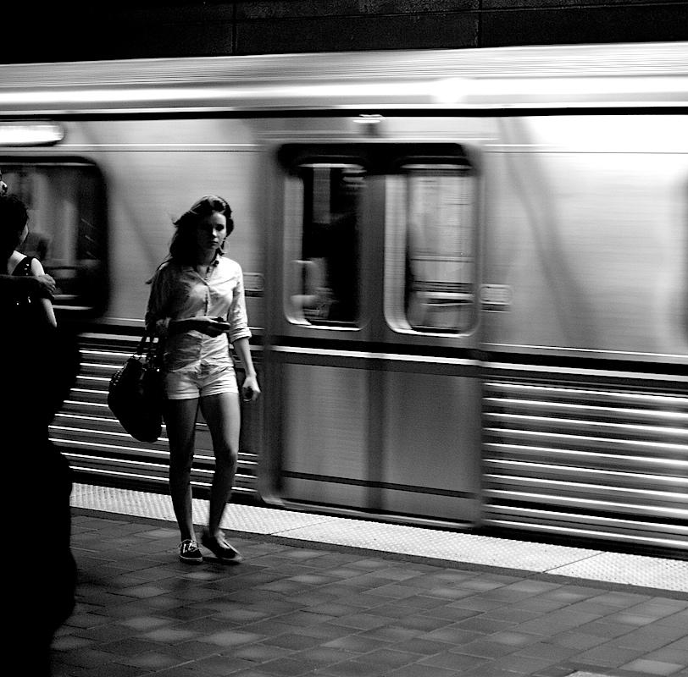
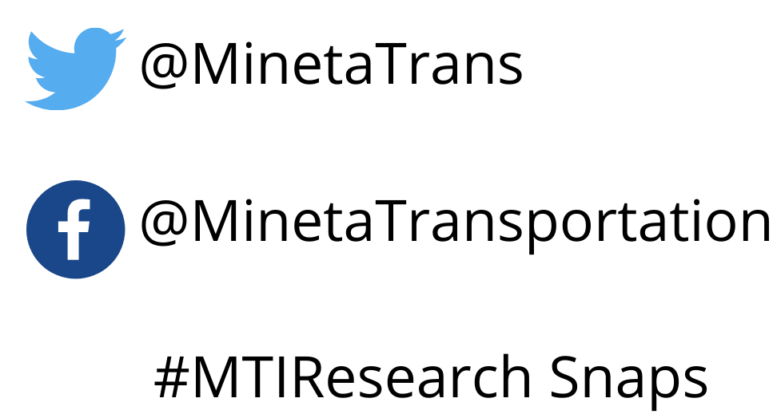
MTI Research Snaps: Sexual Harassment on Public Transportation - The University Student Experience
Presented by Asha Weinstein Agrawal, PhD Anastasia Loukaitou-Sideris, PhD March 19, 2020

Slide 2
What are sexual harassment and assault?
Sexual harassment is “any unwanted attention including lewd comments, leering, sexual invitations, threats, displaying pornographic material, being followed or pictured, and public masturbation.”
Sexual assault refers to situations “when someone is threatened, coerced, or forced into non-consensual sexual acts.”
Gekoski, et al. (2017). “The Prevalence and Nature of Sexual Harassment and Assault against Women and Girls on Public Transport: An International Review.” Journal of Criminological Research, Policy and Practice 3 (1): 3–16.

Slide 3
Study objectives
Examine the SJSU student experience with respect to sexual harassment & assault on public transit trips:
Have they experienced harassment?
Does concern about harassment influence if and how they use public transit?
What types of behavioral and travel adaptations do they adopt in the face of these concerns?
How do these experiences and perceptions vary by gender?
How does the SJSU experience compare to global student experience?
What strategies hold promise to combat sexual harassment in the public transit journey?

Slide 4
Study method: a survey of SJSU students
Sample: 891 randomly selected SJSU students
Survey mode: online
Questionnaire design:
Experiences related to sexual harassment when using public transit, perceived safety on transit, safety precautions taken on transit, etc. Questions very similar to other surveys in a global project

Slide 5
About SJSU
Public university in the San Francisco Bay Area region, in California
About 33,000 students
Located in San Jose, a city of ~1 million diverse residents
The university itself is well-served by transit, but the surrounding communities are not

Slide 6
About the 891 respondents
Gender: 51% women
LGBTQI: 9%
Ethnicity: 26% Latina/o
Race: 59% Asian/Asian-American, 28% white, 13% other
Age: 88% between 18 and 29
Transit use: 61% used bus and/or rail (53% bus, 46% rail)

Slide 7
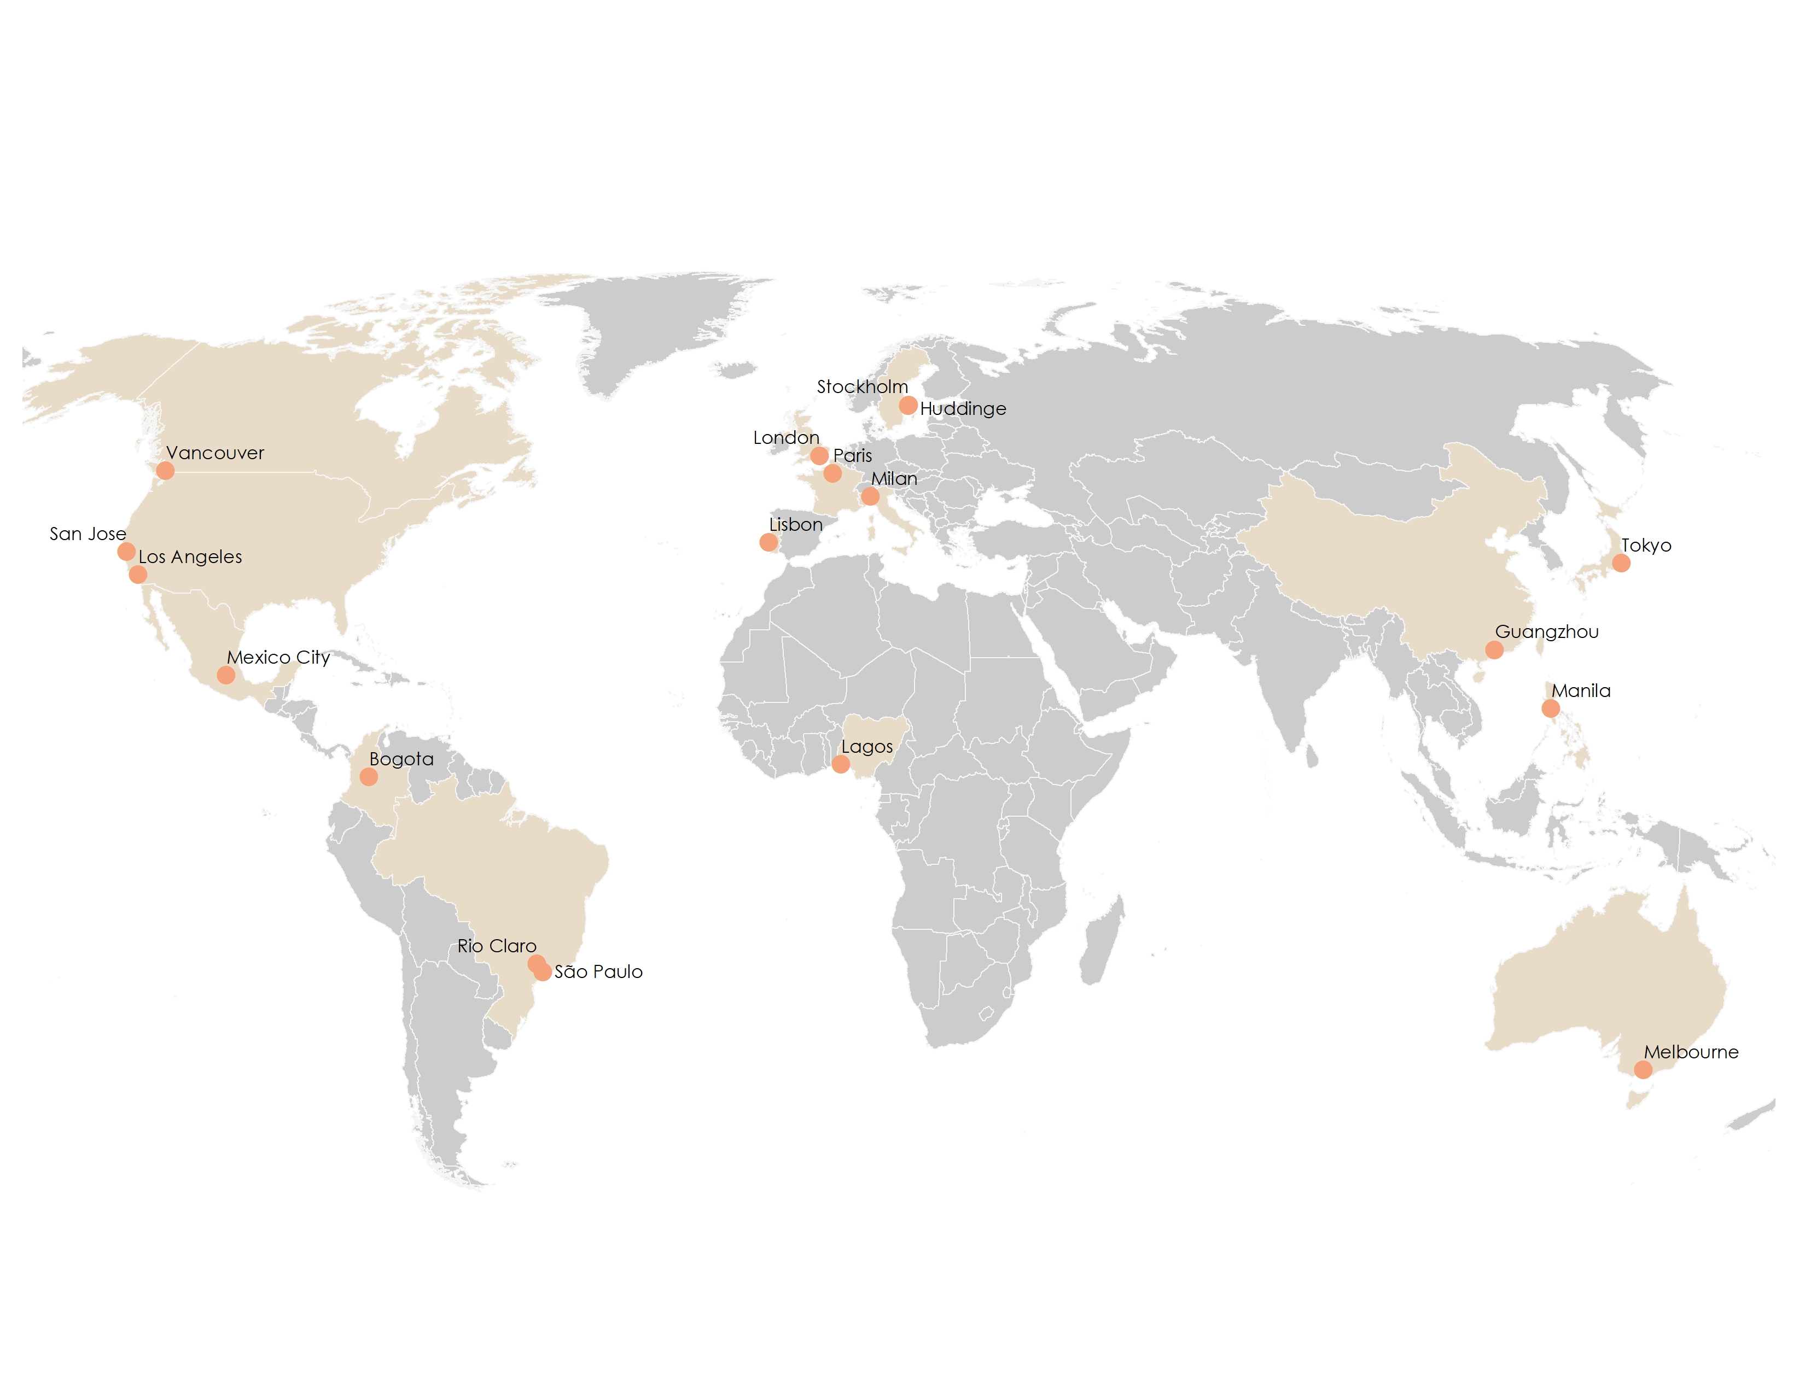
The global study – 18 Cities

Slide 8
Finding 1
Sexual harassment is a routine experience for transit users
Notes:
63% had experienced some form of harassment somewhere along the transit journey.

Slide 9
Extent of harassment
63% reported some form of harassment during the transit journey
Harassment is a problem for both bus and train riders, though slightly more for the former
Problem is roughly equal onboard, waiting, and traveling to/from stops
Verbal and non-verbal harassment much more common than physical
Far more women than men experience harassment….
…..but harassment is a problem for many men
No statistically sig. difference by LGBTQI status

Slide 10
Percent
who
experienced
different
types of
harassment,
by
gender

Slide 11
Finding 2
There is not clear understanding of the term “sexual harassment”

Slide 12
Different questions → different answers (63% v. 22%)
“In the last 3 years, have you experienced any of the following
types of harassment ….?”
63% checked at least one option
“If you have been a victim of sexual assault, harassment, or other
crime while riding transit…..”
22% said they had been a victim

Slide 13
Finding 3
Most harassment is never officially reported

Slide 14
Reporting by victims
Only 22% of victims report at all
Very few of these reported in any official capacity (police, transit operator, etc.)

Slide 15
Finding 4
Sexual harassment creates fear and
reduces transit use

Slide 16
Fear of harassment impacts transit use
Up to half of riders feel unsafe, depending on the transit environment
One-quarter to one-third of riders consider sexual harassment a safety concern, depending on the transit environment
About one-quarter of riders said that fear of sexual harassment prevented them from using transit more
61% of bus and 45% of train riders take at least one safety precaution on transit
Prior experience with harassment has a major impact on fear and self-limiting behavior

Slide 17
Finding 5
Sexual harassment affects both genders,
but far more women

Slide 18
Gender differences
Roughly twice as many women as men reported verbal and non-verbal harassment
Women were more likely to have been physically harassed.
Women were much more likely than men to take almost every type of safety precaution when using transit
But substantial numbers of men are affected as well

Slide 19
Finding 6
The SJSU experience is a global experience

Slide 20
SJSU victim rates comparable to other cities
% of bus
riders
who have been
harassed
San Jose

Slide 21
Conclusion: Policy Implications

Slide 22
Multi-pronged approach: research/design/policy/security
Educate the public about sexual harassment and transit
Include questions about sexual harassment on passenger surveys
Make it easy to report harassment
Give attention to the physical environment: good maintenance and lighting
Safe-guard against anti-social behaviors
Learn from industry best practices
Notes:
Topics for education
What constitutes sexual harassment
The prevalence of the problem
That men as well as women are victims
Reporting options
The value of reporting crimes
Ways witnesses can help victims

Slide 23
Acknowledgements
Co-authors: Cristina Tortora, PhD, and Yajing Hu, PhD
Our thanks to the SJSU university partners who fielded the survey and the students who completed it
The work was supported by:

Slide 24
Resources
Contact the MTI study authors:
Asha Weinstein Agrawal
asha.weinstein.agrawal@sjsu.edu
Anastasia Loukaitou-Sideris
Sideris@ucla.edu
View the MTI report: https://transweb.sjsu.edu/research/1810
Global study results: V. Ceccato and A. Loukaitou-Sideris, eds., Transit Crime and Sexual Violence in Cities: International Evidence and Prevention (Routledge, June 2020)

Slide 25
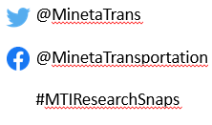
Thank you for joining us for:
Sexual Harassment on Public Transit: The University Student Experience
View the full report at: https://transweb.sjsu.edu/research/1810
Tune in for the next MTI Research Snap webinar “Mitigation v. Adaptation, Combating Climate Change through Transportation and Land-use Planning” on June 4, 2020 at 10 a.m.!
Have a suggestion for a webinar topic you’d like to see featured? Email irma.Garcia@sjsu.edu

