Slide 1
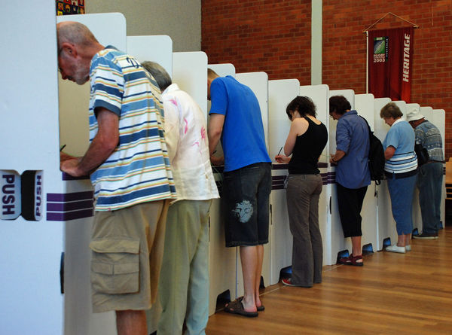
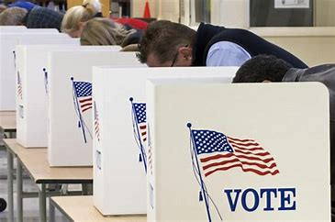
Transportation Finance and Direct Democracy in California
Martin Wachs
Distinguished Professor Emeritus
UCLA
October 24, 2018

Slide 2

November 6th
Proposition 6 has our attention but
Voters across the country will decide whether they want their city, county, or state to invest more (or less)in transportation.
Voters in 25 states will decide on over 250 transportation ballot measures on Nov 6th.
Totaling over $55 billion in potential investment.
196 measures have already appeared before voters earlier this year.

Slide 3
Voting for transportation dollars is a big deal & we need to understand it….
Look at the history of voting for transportation investments
Consider California specifically
  More measures than any other state
  Longer history than any other state
  More money needed and raised than any other state
Take a deep dive into Local Option Sales Taxes (LOSTs) - A California Invention
    Santa Clara County is central to this history – The first LOST in 1976; The Guardino decision and two recent measures
NOT predict, analyze or take a position on Proposition 6

Slide 4
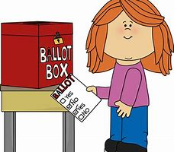
Wide variety of transportation ballot measures across the county – general revenue & user fees
Property tax increases
Real estate transaction taxes
Vehicle license fees
Fuel tax increases
Many statewide measures but steady pattern of devolution from federal to state to local responsibility for transportation funding
In California of total $35 billion per year (Before SB1):
  $16 billion from local governments
  $12 billion from state
  $7 billion from federal sources.

Slide 5
Some measures in other states on Nov. 6th
Connecticut: Voters will decide on a constitutional amendment to put the state’s Special Transportation Fund into a trust fund.
Colorado: Voters will consider two competing transportation measures: one that raises new revenue for all transportation modes, and one that funds road improvements using existing revenue.
Missouri: Voters will vote on Proposition D, which would raise the gasoline tax to fund transportation improvements.
Hillsborough County (Tampa), Florida: Voters will decide whether to raise the sales tax to fund transportation improvements.

Slide 6
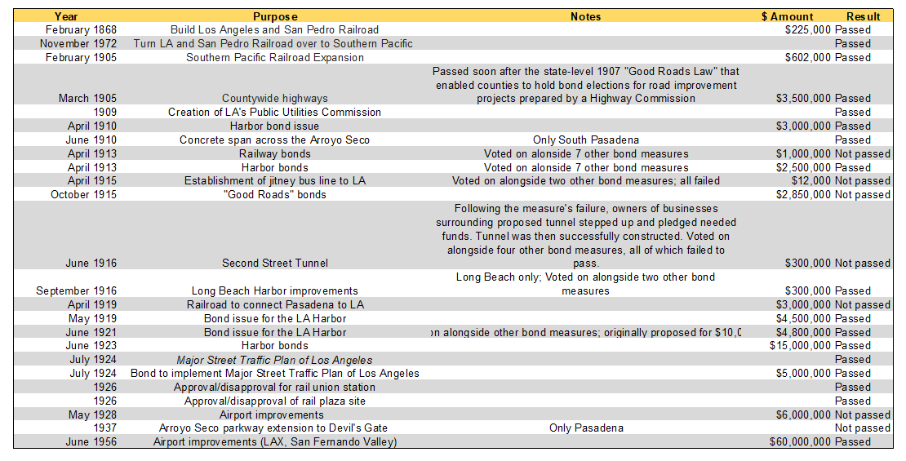
Direct Democracy in California has a long history for transportation projects – e.g. LA County

Slide 7
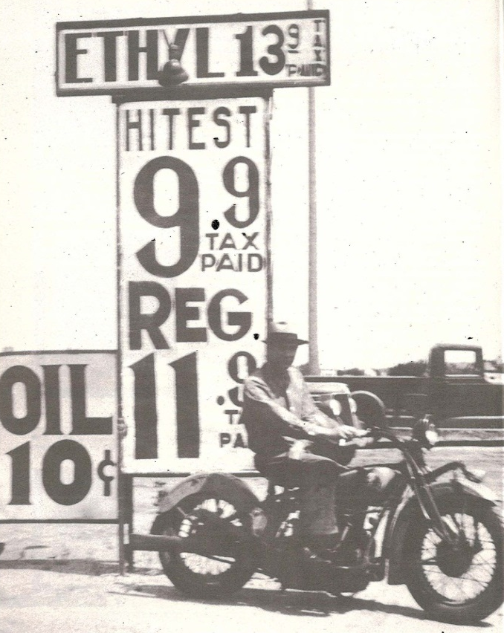
Between 1930 and 1970 there were few transportation ballot measures
States adopted gasoline and diesel fuel taxes between 1918 and 1940
Federal gasoline tax
Federal highway trust fund adopted in 1956
“Hypothecation” or “earmarking” through trust funds
Car ownership and miles of driving grew steadily and revenue grew in parallel with expenditures

Slide 8
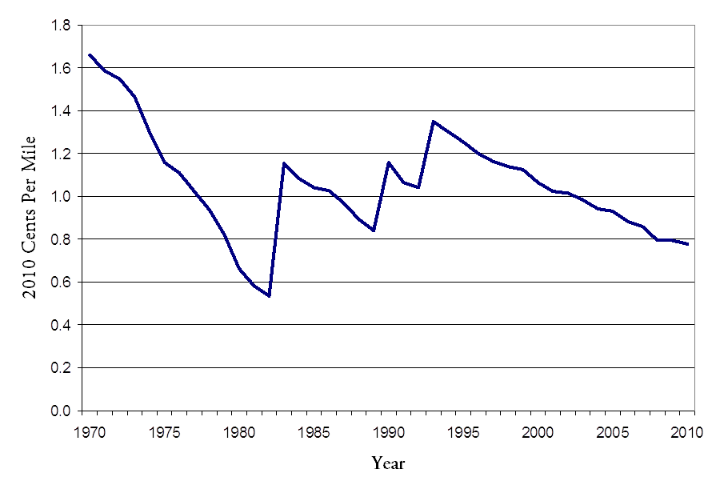
Declining Federal funding led to recent increase in propositions & initiatives
Congress increased Federal gas tax 8 times between 1956 & 1993 – every 4 to 5 years
No Federal fuel tax Increase since 1993 – $0.184/gal
Federal gas tax was 17% of price at the pump in 1993; in 2017 it was 8%
Purchasing power of gas tax – fed and state - declined by 35% between 2003 and SB1
Inflation & increases in MPG slowed
revenue in relation to driving

Slide 9
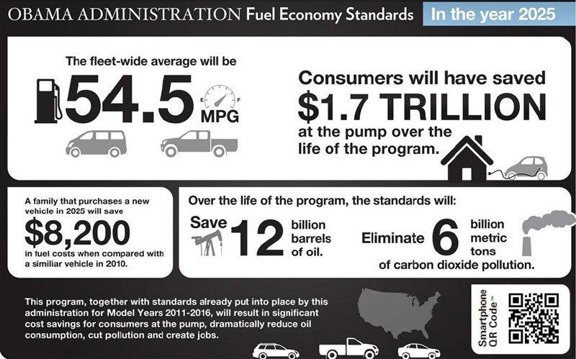
Vehicle fuel efficiency gains reduce revenue

Slide 10
VMT growth will outpace fuel consumption increase for decades
Index (1980 = 100%)
2
.
300
VMT (FHWA)
250
1
.
5
VMT (EIA)
200
1
.
0
150
0
.
5
Fuel consumption
100
0
.
0
-
0
50
.
5
1980
1990
2000
2010
2020
2030

Slide 11

Many statewide transportation revenue measures in recent years
A small sampling:
  Transportation Development Act(TDA) in 1971 – Very complex & important, created the transit account
  Proposition 1A - $9.95 Billion in High Speed Rail Bonds in 2009 – added many restrictions on High Speed Rail Program
  Proposition 91 in 2009 tried to create a “locked box” for all transportation revenue and was defeated
  Proposition 69 in June of this year tried again and was approved.
Do voters understand the issues they are voting on? Do they understand the complexity of the measures given the simple campaign slogans? Do they change their minds after voting?

Slide 12

CA invented the Local Option Sales Tax (LOST)
Proposition 13 created the context - property tax revenue less available
Voter approved sales taxes
Expenditure plans enumerated in measures
Most have fixed sunset dates and need to be “reauthorized”
Many have accountability provisions & limits on amendments

Slide 13
California LOSTS over time
No measures
in 2017; three
county measures
on November
2018 ballot

Slide 14


Research on LOSTs at UCLA
Collected the text of 53 county measures (rural, earliest, failed measures not found)
Collected pro and con campaign material and media coverage
Voting records by precinct correlated with census data
Interviews with 50+ election officials, measure proponents and opponents

Slide 15
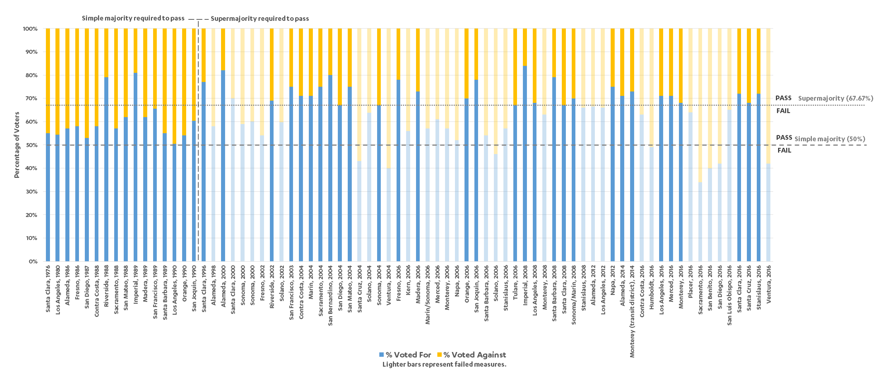
Measure Support Over Time
Since the 1995 Guardino Decision:
8 of 50 measures (16%) failed to garner a simple majority
15 of the 50 (30%) received a majority of votes in favor, but not a supermajority
27 of the 50 (54%) received supermajority support and were enacted

Slide 16
Terms of the Taxes in LOSTs
93% of California LOSTs have specified
lives; only five were permanent, and
four of these passed:
Los Angeles, Proposition A, 1980
Los Angeles, Proposition C, 1990
Los Angeles, Measure M, 2016
(also made earlier measure permanent)
Santa Clara, Measure A1, 1976 (failed)

Slide 17
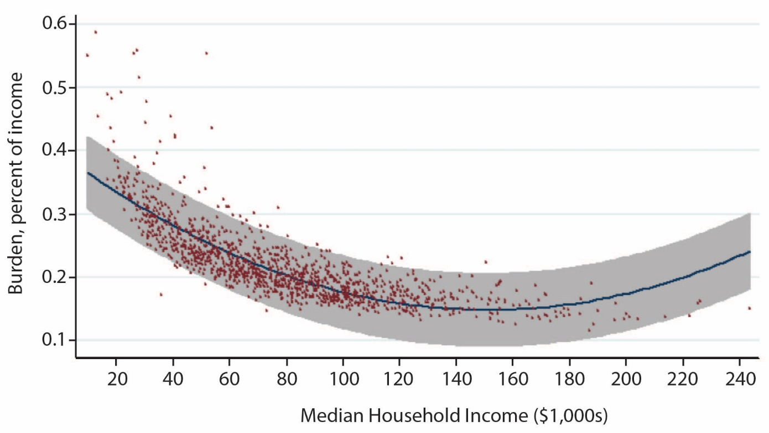
LOST tax burden as % of household income
LOSTs are regressive but so are fuel taxes. LOSTs may be “doubly regressive.”
Despite this, the are popular because they are borne in many small transactions
rather than fewer larger ones

Slide 18
LOSTs have created a new transportation politics
LOSTs do not pass just because they are inherently popular
An industry of campaign consultants and public officials have learned by trial and error how to get votes and measures are shaped according to a complex set of principles based on precedent.
Does what is done to achieve a supermajority of votes match what would be the best transportation plan for a county if voting was not required?
The question is in a sense “academic” because the revenue is needed and elections are held; and, of course we differ from one another in our beliefs as to how much should be spent on what but it is not an unimportant question either – voting is not benefit cost analysis.

Slide 19
Example of the new politics of transportation
In three counties (Riverside, Orange, San Diego) early measures were vehemently opposed by environmental groups (e.g. Sierra Club, NRDC) - roads destroy the environment!
In later measures those counties committed to spending money on acquiring land to mitigate transportation impacts on the environment – advance mitigation - under the Endangered Species Act.
Environmental groups encouraged their members to vote FOR those measures and they were approved.
Transportation advocates did not want to spend “transportation” money to protect the kangaroo rat but wanted the measures to pass

Slide 20
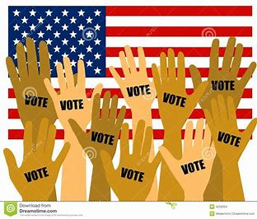
If you try and don’t succeed…..try & try again
Sonoma County ½% LOSTs
Transit & Road Improvements Failed 46.0%
1998 Highway, Road, Transit, Bike & Failed 47.6%
Pedestrian Projects
2000 Highway Improvements Failed 58.5%
2000 Rail/Bus Road Maintenance, Failed 60.3%
Pedestrian & Bicycle Projects
2004 Highway, Road, Transit, Bike, Passed 67.2%
Pedestrian Projects

Slide 21
Designing LOSTs to win
Spread the money geographically, especially to highly populated areas
Spread the money across modal interests….highways, rail, bikes, pedestrians, ferries.
Spread the money over time but make sure each constituency gets some early benefits.
Balance among capital projects and operating projects.
Promise relief on many fronts for many interests.
But, all politics are local and there are a few exceptions reflecting that ….e.g. fund only one program or project or mode, particularly where there is an earlier measure in place

Slide 22
LOSTS fund many programs to attract many constituencies
Share of all LOST money by “mode”
Comments
Mode | Mean | Median | Range
Highways | 27% | 26% | 0-66%
Public Transit | 31% | 26% | 0-100%
Local Roads | 34% | 30% | 0-100%
Bike/Pedestrian | 2.4% | 0.7% | 0-17%
Safe Routes to School | 1.8% | 0% | 0-11%
Seniors/Disabled | 4.4% | 1% | 0-100%
Urban counties allocate a larger share of funds raised by LOSTs to transit than transit’s share of trips in those counties
Rural counties spend mostly on local roads
For each “mode” shown counties also differ in terms of capital versus operating expenditures

Slide 23
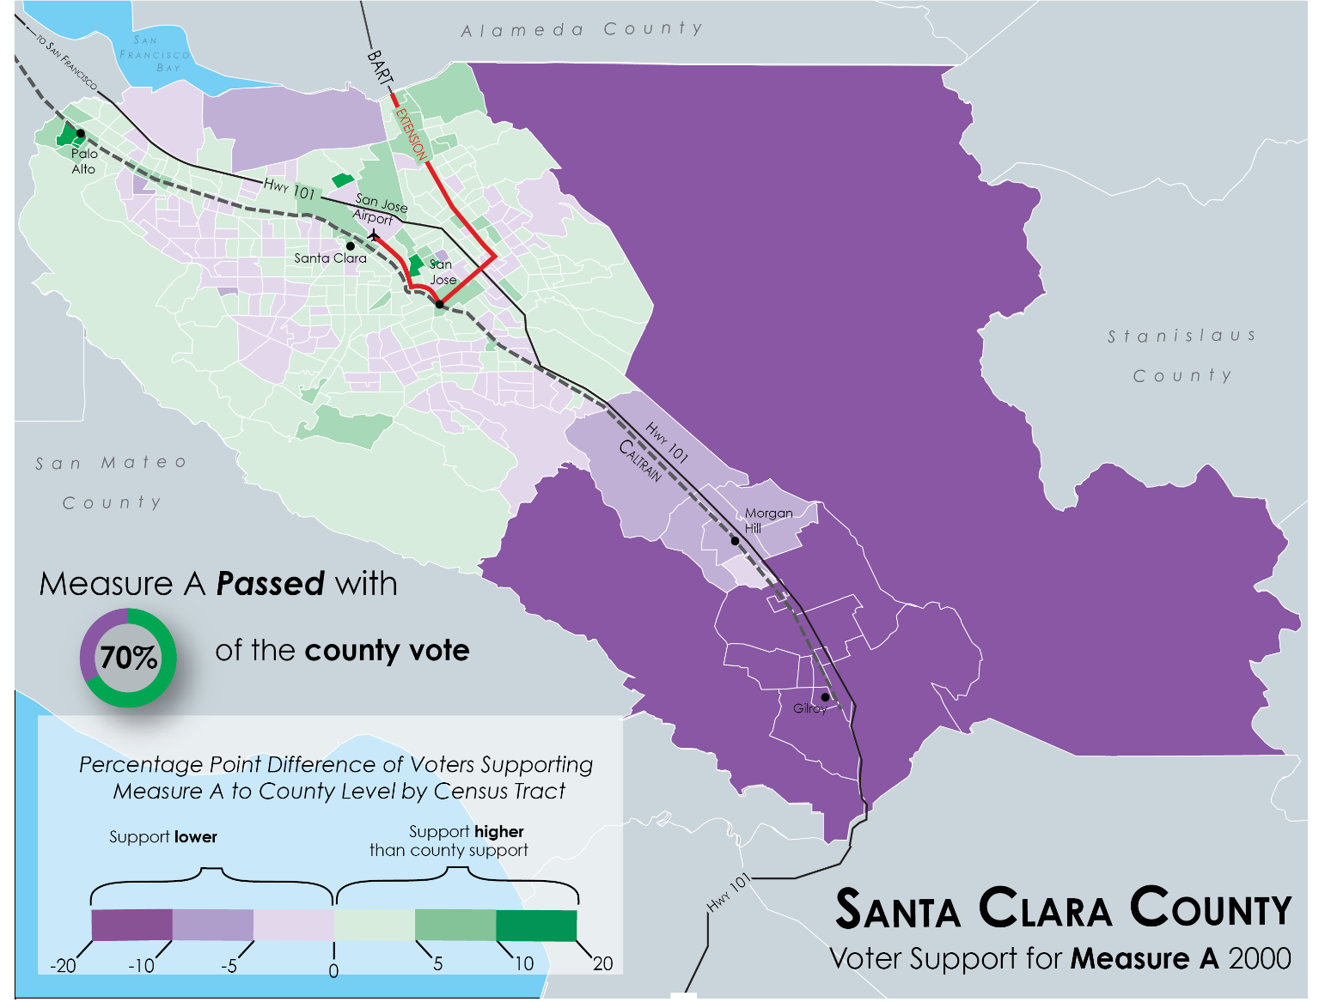
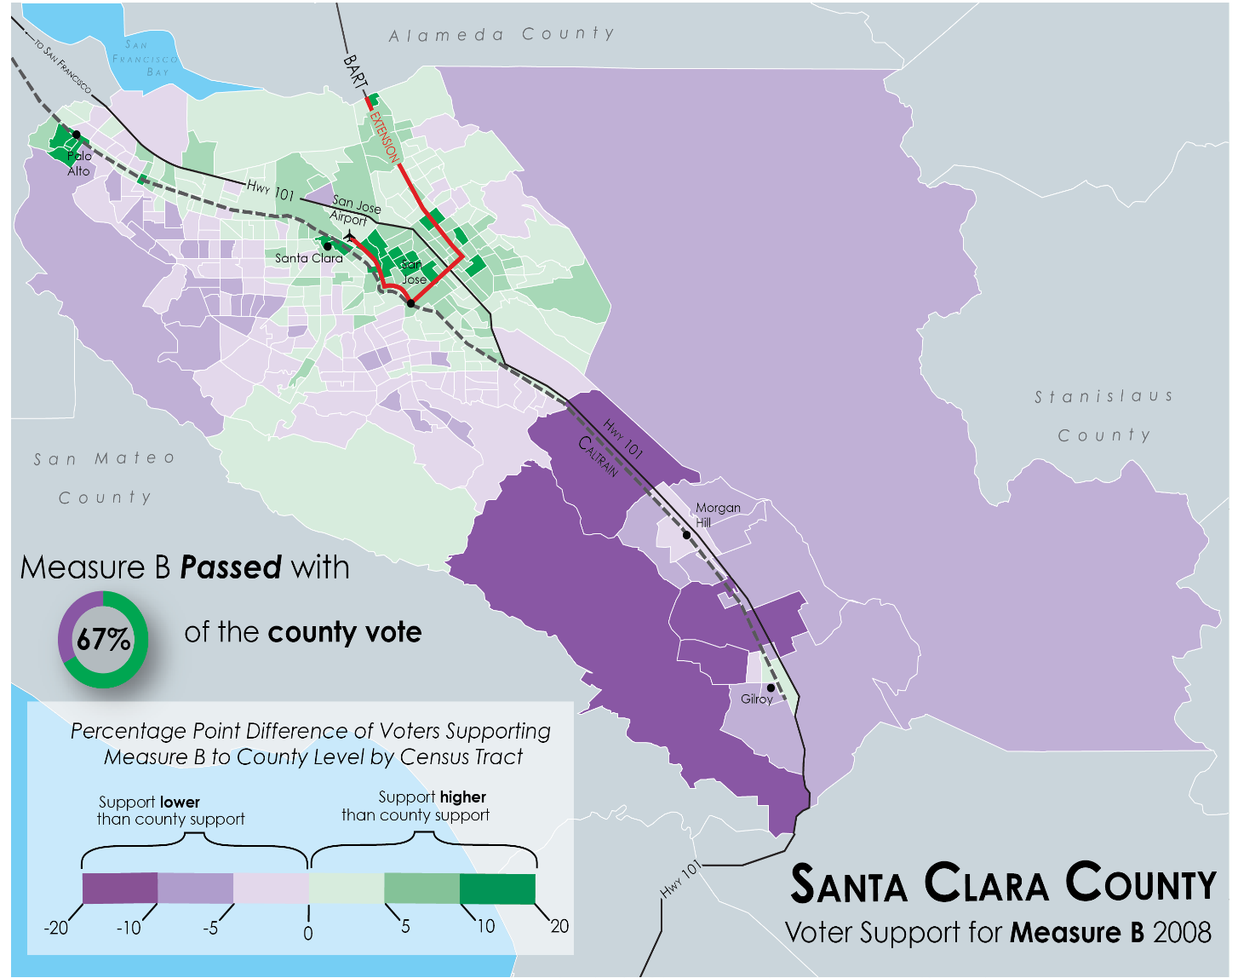
Spatial Distribution of Voter Support, Santa Clara County Measure A (2000) & Measure B (2008)

Slide 24
Ballot arguments refer to equity rather loosely; far more frequently in opposition
Equity Argument Frequency in LOST Measures
Type of Equity | Number of Measures in which Equity is Debated
General Equity | 29
Income Equity | 14
Geographic Equity | 28
Modal Equity | 26
Temporal Equity | 8
“Measure M is a SALES TAX INCREASE that will damage our economy, hurting those who can least afford it”
“...because this is a sales tax, Measure A will hit seniors and working families especially hard”
“Many elderly citizens live in poverty. This tax will hurt seniors; reduces their buying power”

Slide 25
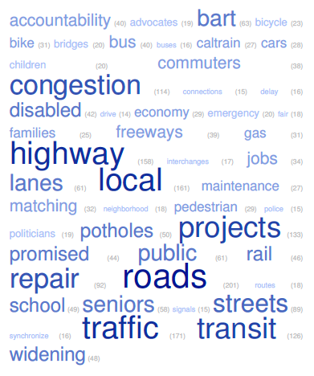
Congestion Relief is always promised and most popular, hard to measure, rarely delivered
Vote YES on Measure M to relieve congestion, improve traffic safety and fix local roads—without raising taxes!
Vote YES to reduce gridlock and improve police, fire and paramedic response times.
Relieve traffic congestion on all Expressways and key highway interchanges

Slide 26
Local return is increasing over time

Slide 27
My big worry
To get a supermajority vote, we promise more than we can deliver.
Once the taxes are in place and the projects are under construction, we find we do not have enough money to complete the projects to which we have committed.
The more we raise taxes, the more we need to raise taxes. This is a really big problem.
Los Angeles has FOUR half cent permanent measures and will raise $240 billion in forty years. It has bonded against future tax revenue and yet is looking for more funding.

Slide 28
Research is Continuing
We do not yet completely understand the complex new politics of LOSTs
We are looking in depth into local returns – how much used for what and where?
We are looking in depth into “accountability.” Are any counties shifting money away from promised projects?
We are analyzing lawsuits brought against counties for violating their LOSTs
Research on voter behavior & understanding is still needed.

Slide 29
THANK YOU!
ITS TIME FOR YOUR
QUESTIONS AND COMMENTS
Contact me at: mwachs@ucla.edu

